Slide 1
A Comparative Study of Pointers
Yifei Guan

Slide 2
What is pointers
Pointers are a type of variable that stores a memory address
and can be used to access and manipulate data stored at that
address.

Slide 3
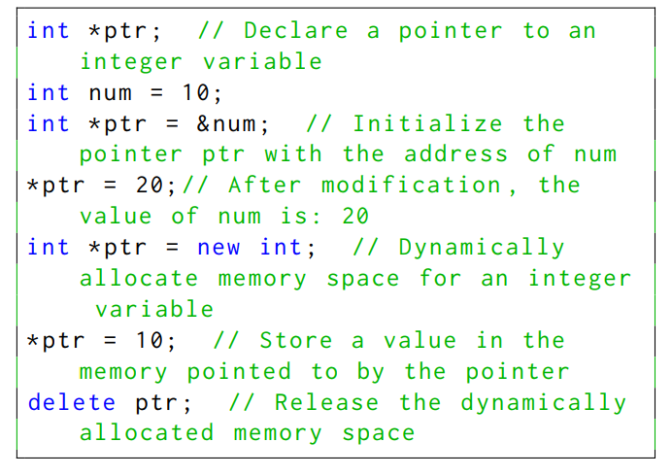
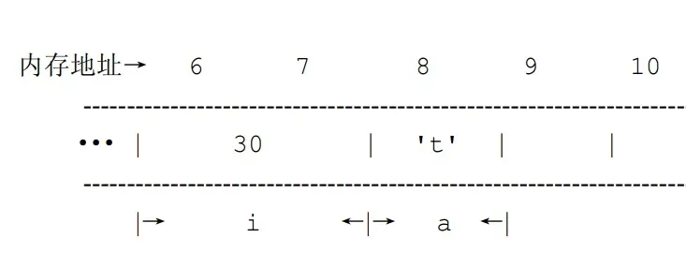
Pointers in C/C++

Slide 4
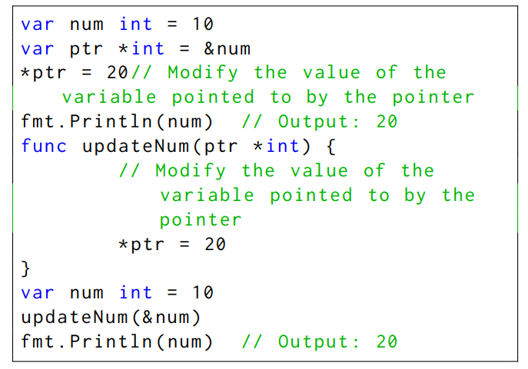
Pointers in Go

Slide 5
C/C++ VS Go
1. Automatic memory management
2. Pointer arithmetic
3. Reference types
4. Dereferencing null pointers

Slide 6

Automatic memory management
Go has automatic garbage collection and does not require manual memory management like C++, which uses new and delete operators to allocate and deallocate memory. This makes it easier to avoid memory leaks or dangling pointers in Go.

Slide 7
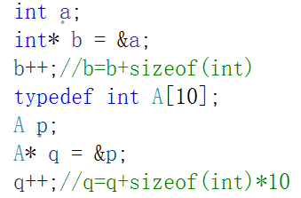
Pointer arithmetic
C++ allows arithmetic operations on pointers, such as pointer addition and subtraction, while Go does not allow pointer arithmetic and only allows comparison operations.

Slide 8
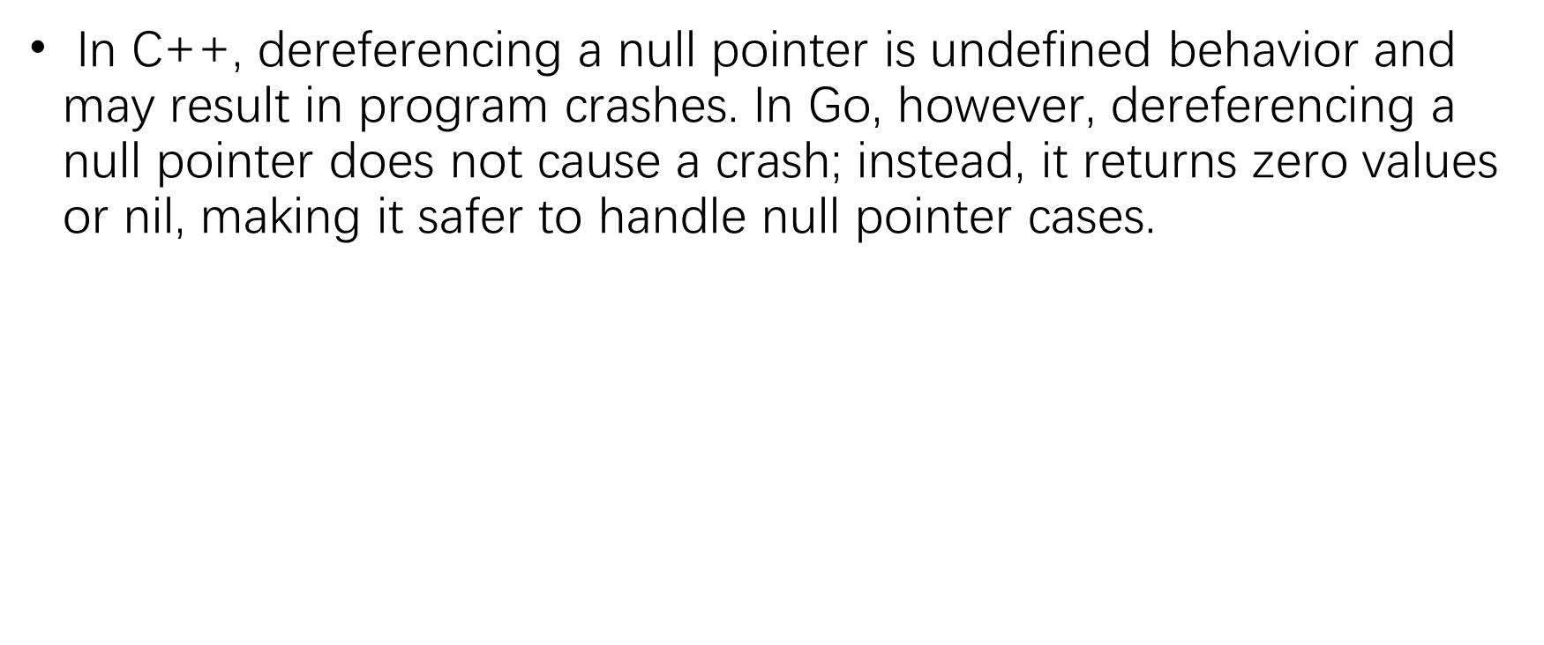
Reference types
In Go, pointers can be used to reference non-basic types such as slices, maps, and channels, not just basic data types. This allows for convenient passing and modification of reference type values in Go. In contrast, in C++, pointers are mainly used to reference basic data types and objects of custom types.
Dereferencing null pointers

Slide 9

References in Java
In Java, reference types refer to all non-primitive types, including classes, interfaces, arrays, and enum types, etc. In Java, all objects must be accessed through references, which means variables store references to objects rather than the objects themselves. In Java, reference types are instantiated using the "new" keyword.

Slide 10



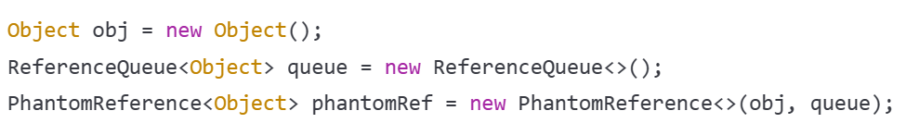
References in Java
Strong Reference
Soft Reference
Weak Reference
Phantom Reference

Slide 11

References in Python
In Python, reference types are also known as object types, which include numbers, strings, lists, tuples, dictionaries, and so on. In Python, all variables are references to objects rather than the objects themselves. In Python, reference types do not need to be instantiated using the "new" keyword.

Slide 12
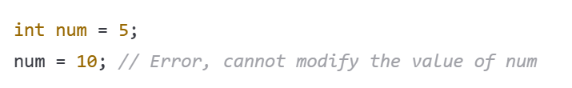
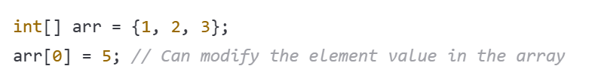
Java VS Python
In Java, primitive data types (such as int, float, boolean, etc.) are immutable, which means once they are declared and assigned a value, their value cannot be changed.

Slide 13
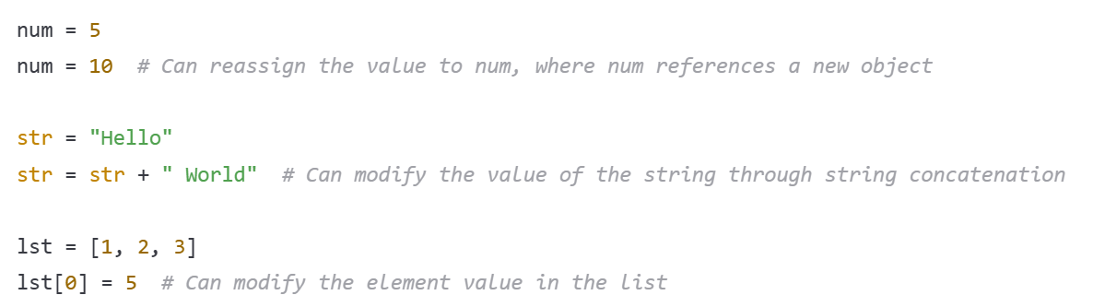
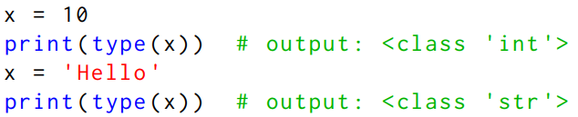
Java VS Python
In contrast, in Python, all objects are mutable, including numbers, strings, lists, dictionaries, etc. This means that objects can be directly modified without the need to allocate new memory space. For example:

Slide 14
Thank you!

