Slide 1
Review

Slide 2
期末考试
时间：12月25日周三1-2节，8:00-9:50
地点：上课教室（仙II-110）
闭卷
总成绩
不参加考试的同学无成绩，请及时联系教务员退选
参加考试的同学：作业30% + 考试70%

Slide 3
阅读理解&写作
If I show you a formal system, can you apply it to examples?
Given a small-step operational semantics, write down a full execution path of a program from an initial state
Given a big-step operational semantics, write down the derivation of a big-step transition
Given a type system, write down the typing derivation
Given a program logic, write down the proof of a specification
Given a definition of a property, tell whether it holds
If I tell you the informal meaning of a property, can you formalize it?
Please do not use natural language in your formalization

Slide 4
What is a programming language
Syntax
Operational semantics
Small-step operational semantics
Big-step operational semantics
----------------------------------------------------
Ensuring correctness: type system / program logic
Typing rules / logic rules
Soundness & completeness

Slide 5
Course Contents
Lambda Calculus
Untyped
Simply typed
System F
Imperative languages
Operational semantics
Hoare logic
Separation logic

Slide 6

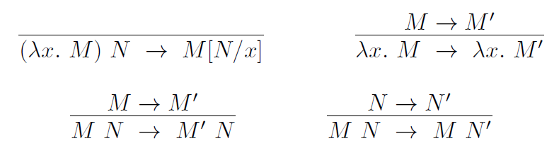
Untyped lambda calculus
Syntax
Semantics (reduction rules)

Slide 7
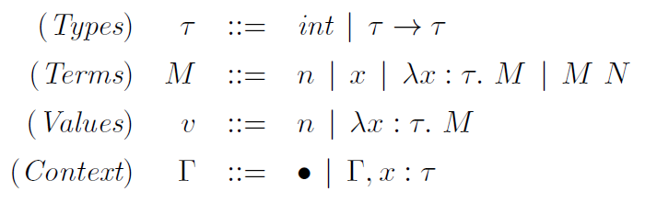
Simply-typed lambda calculus
Syntax
Reduction rules

Slide 8
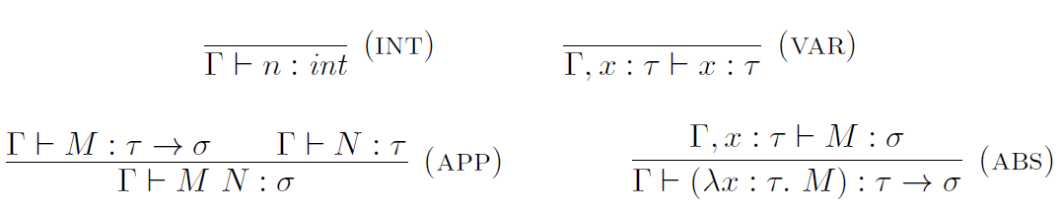
Simply-typed lambda calculus – Type system
Typing context
Typing rules
Soundness

Slide 9
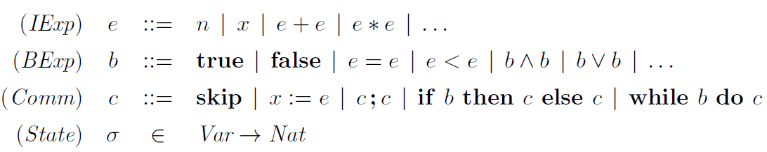
A simple imperative language
Syntax

Slide 10
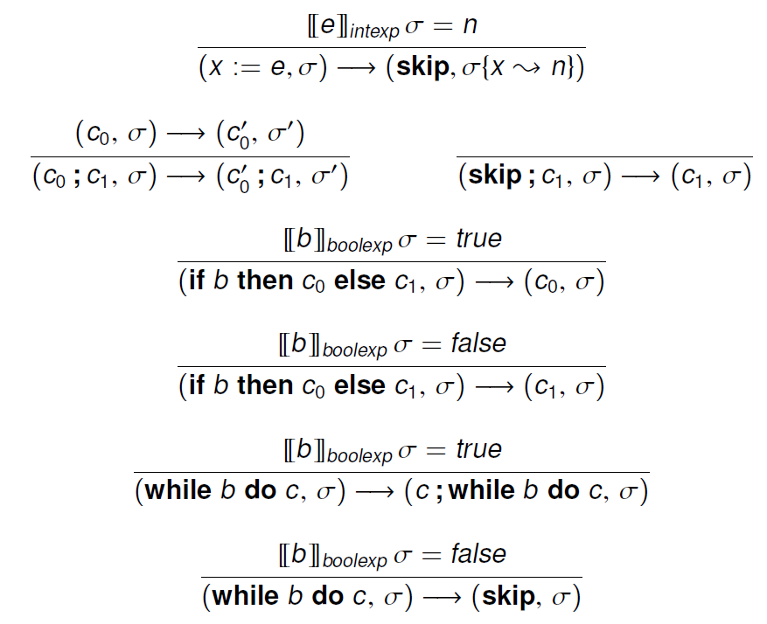
Operational semantics
Small-step

Slide 11
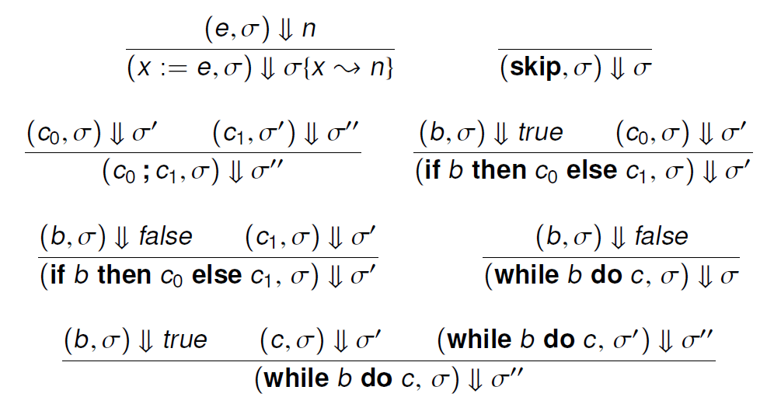
Operational semantics
Big-step

Slide 12
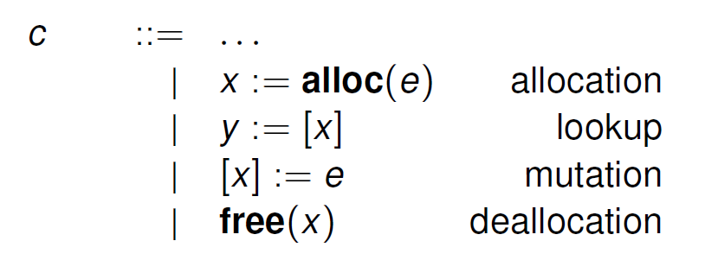
Extensions: a language with heap manipulation
Syntax

Slide 13
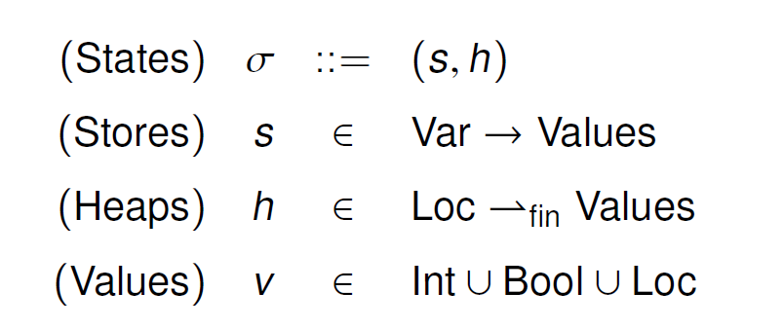
Extensions: a language with heap manipulation
States

Slide 14
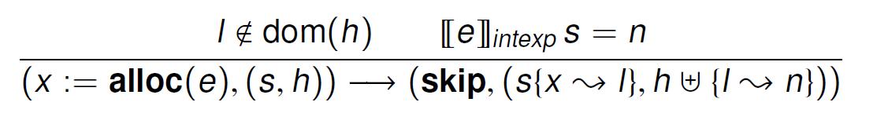
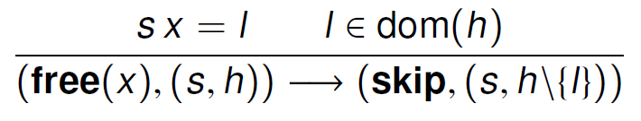
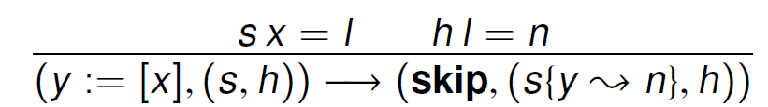
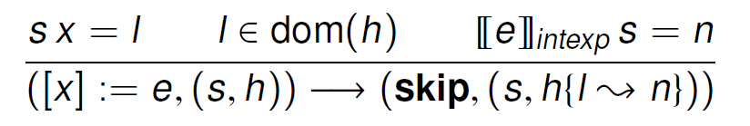
Extensions: a language with heap manipulation
Small-step operational semantics

Slide 15

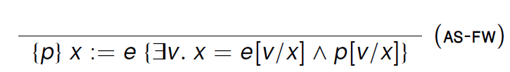

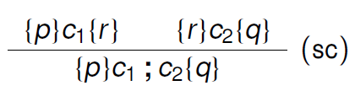
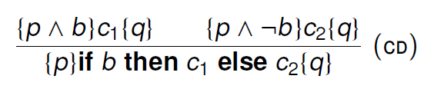
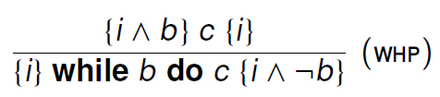
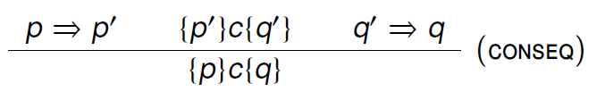
Hoare logic
Inference rules for partial correctness
Judgement semantics (validity of Hoare triples)
Soundness

Slide 16
Formal Semantics of Prog. Lang.
Lambda Calculus
Untyped
Reduction
Simply typed
Typing
Imperative languages
Operational semantics
Small-step & big-step
Hoare logic
Users: reasoning using logic rules; Designers: logic soundness

