Slide 1
An overview of Rocq (Coq)

Slide 2
What is Coq?
A proof assistant developed by INRIA
https://rocq-prover.org/
Coq is a formal proof management system. It provides a formal language to write mathematical definitions, executable algorithms and theorems together with an environment for semi-interactive development of machine-checked proofs …

Slide 3
What is Coq?
A functional programming language with rich type system
Define inductive data types and write algorithms manipulating them.
All programs must terminate.
A higher-order logic with interactive theorem prover
Allows you to reason about mathematical structures and your programs
Generates machine-checkable proofs
A meta-language/logic
Allows you to encode another language/logic and prove the properties of that language/logic

Slide 4
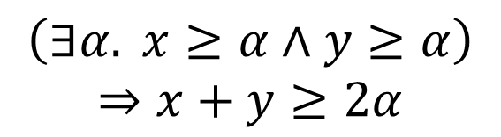
Why Coq?
To have more rigorous formal reasoning
For mathematics
This is NOT acceptable:
$$\left(∃α. x≥α∧y≥α\right)$$
$$⇒x+y≥2α$$

Slide 5
Why Coq?
To have more rigorous formal reasoning
For mathematics and program verification
Tools like Coq boost program verification

Slide 6
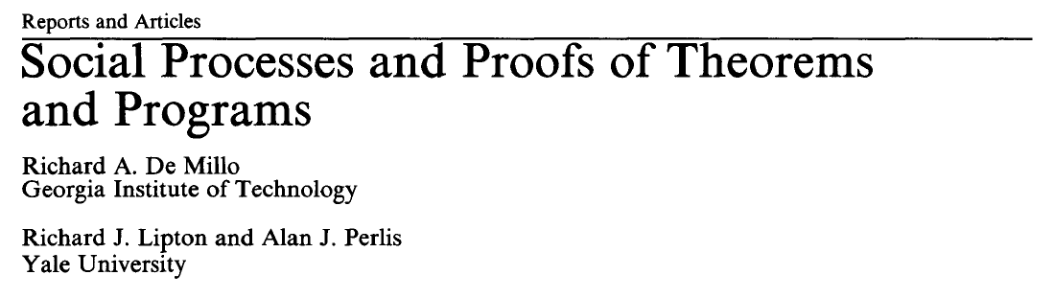
Program verification under attack
[CACM 1979]
Mathematical proofs can often be wrong!
Program verification would never work …
Mathematics is trustworthy because of the social process to check/validate proofs.
But nobody would care or check proofs for programs: “The verification of even a puny program can run into dozens of pages, and there's not alight moment or a spark of wit on any of those pages. Nobody is going to run into a friend's office with a program verification … Nobody is ever going to read it.”

Slide 7
Problem addressed by tools like Coq
Proofs are mechanized and machine-checkable
through Curry-Howard isomorphism [first published paper in 1980]
Proof checking is as simple as type checking
Fully automatic
Very simple algorithm
No longer need to trust the proofs
Check them!
Only need to trust the proof checker
Simple, can be reviewed by human experts …

Slide 8
A framework for certified software
Specifications
No
Proof
Proof Checker
Machine code
Yes
CPU
certified code (code + proof)
specifications: lang. semantics + program safety/security/correctness …
automated proof checker
need not trust the correctness of proofs

Slide 9
Applications of Coq
Formal proofs of mathematical theorems
Formal proof of 4-color theorem
By Georges Gonthier and Benjamin Werner, 2004
Other: Feit–Thompson theorem proved in Coq in 2012
Formal verification
OS kernels and hypervisors
CertiKOS project at Yale
seL4 in Isabelle at NICTA
Compilers
CompCert at INRIA and following projects
LLVM verification and Upenn
Others
Web servers (bedrock projects @ MIT)
Certified software tool chains (e.g., analysis algorithms) @ Princeton
Teaching: logic, programming languages, …
Benjamin C. Pierce, et al. Software Foundations. https://softwarefoundations.cis.upenn.edu/

Slide 10
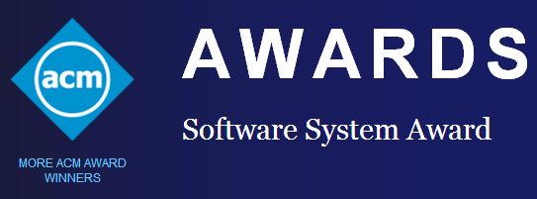
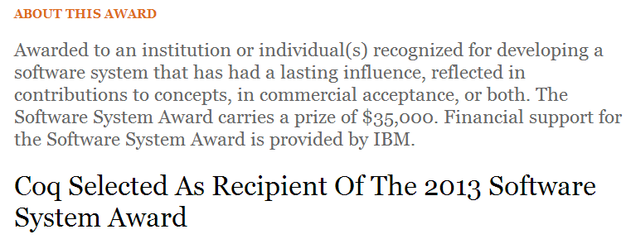
Gains lots of popularity
Other recipients of the award：
Unix、TCP/IP、World-Wide Web、Java、Make、VMWare、Eclipse、LLVM …

Slide 11
Gains lots of popularity
Coq applications
CompCert: 2021 ACM Software System Award
Other projects of formal verification
seL4: 2022 ACM Software System Award

Slide 12
Demo:
Small examples

