Slide 1
Simply-Typed Lambda Calculus
(Slides mostly follow Dan Grossman’s teaching materials)

Slide 2

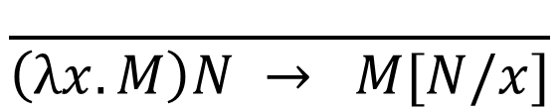


Review of untyped λ-calculus
Syntax: notation for defining functions
  (Terms) M, N ::= x | λx. M | M N
Semantics: reduction rules
$$\frac{ }{\left(λx.M\right)N → M[N/x]}$$
(β)
$$\frac{M→M′}{M N→M^{′}N }$$
$$\frac{N→N′}{M N →M N′ }$$
$$\frac{M→M′}{λx.M→λx.M′}$$

Slide 3
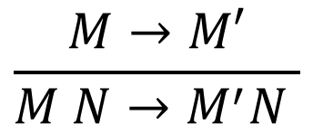
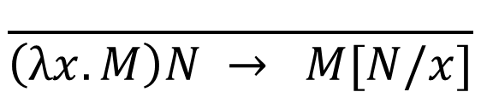
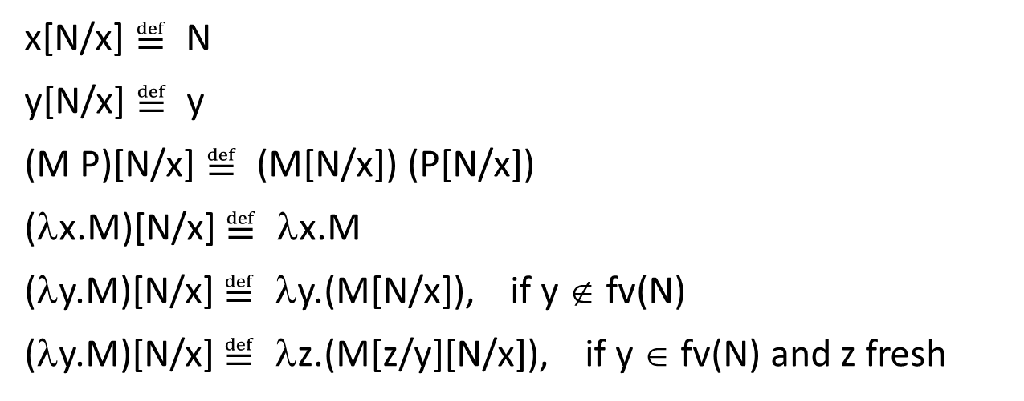
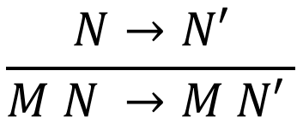
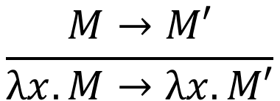
$$\frac{ }{\left(λx.M\right)N → M[N/x]}$$
$$\frac{M→M′}{M N→M^{′}N }$$
$$\frac{N→N′}{M N →M N′ }$$
$$\frac{M→M′}{λx.M→λx.M′}$$
  x[N/x] $≝$ N
  y[N/x] $≝$ y
  (M P)[N/x] $≝$ (M[N/x]) (P[N/x])
  (λx.M)[N/x] $≝$ λx.M
  (λy.M)[N/x] $≝$ λy.(M[N/x]), if y ∉ fv(N)
  (λy.M)[N/x] $≝$ λz.(M[z/y][N/x]), if y ∈ fv(N) and z fresh
Example: (λf. λx. f (f x)) (λy. y x)

Slide 4
Review of untyped λ-calculus
(λx. x x) (λx. x x)
→ (λx. x x) (λx. x x)
→ …
This class: adding a type system
(We will see that well-typed terms in STLC always terminate.)

Slide 5
Why types
Type checking catches “simple” mistakes early
  Example: 2 + true + “a”
(Type safety) Well-typed programs will not go wrong
  Ensure execution never reach a “meaningless” state
  But “meaningless” depends on the semantics (each language typically defines some as type errors and others run-time errors)
Typed programs are easier to analyze and optimize
  Compilers can generate better code (e.g. access components of structures by known offset)
Cons: impose constraints on the programmer
  Some valid programs might be rejected

Slide 6
Why formal type systems
Many typed languages have informal descriptions of the type systems (e.g., in language reference manuals)
A fair amount of careful analysis is required to avoid false claims of type safety
A formal presentation of a type system is a precise specification of the type checker
And allows formal proofs of type safety

Slide 7
What we will study about types
Type system
  Typing rules: assign types to terms
  Type safety (soundness of typing rules): well-typed terms cannot go wrong
Connection to constructive propositional logic
  Curry-Howard isomorphism: “Propositions are Types”, “Proofs are Programs”

Slide 8
Adding types to λ-calculus – wrong attempt
base type
(e.g. int, bool)
function type
(Types) τ, σ ::= T | fun

Slide 9

Adding types to λ-calculus – wrong attempt
Typing judgment (to assign types to terms)
Typing rules (to derive the typing judgment)
M is of type τ
$$⊢M :τ$$
Judgment
A statement J about certain formal properties
Has a derivation $⊢J$(i.e. “a proof”)
Has a meaning (“judgment semantics”) $⊨J$

Slide 10

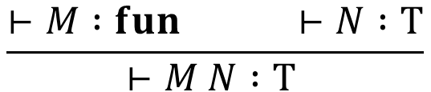
Adding types to λ-calculus – wrong attempt
Typing rules
$$\frac{ }{⊢\left(λx.M\right) :fun }$$
$$\frac{⊢M :fun ⊢N :T}{⊢M N :T }$$
Not type safe, since well-typed terms may go wrong (reduce to a “meaningless” state)
e.g. ((λf. f 1) 3) will go “wrong”, though $⊢\text{(}\text{λ}\text{f}\text{. }\text{f}\text{ 1) 3 }:int$

Slide 11
Adding types to λ-calculus – getting it right
Classify functions using argument and result types
  (λx. x) and (λf. f 1) should be of different types: ((λx. x) 3) is acceptable, but ((λf. f 1) 3) is not
  Explicitly specify argument types in function syntax
Type-check function bodies, which have free variables
  Types of free variables are the context: type of (f 1) depends on the type of f

Slide 12
Simply-typed λ-calculus (STLC)
base type
(e.g. int, bool)
function type
(Types) τ, σ ::= T | σ → τ
An infinite number of types:
int → int, int → (int → int), (int → int) → int, …
→ is right-associative: τ → τ → τ is τ → (τ → τ)

Slide 13
Simply-typed λ-calculus (STLC)
(Types) τ, σ ::= T | σ → τ
(Terms) M, N ::= x | λx : τ. M | M N

Slide 14
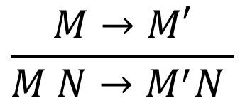
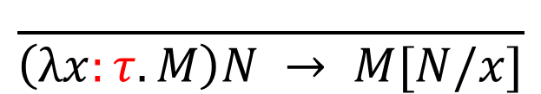
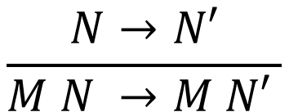
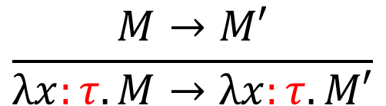
Reduction rules
$$\frac{ }{\left(λx:τ.M\right)N → M[N/x]}$$
(β)
$$\frac{M→M′}{M N→M^{′}N }$$
Same as
untyped λ-calculus
$$\frac{N→N′}{M N →M N′ }$$
$$\frac{M→M′}{λx:τ.M→λx:τ.M′}$$

Slide 15
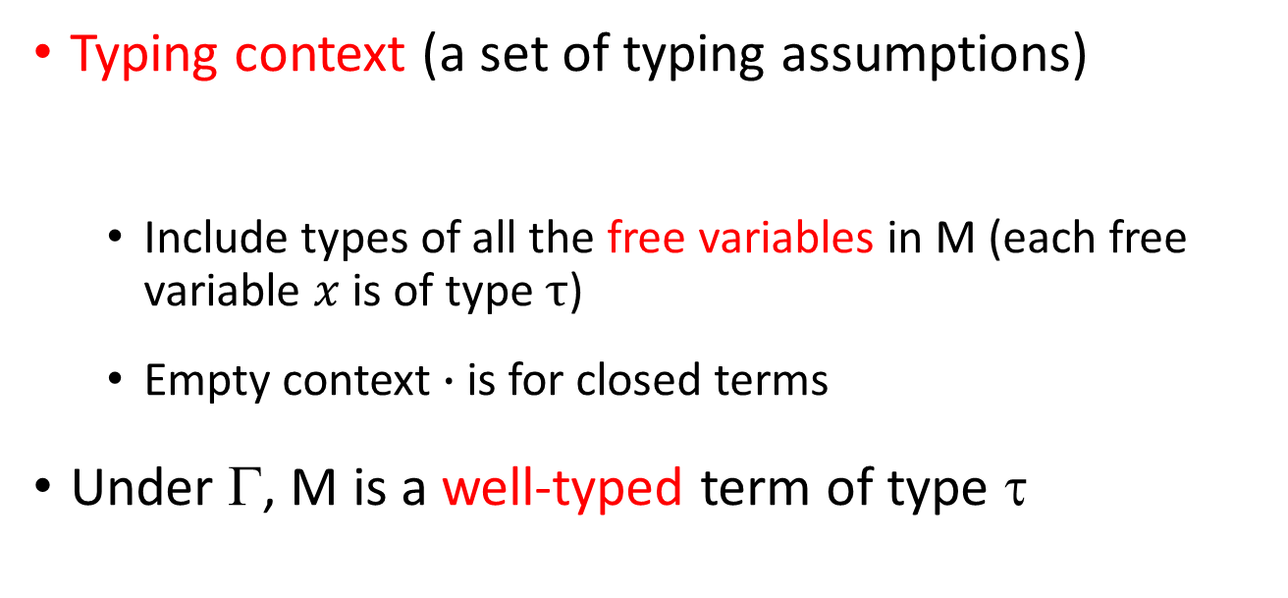


Typing judgment
M is of type τ in context Γ
$$Γ ⊢M :τ$$
Typing context (a set of typing assumptions)
  Include types of all the free variables in M (each free variable $x$ is of type $τ$)
  Empty context $∙$ is for closed terms
Under Γ, M is a well-typed term of type τ
$$Γ ∷= ∙| Γ, x:τ$$

Slide 16
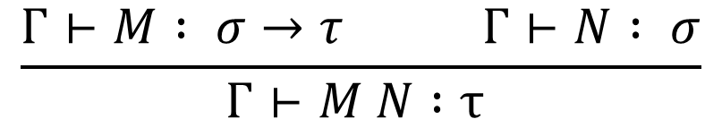
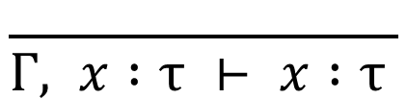
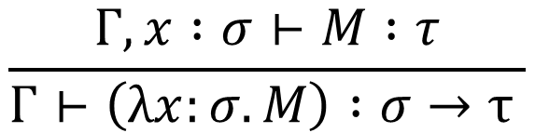
Typing rules
$$\frac{ }{Γ, x :τ ⊢ x :τ }$$
(var)
$$\frac{Γ⊢M : σ→τ Γ⊢N : σ}{Γ⊢M N :τ }$$
(app)
$$\frac{Γ, x :σ⊢M :τ}{Γ⊢\left(λx:σ.M\right) :σ→τ }$$
(abs)

Slide 17


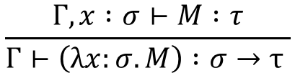


Typing derivation examples
(var)
$$\frac{ }{Γ, x :τ ⊢ x :τ }$$
$$\frac{Γ⊢M : σ→τ Γ⊢N : σ}{Γ⊢M N :τ }$$
(app)
$$\frac{Γ, x :σ⊢M :τ}{Γ⊢\left(λx:σ.M\right) :σ→τ }$$
(abs)
(var)
$x:τ ⊢$ $x:τ$
(abs)
$$⋅ ⊢\left(λx:τ. x\right) :τ→τ$$

Slide 18


Typing derivation examples
(var)
$$\frac{ }{Γ, x :τ ⊢ x :τ }$$
$$\frac{Γ⊢M : σ→τ Γ⊢N : σ}{Γ⊢M N :τ }$$
(app)
$$\frac{Γ, x :σ⊢M :τ}{Γ⊢\left(λx:σ.M\right) :σ→τ }$$
(abs)
(var)
$$x:τ, y:σ ⊢x :τ$$
(abs)
$x:τ ⊢$ $\left(λy:σ.x\right) :σ→τ$
(abs)
$$⋅ ⊢\left(λx:τ. λy:σ.x\right) :τ→σ→τ$$

Slide 19




Typing derivation examples
(var)
$$\frac{ }{Γ, x :τ ⊢ x :τ }$$
$$\frac{Γ⊢M : σ→τ Γ⊢N : σ}{Γ⊢M N :τ }$$
(app)
$$\frac{Γ, x :σ⊢M :τ}{Γ⊢\left(λx:σ.M\right) :σ→τ }$$
(abs)
(var)
(var)
$$x:τ→τ, y:τ ⊢x:τ→τ$$
$$x:τ→τ, y:τ ⊢y:τ$$
(app)
$x:τ→τ, y:τ ⊢$ $x y :τ$
(abs)
$x:τ→τ ⊢$ $\left(λy:τ.x y\right) :τ→τ$
(abs)
$$⋅ ⊢\left(λx:τ→τ. λy:τ.x y\right) :(τ→τ)→τ→τ$$

Slide 20
Soundness and completeness
A sound type system never accepts a program that can go wrong
  No false negatives
  The language is type-safe
A complete type system never rejects a program that can’t go wrong
  No false positives
However, for any Turing-complete PL, the set of programs that may go wrong is undecidable
  Type system cannot be sound and complete
  Choose soundness, try to reduce false positives in practice
Notes:
if (complicated expression that could run forever) then (go wrong) else (go wrong)

Slide 21
Soundness – well-typed terms in STLC never go wrong
Theorem (Type Safety):
That is, the reduction of a well-typed term either diverges, or terminates in a value of the expected type.
Follows from two key lemmas (next page).
$$For any M,M^{′} and τ,if ⋅ ⊢M:τ and M→^{∗}M^{′}, then$$
$$⋅ ⊢M′:τ,and either M′∈Values or ∃M′′. M′→M′′$$
Defined in language semantics (e.g. λ-abstraction, constants)

Slide 22
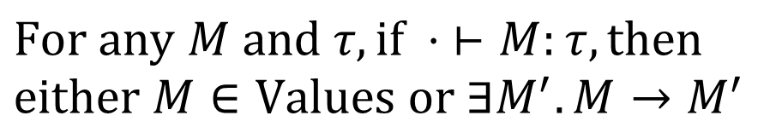
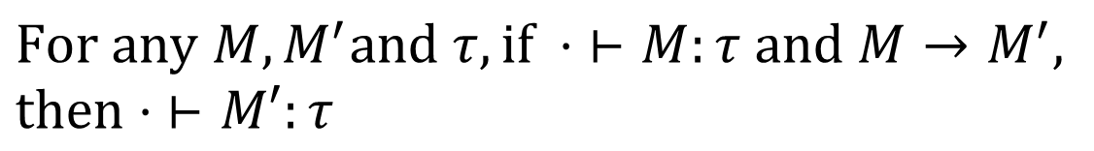
Soundness – well-typed terms in STLC never go wrong
Preservation (subject reduction): well-typed terms reduce only to well-typed terms of the same type
Progress: a well-typed term is either a value or can be reduced
$$For any M, M^{′}and τ, if ⋅ ⊢M:τ and M→M^{′},$$
$$then⋅ ⊢M′:τ$$
$$For any M and τ,if ⋅ ⊢M:τ, then$$
$$either M∈Values or ∃M^{′}. M→M^{′}$$

Slide 23

Not complete – the type system may reject terms that do not go wrong
(λx. (x (λy. y)) (x 3)) (λz. z)
Cannot find σ, τ such that
because we have to pick one type for x
But
$x:σ ⊢$ $\left(x \left(λy.y\right)\right)\left(x 3\right) : τ$
(λx. (x (λy. y)) (x 3)) (λz. z)
→ ((λz. z) (λy. y)) ((λz. z) 3)
→ (λy. y) ((λz. z) 3)
→ (λy. y) 3 → 3

Slide 24



Well-typed terms in STLC always terminate (strong normalization theorem)
Recall
(λx. x x) (λx. x x) cannot be assigned a type
(λx. x x) (λx. x x)
→ (λx. x x) (λx. x x)
→ …
Expect σ to be in the form of σ → τ,
which is impossible!
$$x:σ ⊢x:?$$
$$x:σ ⊢x:σ$$
$x:σ ⊢$ $x x : ?$
Notes:
If |- M : tau, then there exists v such that e →* v

Slide 25

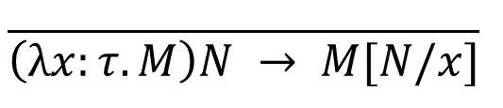
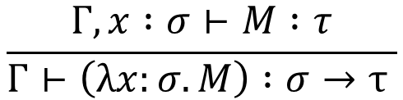
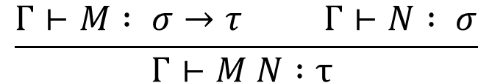
Main points of STLC
(Types) τ, σ ::= T | σ → τ
(Terms) M, N ::= x | λx : τ. M | M N
Reduction rules
$$\frac{ }{\left(λx:τ.M\right)N → M[N/x]}$$
(β)
Typing rules
$$\frac{Γ, x :σ⊢M :τ}{Γ⊢\left(λx:σ.M\right) :σ→τ }$$
$$\frac{ }{Γ, x :τ ⊢ x :τ }$$
(var)
(abs)
$$\frac{Γ⊢M : σ→τ Γ⊢N : σ}{Γ⊢M N :τ }$$
(app)
Soundness (type safety)

Slide 26
Adding stuff
Use STLC as a foundation for understanding other common language constructs
Extend the syntax (types & terms)
Extend the operational semantics (reduction rules)
Extend the type system (typing rules)
Extend the soundness proof (new proof cases)

Slide 27
Adding product type
(Types) τ, σ ::= … | σ × τ
(Terms) M, N ::= … | <M, N> | proj1 M | proj2 M
Consider structures in C:
struct date{
int year;
int month;
int day;
}

Slide 28
Product type
(Types) τ, σ ::= … | σ × τ
(Terms) M, N ::= … | <M, N> | proj1 M | proj2 M
Reduction rules
proj1 <M, N> → M
proj2 <M, N> → N
M → M’
N → N’
<M, N> → <M’, N>
<M, N> → <M, N’>
M → M’
M → M’
proj1 M → proj1 M’
proj2 M → proj2 M’

Slide 29
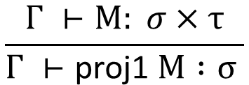
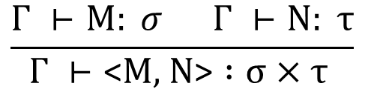
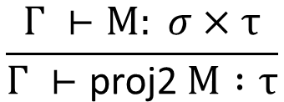
Product type
(Types) τ, σ ::= … | σ × τ
(Terms) M, N ::= … | <M, N> | proj1 M | proj2 M
Typing rules
$$\frac{Γ ⊢M: σ Γ ⊢N: τ}{Γ ⊢\text{<}M\text{, }\text{N}\text{>} :σ×τ }$$
(pair)
$$\frac{Γ ⊢M: σ×τ}{Γ ⊢\text{proj}\text{1 }M :σ }$$
$$\frac{Γ ⊢M: σ×τ}{Γ ⊢\text{proj}\text{2 }M :τ}$$
(proj1)
(proj2)

Slide 30




Typing derivation example
(var)
(var)
$$x:σ×τ ⊢x:σ×τ$$
$$x:σ×τ ⊢x:σ×τ$$
(proj2)
(proj1)
$$x:σ×τ ⊢\text{p}\text{roj}\text{2} x :τ$$
$$x:σ×τ ⊢\text{p}\text{roj}\text{1} x :σ$$
(pair)
$$x:σ×τ ⊢\text{<}\text{p}\text{roj}\text{2} x\text{,} \text{p}\text{roj}\text{1} x\text{>} :τ×σ$$
(abs)
$$⋅ ⊢\left(λx:σ×τ.\text{<}\text{p}\text{roj}\text{2} x\text{,} \text{p}\text{roj}\text{1 }x\text{>}\right) :(σ×τ)→(τ×σ)$$

Slide 31
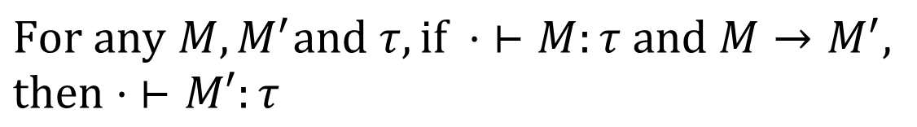
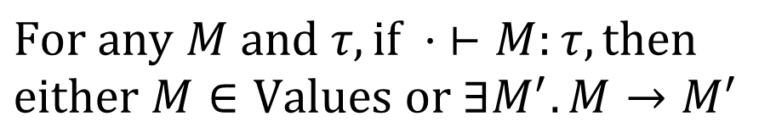
Soundness theorem (type safety)
Preservation:
Progress:
$$For any M, M^{′}and τ, if ⋅ ⊢M:τ and M→M^{′},$$
$$then⋅ ⊢M′:τ$$
$$For any M and τ,if ⋅ ⊢M:τ, then$$
$$either M∈Values or ∃M^{′}. M→M^{′}$$
Include <v1, v2> now
Notes:
If |- v : sigma * tau, then v must be in the form of <v1, v2>

Slide 32
Adding sum type
(Types) τ, σ ::= … | σ + τ
(Terms) M, N ::= … | left M | right M | case M do M1 M2
Consider unions in C:
union data{
int i;
float f;
char c;
}
Using the same location
for multiple data.
Can contain only one value at any given time.

Slide 33
Adding sum type
(Types) τ, σ ::= … | σ + τ
(Terms) M, N ::= … | left M | right M | case M do M1 M2
Subclasses in Java:
abstract class t {abstract t’ m();}
class A extends t { t1 x; t’ m(){...}}
class B extends t { t2 x; t’ m(){...}}
...
e.m();
case e do A.m B.m

Slide 34
Adding sum type
(Types) τ, σ ::= … | σ + τ
(Terms) M, N ::= … | left M | right M | case M do M1 M2
In Coq:
Inductive bool : Set :=
| true : bool
| false : bool.
Definition not (b : bool) : bool :=
match b with
| true => false
| false => true
end.

Slide 35
Sum type: reduction rules
case (left M) do M1 M2 → M1 M
case (right M) do M1 M2 → M2 M
M → M’
case M do M1 M2 → case M’ do M1 M2
M → M’
left M → left M’
M1 → M1’
case M do M1 M2 → case M do M1’ M2
M → M’
M2 → M2’
right M → right M’
case M do M1 M2 → case M do M1 M2’

Slide 36
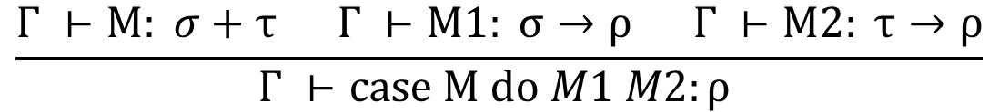
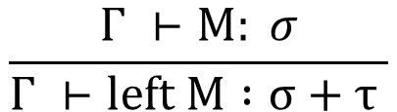
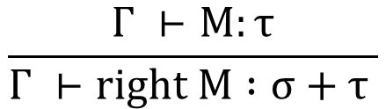
Sum type: typing rules
$$\frac{Γ ⊢M: σ}{Γ ⊢left M :σ+τ }$$
$$\frac{Γ ⊢M:τ}{Γ ⊢right M :σ+τ }$$
(left)
(right)
$$\frac{Γ ⊢M: σ+τ Γ ⊢M1: σ→ρ Γ ⊢M2: τ→ρ}{Γ ⊢case M do M1 M2:ρ }$$
(case)

Slide 37




Typing derivation examples
(var)
(var)
$$x:τ ⊢x:τ$$
$$x:τ ⊢x:τ$$
(left)
(left)
$$x:τ ⊢\text{left} x:τ+σ$$
$$x:τ ⊢\text{left} x:τ+ρ$$
(pair)
$$x:τ ⊢\text{<}\text{left} x\text{, }\text{left} x\text{>} :\left(τ+σ\right)×(τ+ρ)$$
(abs)
$$⋅ ⊢\left(λx:τ.\text{<}\text{left} x\text{,} \text{left} x\text{>}\right) :τ→\left(τ+σ\right)×(τ+ρ)$$
other side can be anything

Slide 38
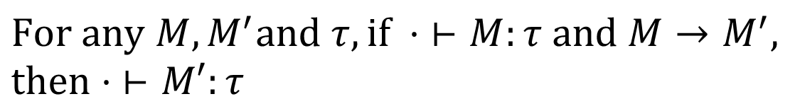
Soundness theorem (type safety)
Preservation:
Progress:
$$For any M, M^{′}and τ, if ⋅ ⊢M:τ and M→M^{′},$$
$$then⋅ ⊢M′:τ$$
$$For any M and τ,if ⋅ ⊢M:τ, then$$
$$either M∈Values or ∃M^{′}. M→M^{′}$$
Include “left v” and “right v” now
Notes:
If |- v : sigma + tau, then v must be in the form of “left v1” or in the form of “right v1”

Slide 39
Products vs. sums
“logical duals” (more on this later)
  To make a σ × τ, we need a σ and a τ
  To make a σ + τ, we need a σ or a τ
  Given a σ × τ, we can get a σ or a τ or both (our “choice”)
  Given a σ + τ, we must be prepared for either a σ or a τ (the value’s “choice”)

Slide 40
Main points till now
STLC extended with products and sums:
Next: recursion
(Types) τ, σ ::= T | σ → τ | σ × τ | σ + τ
(Terms) M, N ::= x | λx : τ. M | M N
| <M, N> | proj1 M | proj2 M
| left M | right M | case M do M1 M2

Slide 41
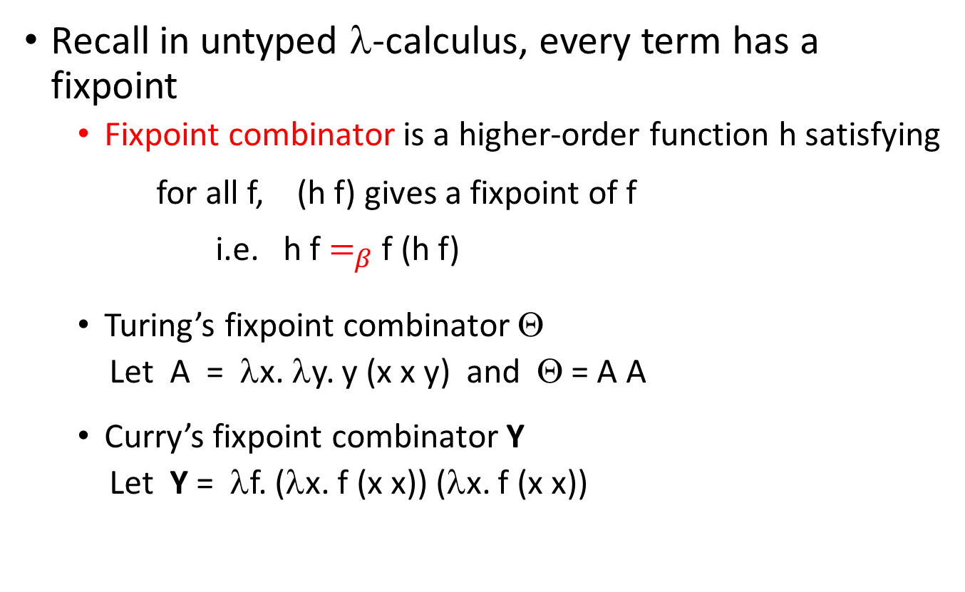
Recursion
Recall in untyped λ-calculus, every term has a fixpoint
  Fixpoint combinator is a higher-order function h satisfying
for all f, (h f) gives a fixpoint of f
i.e. h f $=_{β}$ f (h f)
  Turing’s fixpoint combinator Θ
  Let A = λx. λy. y (x x y) and Θ = A A
  Curry’s fixpoint combinator Y
  Let Y = λf. (λx. f (x x)) (λx. f (x x))

Slide 42
Recursion
Recall “strong normalization theorem”: well-typed terms in STLC always terminate
  Extensions so far (products & sums) preserve termination
Recursion is not allowed by the typing rules: it is impossible to find types for fixed-point combinators
So we add an explicit construct for recursion
(Terms) M, N ::= … | fix M
(Types) τ, σ ::= … (no new types)

Slide 43
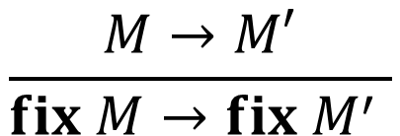
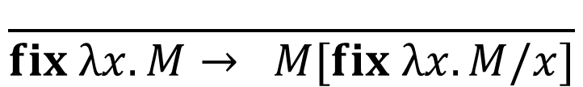
Reduction rules for fix
$$\frac{M→M′}{fix M→fix M^{′} }$$
$$\frac{ }{fix λx.M→ M[fix λx.M/x]}$$
( fix λf. λn. if (n == 0) then 1 else n * f(n-1) ) 3
→ (λn. if (n == 0) then 1 else n*((fix λf. λn. if (n == 0) then 1 else n * f(n-1))(n-1))) 3
→ if (3 == 0) then 1 else 3 * ((fix λf. λn. if (n == 0) then 1 else n * f(n-1))(3-1))
→ 3 * ((fix λf. λn. if (n == 0) then 1 else n * f(n-1))(3-1))
→ …

Slide 44
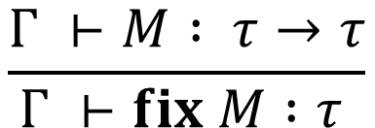
Typing fix
$$\frac{Γ ⊢M : τ→τ}{Γ ⊢fix M :τ }$$
(fix)
Math explanation: If M is a function from τ to τ , then fix M, the fixed-point of M, is some τ with the fixed-point property
Operational explanation: fix λx.M’ reduces to M’[fix λx.M’/x].
  The substitution means x and fix λx.M’ need the same type
  The result means M’ and fix λx.M’ need the same type
Soundness (type safety) is straightforward
But strong normalization is eliminated

Slide 45
Main points till now
STLC with products and sums:
We can also add recursion
Next: Curry-Howard isomorphism
(Types) τ, σ ::= T | σ → τ | σ × τ | σ + τ
(Terms) M, N ::= x | λx : τ. M | M N
| <M, N> | proj1 M | proj2 M
| left M | right M | case M do M1 M2

Slide 46

Curry-Howard Isomorphism
What we did:
  Define a programming language
  Define a type system to rule out “bad” programs
What logicians do:
  Define logic propositions
    E.g. p, q ::= B | p ∧ q | p ∨ q | p ⇒ q
  Define a proof system to prove “good” propositions
Turn out to be related
  Propositions are Types
  Proofs are Programs

Slide 47
Curry-Howard Isomorphism
Slogans
  Propositions are Types
  Proofs are Programs
In this class, we will show correspondence between formulas of constructive propositional logic
and types of STLC with products and sums
(Prop) p, q ::= B | p ⇒ q | p ∧ q | p ∨ q
(Types) τ, σ ::= T | σ → τ | σ × τ | σ + τ

Slide 48
Examples of terms and types
λx: τ. x
has type
τ → τ

Slide 49
Examples of terms and types
λx: τ. λf: τ → σ. f x
has type
τ → (τ → σ) → σ

Slide 50
Examples of terms and types
λf: τ → σ → ρ. λx: σ. λy: τ. f y x
has type
(τ → σ → ρ) → σ → τ → ρ

Slide 51
Examples of terms and types
λx: τ. <left x, left x>
has type
τ → ((τ + σ) × (τ + ρ))

Slide 52
Examples of terms and types
λf: τ → ρ. λg: σ → ρ. λx: τ + σ. (case x do f g)
has type
(τ → ρ) → (σ → ρ) → (τ + σ) → ρ

Slide 53
Examples of terms and types
λx: τ × σ. λy: ρ. < <y, proj1 x>, proj2 x >
has type
(τ × σ) → ρ → ((ρ × τ) × σ)

Slide 54
Empty and nonempty types
Have seen several “nonempty” types (closed terms of that type)
τ → τ
τ → (τ → σ) → σ
(τ → σ → ρ) → σ → τ → ρ
τ → ((τ + σ) × (τ + ρ))
(τ → ρ) → (σ → ρ) → (τ + σ) → ρ
(τ × σ) → ρ → ((ρ × τ) × σ)
There’re also lots of “empty” types (no closed terms of that type)
τ
τ → σ
τ + (τ → σ)
τ → (σ → τ) → σ
How to know whether a type is nonempty?

Slide 55
How to know whether a type is nonempty?
Let’s replace → with ⇒, × with ∧, + with ∨:
τ ⇒ τ
τ ⇒ (τ ⇒ σ) ⇒ σ
(τ ⇒ σ ⇒ ρ) ⇒ σ ⇒ τ ⇒ ρ
τ ⇒ ((τ ∨ σ) ∧ (τ ∨ ρ))
(τ ⇒ ρ) ⇒ (σ ⇒ ρ) ⇒ (τ ∨ σ) ⇒ ρ
(τ ∧ σ) ⇒ ρ ⇒ ((ρ ∧ τ) ∧ σ)
Can be proved in propositional logic
(corresponding to
nonempty types
– have closed terms)
τ
τ ⇒ σ
τ ∨ (τ ⇒ σ)
Cannot be proved in propositional logic
(corresponding to
empty types – no closed terms)
τ ⇒ (σ ⇒ τ) ⇒ σ

Slide 56






Example – propositional-logic proof
$$Γ ⊢p$$
assumptions
$$τ,τ⇒σ⊢τ⇒σ$$
$$τ,τ⇒σ⊢τ$$
$$τ,τ⇒σ⊢σ$$
$$τ ⊢\left(τ⇒σ\right)⇒σ$$
$$⋅ ⊢τ⇒\left(τ⇒σ\right)⇒σ$$

Slide 57
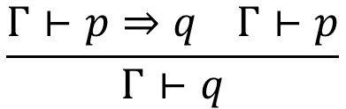
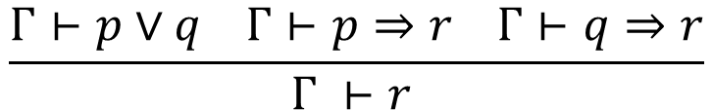
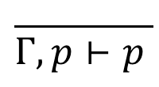
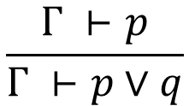
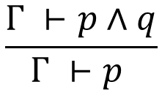
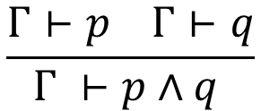
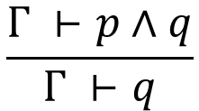
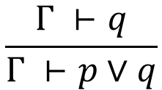
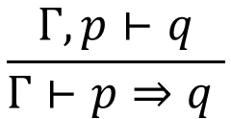
Propositional logic (natural deduction)
(Prop) p, q ::= B | p ⇒ q | p ∧ q | p ∨ q
(Ctxt) Γ ::= ⋅ | Γ, p
$$\frac{Γ, p⊢q}{Γ⊢p⇒q }$$
$$\frac{Γ⊢p⇒q Γ⊢p}{Γ⊢q}$$
$$\frac{ }{Γ, p⊢p }$$
(axiom)
(⇒-intro)
(⇒-elim)
$$\frac{Γ⊢p Γ⊢q}{Γ ⊢p∧q }$$
$$\frac{Γ ⊢p∧q}{Γ ⊢p }$$
$$\frac{Γ ⊢p∧q}{Γ ⊢q}$$
(∧-intro)
(∧-elim-l)
(∧-elim-r)
$$\frac{Γ ⊢p}{Γ ⊢p∨q}$$
$$\frac{Γ ⊢q}{Γ ⊢p∨q}$$
(∨-intro-l)
(∨-intro-r)
$$\frac{Γ⊢p∨q Γ⊢p⇒r Γ⊢q⇒r}{Γ ⊢r }$$
(∨-elim)

Slide 58
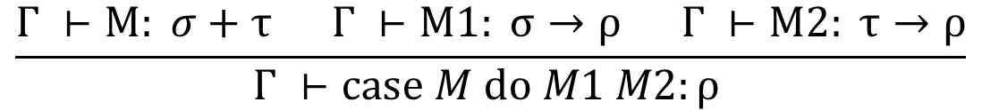
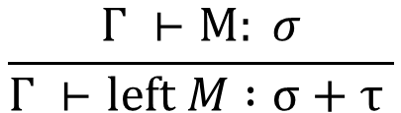
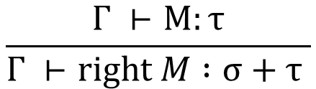

This is exactly our type system, erasing terms, replacing → with ⇒, × with ∧, + with ∨
(var)
$$\frac{Γ, x :σ⊢M :τ}{Γ⊢\left(λx:σ.M\right) :σ→τ }$$
(abs)
$$\frac{ }{Γ, x :τ ⊢ x :τ }$$
$$\frac{Γ⊢M : σ→τ Γ⊢N : σ}{Γ⊢M N :τ }$$
(app)
$$\frac{Γ ⊢M: σ Γ ⊢N: τ}{Γ ⊢\text{<}M\text{, }\text{N}\text{>} :σ×τ }$$
(pair)
$$\frac{Γ ⊢M: σ×τ}{Γ ⊢\text{proj}\text{1 }M :σ }$$
(proj1)
$$\frac{Γ ⊢M: σ×τ}{Γ ⊢\text{proj}\text{2 }M :τ}$$
(proj2)
$$\frac{Γ ⊢M: σ}{Γ ⊢left M :σ+τ }$$
(left)
$$\frac{Γ ⊢M:τ}{Γ ⊢right M :σ+τ }$$
(right)
$$\frac{Γ ⊢M: σ+τ Γ ⊢M1: σ→ρ Γ ⊢M2: τ→ρ}{Γ ⊢case M do M1 M2:ρ }$$
(case)

Slide 59
Curry-Howard isomorphism
Given a well-typed closed term, take the typing derivation, erase the terms, and have a propositional-logic proof
Given a propositional-logic proof, there exists a closed term with that type
A term that type-checks is a proof — it tells you exactly how to derive the logic formula corresponding to its type
Constructive (hold that thought) propositional logic and simply-typed lambda-calculus with pairs and sums are the same thing.
  Computation and logic are deeply connected
  λ is no more or less made up than implication

Slide 60
Revisit our examples: “terms are proofs”
λx: τ. x
is a proof that
τ ⇒ τ

Slide 61
Revisit our examples: “terms are proofs”
λx: τ. λf: τ → σ. f x
is a proof that
τ ⇒ (τ ⇒ σ) ⇒ σ

Slide 62
Revisit our examples: “terms are proofs”
λf: τ → σ → ρ. λx: σ. λy: τ. f y x
is a proof that
(τ ⇒ σ ⇒ ρ) ⇒ σ ⇒ τ ⇒ ρ

Slide 63
Revisit our examples: “terms are proofs”
λx: τ. <left x, left x>
is a proof that
τ ⇒ ((τ ∨ σ) ∧ (τ ∨ ρ))

Slide 64
Revisit our examples: “terms are proofs”
λf: τ → ρ. λg: σ → ρ. λx: τ + σ. (case x do f g)
is a proof that
(τ ⇒ ρ) ⇒ (σ ⇒ ρ) ⇒ (τ ∨ σ) ⇒ ρ

Slide 65
Revisit our examples: “terms are proofs”
λx: τ × σ. λy: ρ. < <y, proj1 x>, proj2 x >
is a proof that
(τ ∧ σ) ⇒ ρ ⇒ ((ρ ∧ τ) ∧ σ)

Slide 66
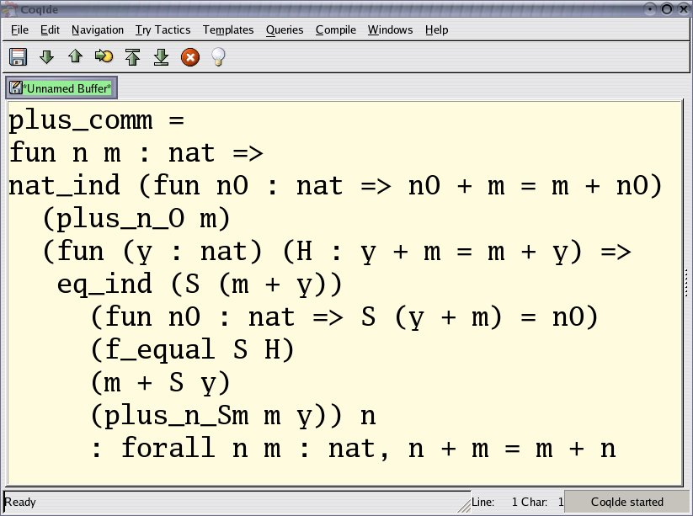
Coq example: proof can be written as functional program
Proof of commutativity of addition on nat in Coq.

Slide 67
Why care?
Because:
  This is just fascinating
  Don’t think of logic and computing as distinct fields
  Thinking “the other way” can help you know what’s possible/impossible
  Can form the basis for automated theorem provers
  Type systems should not be ad hoc piles of rules!
So, every typed λ-calculus is a proof system for some logic...
Is STLC with pairs and sums a complete proof system for propositional logic? Almost...

Slide 68



Classical vs. constructive
Classical propositional logic has the “law of the excluded middle”:
STLC does not support it: e.g. no closed term has type $ρ+(ρ→σ)$
Logics without this rule are called “constructive” or “intuitionistic”.
  Formulae are only considered "true" when we have direct evidence (“proofs produce examples”)
$$\frac{ }{Γ ⊢p∨(p⇒q)}$$
Think $"p ∨¬p"$
Notes:
not p =def (p => false)

Slide 69

Example classical proof
Theorem: There exist two irrational numbers $a$ and $b$ such that $a^{b}$ is rational.
Can be proved using “the law of exclusive middle”.
  It’s known that $\sqrt{2}$ is irrational.
  Consider the number ${\sqrt{2}}^{\sqrt{2}}$.
    If it is rational, the proof is complete, and $a=b= \sqrt{2}$.
    If it is irrational, then let $a={\sqrt{2}}^{\sqrt{2}}$ and $b= \sqrt{2}$. Then $a^{b}={({\sqrt{2}}^{\sqrt{2}})}^{\sqrt{2}} ={\sqrt{2}}^{\sqrt{2}×\sqrt{2}}={(\sqrt{2})}^{2} =2$, and the proof is complete.
Constructive logics would not accept this argument

Slide 70

Classical vs. constructive
In constructive logics, “branch on possibilities” by making “excluded middle” an explicit assumption:
“if any number is either rational or irrational, then there exist two irrational numbers $a$ and $b$ such that $a^{b}$ is rational”
$$(p∨\left(p⇒q\right))∧(p⇒r)∧\left(\left(p⇒q\right)⇒r\right)⇒r$$

Slide 71
What about “fix”?
A “non-terminating proof” is no proof at all
Remember the typing rule
It lets us prove anything! E.g. fix λx:τ. x has type τ
So the “logic” is inconsistent
$$\frac{Γ ⊢M : τ→τ}{Γ ⊢fix M :τ }$$
(fix)

Slide 72

Last word on Curry-Howard
Not just constructive propositional logic & STLC
Every logic has a corresponding typed system
  Classical logics
  Inconsistent logics
If you remember one thing:
$$\frac{Γ⊢M:σ→τ Γ⊢N: σ}{Γ⊢M N :τ }$$
$$\frac{Γ⊢p⇒q Γ⊢p}{Γ⊢q}$$
(app)
(⇒-elim)

