Slide 1
SAS® And Sudoku
Richard A. DeVenezia, Independent Consultant
John R. Gerlach, MaxisIT, Inc.
Larry Hoyle, Institute for Policy and Social Research, Univ. of Kansas
Talbot M. Katz, Analytic Data Information Technologies
Rick Langston, SAS Institute Inc.

Slide 2
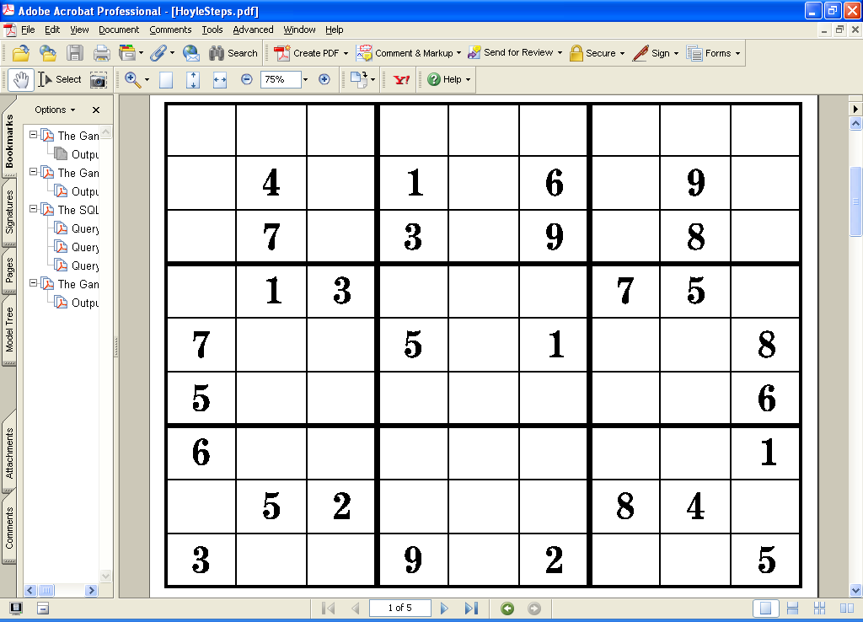
Sudoku Puzzles

Slide 3
Rules for Sudoku Puzzles
The numbers 1 through 9 can appear in each cell of the grid.

Slide 4
Rules for Sudoku Puzzles
The numbers 1 through 9 can appear in each cell of the grid.
Each of the 9 values must appear only once in its row,

Slide 5
Rules for Sudoku Puzzles
The numbers 1 through 9 can appear in each cell of the grid.
Each of the 9 values must appear only once in its row,
Each of the 9 values must appear only once in its column

Slide 6
Rules for Sudoku Puzzles
The numbers 1 through 9 can appear in each cell of the grid.
Each of the 9 values must appear only once in its row.
Each of the 9 values must appear only once in its column.
Each of the 9 values must appear only once in its 3 by 3 block.

Slide 7
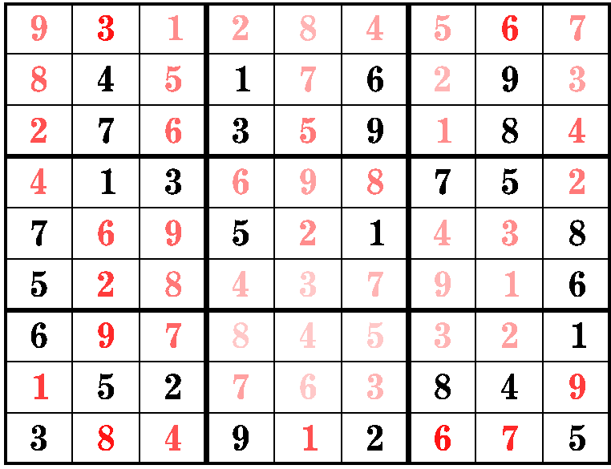
Rules for Sudoku Puzzles
The numbers 1 through 9 can appear in each cell of the grid.
Each of the 9 values must appear only once in its row.
Each of the 9 values must appear only once in its column.
Each of the 9 values must appear only once in its 3 by 3 block.
A valid puzzle should have a unique solution.

Slide 8
Sudoku Puzzle Statistics
6,670,903,752,021,070,000,000 | estimated number of puzzles
5,472,730,538 | "unique" puzzles (reduced to equivalents)
1 | mean seconds per unique puzzle
0.016666667 | mean minutes per puzzle
91,212,176 | total minutes for all unique puzzles
1,520,203 | total hours for all unique puzzles
63,342 | total days for all unique puzzles
174 | total years for all unique puzzles
Estimates of number of puzzles from
Delahaye, Jean-Paul 2006. “The Science Behind Sudoku.” Scientific American 294 (6): 80-87.

Slide 9
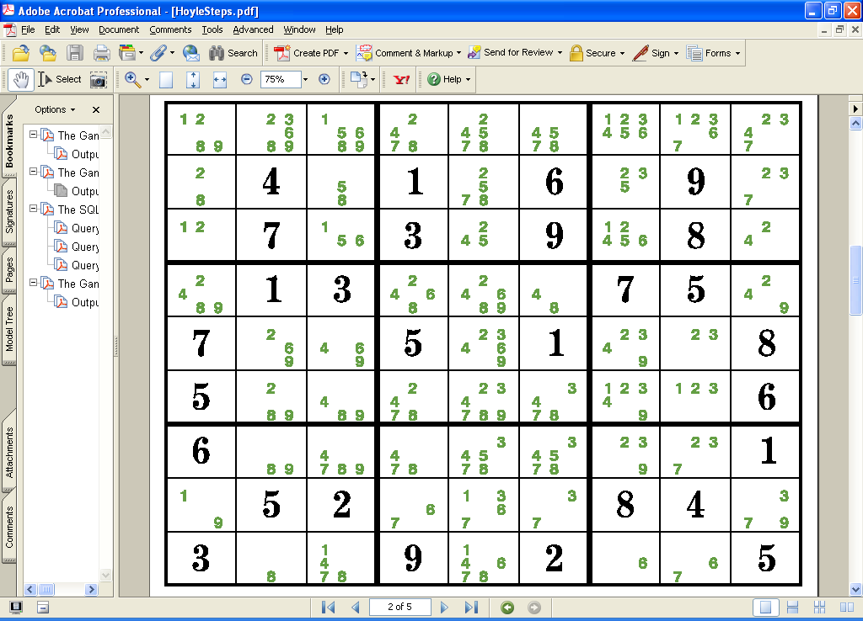
Enumerate the Possible Values

Slide 10
One Strategy – Find Unique Possibilities

Slide 11
One Strategy – Find Unique Possibilities

Slide 12
Another Strategy – “Two of Three”

Slide 13
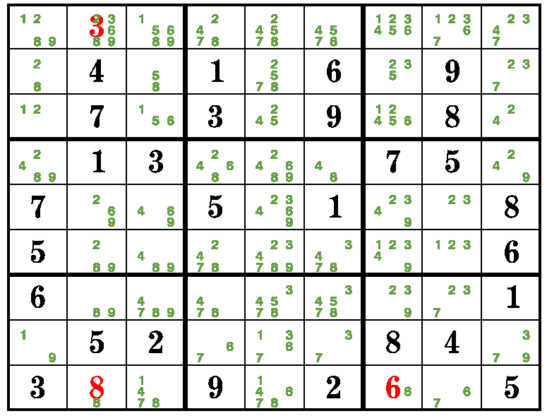
Enumerate Possibilities Again

Slide 14
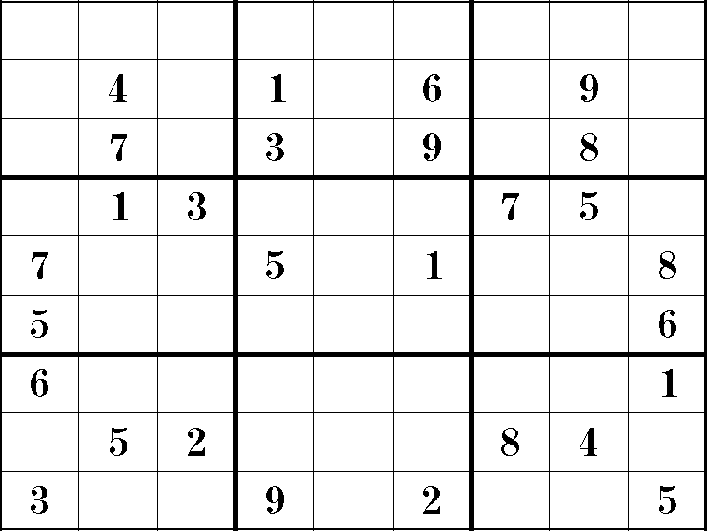
Iterate Strategies to Solve a Puzzle

Slide 15
Difficult Puzzles May Require Guessing and Backtracking
Pick a value for an empty cell
Continue trying to solve
If the value turns out to have been wrong –
  Back up
  Try another value

Slide 16
Using SAS to Solve Puzzles
Many Approaches
Data Step
  Multiple algorithms, Multiple data structures
PROC CLP
PROC LP
PROC OPTMODEL
PROC SQL
SAS calling external solver engine

Slide 17
John Gerlach

Slide 18
Using a Cube to Solve the Square
John R. Gerlach
MaxisIT, Inc.
jgerlach@maxisit.com

Slide 19
A Geometric Solution
Imagine a cube behind the square.
The cube represents a collection of orthogonal vectors for each XY cell such that the Z-coordinate denotes all the possible values of each XY cell.

Slide 20
A Solved Puzzle
The set of n² triples XYZxyz represents the solution to the puzzle.
All XY pairs are unique.
All XZ pairs are unique.
All YZ pairs are unique.

Slide 21
Abstract Data Structures
The Square
  XY11-XY19, XY21-XY29, …,
  …, XY91-XY99
The Cube
  XYZ111-XYZ119, …, XYZ191-XYZ199
  : : : :
  XYZ911-XYZ919, …, XYZ991-XYZ999

Slide 22
Cell (2,5) = 8
Cube
  XYZ258 represents the 2nd row, 5th column, and the 8th cell in the orthogonal vector.
  XYZ258 = Z = 8.
Square
  XY25 represents the 2nd row, 5th column.
  XY25 = XYZ258 = 8.

Slide 23
SAS Solution (Preliminaries)
Create Variables XYxy & XYZxyz
  Macro
Map Cell (x,y) to a Sub-Matrix (1-9)
  Control Input Data Set
Determine Starting Coordinate of Each
Sub-matrix
  Simple Format

Slide 24
Puzzle → Data
9 . 5 . 6 . . . .
. . . . . 5 8 . 6
. . . . . 4 . 5 9
. . . . 5 1 3 4 .
. . 2 . . . 6 . .
. 7 4 6 2 . . . .
3 5 . 1 . . . . .
8 . 9 3 . . . . .
. . . . 8 . 7 . 4

Slide 25
The Square
p
u
z x x x x x x x x x x x x x x x x x x x x x x x x x x x x x x x x x x x x x x x x x
z y y y y y y y y y y y y y y y y y y y y y y y y y y y y y y y y y y y y y y y y y
l 1 1 1 1 1 1 1 1 1 2 2 2 2 2 2 2 2 2 3 3 3 3 3 3 3 3 3 4 4 4 4 4 4 4 4 4 5 5 5 5 5
e 1 2 3 4 5 6 7 8 9 1 2 3 4 5 6 7 8 9 1 2 3 4 5 6 7 8 9 1 2 3 4 5 6 7 8 9 1 2 3 4 5
1 . . . . 9 . . 7 . . 1 9 7 . . . . . 8 3 . . . . . . . . . 2 1 . 6 . 5 . . . . . 4
2 2 7 . 9 . . . . . . . . . . 6 . 2 . . 6 . . . . . 7 5 . . . 2 . . 3 . . 6 . 5 . .
3 . . . . . . . 7 . . 1 9 7 . . . . . 8 3 . . . . . . . . . . . . 6 . 5 . . . . . 4
p
u
z x x x x x x x x x x x x x x x x x x x x x x x x x x x x x x x x x x x x x x x x
z y y y y y y y y y y y y y y y y y y y y y y y y y y y y y y y y y y y y y y y y
l 5 5 5 5 6 6 6 6 6 6 6 6 6 7 7 7 7 7 7 7 7 7 8 8 8 8 8 8 8 8 8 9 9 9 9 9 9 9 9 9
e 6 7 8 9 1 2 3 4 5 6 7 8 9 1 2 3 4 5 6 7 8 9 1 2 3 4 5 6 7 8 9 1 2 3 4 5 6 7 8 9
1 . 7 . 3 4 . 5 3 8 . . . . 6 4 . . . 8 . . . . . . 2 . . . 4 . . . 8 . . 1 3 6 9
2 8 . . . . 2 4 . . . . . . 9 . 8 7 . . . . . . . . . 2 . . . . . 4 . . . 5 7 1 .
3 . 7 . 3 4 . . 3 8 . . . . 6 4 . . . 8 . . . . . . 2 . . . 4 . . . 8 . . 1 3 6 9

Slide 26
The Cube (Conventions)
Z-value The value that has been assigned to the grid.
Zero The Z-value is no longer viable.
Missing A possible value for the grid.

Slide 27
The Cube (Non-Missing Values)
Populate the Z-vector in the cube with zeros, except for the XYZ coordinate that is assigned the value of the XY coordinate.
Populate the cube with respect to the sub-matrix.

Slide 28
The Cube (Non-Missing Values)
Populate the Y-vector in the cube based on the constant values of X and Z, assigning the values 0 or Z.
Populate the X-vector in the cube based on the constant values of Y and Z, assigning the values 0 or Z.

Slide 29
The Cube (Z-Vector)
--------------- Z ---------------
X Y 1 2 3 4 5 6 7 8 9
-------------------------------------------
1 1 0 0 0 0 0 0 0 0 9
2 0 0 . 0 . 0 0 . 0
3 0 . . 0 0 . 0 . 0
4 0 0 . . 0 . 0 0 0
5 0 0 . 0 . . 0 0 0
6 0 0 0 0 0 0 7 0 0
7 0 . . 0 0 0 0 0 0
8 1 0 0 0 0 0 0 0 0
9 0 0 . 0 0 0 0 . 0
2 1 0 0 0 0 0 0 0 . 0
2 0 0 0 0 0 0 7 0 0
3 0 0 0 4 0 0 0 0 0
4 . 0 . 0 0 0 0 0 0
5 0 0 . 0 0 0 0 0 0
6 0 2 0 0 0 0 0 0 0
7 0 0 . 0 0 0 0 0 .
8 0 0 0 0 0 6 0 0 0
9 0 0 0 0 5 0 0 0 0

Slide 30
The Cube (Sub-Matrix)
--------------- Z ---------------
Block X Y 1 2 3 4 5 6 7 8 9
--------------------------------------------------
1 1 1 0 0 0 0 0 0 0 0 9
2 0 0 . 0 . 0 0 . 0
3 0 . . 0 0 . 0 . 0
2 1 0 0 0 0 0 0 0 . 0
2 0 0 0 0 0 0 7 0 0
3 0 0 0 4 0 0 0 0 0
3 1 0 0 0 0 . . 0 0 0
2 1 0 0 0 0 0 0 0 0
3 0 . . 0 0 . 0 0 0

Slide 31
Solving The Square
Twenty attempts
Walk-Through the matrix
  Z-Vector contains one missing value.
  Assign cell the value of Z.
  Update the cube.
  Continue …

Slide 32
Updating The Cube
Populate
  Sub-matrix
  Z-vector, pivoting on XY
  Y-vector, pivoting on XZ
  X-vector, pivoting on YZ

Slide 33
The SAS Solution
data sudoku2;
array square{9,9} %elements(square);
array cube{9,9,9} %elements(cube);
array vector{9} v1-v9;
set sudoku1;
do n = 1 to 20;
* Process X,Y,Z Coordinates ;
* Process Y,Z,X Coordinates ;
* Process X,Z,Y Coordinates ;

Slide 34
The SAS Solution
if nmiss(of square{*}) eq 0
then do;
output;
stop;
end;
end;
output;
return;
cube:
* Obtain X,Y coordinate in sub-matrix ;
* Assign Z the value of X,Y ;
* Update the sub-matrix ;
* Update the X-vector ;
* Update the Y-vector ;
return;
run;

Slide 35
Solved Puzzle
1 2 3 4 5 6 7 8 9
----------------------------------------
1 9 5 3 4 6 7 2 1 8
2 8 7 4 1 3 2 9 6 5
3 6 1 2 8 9 5 4 7 3
4 2 3 6 7 8 4 5 9 1
5 1 9 8 2 5 3 7 4 6
6 7 4 5 6 1 9 3 8 2
7 5 8 7 3 4 1 6 2 9
8 3 2 1 9 7 6 8 5 4
9 4 6 9 5 2 8 1 3 7

Slide 36
Unfair Puzzles
Insufficient information to solve the puzzle without resorting to relentless trial and error.

Slide 37
Unsolved Puzzle
1 2 3 4 5 6 7 8 9
------------------------------------
1 5 . . . . 8 2 6 3
2 9 3 8 . . . 1 4 7
3 . . . . . 7 9 . .
4 . . . 7 9 . . . 1
5 6 . . . 8 . . . 4
6 . . 3 . . . . 9 2
7 2 8 . 4 . . . 1 .
8 3 . . . . . . . .
9 7 1 . . 5 . 4 . .

Slide 38
Bootstrapping
Identify possible values for empty cells.
Order the frequency of occurrence, pivoting on the X-coordinate.
Store triplets in parallel arrays.
Apply values to optimize the affect on the cube.

Slide 39
The %bootstrap Macro
Parameters
  XCOORD
  YCOORD
  Value
Applies triplets
Updates cube
Solves Square

Slide 40
Solved Sudoku Puzzle
1 2 3 4 5 6 7 8 9
-----------------------------------
1 5 4 7 9 1 8 2 6 3
2 9 3 8 5 2 6 1 4 7
3 1 6 2 3 4 7 9 5 8
4 4 2 5 7 9 3 6 8 1
5 6 9 1 2 8 5 3 7 4
6 8 7 3 1 6 4 5 9 2
7 2 8 6 4 3 9 7 1 5
8 3 5 4 6 7 1 8 2 9
9 7 1 9 8 5 2 4 3 6

Slide 41
Conclusion
Natural (Geometric) Solution
Data Step / Macro Language
No Statistical Procedures
John R. Gerlach
jgerlach@maxisit.com

Slide 42
Larry Hoyle
SAS® and Sudoku SGF 2007, This slide copyright Larry Hoyle, 2007
Bar size 2048

Slide 43
Larry Hoyle
Institute for Policy and Social Research
University of Kansas
LarryHoyle@ku.edu
SAS® and Sudoku SGF 2007, This slide copyright Larry Hoyle, 2007
Bar size 2048

Slide 44
An SQL Approach
SQL example for class use
  All SQL except for:
    Data step to read puzzle
    Macro to iterate
    PROC TABULATE to display puzzle
  Full program is in the paper
SAS® and Sudoku SGF 2007, This slide copyright Larry Hoyle, 2007
Bar size 2048

Slide 45
Model Human Strategies
SQL models three strategies a person might use
  Only one possible value
  “Two of three” in columns
  “Two of three” in rows
SAS® and Sudoku SGF 2007, This slide copyright Larry Hoyle, 2007
Bar size 2048

Slide 46
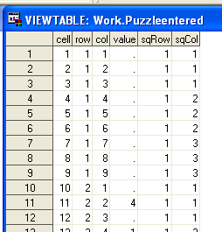
Data Structure for Original Puzzle
One row per cell
Variables for:
  Row
  Column
  Row of block (1 to 3)
  Column of block
  Initial value
SAS® and Sudoku SGF 2007, This slide copyright Larry Hoyle, 2007
Bar size 2048

Slide 47
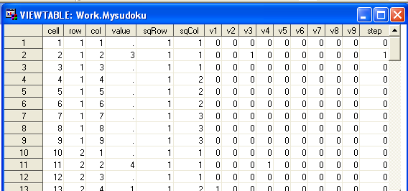
Augmented Data Structure for Puzzle
Add
  Boolean indicators for solved values
  Step at which value found
SAS® and Sudoku SGF 2007, This slide copyright Larry Hoyle, 2007
Bar size 2048

Slide 48
Self Join
A self join will allow tabulating constraints for each cell
Match empty cells (our targets) with filled cells (constraints)
SAS® and Sudoku SGF 2007, This slide copyright Larry Hoyle, 2007
Bar size 2048

Slide 49
Self Join Where Clause
from &mySudoku. as a, &mySudoku. as b
where
(a.value = .) and /* empty cells (a) */
(b.value ne .) and /* match filled cells (b) */
(a.cell ne b.cell) and /* not themselves */
/* the Sudoku rules */
(a.row=b.row or /* same row */
a.col=b.col or /* same column */
(a.sqRow=b.sqRow and
a.sqCol=b.sqCol) /* same block */
)
SAS® and Sudoku SGF 2007, This slide copyright Larry Hoyle, 2007
Bar size 2048

Slide 50
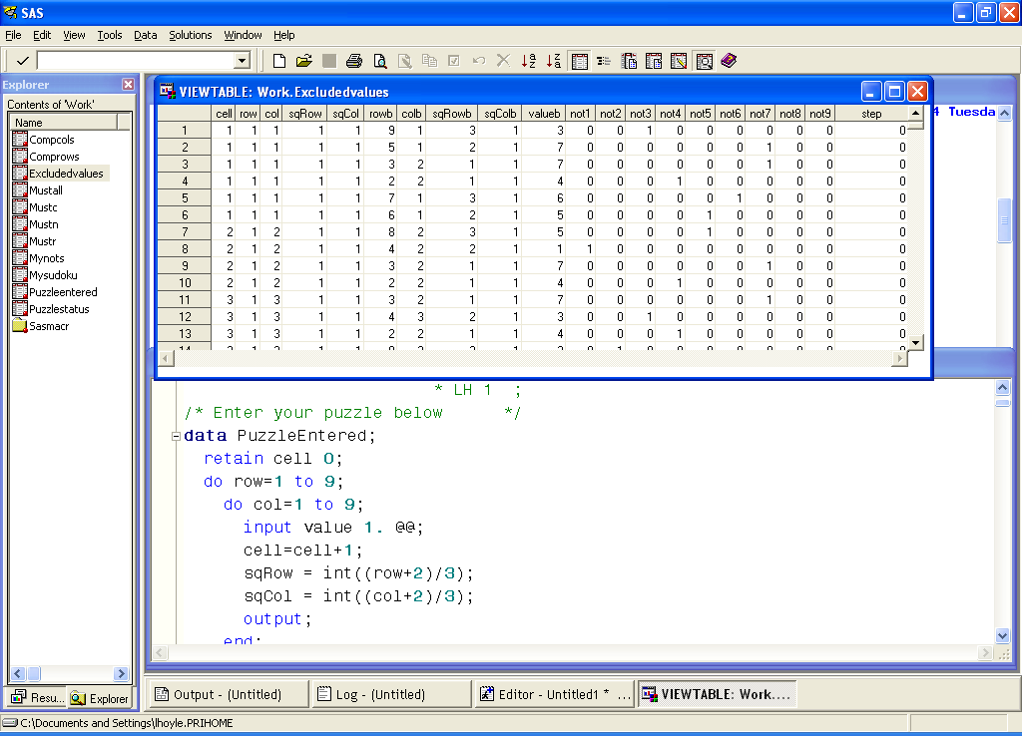
Self Join Yields Cell Constraints
Match empty cells with filled cells
For each empty cell, one row per filled in value in same row, column or block
Example: Cell 1,1 is empty
  Cell 2,2 in the same block has a 4
  Cannot be 3,4,5,6,7
SAS® and Sudoku SGF 2007, This slide copyright Larry Hoyle, 2007
Bar size 2048

Slide 51
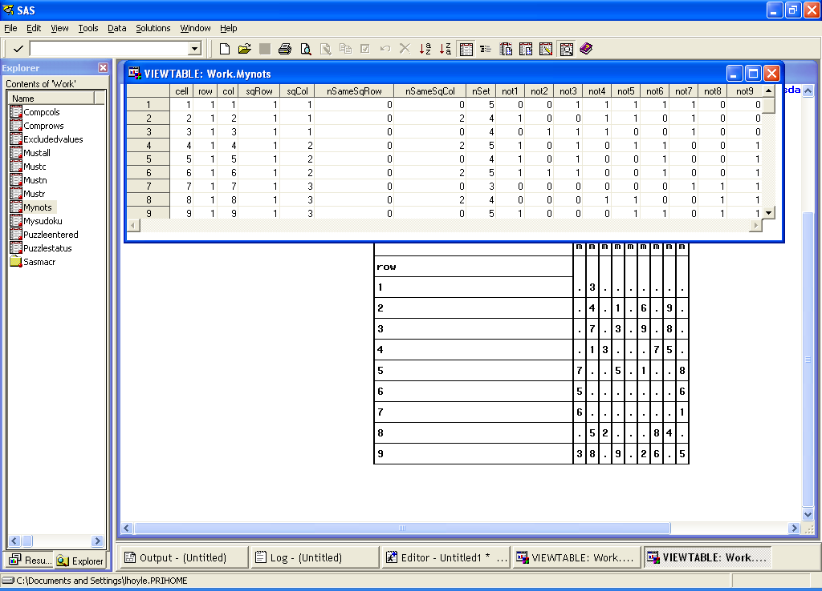
“Group By” Query Gives One Row per Cell
Max of each “not” captures whether the value is constrained
SAS® and Sudoku SGF 2007, This slide copyright Larry Hoyle, 2007
Bar size 2048

Slide 52
“Group By” Helps Identify “Two of Three” Possibilities
Example: count those in the same column and same block row
sum(col=colb and sqRow=sqRowb
and sqCol=sqColb) as nSameSqCol
{
SAS® and Sudoku SGF 2007, This slide copyright Larry Hoyle, 2007
Bar size 2048

Slide 53
“Group By” Also Counts Constraints
Not normalized, but aids comprehensibility
  (same with sqRow and sqCol which can be derived from row and col)
SAS® and Sudoku SGF 2007, This slide copyright Larry Hoyle, 2007
Bar size 2048

Slide 54
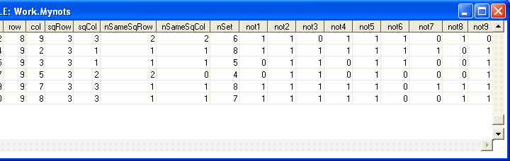
Cells with NSet=8 are solved
The one “not” column that is “0” has to be the value
SAS® and Sudoku SGF 2007, This slide copyright Larry Hoyle, 2007
Bar size 2048

Slide 55
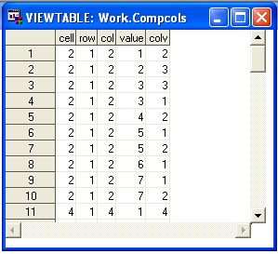
“Two of Three” Values
MyNots joined to the Puzzle table to check for two identical values not in the empty cell’s column or block
SAS® and Sudoku SGF 2007, This slide copyright Larry Hoyle, 2007
Bar size 2048

Slide 56
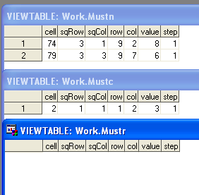
The Puzzle Gets Updated With Found Values
The process iterates until nothing is found
SAS® and Sudoku SGF 2007, This slide copyright Larry Hoyle, 2007
Bar size 2048

Slide 57
Generating New Puzzles – One Approach
198765432
z2zzqznzm
zz3zzrzoz
azz4zzszp
zazz5zztz
gzczz6zzu
zhzdzz7zz
kzizezz8z
zlzjzfzz9
Dataset –
  numbers specify initial desired values
SAS® and Sudoku SGF 2007, This slide copyright Larry Hoyle, 2007
Bar size 2048

Slide 58
Generating New Puzzles – One Approach
198765432
z2zzqznzm
zz3zzrzoz
azz4zzszp
zazz5zztz
gzczz6zzu
zhzdzz7zz
kzizezz8z
zlzjzfzz9
Dataset –
  numbers specify initial desired values
  Fill in other cells alphabetical order
SAS® and Sudoku SGF 2007, This slide copyright Larry Hoyle, 2007

Slide 59
Generating New Puzzles – One Approach
198765432
z2zzqznzm
zz3zzrzoz
azz4zzszp
zazz5zztz
gzczz6zzu
zhzdzz7zz
kzizezz8z
zlzjzfzz9
Dataset –
  numbers specify initial desired values
  Fill in other cells alphabetical order
Procedure-
  LOOP
    Fill in value
    Find multiple solutions (e.g. with CLP)
    Stop at last valid solution(s)
  Pick one valid solution
  LOOP
    Empty cells in reverse alphabetical order until there is a unique solution
SAS® and Sudoku SGF 2007, This slide copyright Larry Hoyle, 2007

Slide 60
Talbot Michael Katz
SAS® and Sudoku SGF 2007, This slide copyright Larry Hoyle, 2007
Bar size 2048

Slide 61
SAS® and Sudoku
SGF Paper 011-2007
Co-Authors:
  Richard A. DeVenezia, Independent Consultant
  John R. Gerlach,
  MaxisIT, Inc.
  Larry Hoyle,
  Institute for Policy and Social Research, Univ. of Kansas
  Talbot M. Katz,
  Analytic Data Information Technologies
  Rick Langston,
  SAS Institute Inc.
Topic:
SAS/OR® and Sudoku
  Talbot Michael Katz
Notes:
Thanks to Larry Hoyle for inviting us to participate in his session. I have to commend Larry for choosing to devote his session to Sudoku rather than something for social benefit or career enhancement.
Actually, we can relate this to a purpose of the Application Development section, which is to find the right tools for the job. In some cases you want to build your own tool, and in others, you look for a pre-made widget; in SAS the widgets are, of course, PROCs.

Slide 62
Background 1: My Personal History with SAS and Sudoku
TMK:
Became a regular SAS user in 1990
  Version 5.18
  IBM Mainframe VM/CMS
  Have since created many .sas7bdat files, yet have never used SAS Version 7
First SAS-L post on July 12th, 2001
  “Hierarchical Bayes Conjoint Analysis”
    Still waiting for a response
Became addicted to Sudoku puzzles in 2005
  Around the time they first showed up in (free) daily newspapers
  Previous dysfunctional relationships with Jumble® and Wordy-Gurdy
Sudoku first mentioned in SAS-L on October 24th, 2005
  Ben Powell: “Re: New hash sample - solve a Jumble”
    Thread started by R.A. DeVenezia on October 20th, 2005
  Two more responses in thread involving Sudoku
  1. Powell: “Bravo. How is the SAS-Sudoku game coming along?”
  2. Paul Choate: “There are plenty of examples out there in python, perl, c++, fortran and such.
  “Here's a fun Java Sudoku solver for use on the web: http://sudoku.klaas.nl/
  “This kind of brute force solver isn't such a big deal, just 27 simutaneous equations in 81 variables. Start at the top and permute until it works.
  “Now, something elegant would be a little harder. ;-)”
  3. David Cassell: “Something more elegant? How about integer programming using the SAS/OR routines? You can do integer programming in PROC LP.”
Notes:
If not for SAS-L I might have resisted writing a Sudoku solver. But I didn’t do it right away.
I’d been tempted to do it, because I love applications of integer programming, but now the surprise element was gone, because somebody else mentioned the LP angle publicly.

Slide 63

Background 2: One Slide Guide to Linear Programming
From the Overview section of the SAS/OR® software PROC LP documentation for SAS 9.1.3
  http://support.sas.com/onlinedoc/913/docMainpage.jsp
“… the LP procedure solves the general mixed-integer program of the form
  minimize c^{T}x
  subject to
    Ax {≥,=,≤} b
    l ≤ x ≤ u
    x_{i} is integer,
“where:
  A is an m x n matrix of technological coefficients
  b is an m x 1 matrix of right-hand-side (RHS) constants
  c is an n x 1 matrix of objective function coefficients
  x is an n x 1 matrix of structural variables
  l is an n x 1 matrix of lower bounds on x
  u is an n x 1 matrix of upper bounds on x
  S is a subset of the indices {1,…,n}”
N.B.: can maximize instead
The theory and practice of linear programming are well-established, so we will treat PROC LP as a black box**
Notes:
Does this general LP set-up automatically suggest to you that linear programming is the way to approach Sudoku?
If Sudoku can be made to look like this, the LP solver will take care of it.

Slide 64
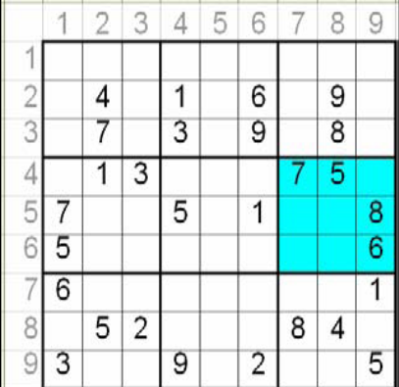



Casting Sudoku as an LP 1
Why would we expect Sudoku to be amenable to linear programming?
How would we cast Sudoku as a linear program?
In Sudoku, you put objects into positions.
One of the most well-studied problems in (binary integer) linear programming is the Assignment Problem:
  Decision variables v{i,j}=1 if object i is in position j, 0 otherwise
  Corresponding payoff values c{i,j}
  For N objects and M positions, have
    for each 1 = j = M
    for each 1 = i = N
  Maximize (minimize)
Take an analogous approach, with 9 objects (digits) and 81 positions, have 729 binary valued variables
  Number positions consecutively, 1-81,
  top row 1-9, bottom row 73-81
  In example below, C11V4=1 (digit 4 in position 11), C13V1=1 (1 in position 13)
  Each object (digit) occupies 9 positions
  Additional constraints besides positions per object and objects per position
In this formulation,
the 27 conditions that
define Sudoku each
translate into nine
constraints
  Still need all 81
  “one digit per
  position” constraints
Notes:
People like to point out the Sudoku doesn’t involve any mathematics. By using some math, we avoid a lot of hard work!

Slide 65
Casting Sudoku as an LP 2
Objective to maximize can be sum of all
the variables – maximal value will be 81.
Initial configuration becomes a set of constraints, all other constraints (324) fixed
Rows: one constraint per digit, so each row has nine constraints, such as:
C01V1+C02V1+C03V1+C04V1+C05V1+C06V1+C07V1+C08V1+C09V1 = 1
C01V2+C02V2+C03V2+C04V2+C05V2+C06V2+C07V2+C08V2+C09V2 = 1
…
C01V9+C02V9+C03V9+C04V9+C05V9+C06V9+C07V9+C08V9+C09V9 = 1
Columns: one constraint per digit, so each column has nine constraints, such as:
C01V1+C10V1+C19V1+C28V1+C37V1+C46V1+C55V1+C64V1+C73V1 = 1
3x3 Squares: one constraint per digit, so each block has nine constraints, such as:
C01V1+C02V1+C03V1+C10V1+C11V1+C12V1+C19V1+C20V1+C21V1 = 1
One digit per square: one constraint per square, such as:
C01V1+C01V2+C01V3+C01V4+C01V5+C01V6+C01V7+C01V8+C01V9 = 1
The LP set-up can be expressed readily as a matrix, with:
  One row per constraint (including the objective, and specification of variable type as integer)
  One column per variable
Most constraints for Sudoku involve nine or fewer variables, so most of the entries in each row are zeroes
  “sparse matrix”
PROC LP specification can be a standard matrix or a sparse format matrix
  Sparse format has one observation per row-column of constraint, zeroes can be eliminated

Slide 66
Casting Sudoku as an LP 3
Obs _row_ _col_ _type_ _coef_
1 1 OBJECTIVE MAX .
2 1 OBJECTIVE C01V1 1
3 1 OBJECTIVE C01V2 1
4 1 OBJECTIVE C01V3 1
5 1 OBJECTIVE C01V4 1
6 1 OBJECTIVE C01V5 1
7 1 OBJECTIVE C01V6 1
8 1 OBJECTIVE C01V7 1
9 1 OBJECTIVE C01V8 1
10 1 OBJECTIVE C01V9 1
11 1 OBJECTIVE C02V1 1
...
730 1 OBJECTIVE C81V9 1
731 2 BINARY BINARY .
732 2 BINARY C01V1 1
733 2 BINARY C01V2 1
734 2 BINARY C01V3 1
...
1460 2 BINARY C81V9 1
1461 3 ROW 1 VAL 1 _RHS_ EQ 1
1462 3 ROW 1 VAL 1 C01V1 1
1463 3 ROW 1 VAL 1 C02V1 1
1464 3 ROW 1 VAL 1 C03V1 1
1465 3 ROW 1 VAL 1 C04V1 1
1466 3 ROW 1 VAL 1 C05V1 1
1467 3 ROW 1 VAL 1 C06V1 1
1468 3 ROW 1 VAL 1 C07V1 1
1469 3 ROW 1 VAL 1 C08V1 1
1470 3 ROW 1 VAL 1 C09V1 1
1471 3 ROW 1 VAL 2 _RHS_ EQ 1
1472 3 ROW 1 VAL 2 C01V2 1
...
Obs _row_ _col_ _type_ _coef_
2270 3 ROW 9 VAL 9 C81V9 1
2271 4 COL 1 VAL 1 _RHS_ EQ 1
2272 4 COL 1 VAL 1 C01V1 1
2273 4 COL 1 VAL 1 C10V1 1
2274 4 COL 1 VAL 1 C19V1 1
2275 4 COL 1 VAL 1 C28V1 1
2276 4 COL 1 VAL 1 C37V1 1
2277 4 COL 1 VAL 1 C46V1 1
2278 4 COL 1 VAL 1 C55V1 1
2279 4 COL 1 VAL 1 C64V1 1
2280 4 COL 1 VAL 1 C73V1 1
2281 4 COL 1 VAL 2 _RHS_ EQ 1
2272 4 COL 1 VAL 2 C01V2 1
...
3080 4 COL 9 VAL 9 C81V9 1
3081 5 BOX 1 VAL 1 _RHS_ EQ 1
3082 5 BOX 1 VAL 1 C01V1 1
3083 5 BOX 1 VAL 1 C02V1 1
3084 5 BOX 1 VAL 1 C03V1 1
3085 5 BOX 1 VAL 1 C10V1 1
3086 5 BOX 1 VAL 1 C11V1 1
3087 5 BOX 1 VAL 1 C12V1 1
3088 5 BOX 1 VAL 1 C19V1 1
3089 5 BOX 1 VAL 1 C20V1 1
3090 5 BOX 1 VAL 1 C21V1 1
3091 5 BOX 1 VAL 2 _RHS_ EQ 1
3092 5 BOX 1 VAL 2 C01V2 1
...
Obs _row_ _col_ _type_ _coef_
3890 5 COL 9 VAL 9 C81V9 1
3891 6 CELL 01 _RHS_ EQ 1
3892 6 CELL 01 C01V1 1
3893 6 CELL 01 C01V2 1
3894 6 CELL 01 C01V3 1
3895 6 CELL 01 C01V4 1
3896 6 CELL 01 C01V5 1
3897 6 CELL 01 C01V6 1
3898 6 CELL 01 C01V7 1
3899 6 CELL 01 C01V8 1
3900 6 CELL 01 C01V9 1
3901 6 CELL 02 _RHS_ EQ 1
3902 6 CELL 02 C02V1 1
...
4700 6 CELL 81 C81V9 1
4701 7 CONFIG 11 _RHS_ EQ 1
4702 7 CONFIG 11 C11V4 1
4703 7 CONFIG 13 _RHS_ EQ 1
4704 7 CONFIG 13 C13V1 1
...
Notes:
Sparse matrix format example of puzzle from earlier picture

Slide 67
What Really Happened in May of 2006?
Wednesday, May 10th: Larry Hoyle posts the PROC SQL Sudoku solver on SAS-L, gets a flurry of responses.
  5 posts on Wednesday, more later
Around the same time, I found out about PROC CLP.
  Constraint programming, no optimization necessary
Seeing Larry’s solver inspired me to try to learn PROC CLP to write a Sudoku solver.
  One variable per square, with actual range of possible values {1,…,9}
  One constraint for each of the 27 conditions, e.g.:
  ALLDIFF (value1 – value9);
  Initial configuration strung together by commas in a LINCON statement.
Thursday, May 11th: I post the PROC CLP Sudoku solver on SAS-L.
  Several responses, and new Sudoku-oriented threads, followed
  David Cassell (again!): “I think you and Larry have a paper for SUGI 32/SGF 1 !”
I tested the PROC CLP solver on a few puzzles, one took more than a half hour to solve; only then did I decide to bite the bullet and produce the LP solution.
Friday, May 12th: I post a cleaner version of the PROC CLP Sudoku solver, and a first version of the PROC LP Sudoku solver on SAS-L.
  Same day, John Gerlach announces his solver.
  One week later, DeVenezia joins the fray.
Notes:
I’ve cheated a bit, that was not the historical development.
Tenses mixed to give it a “You Are There” feel.
Soon after the initial outburst, I saw that another group, Vatsala Karwe, Patricia Seunarine, and Carol Razafindrakoto had submitted a Sudoku presentation to NESUG.
I also saw that SAS had published, in their Summer 2006 Academic Program Research Newsletter, a PROC LP Sudoku solver submitted by Professor Machiel Kruger.

Slide 68
A Curious Fact About Sudoku
You won’t find this in the Scientific American article.
How many conditions are necessary to define a Sudoku puzzle?
  Not the same question as how many points are needed in the initial configuration.
You can eliminate five of the 27 conditions.
  Either one row or one column (but not both a row and column) can go.
  Four 3x3 squares (the middle box on each side) can also go.
Notes:
The PROC CLP solver may have been slowed down by my attempt to make it more efficient…

Slide 69
Rick Langston
SAS® and Sudoku SGF 2007, This slide copyright Larry Hoyle, 2007
Bar size 2048

Slide 70
Rick Langston
Rick.Langston@sas.com

Slide 71
My sudoku solver
I was interested in teaching strategies
The end result was not really the goal
Speed was not the major concern
All done using the DATA step
Some of the basic strategies are...

Slide 72
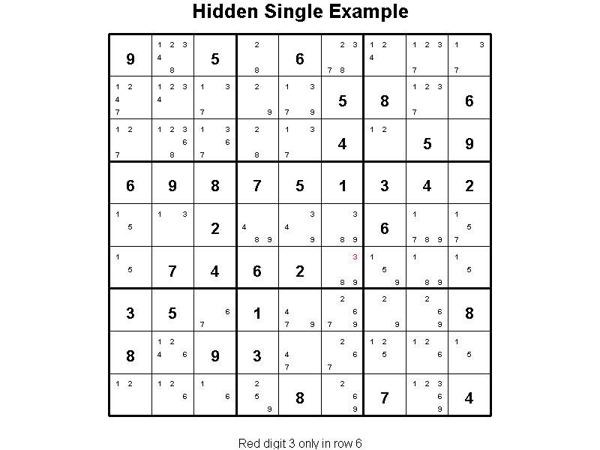
Bar size 2048

Slide 73
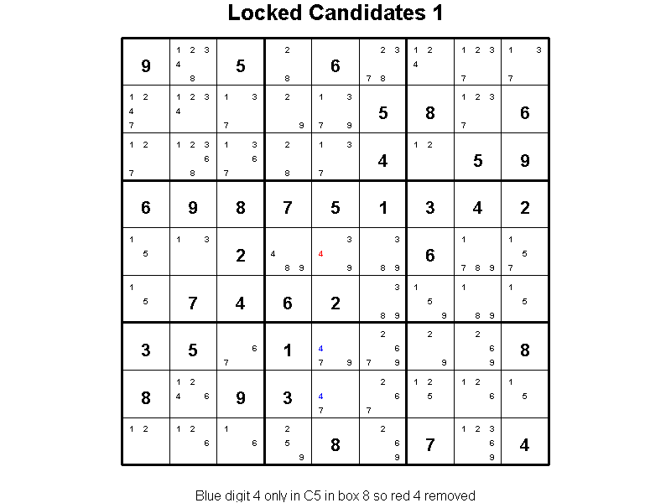
Bar size 2048

Slide 74
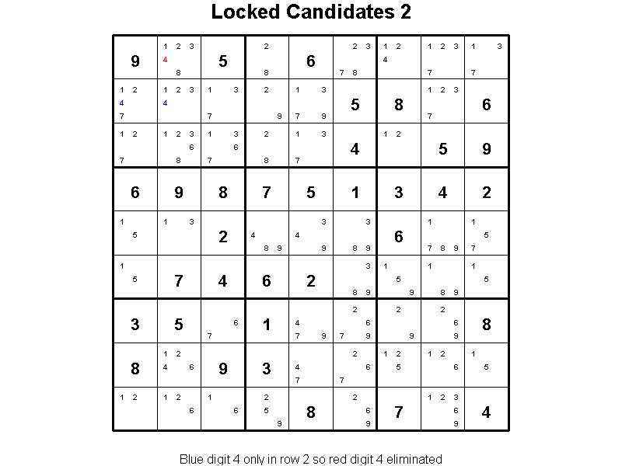
Bar size 2048

Slide 75
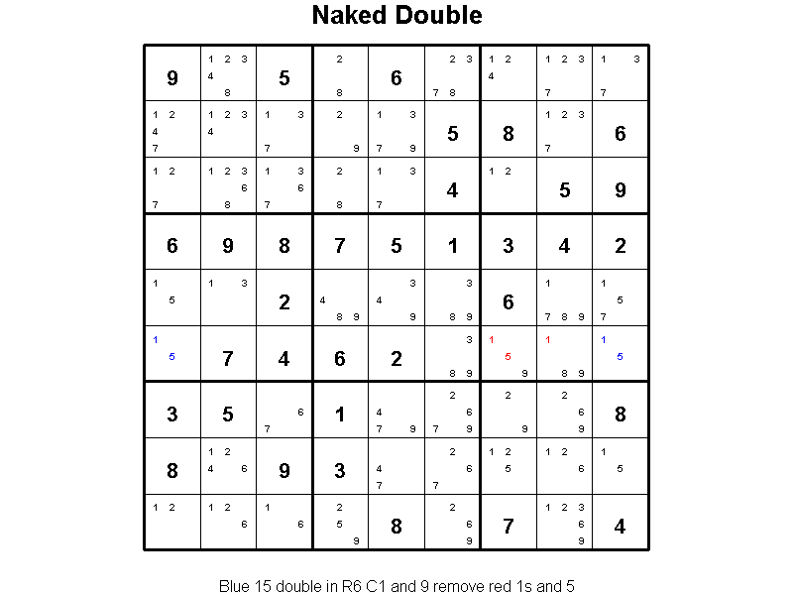
Bar size 2048

Slide 76
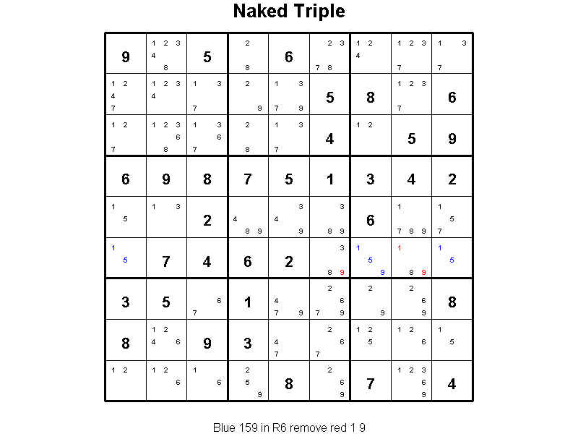
Bar size 2048

Slide 77
Also X/Y/Z Wings, Swordfish
A DO WHILE(1) loop runs through them all
All strung together with LINK statements
Trial-and-error method as the last resort
Each step is shown for the user

Slide 78
Dr. Goodnight’s implementation
He lists sudoku as one of his hobbies
He implemented a solver using the DATA step
Basic candidate elimination done first
Then a trial path process is used
A very fast algorithm

Slide 79
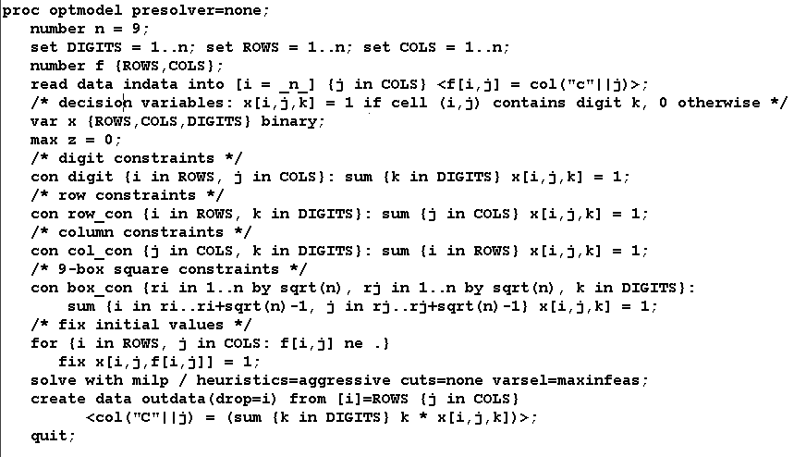
PROC OPTMODEL

Slide 80


Slide 81

Copyright © 2007, SAS Institute Inc. All rights reserved. SAS and all other SAS Institute Inc. product or service names are registered trademarks or trademarks of SAS Institute Inc. in the USA and other countries. ® indicates USA registration.

