Slide 1
Affordable Housing
Data Analysis and insights
Feature Engineering
Pipeline
Model Selection
Model Results

Slide 2
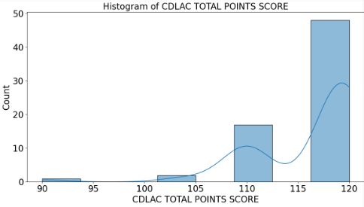
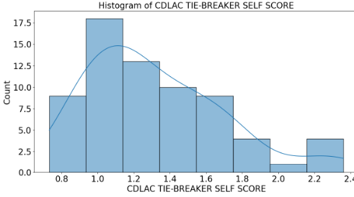
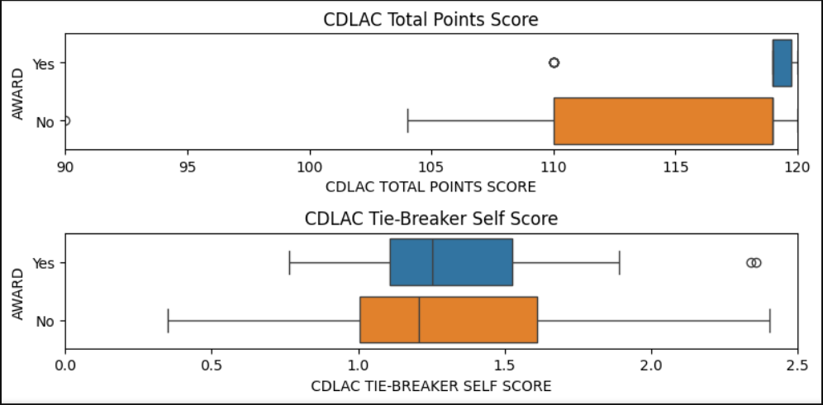
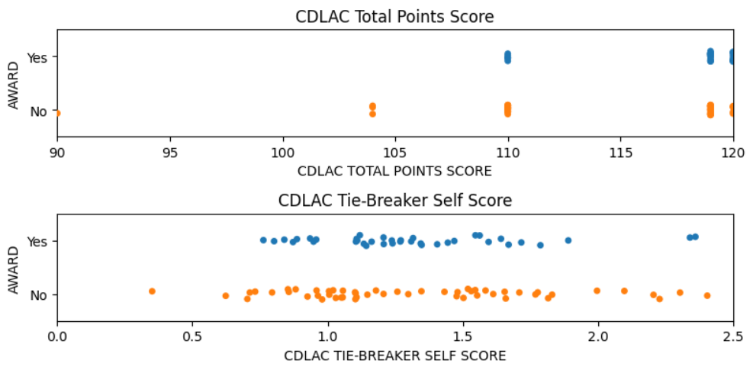
Total Points and Self Scores

Slide 3
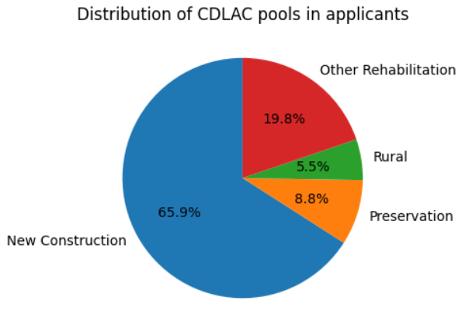

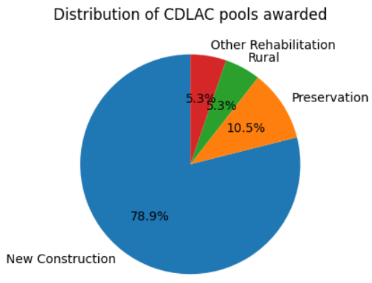

CDLAC Pools
Total Applicants
Awarded Applicants

Slide 4

Total Points per CDLAC Pools

Slide 5

Self Points per CDLAC Pools

Slide 6
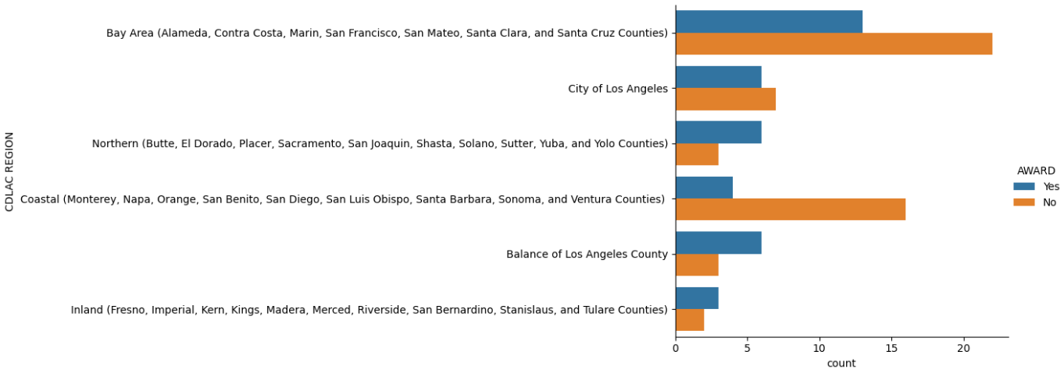
Regions

Slide 7

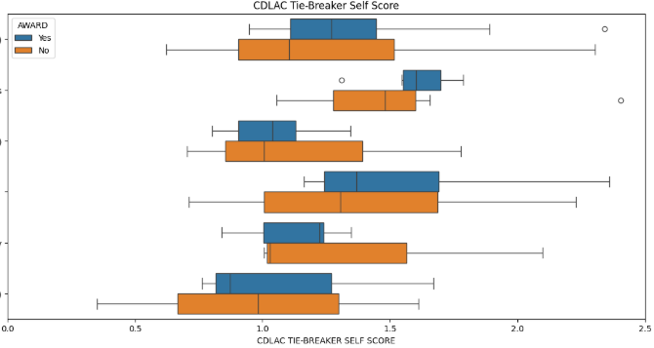
Points and Self Score per Region

Slide 8

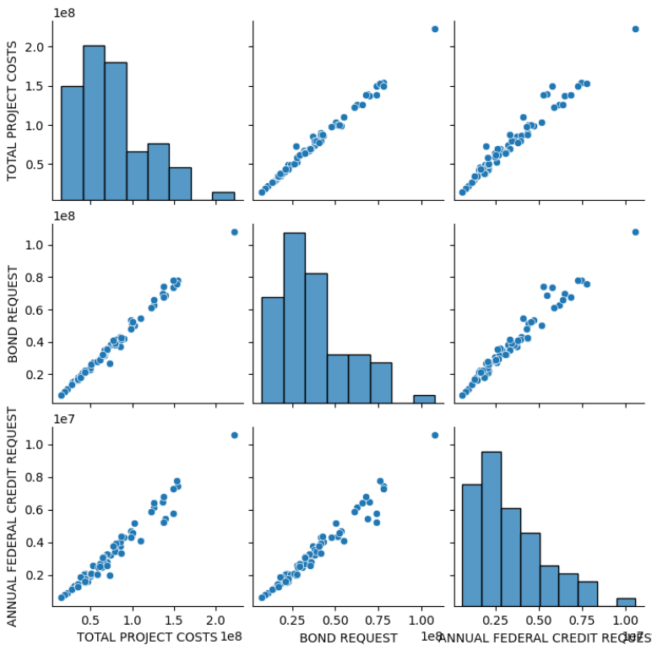


Bond Request, Annual Federal Credit Request, Project Cost
These 3 features are highly correlated (r close to 1)

Slide 9
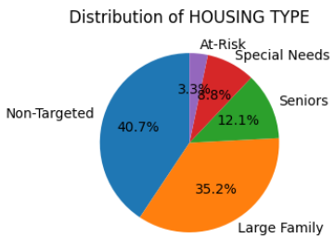
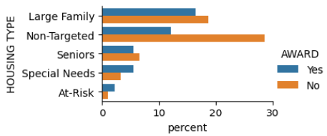
Housing Types

Slide 10
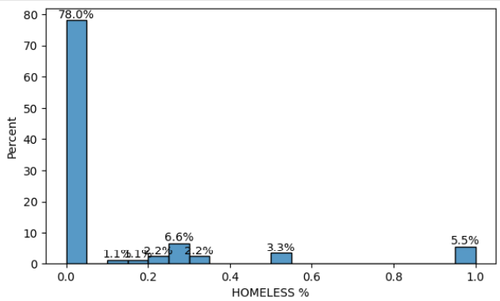
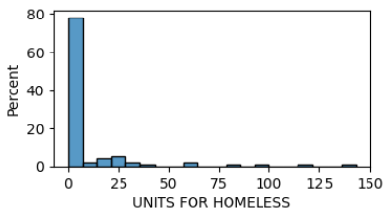
Homeless

Slide 11
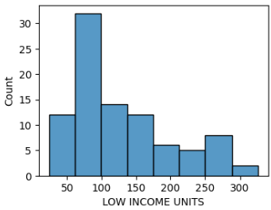
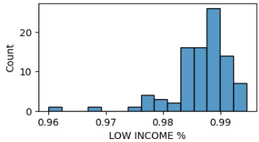
Low Income

Slide 12
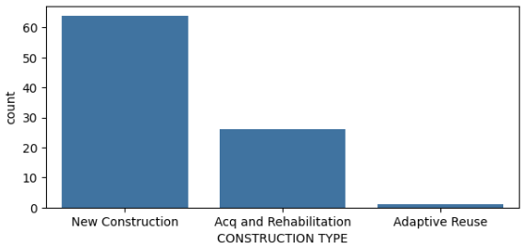
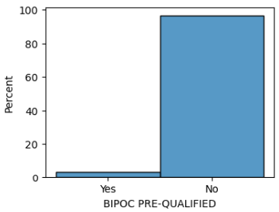
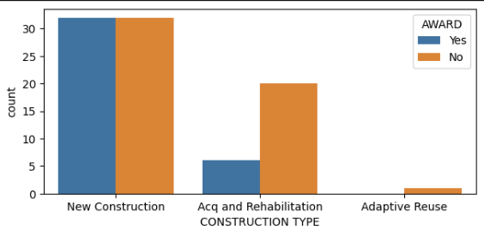
BIPOC
Construction Types

Slide 13
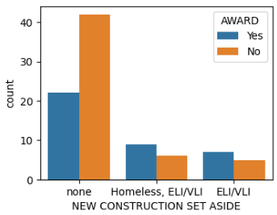
New Construction Set Aside

Slide 14
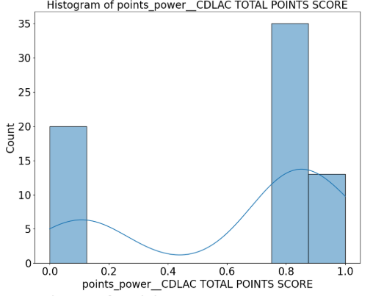
Power Transformation
Other transformations not shown include: homeless binary conversion, one-hot-encoding and other standardization

Slide 15

Model Pipeline
Model

Slide 16
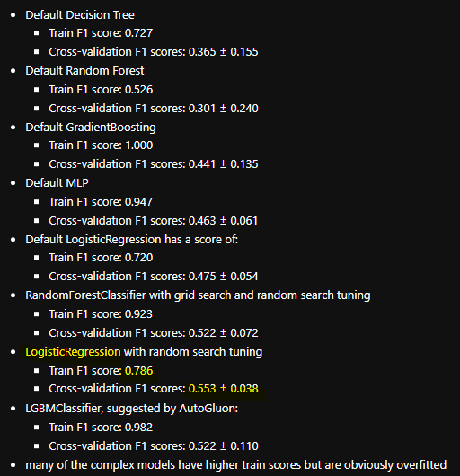
Model Selection
LogisticRegression is simple and therefore seems to not overfit to the small dataset size.

Slide 17
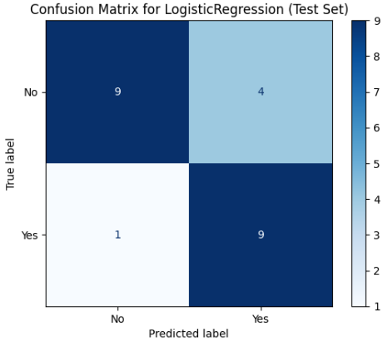
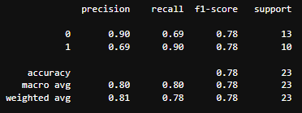
Model Test Results
78% f1 score

Slide 18
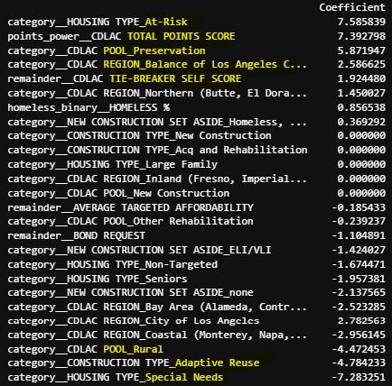
Model Coefficients
At risk housing types, total points score, special needs housing types are the 3 most important features.

