Slide 1
FINAL PROJECT SOFTWARE ENGINEERING
Ton Duc Thang University
Subject ID: 502045
Professor: Pham Thai Ky Trung

Slide 2
OUR GROUP
GOSTUDIO
Our group has two students:
521H0006 – Nguyen Hoang Anh
521H0091 – Hong Kiet

Slide 3
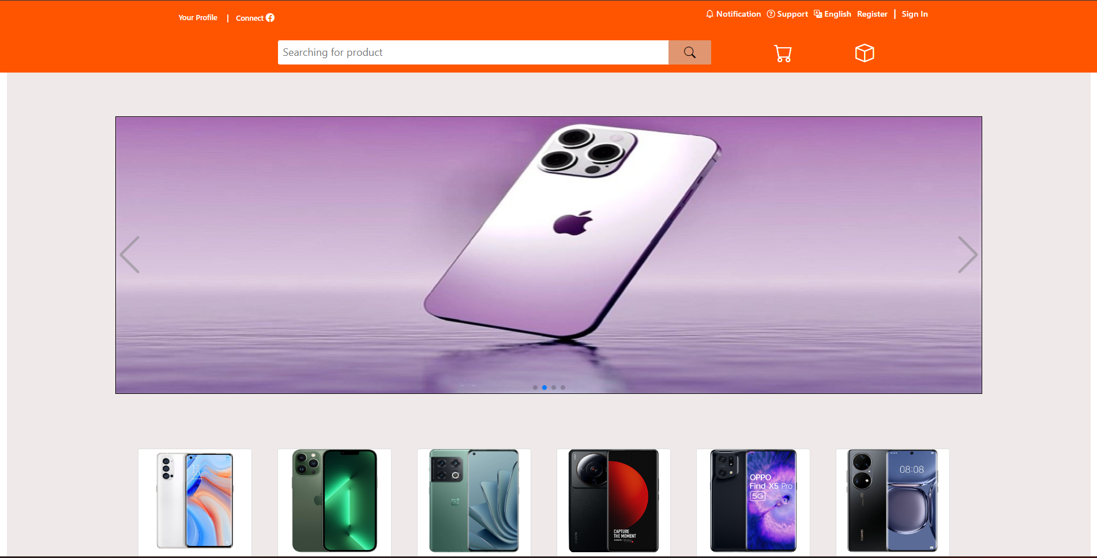
About webform:

Slide 4
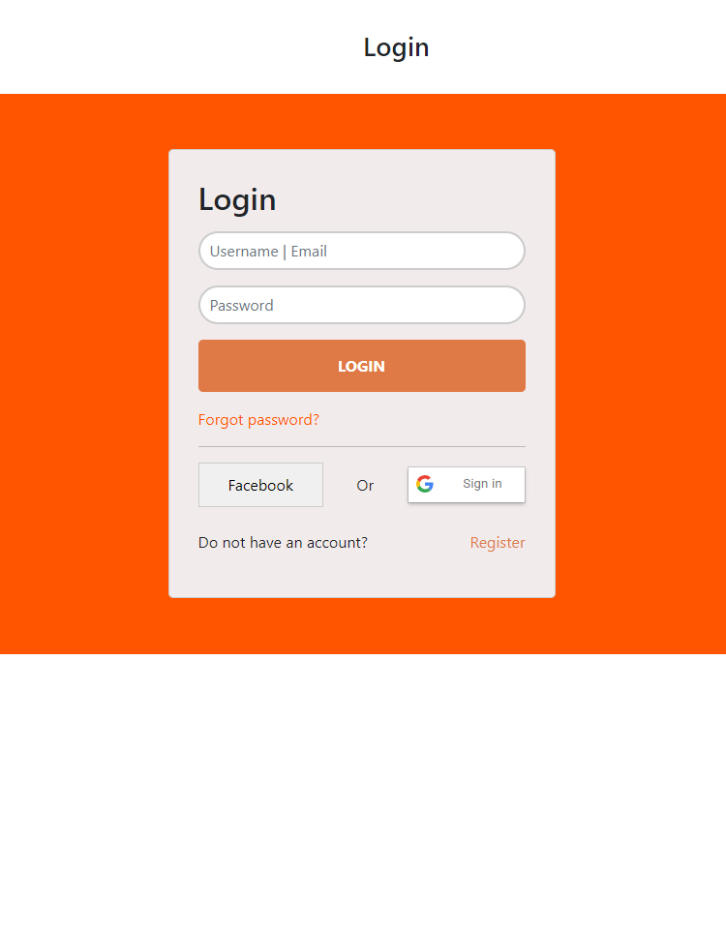
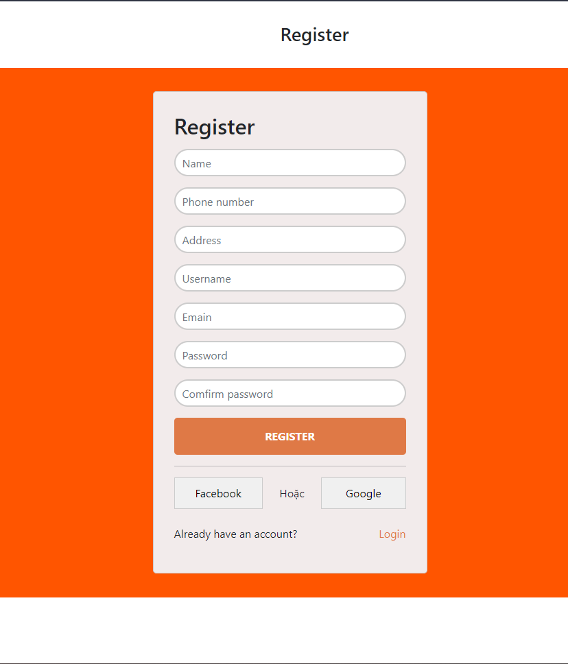
About webform:

Slide 5
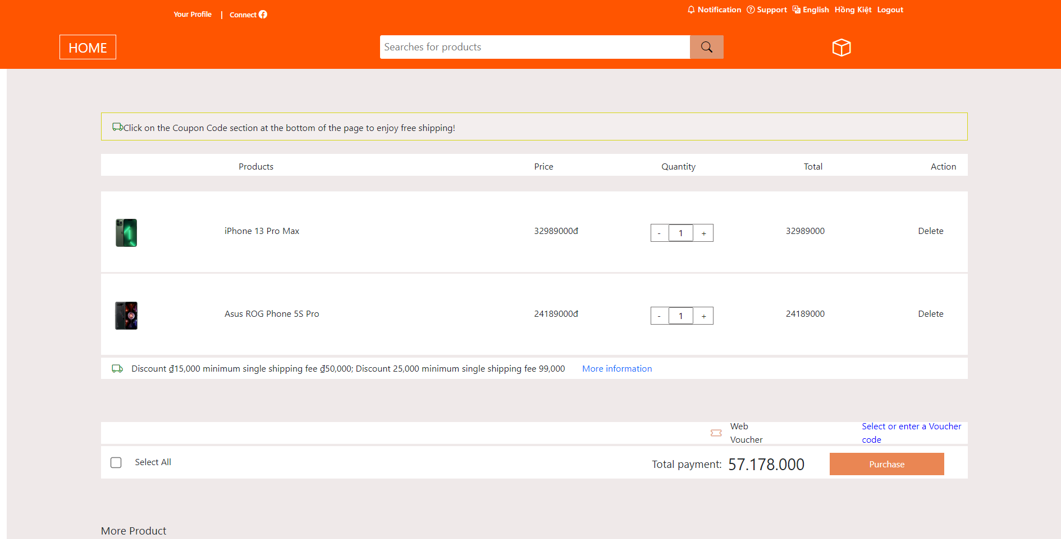
About webform:

Slide 6
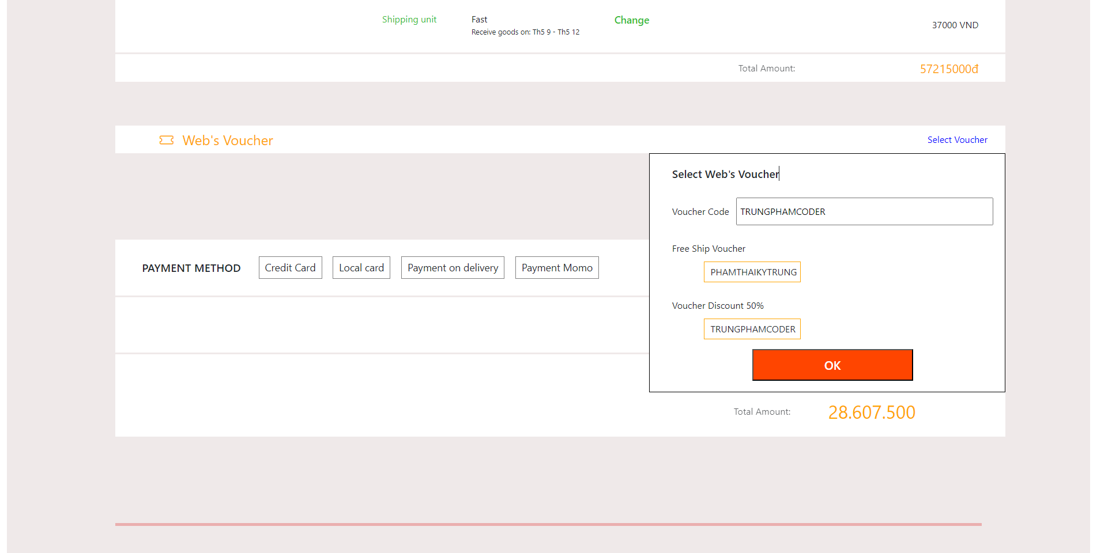
About webform:

Slide 7
About webform:

Slide 8
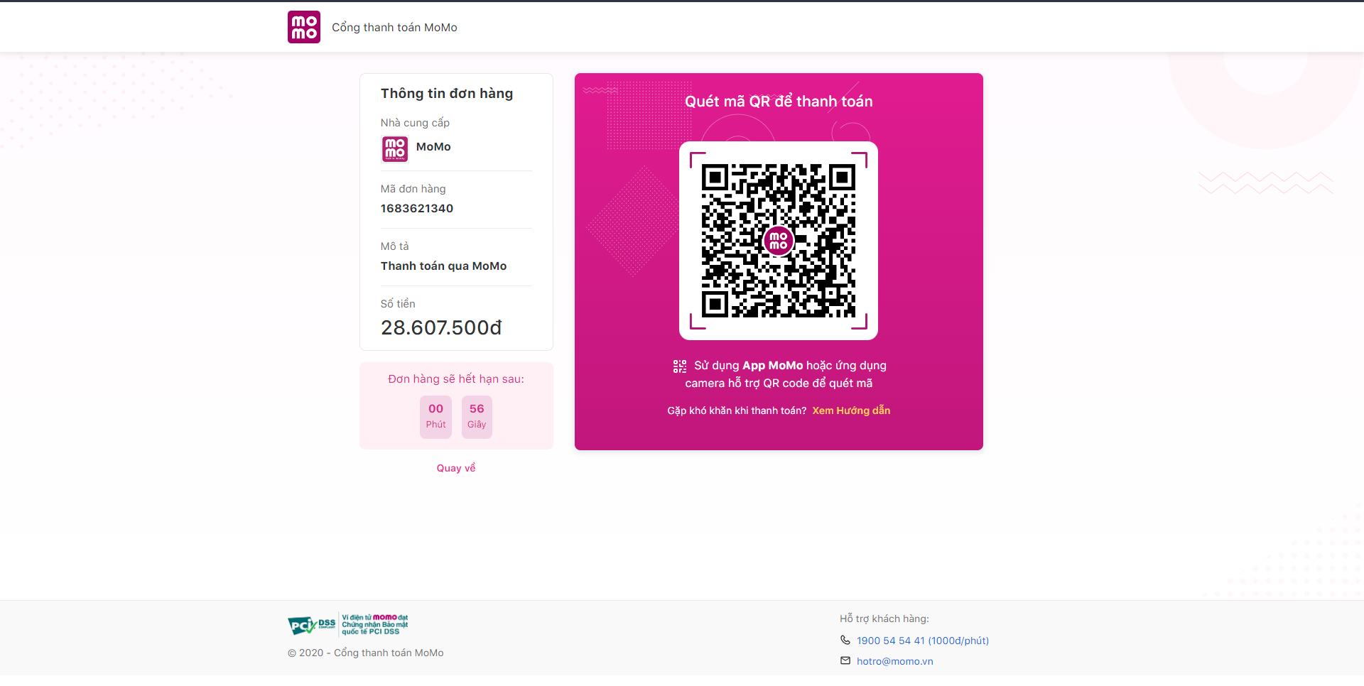
About webform:

Slide 9
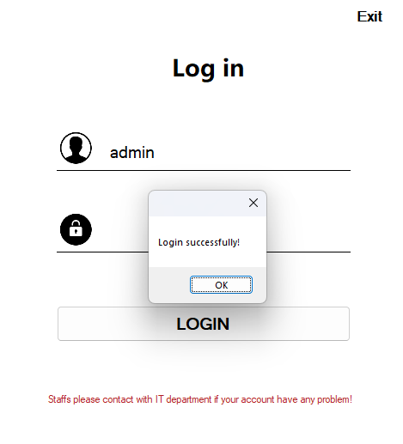
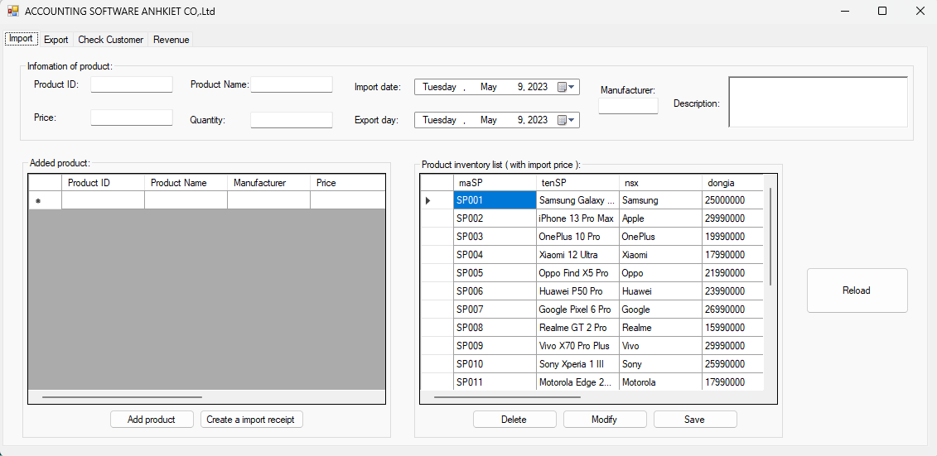
About winform:

Slide 10
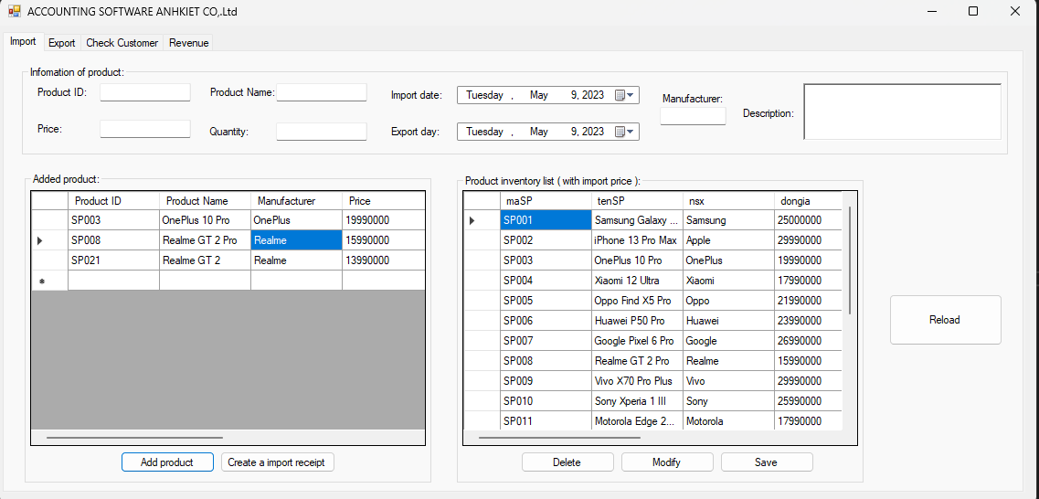
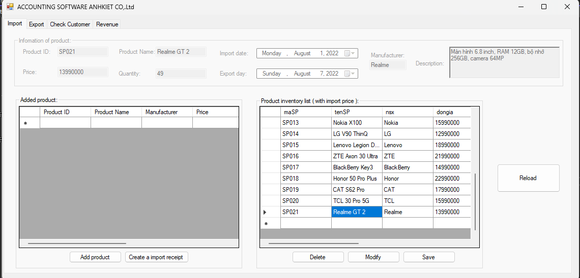
About winform:

Slide 11
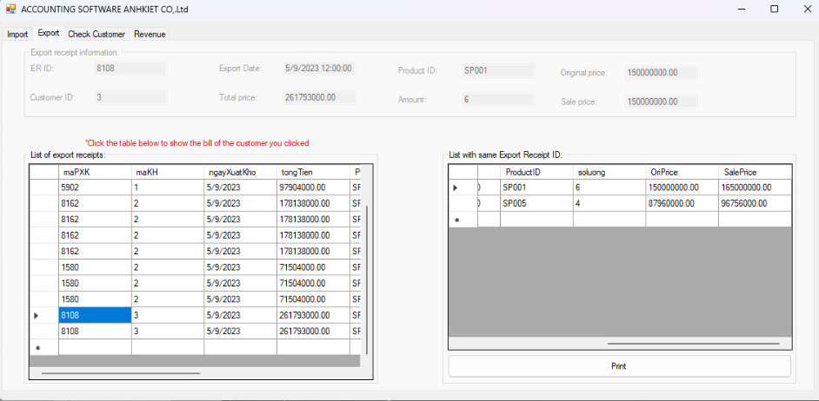
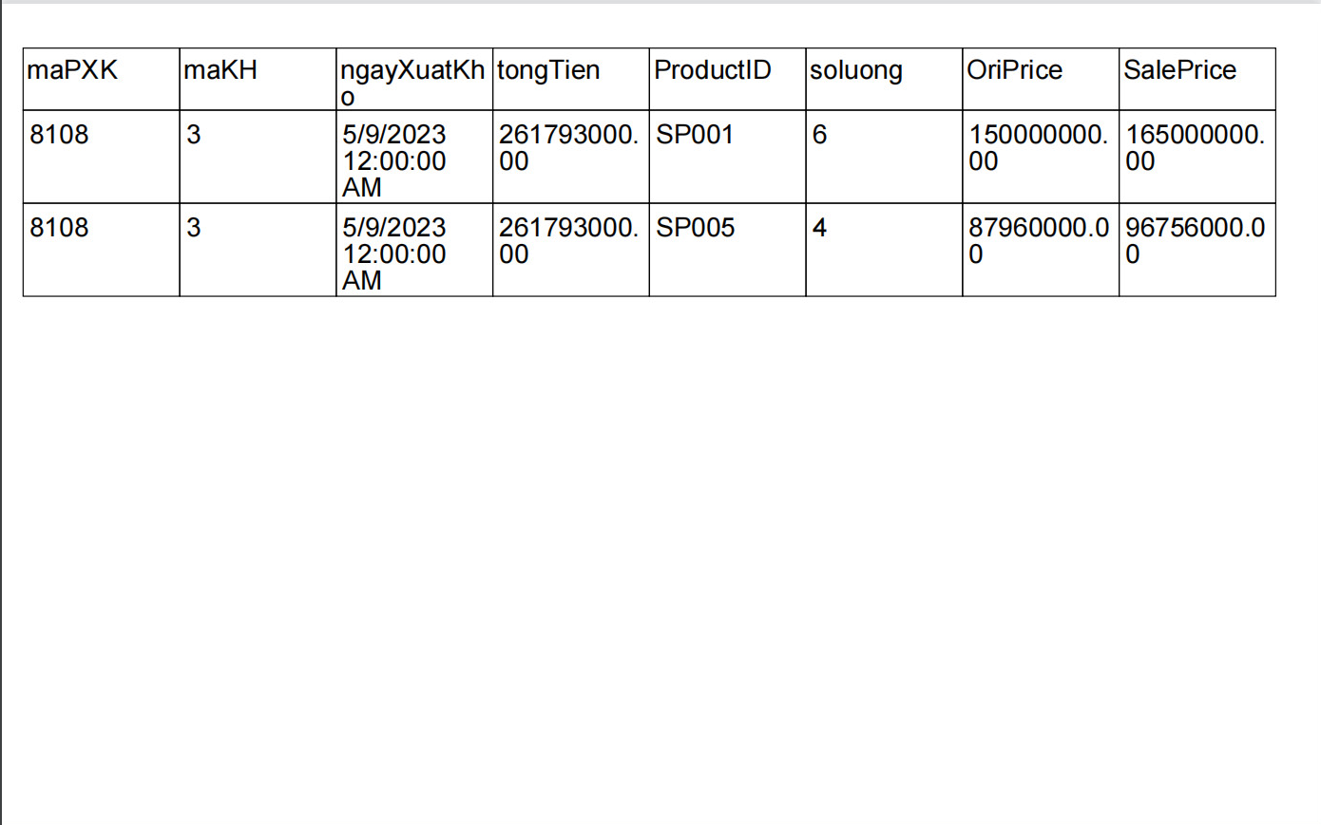
About winform:

Slide 12
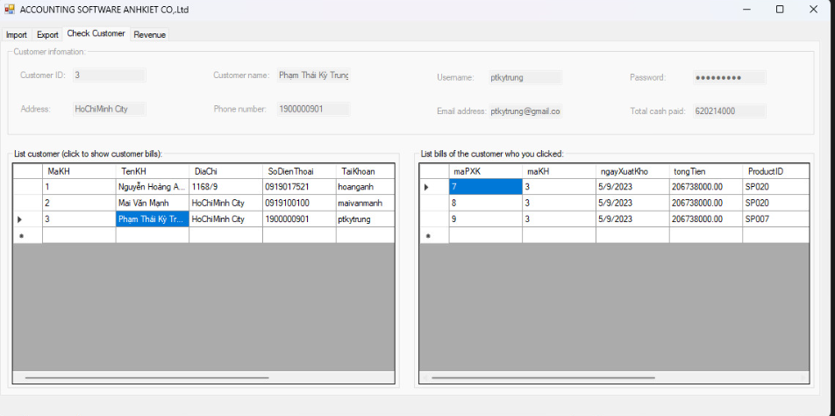
About winform:

Slide 13
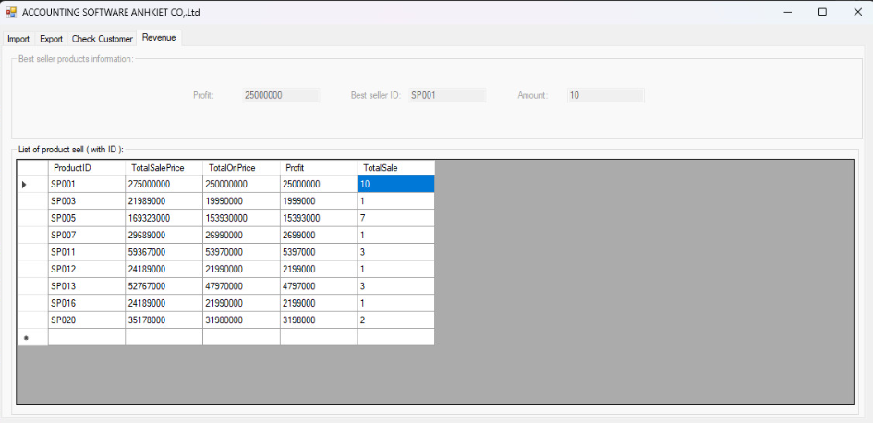
About winform:

Slide 14
THANKS FOR FORCUSING AND LISTENING!

