Slide 1

Measuring Delay with
AfNOG Network Management Tutorial

Slide 2

Introduction
Based on RRDTool (the same author)
Measures ICMP delay and can measure status of services such as HTTP, DNS, SMTP, SSH, LDAP, etc.
Allows you to define ranges on statistics and generate alarms.
Written in Perl for portability
Relatively easy to install. In Ubuntu it's very simple.

Slide 3

Introduction: “Marketing”
SmokePing keeps track of your network latency:
Best of breed latency visualisation.
Interactive graph explorer.
Wide range of latency measurment plugins.
Master/Slave System for distributed measurement.
Highly configurable alerting system.
Live Latency Charts with the most 'interesting' graphs.
Free and OpenSource Software written in Perl written by Tobi Oetiker, the creator of MRTG and RRDtool

Slide 4
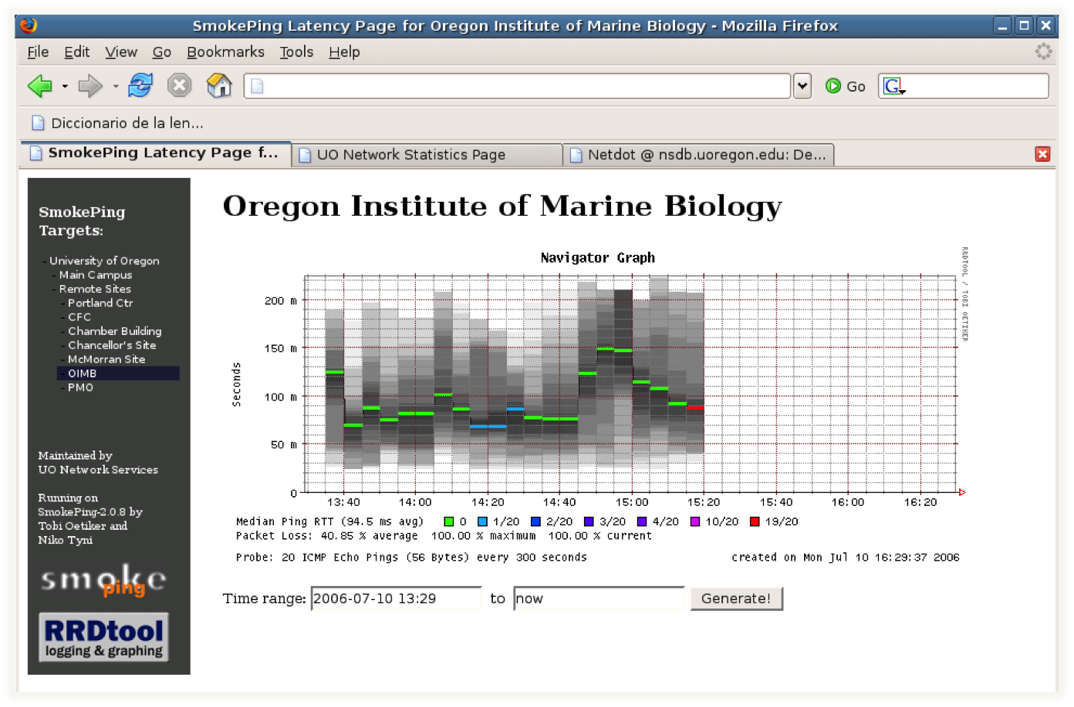
The “Smoke” and the “Pings”

Slide 5
How to Read Smokeping Graphs
How to Read Smokeping Graphs
Smokeping sends multiples tests (pings), makes note of RTT, orders these and selects the median.
The different values of RTT are shown graphically as lighter and darker shades of grey (the “smoke”). This conveys the idea of variable round trip times or jitter.
The number of lost packets (if any) changes the color of the horizontal line across the graph.

Slide 6
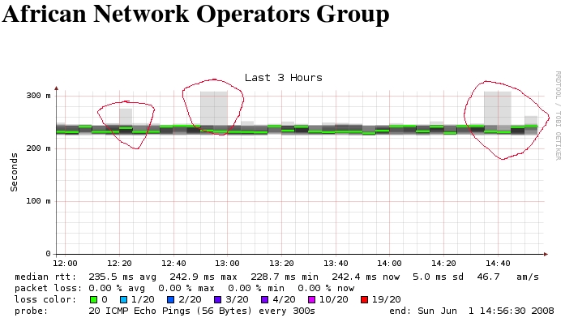
An Example

Slide 7



The Bits and Pieces
The following packages are needed or recommended:
  rrdtool http://oss.oetiker.ch/rrdtool/
  fping http://www.fping.com/
  echoping http://echoping.sourceforge.net/
  speedyCGI http://www.daemoninc.com/SpeedyCGI/
  Apache http://httpd.apache.org/
  Perl http://www.perl.org/

Slide 8
Smokeping: Instalation
Debian/Ubuntu:
apt-get install smokeping
Configure /etc/smokeping/config.d/*
Change Smokeping's appearance here:
  /etc/smokeping/basepage.html
Restart the service:
  /etc/init.d/smokeping restart
  /etc/init.d/smokeping reload

Slide 9
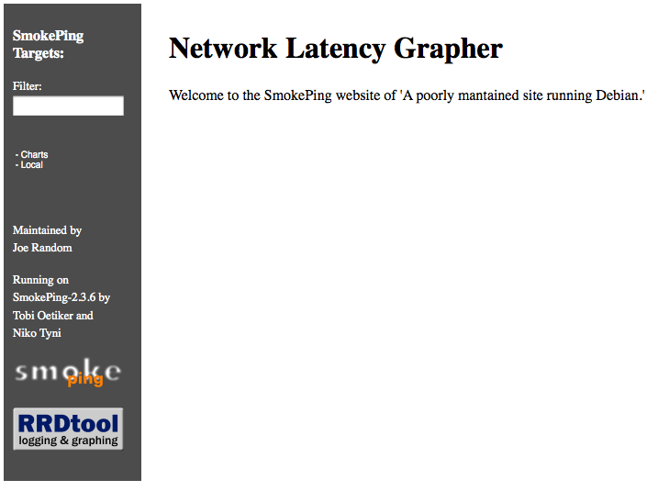
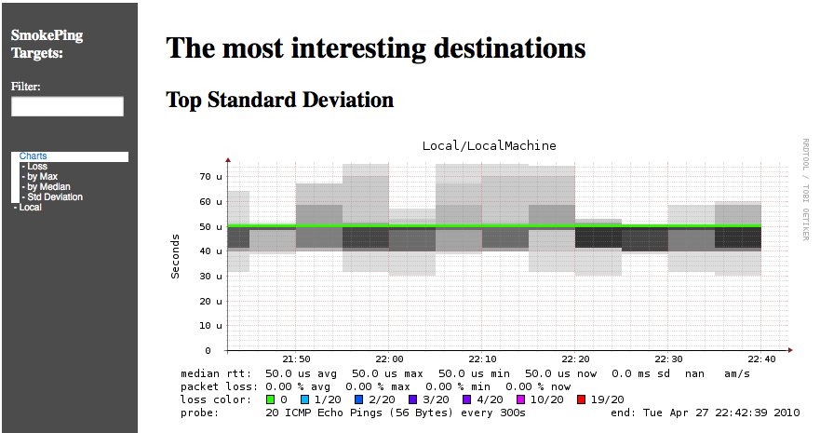
Smokeping Installation
You will find Smokeping running here:
http://localhost/cgi-bin/smokeping.cgi
During the presentation you can view Smokeping at http://noc/cgi-bin/smokeping.cgi

Slide 10
Configuration
Smokeping configuration files in Ubuntu 9.10 include:
/etc/smokeping/config.d/Alerts
/etc/smokeping/config.d/Database
/etc/smokeing/config.d/General
/etc/smokeping/config.d/pathnames
/etc/smokeping/config.d/Presentation
/etc/smokeping/config.d/Probes
/etc/smokeping/config.d/Slaves
/etc/smokeping/config.d/Targets
Generally we spend most of our time in Alerts, General, Probes and Targets.

Slide 11
Configuration: Alerts
Very flexible. Create your own type of alert.
Send alerts to ticket queues (RT using rt-mailgate, for instance)
Somewhat complex to understand. Read the Alerts section of the Smokeping
on-line configuration documentation:
http://oss.oetiker.ch/smokeping/doc/smokeping_config.en.html
*** Alerts ***
to = net@noc.mgmt.ws.afnog.org
from = smokeping-alert@localhost
+bigloss
type = loss
# in percent
pattern = ==0%,==0%,==0%,==0%,>0%,>0%,>0%
comment = suddenly there is packet loss
+someloss
type = loss
# in percent
pattern = >0%,*12*,>0%,*12*,>0%
comment = loss 3 times in a row over 12 samples
Remember this goes to our RT queue.
Ubuntu-specific alert. The name is misleading as the alert is for any loss when there was none previously.

Slide 12
Configuration: Database
Defines how RRDtool will save data over time in Round Robin Archives (RRAs)
By default each step is 300 seconds (5 minutes).
You cannot trivially change the step setting once data has been collected.
Details on each column in the Database section of the Smokeping on-line
configuration documentation:
http://oss.oetiker.ch/smokeping/doc/smokeping_config.en.html
*** Database ***
step = 300
pings = 20
# consfn mrhb steps total
AVERAGE 0.5 1 1008
AVERAGE 0.5 12 4320
MIN 0.5 12 4320
MAX 0.5 12 4320
AVERAGE 0.5 144 720
MAX 0.5 144 720
MIN 0.5 144 720
consfn: Consolidation function
mrhb: Percent of consolidated steps that
must be known to warrant an entry.
steps: How many steps to consolidate for
each entry in the RRA.
total: Total number of rows to keep in the RRA. Use rows and steps to
determine time data will be saved.
12 steps = 12 x 300 sec = 1 hour
4320 rows = 4320 hours = 180 days

Slide 13
Configuration: General
Update:
  owner ➔ AfNOG 2010 User
  contact ➔ afnog@localhost
  cgiurl ➔ http://localhost/cgi-bin/smokeping.cgi
  mailhost ➔ localhost
*** General ***
@include /etc/smokeping/config.d/pathnames
# Please edit this to suit your installation
owner = AfNOG 2010 User
contact = afnog@localhost
cgiurl = http://localhost/cgi-bin/smokeping.cgi
mailhost = localhost
# specify this to get syslog logging
syslogfacility = local0
# each probe is now run in its own process
# disable this to revert to the old behaviour
# concurrentprobes = no

Slide 14
Configuration: pathnames
Normally you should not need to update this file:
sendmail = /usr/sbin/sendmail
imgcache = /var/www/smokeping
imgurl = ../smokeping
datadir = /var/lib/smokeping
dyndir = /var/lib/smokeping/__cgi
piddir = /var/run/smokeping
smokemail = /etc/smokeping/smokemail
tmail = /etc/smokeping/tmail
precreateperms = 2775

Slide 15
Configuration: Presentation
If you wish to customize Smokeping’s look and feel you can edit the file
/etc/smokeping/basepage.html
To change how Smokeping presents graphs you can edit this file.
*** Presentation ***
template = /etc/smokeping/basepage.html
+ charts
menu = Charts
title = The most interesting destinations
++ stddev
sorter = StdDev(entries=>4)
title = Top Standard Deviation
menu = Std Deviation
format = Standard Deviation %f
++ max
sorter = Max(entries=>5)
title = Top Max Roundtrip Time
menu = by Max
format = Max Roundtrip Time %f seconds
File continues…

Slide 16
Configuration: Probes
Smokeping is installed with a number of additional probes. They must, however, be specified here – including their default behaviors.
*** Probes ***
+ FPing
binary = /usr/sbin/fping
+ DNS
binary = /usr/bin/dig
lookup = DNS-ROOT.MGMT
pings = 5
step = 180
+ EchoPingHttp
binary = /usr/bin/echoping
ignore_cache = yes
pings = 5
url = /
+ EchoPingHttps
binary = /usr/bin/echoping
pings = 5
url = /
+ EchoPingSmtp
binary = /usr/bin/echoping
forks = 5
Use the DNS probe to verify
that your Registry services
are available and responding as expected.

Slide 17
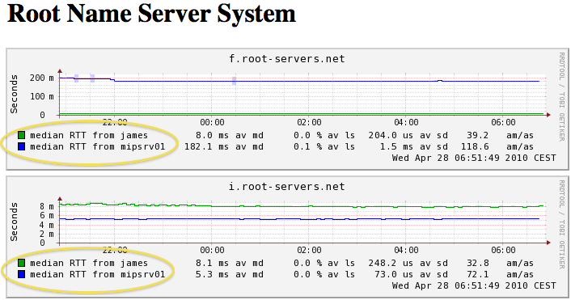
Configuration: Slaves
Smokeping slave servers allow for multi-viewpoint monitoring and graphing of the same services, machines or links. Details here:
http://oss.oetiker.ch/smokeping/doc/smokeping_master_slave.en.html
# *** Slaves ***
#
## make sure this is not world-readable!
## secrets=/etc/smokeping/slave-secrets
#
# +slave1
# display_name=slave_name
# color=0000ff
That is, you can externally monitor your network!

Slide 18
Configuration: Targets
Where we spend most of our
time configuring Smokeping.
Web menu hierarchy defined
by “+”, “++”, etc.
Each new probe statement
resets the default probe in use.
Probes have defaults set in
the Probes config file. These
can be overridden in Targets.
*** Targets ***
probe = FPing
menu = Top
title = Network Latency Grapher
+ UO
menu = University of Oregon
title = UO webserver
host = www.uoregon.edu
+ NSRC
menu = NSRC
title = Network Startup Resource Center
host = www.nsrc.org
++ HTTP
menu = HTTP
probe = EchoPingHttp
+++ www
menu = NSRC web
host = www.nsrc.org
++ DNS
menu = DNS
probe = DNS
+++ dns
menu = NSRC DNS
host = www.nsrc.org

Slide 19
Default Probe: FPing
Probing for delay and jitter (ping)‏
Performance and availability probe of a
server.
Entry belongs in the Targets file:
Latency
+++ LocalMachine
menu = NOC
title = The NOC@AfNOG
host = noc.mgmt.ws.afnog.org
alerts = startloss,someloss,bigloss,rttdetect

Slide 20

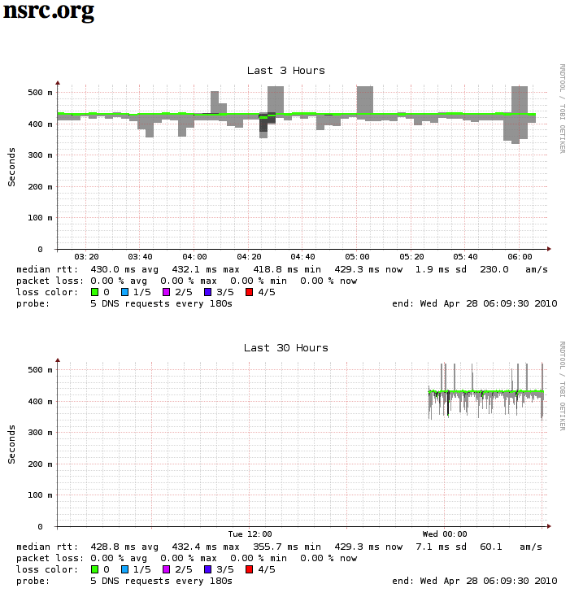
Probe: DNS Check
In /etc/smokeping/config.d/Targets:
DNS Latency
++ DNS
probe = DNS
menu = External DNS Check
title = DNS Latency
+++ nsrc
host = nsrc.org

Slide 21
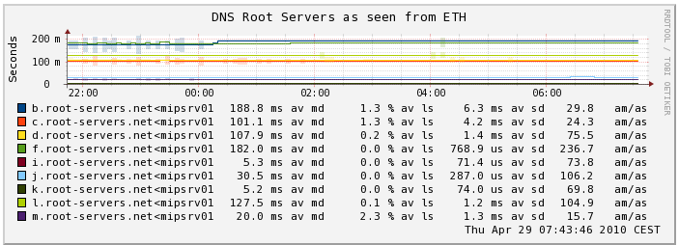
MultiHost Graphing
Solve the issue of multiple hosts, one probe and missing differences in the Y axis (time):
http://oss.oetiker.ch/smokeping/doc/smokeping_examples.en.html
Sample configuration
+++MultihostRouters
menu = MutihostRouters
title = Combined Router Results
host = /Local/Routers/bb-rtr1 /Local/Routers/bb-rtr2
/Local/Routers/bb-rtr3 /Local/Routers/bb-rtr3

Slide 22
More Types of Probes
More information available here:
http://oss.oetiker.ch/smokeping/probe/index.en.html
A few more probes...
  DNS - CiscoRTTMonDNS - Radius
  HTTP(S) - CiscoRTTMonTcpCon - IOS
  LDAP - Tacacs - FPing6
  Whois - WebProxyFilter - Etc.
  SMTP - WWW-Cache

Slide 23
Summary
Simple but powerful network monitoring
Monitor machines, services and link health
Distributed instances for external views – often a paid-for service
Easy to configure and customize, but very extensible.
Can use with Ticketing Systems to automate alerts
Very small disk and CPU footprint

Slide 24
References
Smokeping website:
http://oss.oetiker.ch/smokeping/
Smokeping Demo:
  http://oss.oetiker.ch/smokeping-demo/?target=Customers.OP
Good examples:
http://oss.oetiker.ch/smokeping/doc/smokeping_examples.en.html

