Slide 1
CSE 373
Google Guava Collection Library
slides created by Marty Stepp
http://www.cs.washington.edu/373/
© University of Washington, all rights reserved.

Slide 2
US Presidents data
Suppose we have data about US Presidents of the form:
  // president party years vp
  George Washington:I:1789:1797:John Adams
  John Adams:F:1797:1801:Thomas Jefferson
How can we answer questions such as the following:
  Who was president in 1873?
  Which party has had the most Presidents?
  Who are all the Presidents with the first name "William"?
  Who was James Garfield's VP?
  Who was president when Adlai Stevenson was VP?
  How many total years has a Republican been President?
Java's collection classes can answer these questions, but not without some effort. Guava can make it easier.

Slide 3

Google's Guava library
guava: Google's add-on library for Java.
  used and developed internally for years by Google developers
  now released as free open source software
  adds many useful classes and features to Java libraries
    avoiding null, exception handling, new collections, functional programming, simple I/O, event processing, math functions, reflection, ...
  download from http://code.google.com/p/guava-libraries/
  API docs at http://docs.guava-libraries.googlecode.com/git-history/release/javadoc/index.html

Slide 4
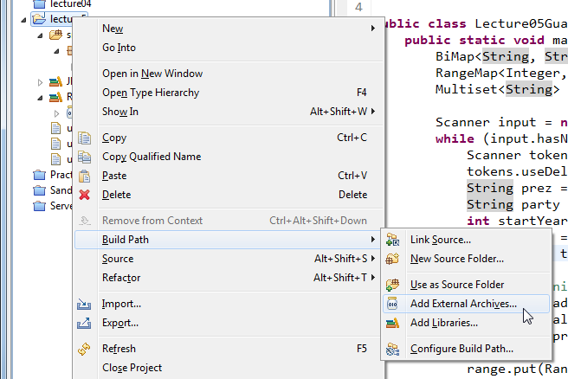
Using Guava library
Download Guava JAR from: http://code.google.com/p/guava-libraries/
Attach Guava to your Eclipse project:
  right-click project, choose Build Path → Add External Archives ...
  browse to the Guava JAR and select it
  in your code: import com.google.common.collect.*;

Slide 5
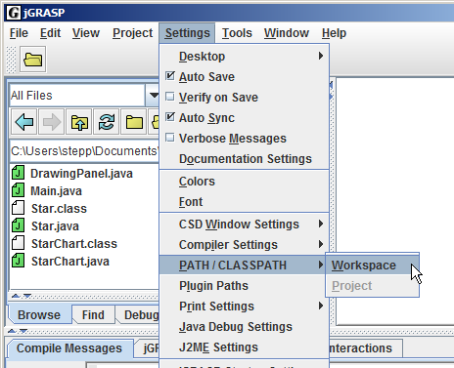
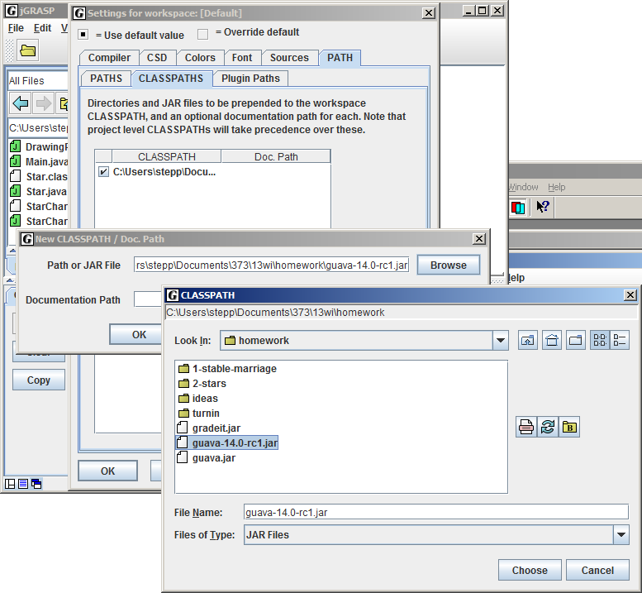
Guava and jGRASP
  Click Settings → PATH/CLASSPATH → Workspace.
  A dialog box pops up. Click the CLASSPATHS tab.
  Another box pops up. Click New. Click Browse.
  Now a file browser pops up.
  Go find the location of your Guava .jar file and select it.
  Click OK until you're back at your code.

Slide 6
Multiset
multi-set: a set of counters; also called a "bag"
  counts the # of times each unique value was added
  meant to replace Map<K, Integer>
  implementations: HashMultiset,LinkedHashMultiset,TreeMultiset
    // convention: construct using create() method
    Multiset<String> mset = HashMultiset.create();
"the"=7
"if"=2
"of"=1
mset.count("to")
"to"=3
"down"=1
"from"=4
3
set.count("boo")
set.contains("boo")
"by"=2
"she"=2
0
false
"in"=5
"you"=4
"him"=2
multiset

Slide 7
Multiset methods
class.create() class.create(collection) | creates a new empty multiset, or one based on the elements of a collection
add(value) add(value, count) | adds 1 occurrence of value to collection; or adds the given # of occurrences
contains(value) | true if set contains ≥ 1 occurrence of value
count(value) | returns # of occurrences of value; 0 if not found
iterator() | an object to examine all values in the set
remove(value) remove(value, count) | removes 1 occurrence of the given value; or removes the given # of occurrences
setCount(value, count) | causes the given value to have the given count
size() | returns sum of all counts
toString() | string such as "[a x 4, b x 2, c]"
elementSet(), entrySet() | collection views of the multiset

Slide 8
Multimap
multi-map: a map from keys to collections of values
  meant to replace Map<K, Set<V>> or Map<K, List<V>>
  implementations: ArrayListMultimap, LinkedListMultimap,
  HashMultimap, LinkedHashMultimap, TreeMultimap
  // political party -> people in it
  Multimap<String, String> mmap = TreeMultimap.create();
  mmap.put("D", "Gore");
  mmap.put("D", "Clinton");
"R"
[Obama, Kerry, Gore, Clinton]
"D"
[Paul, Johnson]
"I"
[Romney, McCain, Bush]
keys
values

Slide 9
Multimap methods
class.create() class.create(map) | creates a new empty multimap, or one based on the elements of a map
clear() | removes all key/value pairs
containsKey(key) | returns true if the given key is stored
get(key) | returns collection of values associated with key
put(key, value) | adds value to this key's collection
putAll(key, collection) | adds all given values to this key's collection
remove(key, value) | removes value from this key's collection
removeAll(key) | removes all values associated with this key
size() | returns number of key/value pairs
toString() | string such as "{a=[b, c], d=[e]}"
asMap(), keys(), keySet(), values() | various collection views of the map's data

Slide 10
Choosing a Multimap
The Multimap has two sub-ADT interfaces:
    ListMultimap → ArrayListMultimap, LinkedListMultimap
    SetMultimap → Hash, LinkedHash, TreeMultimap
  If you need list-specific methods, declare it as a ListMultimap.
  ListMultimap<String, String> mmap =
  ArrayListMultimap.create();
  mmap.put("D", "Gore");
  mmap.put("D", "Clinton");
  System.out.println(mmap.get("D").get(0); // Gore
  System.out.println(mmap.get("D").get(1); // Clinton

Slide 11
BiMap
bi-map: a two-directional map
  for data where a → b and also b → a in symmetry
  avoids need to try to "invert" a map or store an inverse map
  implementations: HashBiMap
  // state <--> state capital
  BiMap<String, String> bmap = HashBiMap.create();
  mmap.put("Arizona", "Phoenix");
  mmap.put("Washington", "Olympia");
"Washington"
"Sacramento"
"California"
"Phoenix"
"Arizona"
"Olympia"
keys
values

Slide 12
BiMap methods
all methods from Map are present as well
  clear, containsKey, containsValue, equals, get, isEmpty, keySet, put, putAll, remove, size, toString
class.create() class.create(map) | creates a new empty bi-map, or one based on the elements of a map
inverse() | returns BiMap<V, K> in opposite direction
values() | returns set of all values

Slide 13
Table
table: a two-dimensional (key+key) / value structure
  meant to replace Map<R, Map<C, V>>
  a map stores pairs of form (K, V) where only K is known later;
  a table stores triples of form (R, C, V) where R,C are known later
  implementations: HashBasedTable, TreeBasedTable,
  ArrayTable
  // (name + SSN => age)
  Table<String, String, Integer> table = TreeBasedTable.create();
  table.put("Marty Stepp", "597-24-6138", 29);
name | SSN | age
Marty Stepp | 597-24-6138 | 29
Stuart Reges | 703-34-1593 | 84

Slide 14
Table methods
class.create() | creates a new empty table, etc.
cellSet() | set of all (R, C, V) triples
clear() | remove all values
column(C) | returns column for given key as Map<R,V>
contains(R, C) | true if table has a mapping for the given keys
containsRow(R), containsColumn(C) | true if table has any mapping that includes the given row or column key
get(R, C) | returns value for the given keys, or null
isEmpty() | true if there are no values
put(R, C, V) | stores (R, C, V) triple in the table
putAll(table) | adds all of the given table's data to this one
remove(R, C) | removes any value mapped from the given keys
row(R) | returns row for given key as a Map<C,V>
size() | number of triples in table
toString() | string such as "{a={b=c, d=e},f={g=h}}"

Slide 15
RangeSet
range set: a group of comparable ranges of values
  like a set, but you can add an entire range at a time
  implementations: TreeRangeSet
  // teenagers and old people
  RangeSet<Integer> ages = TreeRangeSet.create();
  ages.add(Range.closed(13, 19));
  ages.add(Range.atLeast(65));
  System.out.println(rset.contains(15)); // true
  System.out.println(rset.contains(72)); // true
< 0 | 0 ... 12 | 13 ... 19 | 20 ... 64 | ≥ 65 ...

Slide 16
RangeSet methods
class.create() | creates a new empty range set, etc.
add(range) | adds the given range of values
addAll(rangeset) | adds all ranges from the given set
clear() | removes all ranges
encloses(range) | true if set contains the entire given range
enclosesAll(rangeset) | true if set contains all ranges in given set
isEmpty() | true if there are no ranges
remove(range) | removes the given range of values
span() | a Range representing all values in this set
subRangeSet(range) | subset containing relevant ranges
toString() | string such as "[1..3], (6..65]"

Slide 17
Specifying ranges
Specify a range of values by calling static methods of the Range class, each of which returns a Range object.
Range.closed(min, max) | [min .. max] including both endpoints
Range.open(min, max) | (min .. max) excluding min and max
Range.closedOpen(min, max) | [min .. max) include min, exclude max
Range.openClosed(min, max) | (min .. max] exclude min, include max
Range.atLeast(min) | [min .. ∞) including min
Range.greaterThan(min) | (min .. ∞) excluding min
Range.atMost(max) | (-∞ .. max] including max
Range.lessThan(max) | (-∞ .. max) excluding max
Range.all() | all possible values, (-∞ .. ∞)
Range.singleton(value) | [value]; just a single value

Slide 18
RangeMap
range map: like a range set, but stores (range, value) pairs
  implementations: TreeRangeMap
  // body mass index -> description
  RangeMap<Double, String> bmi =
  TreeRangeMap.create();
  bmi.put(Range.lessThan(18.5), "underweight");
  bmi.put(Range.closedOpen(18.5, 25.0), "normal");
  bmi.put(Range.closedOpen(25.0, 30.0), "overweight");
  bmi.put(Range.atLeast(30.0), "obese");
  System.out.println(bmi.get(27.1)); // "overweight"
< 18.5 | 18.5 .. 25.0 | 25.0 .. 30.0 | ≥ 30.0
underweight | normal | overweight | obese

Slide 19
RangeMap methods
class.create() | creates a new empty range map, etc.
put(range, value) | adds range/value pair
putAll(rangemap) | adds all range/value pairs from given map
clear() | removes all ranges
get(key) | returns value for range containing key
isEmpty() | true if there are no ranges
remove(range) | removes all values in the given range
span() | a Range representing all keys in this set
subRangeMap(range) | submap containing relevant ranges
toString() | string such as "{[1..3]=a, (6..65]=b}"

Slide 20
Other cool features
  Collections2: utility methods related to all collections
  Lists: utility methods related to lists
  Sets: utility methods related to sets
  Queues: utility methods related to queues
  Multisets, Multimaps: utility methods related to multiset/map
  Tables: utility methods related to tables
  Iterables: utility methods related to collections and for-each
  Iterators: utility methods related to iterators and iteration
  Ordering: easy-to-create comparable and comparator orders
  Immutable*: collections that cannot be modified
see also:
http://code.google.com/p/guava-libraries/wiki/CollectionUtilitiesExplained

Slide 21
Collection views
collection view: a collection that is based on another collection
  links back to the original collection; changes to one affect the other
  important: does not make deep copy of collection (O(1), not O(N))
  Arrays
    public static List<T> asList(T[] elements)
    Returns a List view backed by an array or group of parameter values.
  List<E>
    public List<E> subList(int start, int end)
    Returns a view of indexes [start, end) of this list.
  Map<K, V>
    public Set<K> keySet()
    Returns a Set view of all keys in the given map.
    public Collection<V> values()
    Returns a Collection view of all values in the given map.

Slide 22
Sorted Views
  SortedSet<E> (a TreeSet is a SortedSet)
    public SortedSet<E> subSet(E start, E end)
    public SortedSet<E> headSet(E end)
    public SortedMap<E> tailMap(K start)
    Returns a set view of range [start .. end), (-∞ .. end), or [start .. ∞).
  SortedMap<K, V> (a TreeMap is a SortedMap)
    public SortedMap<K, V> subMap(K start, K end)
    public SortedMap<K, V> headMap(K end)
    public SortedMap<K, V> tailMap(K start)
    Returns a map view of range [start .. end), (-∞ .. end), or [start .. ∞).
  RangeSet<E>
    public RangeSet<E> subRangeSet(Range<E> view)
    Returns a set view of the given range of element values.
  RangeMap<K, V>
    public RangeMap<K, V> subRangeMap(Range<E> view)
    Returns a map view of the given range of key/value pairs.

Slide 23
Immutable views
Collections
  public static List<E> unmodifiableList<List<E> list)
  public static Map<K, V> unmodifiableMap<Map<K, V> map)
  public static Set<E> unmodifiableSet(Set<E> set)
  public static Collection<E> unmodifiableCollection(
  Collection<E> set)
  Returns an appropriate view of the given collection that cannot be modified (calls to methods such as set, remove, clear, etc. will throw an UnsupportedOperationException).
Guava
  many provided immutable collections, e.g. ImmutableBiMap, ImmutableMultimap, ImmutableMultiset, ImmutableRangeSet, ImmutableRangeMap, ImmutableTable, ...
  useful when you want to share a collection without it being changed

Slide 24
Collection view examples
  // sort a sub-portion of a list
  List<String> list = new ArrayList<String>();
  list.add("z"); list.add("y"); list.add("x"); // 0 1 2
  list.add("c"); list.add("b"); list.add("a"); // 3 4 5
  Collections.sort(list.subList(1, 4)); // [z,c,x,y,b,a]
  someUnsafeMethod(Collections.unmodifiableList(list));
  // delete three students' grades
  Map<String, Double> gpa = ...; // fill with data
  gpa.keySet().removeAll(Arrays.asList("Ned", "Rod", "Todd"));
  // body mass index -> description (from prior slide)
  // delete certain body mass ranges from the map
  RangeMap<Double, String> bmi = TreeRangeMap.create();
  bmi.subRangeMap(Range.closed(10, 20)).clear();

