Slide 1
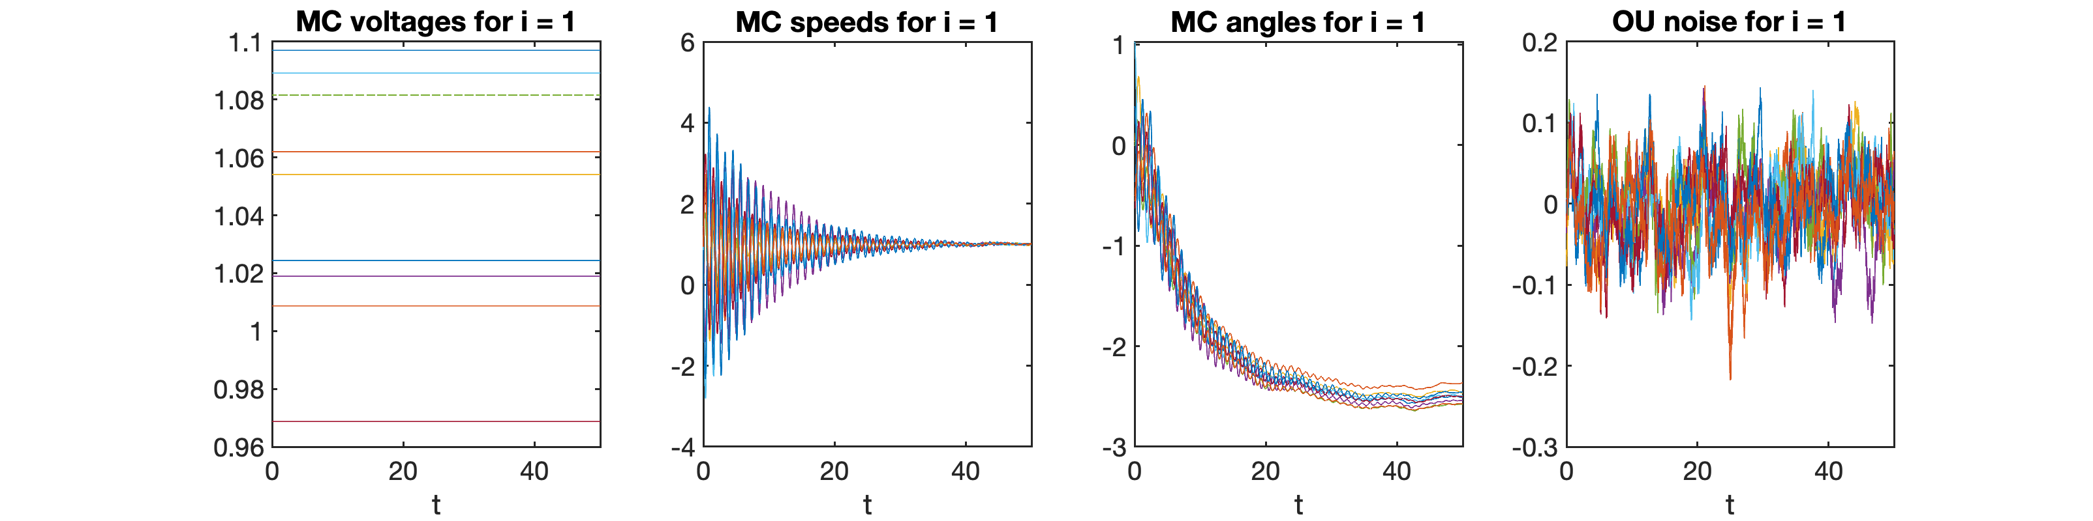
Reduced-order physics-DL model for Power systems
erhtjhtyhy
Hongli (BOB) zhao
ADVISORs
University of Chicago
Adrian Maldonado, Mihai Anitescu
08/05/2023
Lemont, IL

Slide 2
Problem setup
Uncertainty in power generation and demand fluctuations
Risk in power transmission networks
Systematic risk: failure events are rare, but interconnected and devastating
Big Picture: Characterize likelihoods of cascading failures

Slide 3
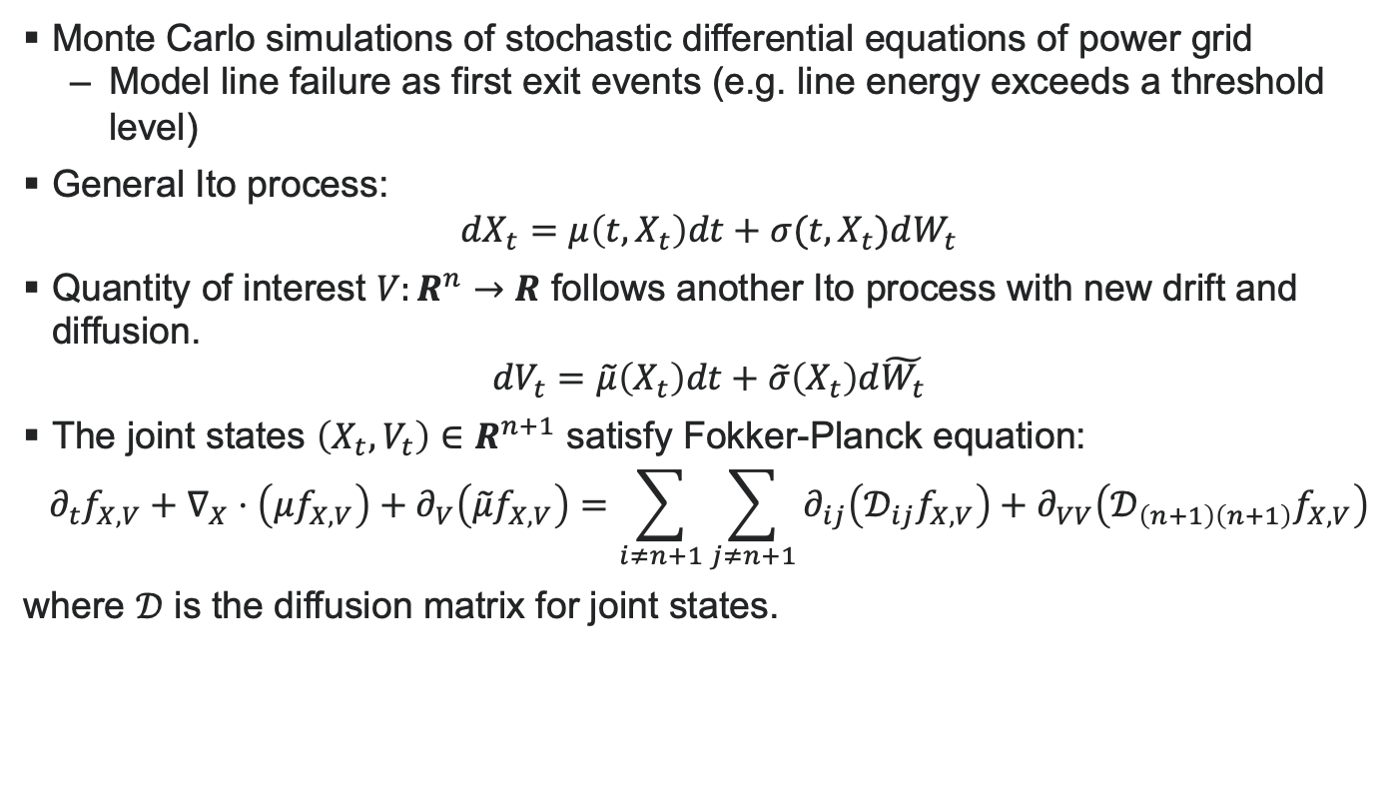
Stochastic dynamical systems
Monte Carlo simulations of stochastic differential equations of power grid
Model line failure as first exit events (e.g. line energy exceeds a threshold level)
General Ito process:
$$dX_{t}=μ\left(t, X_{t}\right)dt+σ(t, X_{t})dW_{t}$$
Quantity of interest $V:R^{n}→R$ follows another Ito process with new drift and diffusion.
$$dV_{t}=\tilde{μ}\left(X_{t}\right)dt+\tilde{σ}\left(X_{t}\right)d\tilde{W_{t}}$$
The joint states $\left(X_{t},V_{t}\right)∈R^{n+1}$ satisfy Fokker-Planck equation:
$$∂_{t}f_{X,V}+∇_{X}⋅\left(μf_{X,V}\right)+∂_{V}\left(\tilde{μ}f_{X,V}\right)={\sum_{i≠n+1}{\sum_{j≠n+1}{∂_{ij}\left(𝒟_{ij}f_{X,V}\right)}}+∂}_{VV}\left(𝒟_{\left(n+1\right)\left(n+1\right)}f_{X,V}\right)$$
where $𝒟$ is the diffusion matrix for joint states.

Slide 4
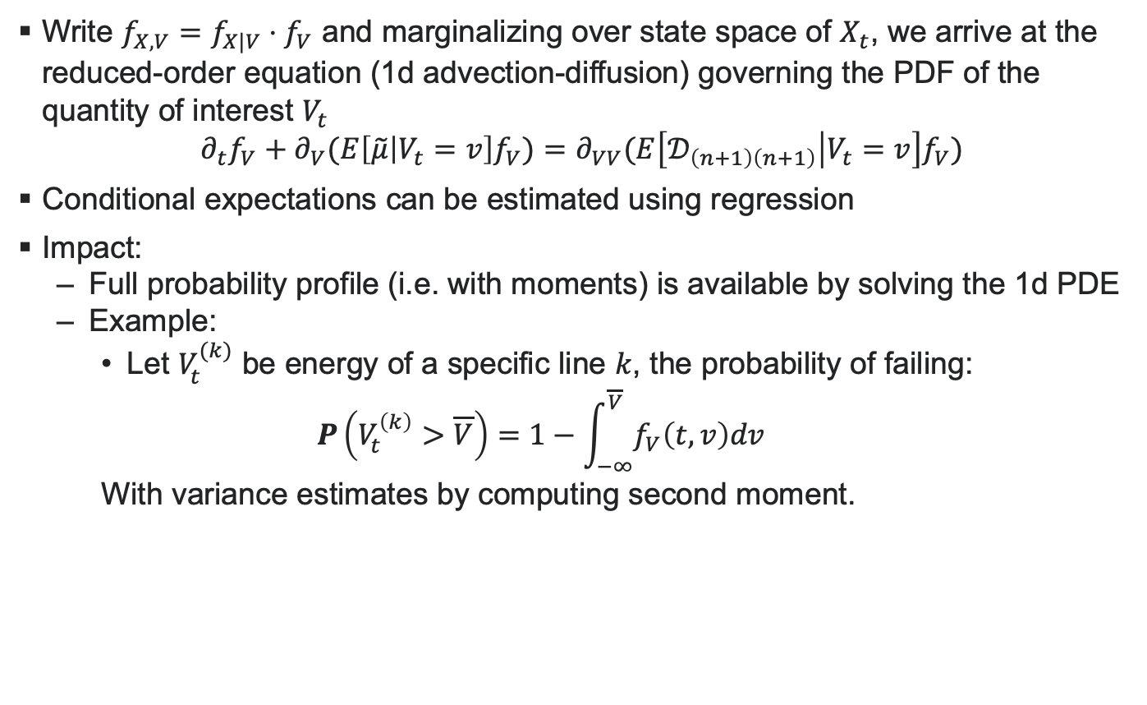
Reduced-order PDF model
Write $f_{X,V}=f_{X|V}⋅f_{V}$ and marginalizing over state space of $X_{t}$, we arrive at the reduced-order equation (1d advection-diffusion) governing the PDF of the quantity of interest $V_{t}$
$$∂_{t}f_{V}+∂_{V}(E\left[\tilde{μ} | V_{t}=v\right]f_{V})=∂_{VV}(E\left[𝒟_{\left(n+1\right)\left(n+1\right)} | V_{t}=v\right]f_{V})$$
Conditional expectations can be estimated using regression
Impact:
Full probability profile (i.e. with moments) is available by solving the 1d PDE
Example:
Let $V_{t}^{(k)}$ be energy of a specific line $k$, the probability of failing:
$$P\left(V_{t}^{\left(k\right)}>\overline{V}\right)=1−\int_{−∞}^{\overline{V}}{f_{V}\left(t,v\right)dv}$$
With variance estimates by computing second moment.

Slide 5
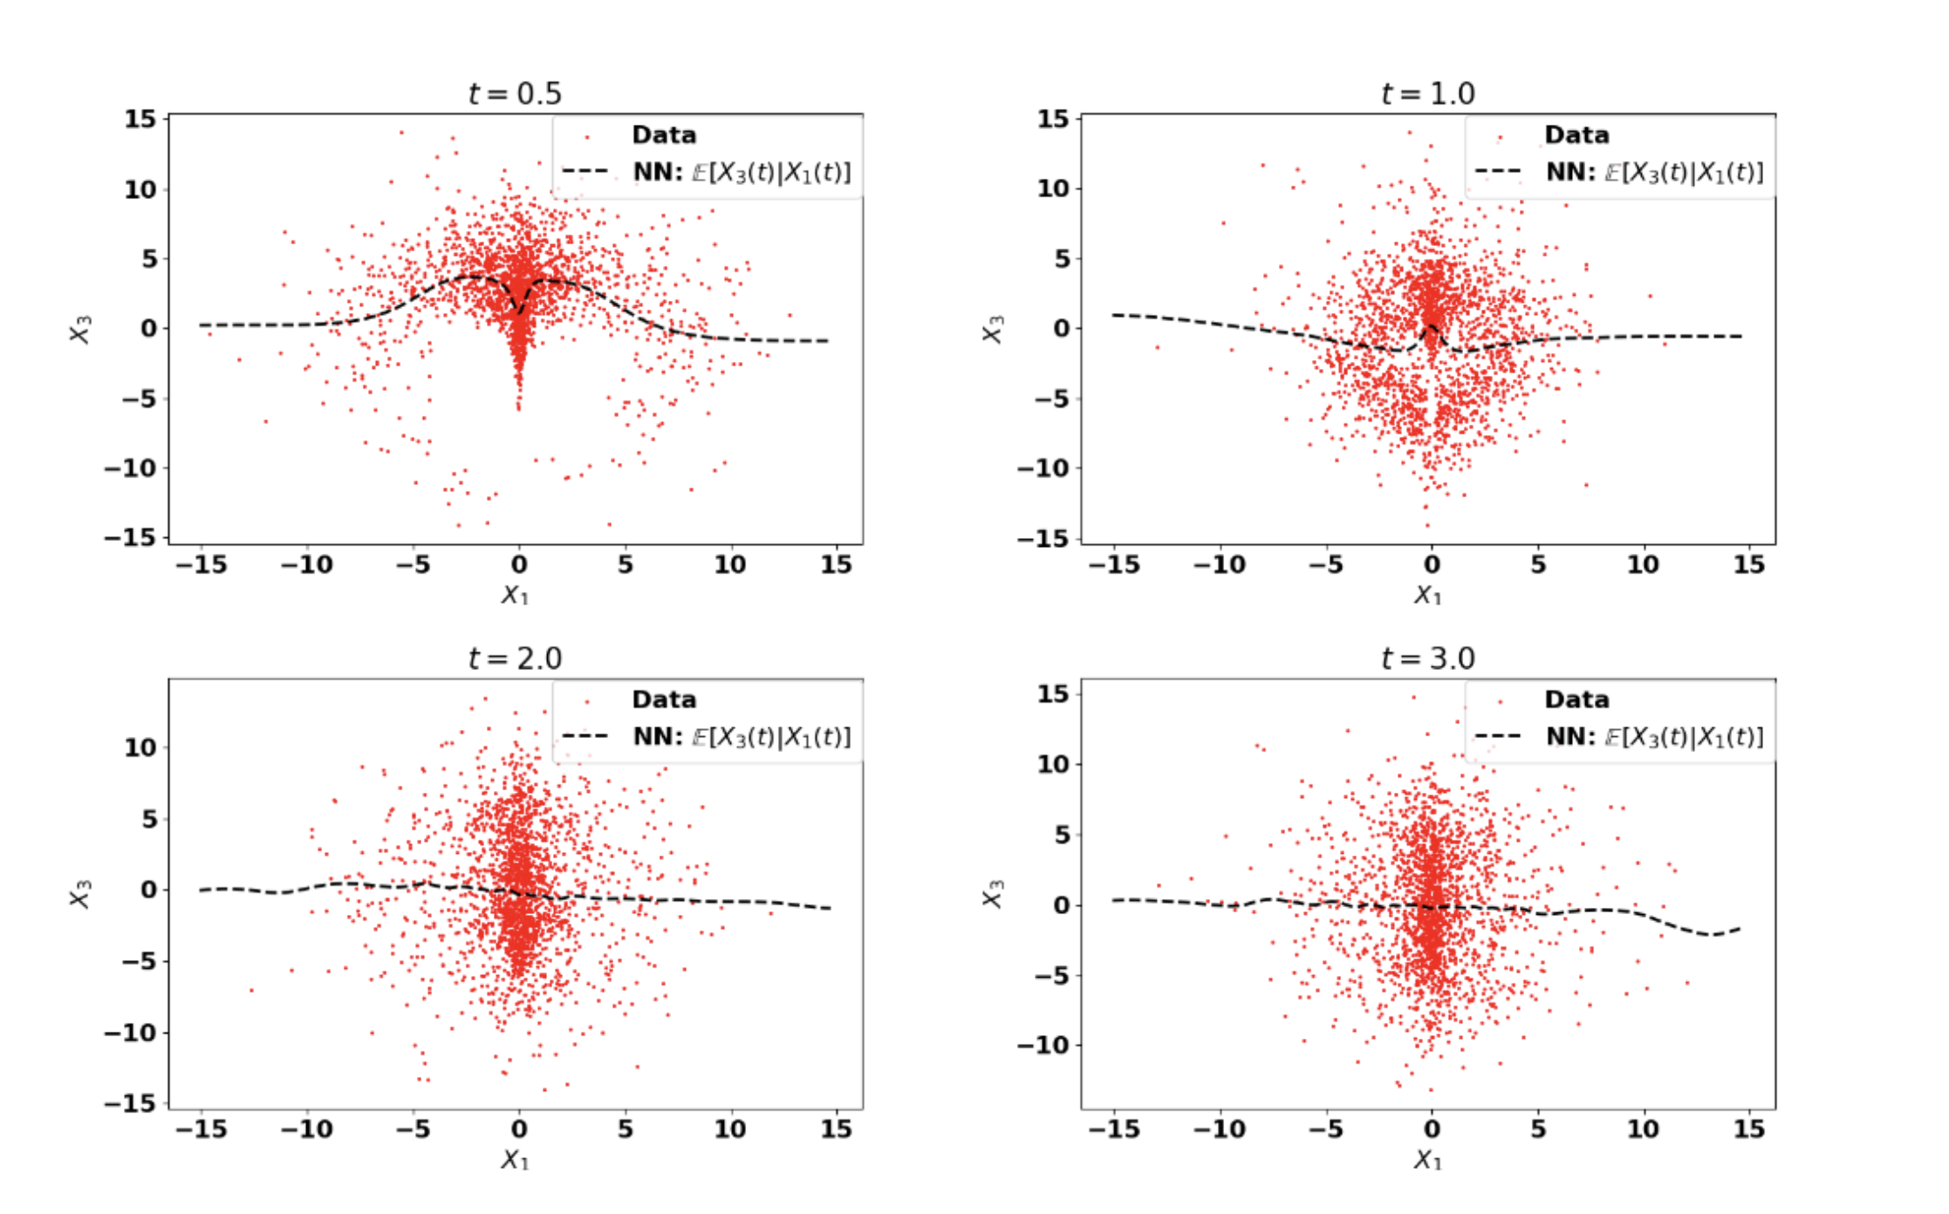
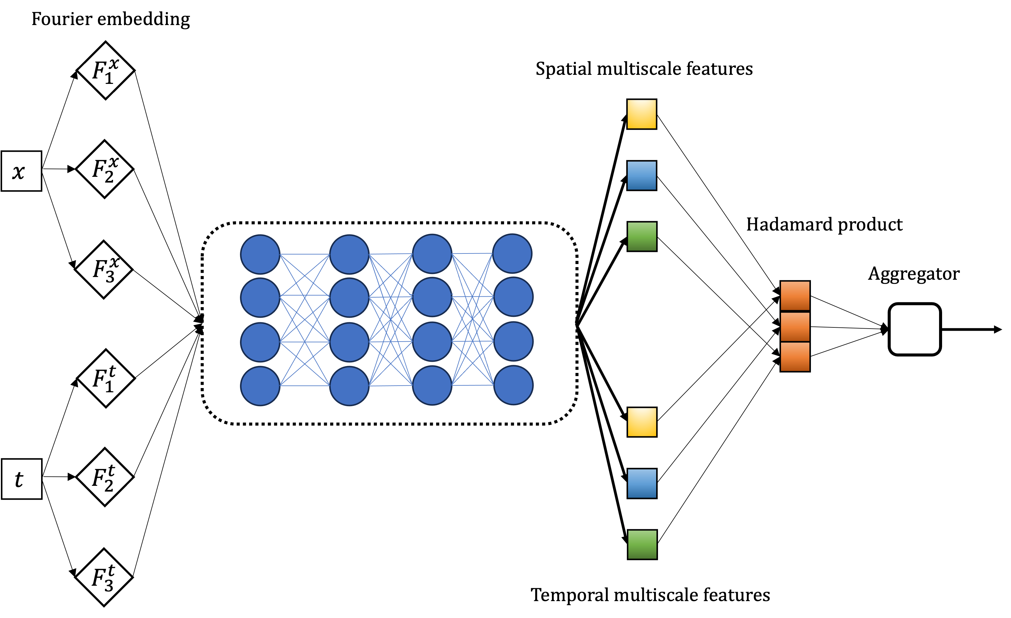
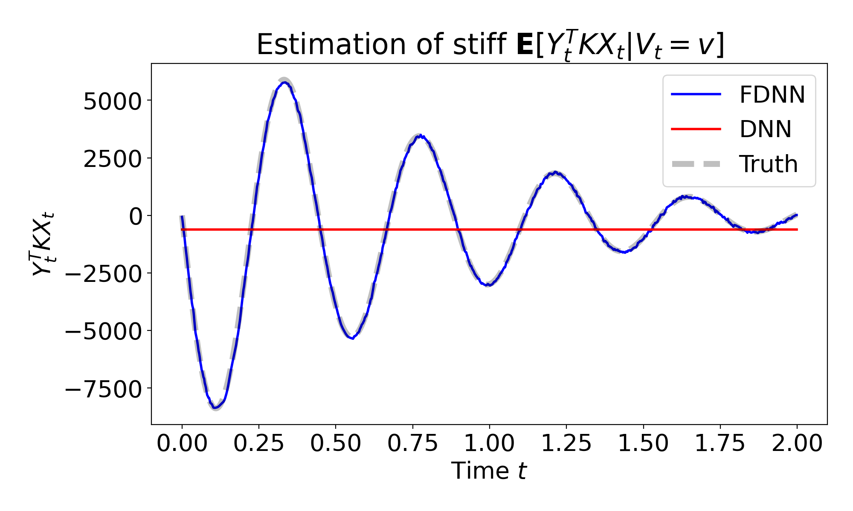
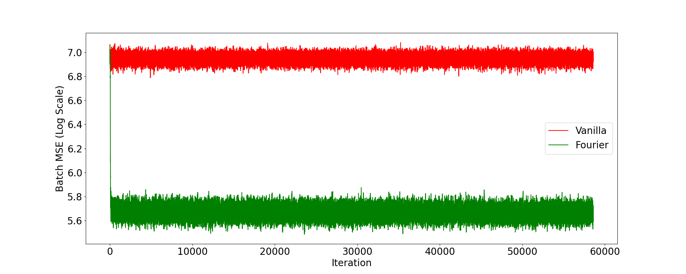
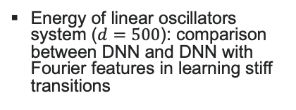
Work in progress
Learning conditional expectation using neural networks
Stochastic Kraichnan-Orszag system: Fully connected DNN estimates from trajectory data
Energy of linear oscillators system ($d=500$): comparison between DNN and DNN with Fourier features in learning stiff transitions
(Top) Fourier net architecture
(Bottom) Training loss for DNN (red) and Fourier DNN (green)

Slide 6
Thank you for listening! Questions?

