Slide 1
SG GoAssist
Autonomous Passenger Assistance System
Project overview and progress draft
25 September 2026
Team members: ______________________________
31 August–30 September 2026 project window
Notes:
Primary source: ../SG_GoAssist_Prototype_Action_Plan.pdf, pp. 1–2. Supporting proposal: ../APAS_Design_Document.docx.
Presenter: ____________________
Draft for group editing. Add the confirmed member names before submission.

Slide 2
Project purpose and intended users
A controlled prototype for a complete assistance journey
The problem
A passenger needs a clear way to request help and know when boarding or alighting is safe.
The proposed response
Connect an explicit request to acknowledgement, safety checks, automated assistance and verified completion.
Intended users
People using mobility aids and passengers who choose extra time or audio, visual or haptic guidance.
02
Notes:
Primary source: ../SG_GoAssist_Prototype_Action_Plan.pdf, pp. 1–3, 13. These are design goals. User findings and measured improvements remain incomplete.
Presenter: ____________________
Status date: 25 September 2026. Blank result fields are intentionally incomplete.

Slide 3
Intended request-to-completion journey
Stage | Passenger or system action | Required outcome
1 Request and recognise | Select assistance and bus. Perception adds cues. | Explicit intent remains authoritative.
2 Prepare and dock | Reserve dwell and align with the boarding fixture. | Correct bus, stop and ramp reach.
3 Mark and check | Show the ramp area and inspect its volume. | Clear, fresh safety inputs.
4 Deploy and board | Open door, deploy ramp and maintain dwell. | Verify deployed position and monitor interlocks.
5 Complete | Retract, verify stowed and close the door. | Save outcome or escalate a fault.
Second demonstration scenario: extra time and guidance without a ramp request.
03
Notes:
Primary source: ../SG_GoAssist_Prototype_Action_Plan.pdf, p. 3. The original nine steps are request, recognise, prepare, dock, mark zone, check zone, deploy, board and complete. Current physical end-to-end completion has not been established.
Presenter: ____________________
Status date: 25 September 2026. Blank result fields are intentionally incomplete.

Slide 4
System architecture and control authority
Shared messages connect software, sensing and the mock bus
Layer | Main components | Responsibility
Passenger | App, tactile stop unit, optional NFC | Record request, confirmation and cancellation.
Perception | Camera, edge observer, ToF/IR | Publish observations and sensor health.
Decision | Backend case state machine, operator console | Match the case and apply deterministic safety gates.
Vehicle | ESP32 controller, ramp/door, limit switches | Repeat local interlocks and verify motion outcome.
Only passenger or operator confirmation establishes ramp intent.
ML supports decisions. It cannot override a safety interlock.
04
Notes:
Primary source: ../SG_GoAssist_Prototype_Action_Plan.pdf, pp. 5, 9; docs/grand-challenge-integrated-prototype.md, Safety policy and Portable build; docs/task-requirements-traceability.md, SR-01–04.
Presenter: ____________________
Status date: 25 September 2026. Blank result fields are intentionally incomplete.

Slide 5
Current progress at a glance
Evidence reviewed as of 25 September 2026
Workstream | Evidence available | Current boundary
Software | App, backend, operator console and documented automated tests | Mock and fixture evidence
Mechanical | Fusion v2 model and discrete clearance checks | Physical reliability remains unverified
Electronics | ESP32-S3 upload and live VL53L0X readings | Single sensor bench result
Machine learning | ML1 label guide, training and evaluation scripts | Measured model results remain incomplete
Integration and users | Interfaces and validation plans | Physical journey and user study evidence pending
05
Notes:
Sources: docs/feature-readiness-matrix.md; docs/grand-challenge-integrated-prototype.md; cad/VALIDATION_v2.md; hardware/esp32-s3-tof-test/README.md; hardware/edge-observer/ml1/README.md. This is a repository evidence review, not a fresh rerun of all software tests.
Presenter: ____________________
Status date: 25 September 2026. Blank result fields are intentionally incomplete.

Slide 6
Software progress
The repository implements the competition software loop
Passenger and operator interfaces
Request assistance, track case status, cancel and expose reasons for blocked or escalated actions.
Backend and mock control
Persist cases and audit events. Reject duplicate actions and verify deployed/stowed telemetry.
Verification still required
Physical actuation and on-device ARM64 Qwen tests. Transport arrivals and selected amenities use labelled fixtures.
06
Notes:
Sources: README.md, Integrated assistance demonstrator and Private hybrid assistant; docs/grand-challenge-integrated-prototype.md; docs/feature-readiness-matrix.md. No assertion that all tests were rerun for this report.
Presenter: ____________________
Status date: 25 September 2026. Blank result fields are intentionally incomplete.

Slide 7
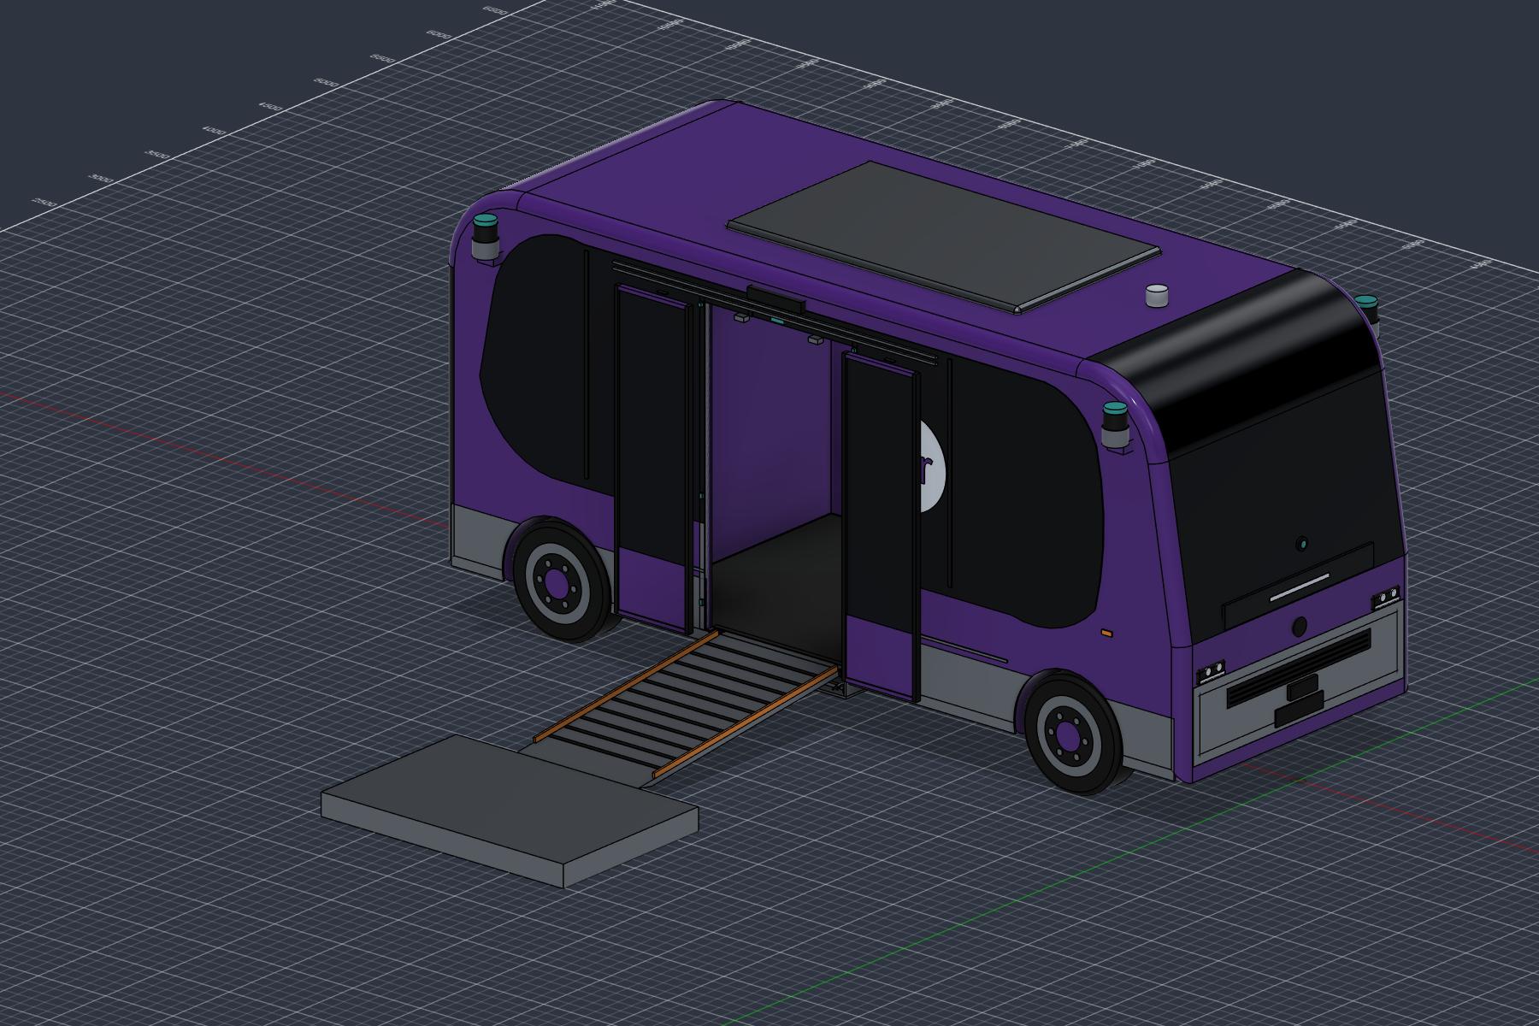
Mechanical design progress
Robobus v2 concept in Autodesk Fusion
73 sampled poses
Zero moving-part intersection volumes in the discrete CAD check.
Native geometry
189 solid bodies and eight as-built joints. Travel and deployed exports available.
CAD packaging evidence only. Structural performance and physical ramp safety remain unverified.
07
Notes:
Sources: cad/VALIDATION_v2.md; cad/README_v2.md; cad/v2_final_report.json; cad/v2_clearance_report.json. Image: cad/Punggol_WeRide_Robobus_v2_deployed.png (project Fusion CAD render, not a photograph). The sweep contains 73 sampled poses, including repeated stationary stages. The separate passage check addresses a static entrance obstruction.
Presenter: ____________________
Status date: 25 September 2026. Blank result fields are intentionally incomplete.

Slide 8
Electronics bench progress
ESP32-S3 and VL53L0X live ranging verified on 23 September
27 consecutive valid samples
30–136 mm after a full sensor power cycle
What this establishes
The controller can identify the connected sensor and receive live distance readings.
Integration issue
The physical sensor is single-zone VL53L0X. Ramp firmware expects a VL53L5CX 8×8 sensor.
Accuracy, calibrated ramp coverage and physical safety performance remain unverified.
08
Notes:
Sources: hardware/esp32-s3-tof-test/README.md, Verification on 23 September 2026; artifacts/apas-tof-build/serial-powercycle-test.txt; hardware/INTEGRATED_PROTOTYPE.md. Measurements are sensor-reported values without a known-distance accuracy comparison.
Presenter: ____________________
Status date: 25 September 2026. Blank result fields are intentionally incomplete.

Slide 9
Machine-learning progress and remaining evidence
Module | Intended decision | Current evidence / next evidence
ML1 Assistance cue | Recognise selected observable aids. | Scripts and label guide ready. Add trained weights, held-out metrics and device latency.
ML2 Ramp zone | Describe objects within the deployment area. | Fusion and sensor interfaces exist. Add trained/evaluated perception and physical obstruction trials.
ML3 Dwell state | Classify active, clear or uncertain boarding. | Training/evaluation evidence pending. Validate the fixed-dwell sensor-clear fallback.
A detection never diagnoses disability or authorizes ramp movement by itself.
09
Notes:
Primary source: ../SG_GoAssist_Prototype_Action_Plan.pdf, pp. 5–8; hardware/edge-observer/README.md; hardware/edge-observer/ml1/README.md; hardware/edge-observer/ml1/LABEL_GUIDE.md. Dataset scope differs: original outline 300–500 ML1 images, later README 800–1,200. Team should confirm controlled-demo scope before capture. No measured trained-model evidence located in reviewed materials.
Presenter: ____________________
Status date: 25 September 2026. Blank result fields are intentionally incomplete.

Slide 10
Original deliverables D1–D5
Status against the original action plan
ID and owner | Deliverable | Progress / missing acceptance
D1 CE1 | Architecture, interfaces and states | Documented. Final group review pending.
D2 EE1 / EE2 / ME1 | Integrated mock bus, stop and fixture | Subsystem evidence exists. Cold-start physical trials pending.
D3 CE1 | Passenger app and dashboard | Implemented in software. Final demonstration evidence pending.
D4 CE2 / EE1 | ML1 package | Training workflow ready. Weights, metrics and model card pending.
D5 CE2 / EE1 / ME1 | ML2 and safety-fusion package | Integration logic exists. Measured perception and safety results pending.
10
Notes:
Primary source: ../SG_GoAssist_Prototype_Action_Plan.pdf, p. 12. Status derives from reviewed repository evidence as of 25 September 2026. D1/D3 software availability does not establish completed hardware acceptance.
Presenter: ____________________
Status date: 25 September 2026. Blank result fields are intentionally incomplete.

Slide 11
Original deliverables D6–D9
Role labels follow the outline. Confirm the final team roster.
ID and owner | Deliverable | Progress / missing acceptance
D6 CE2 / CE1 / EE2 | ML3 or documented fallback | Trained classifier evidence pending. Validate fallback and no-premature-CLEAR cases.
D7 EE2 / ME1 | Mechanical and electrical package | CAD and circuit material available. Final BOM, power and cycle results pending.
D8 All / ME1 | Validation and accessibility report | Protocol available. Physical metrics, baseline and user findings incomplete.
D9 All / CE1 | Competition submission pack | Report and presentation drafts. Video, final evidence and packaging pending.
11
Notes:
Primary source: ../SG_GoAssist_Prototype_Action_Plan.pdf, p. 12; cad/VALIDATION_v2.md; hardware/INTEGRATED_PROTOTYPE.md. The draft report and this deck contribute to D9, but submission acceptance is not established.
Presenter: ____________________
Status date: 25 September 2026. Blank result fields are intentionally incomplete.

Slide 12
Validation targets and results
Original controlled-prototype targets. Result fields intentionally blank.
Measure | Planned target | Measured result
Request delivery | 20/20 local trials, acknowledgement within 2 s
ML1 | At least 90% wheelchair/PMA recall and 10 FPS
Ramp safety | Zero missed obstructions in defined matrix
Actuation | 50 cycles without binding or interlock bypass
Docking | 10 consecutive trials within ramp reach
Dwell | No premature CLEAR in defined sequence tests
End-to-end | At least 9/10 nominal cold-start journeys
12
Notes:
Primary source: ../SG_GoAssist_Prototype_Action_Plan.pdf, pp. 6–8, 12–13. Later docs/task-requirements-traceability.md adds 30 trials per explicit source, acknowledgement P95 <2 seconds, and >=50 interlock/obstruction trials. Preserve both as original targets and additional repository checks, and confirm the final protocol. All result cells intentionally blank.
Presenter: ____________________
Status date: 25 September 2026. Blank result fields are intentionally incomplete.

Slide 13
User feedback and measured impact
Study findings remain incomplete
Study field | Evidence to add
Participants, consent and test date
Clarity and control
Confidence and comfort
Manual baseline versus GoAssist
Design changes from feedback
Baseline measures: acknowledgement, manual interventions, completion and waiting time.
13
Notes:
Primary source: ../SG_GoAssist_Prototype_Action_Plan.pdf, p. 13. Obtain consent before any participant study. If participants are classmates only, describe scenario testing rather than validation by disabled users. Compare the same scripted journey under manual assistance and GoAssist. Blank fields intentionally await actual evidence.
Presenter: ____________________
Status date: 25 September 2026. Blank result fields are intentionally incomplete.

Slide 14
Cost and final evidence register
Complete these fields after hardware and evidence review
Budget / evidence item | Confirmed value or file link
Total component cost (SGD)
Final BOM and power budget
Physical integration photos and cycle logs
Model metrics and model cards
Demo video and final source archive
14
Notes:
Primary source: ../SG_GoAssist_Prototype_Action_Plan.pdf, pp. 12, 14. Cost fields and final evidence links intentionally blank. These are editable working fields, not zero costs or completed submissions.
Presenter: ____________________
Status date: 25 September 2026. Blank result fields are intentionally incomplete.

Slide 15
Remaining work and planned submission dates
The original schedule remains subject to the outstanding evidence
Planned timing | Priority | Responsible roles
25–26 September | Resolve sensor choice. Assemble, calibrate and verify interlocks. | EE1 / EE2 / ME1
25–27 September | Train/evaluate models or validate documented fallback. Run physical scenarios. | CE2 with CE1 / EE1 / EE2
27 September | Freeze validation evidence and presentation content after review. | All
28–30 September | Build and evidence audit, rehearsal, backup video and submission checks. | All, packaged by CE1
Preserve explicit requests, safety gates and a repeatable demonstration when reducing scope.
15
Notes:
Primary source: ../SG_GoAssist_Prototype_Action_Plan.pdf, pp. 11, 14. These are planned gates from the original outline, not verified completions or guaranteed dates. Priorities reflect evidence gaps reviewed on 25 September.
Presenter: ____________________
Status date: 25 September 2026. Blank result fields are intentionally incomplete.

Slide 16
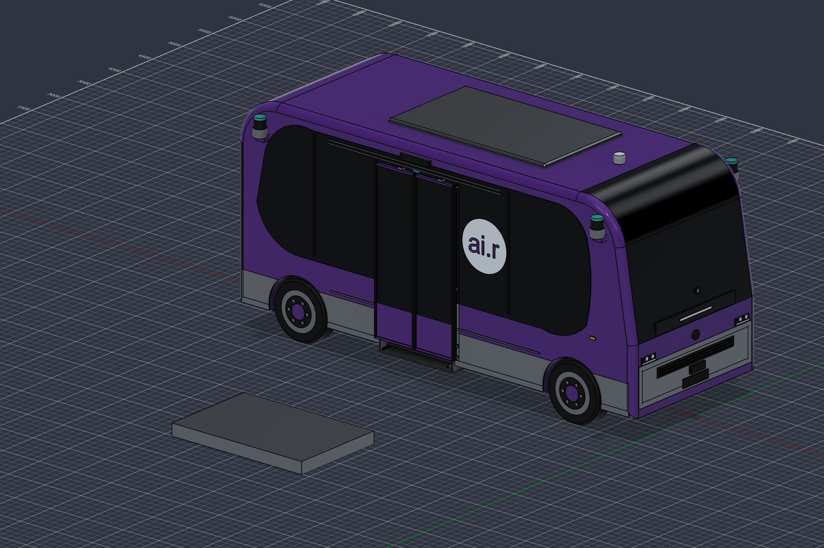
Project position and next demonstration
Software and CAD provide a foundation for integration.
The next milestone is a repeatable physical journey with measured safety, reliability and user feedback.
Final demonstration result:
________________________________________
16
Notes:
Primary source: ../SG_GoAssist_Prototype_Action_Plan.pdf, pp. 2–3, 14–15; docs/feature-readiness-matrix.md; cad/VALIDATION_v2.md. Image: cad/Punggol_WeRide_Robobus_v2_travel.png (project CAD render). No measured benefit or completed physical integration claim.
Suggested closing: the next milestone is a documented, repeatable physical assistance journey with controlled failure scenarios.
Presenter: ____________________
Status date: 25 September 2026. Blank result fields are intentionally incomplete.

