Slide 1
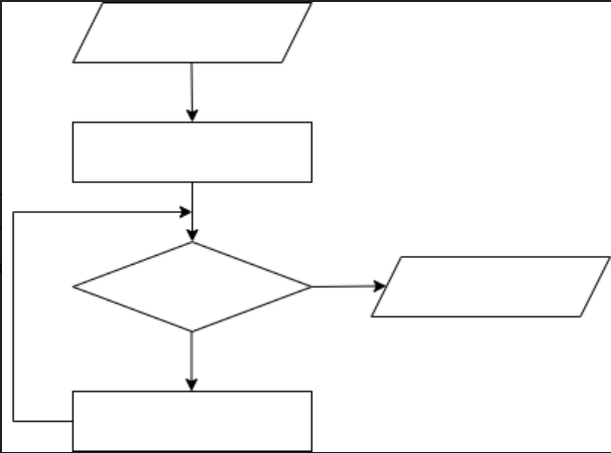
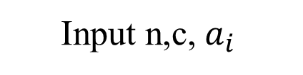
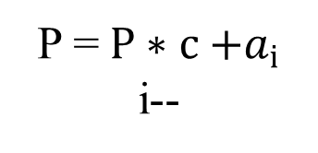
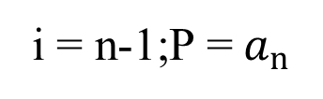
Input n,c, $a_{i }$
i = n-1;P = $a_{n}$
i>=0
Write P
P = $P∗c{+a}_{i}$
i--

