Slide 1

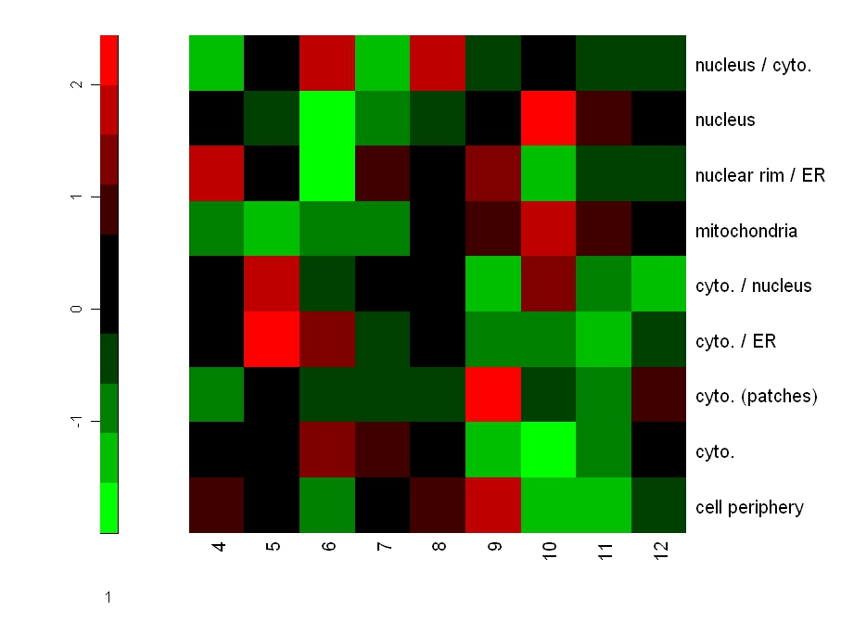
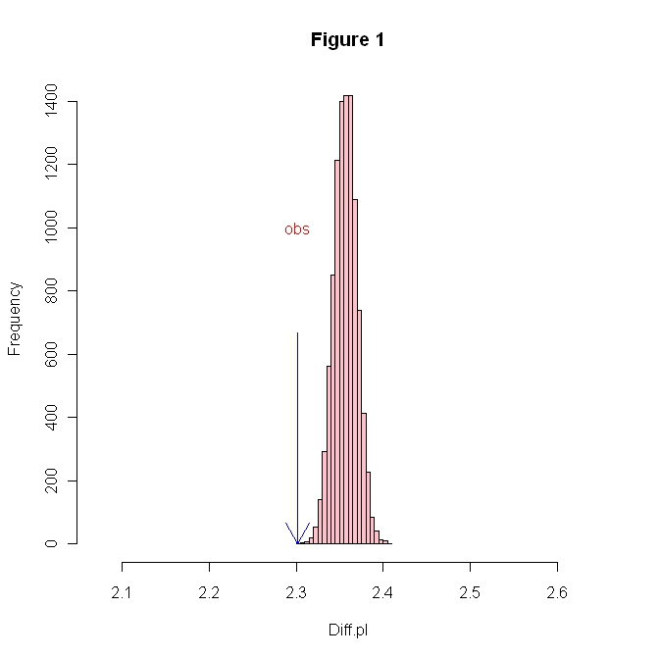
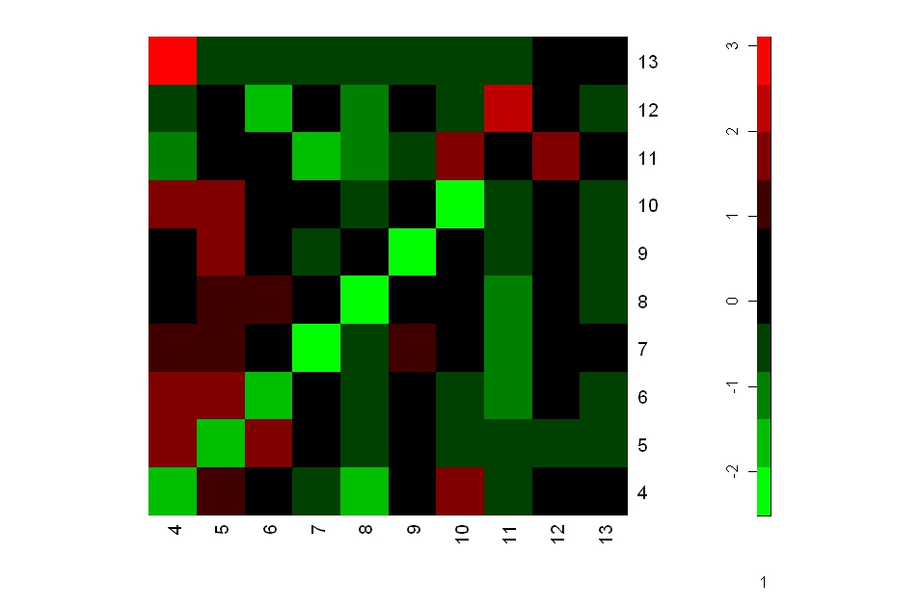


The effects of protein electrostatic property on Protein-Protein
Interactions in the Yeast Cell
Kenee Daffin¹, Brittany Kearse², Dr. Hong Qin³
Biology Department at Spelman College
Introduction
Results Cont.
Summary/Discussion
Different protein-protein interactions that occur within the cell help with the regulation and functions of the cell. The electrostatic properties (pI) influence the way the proteins interact with one another. The electrostatic properties influence the location of the cell and the evolutionary rate. Other studies have shown the relationship between the interacting pairs and the localization. Research has found that proteins with a high rate of interaction are more likely to pair with proteins that have a low rate of interaction. (1) These protein pairings are favored more so than proteins with similar interaction rates. (1) They also found that this favored protein pairing occurs in the nucleus. Our primary focus is to determine if the isoelectric points of proteins affect protein-protein interactions by examining their pI values.
An evaluation of the average pI differences was constructed through a permutation test. A permutation test shuffles observed data to determine how unusual an observed outcome is. From the data pulled from the histogram, we discovered that the observed difference in pI was smaller than the random distribution. The observed average pI was 2.302 after organizing the permutations. The p-value calculated was 1x10⁻⁴. This means that the association pattern of pI in the interacting pairs is nonrandom. This means that the null hypothesis was not affected by the pI. Figure 2 shows the relationship between the pI and the cell location.
Electrostatic properties of the protein have an impact on the location selection. A heat map was used to help make the results more visual. A heat map is a visual presentation of the data that is distinguished by using a color system. The relation between two interacting pIs was shown. According to the heat map, there was a direct relationship among the pI value of the protein and the localization. As the value of the interacting pairs increased, those proteins seemed to localize in the nucleus. Also, when the pI value decreased, these proteins were more attracted to the cytoplasm(ER). Figure 3 indicates that proteins with similar pI values did not tend to interact with each other, whereas, proteins whose pI values ranged further apart had a natural gravitation. From these results, we concluded that our null hypothesis was rejected because the p-value is affected by the protein-protein interactions.
Results
Results
Figure 2: pI of proteins in different Cell Locations
This graph shows that the proteins with different pIs prefer different cell locations. By computing Z scores, we can determine the cell location preference of proteins with different ranges of pI values. The results show that proteins with high pI values of 9 gravitate toward the cytoplasm (patches). In addition, proteins with high pI values of 10 gravitate toward the nucleus of a cell. Furthermore, proteins with low pI values of 5 tend to gravitate toward the cytoplasm/ER.
References
S. Maslov; K. Sneppen, Specificity and Stability in Topology of Protein Networks, Science Vol 296, Pg 910, 3 May 2002. www.sciencemag.org
Acknowledgements
A special thanks to the Seed grant from RIMI at Spelman for providing funding and support to make this research possible.
The R Program
The National Institutes of Health – National Center for Minority Health and Health Disparities
Spelman College
Figure 1. Permutation Test Evaluation of Average pI Difference.
This graph shows the average difference pI of 10000 random permutations for 13668 interacting protein pairs. After running these permutations, we calculated the observed delta pI to be 2.302, which corresponds to a p-value of 1x10⁻⁴. The results imply that we reject the Null Hypothesis. We conclude that protein protein interactions are affected by their pIs and their association pattern is nonrandom.
Figure 3 : Association patterns of proteins in different pI groups
This graph shows the protein preference of their interacting partners based on their pI values. Proteins from pI groups of 4 through 10 tend to avoid interacting with proteins from the same pI groups. Proteins with pIs of 13 prefer proteins with pIs of 4, but proteins with pIs of 4 do not prefer proteins with pIs of 13.

