Slide 1


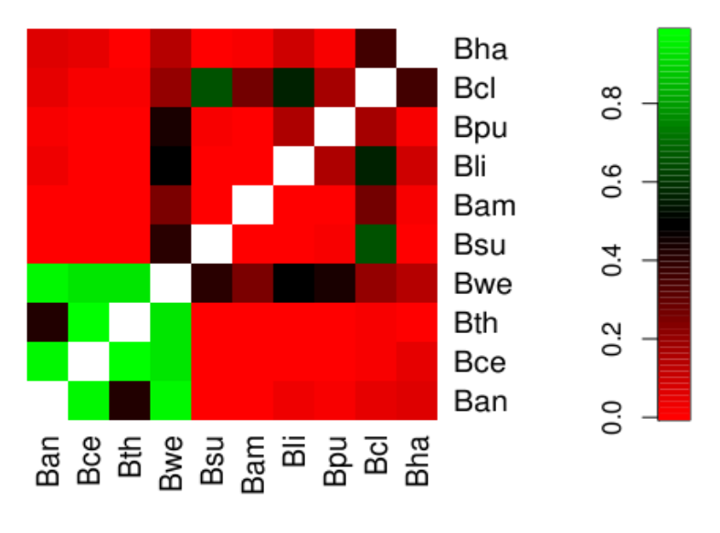
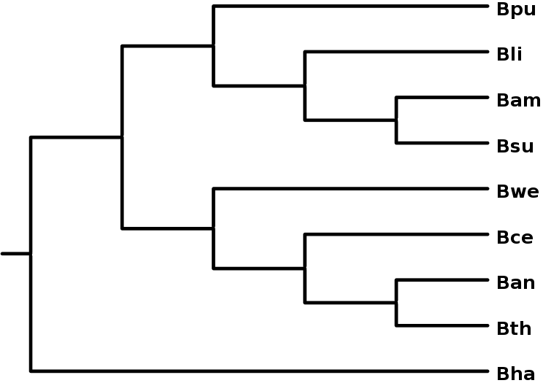
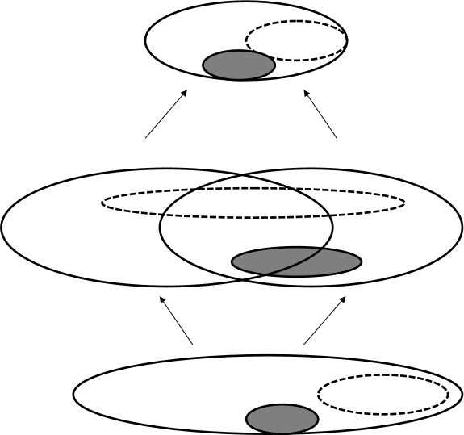
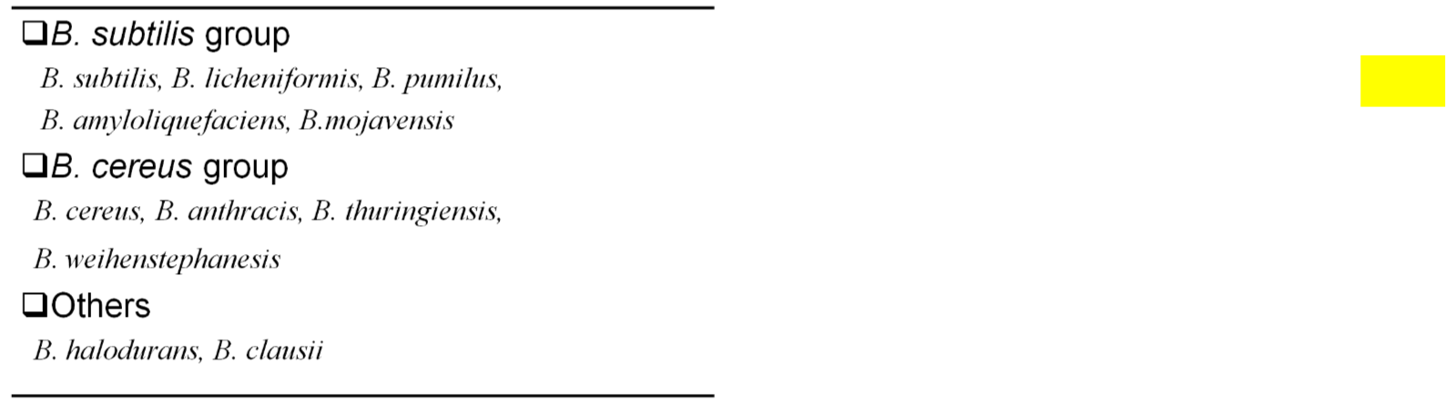
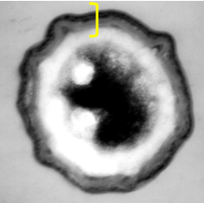
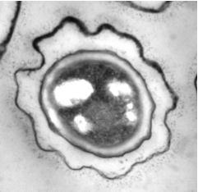
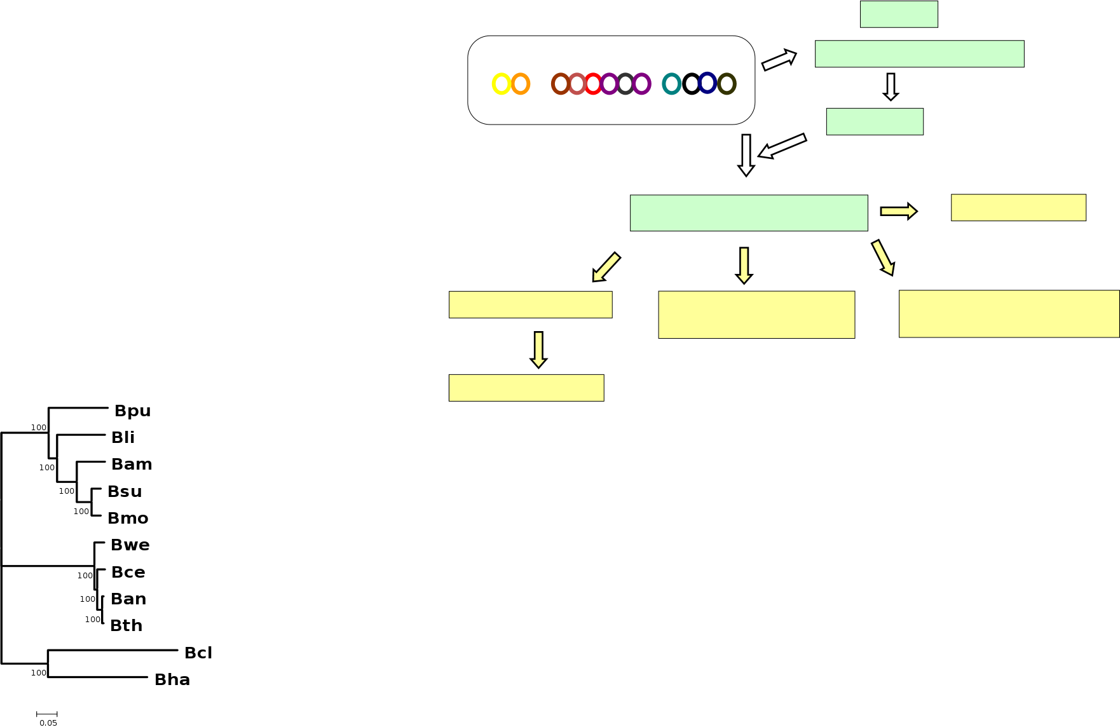
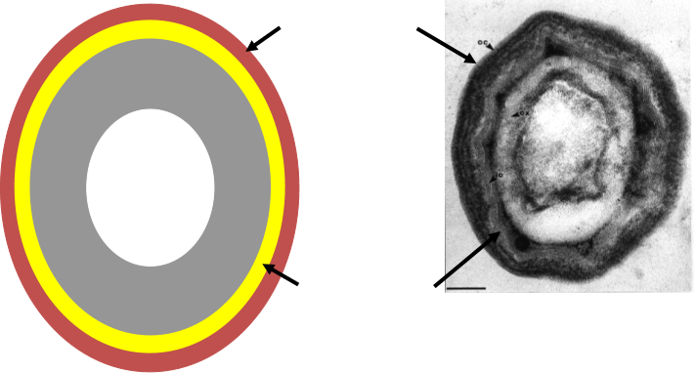
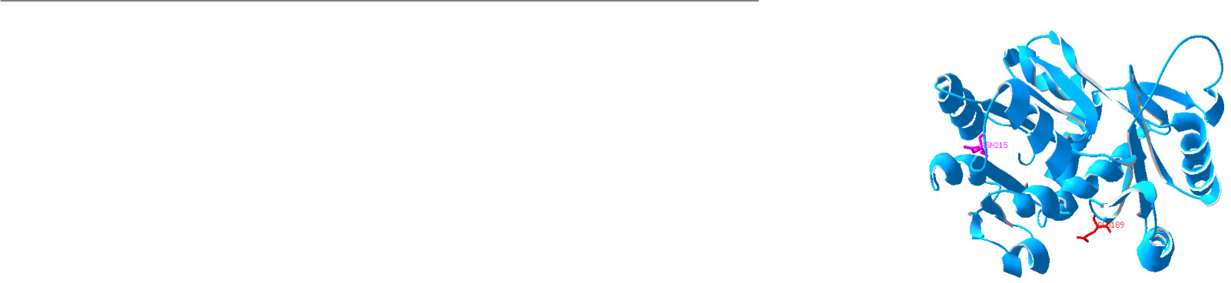
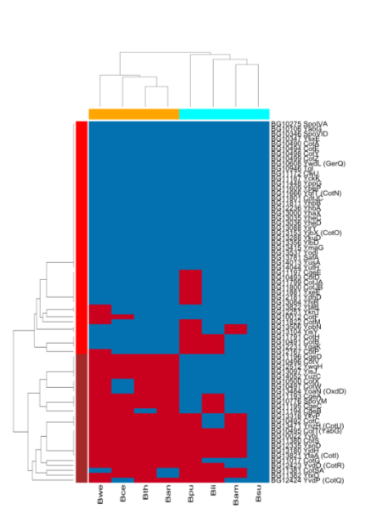
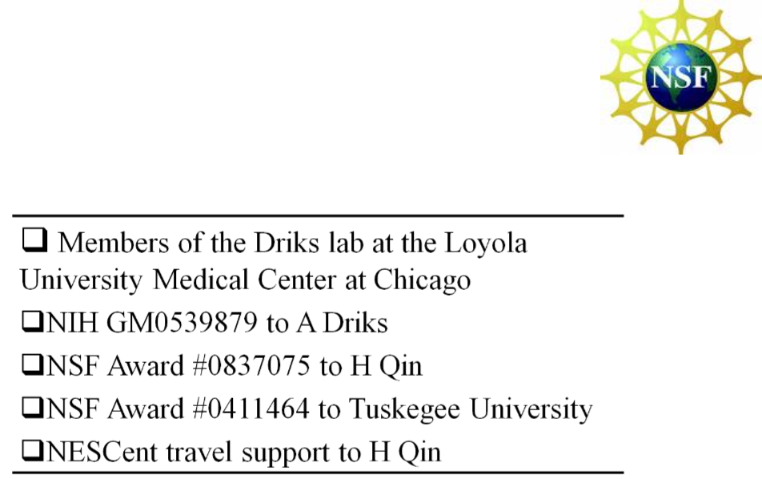

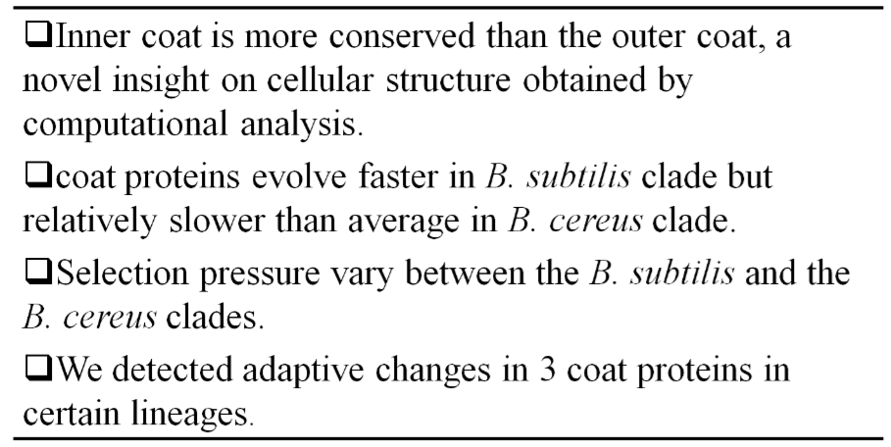


Phylogenomic insights into the evolution the Bacillus spore coat
Hong Qin¹, Adam Driks²
1 Spelman College, 2 Loyola University at Chicago
Bacteria of the genus Bacillus can produce a specialized, highly resistant cell type called a spore under stressful conditions. The coat is a protective layer of the spore comprised of many protein components. Here, we study the evolution of these coat proteins to investigate whether diversity of coat morphology among Bacillus species is related to the evolutionary patterns of their protein components. We curated a list of spore coat proteins in the Bacillus subtilis genome and then identified their orthologs in 9 other Bacillus genomes based on phylogeny. By comparing the phylogenetic profiles between coat proteins and essential genes, we found that coat proteins are evolutionarily more labile than essential proteins. The proteins of the inner layer of the B. subtilis coat are more conserved than those of the outer layer. This is especially interesting given that the inner and outer layers are assembled under the control of different mechanisms and may have distinct functions. By comparing the ratio of non-synonymous and synonymous substitution rates, we found that coat proteins evolve faster than the rest of genomes in B. subtilis and its close relatives and evolve relatively slower than average in a distinct group of species, those of the so-called “B. cereus” group, which includes B. anthracis. Selection pressure between the subtilis and the cereus clades are significantly different among many genes, including coat proteins. We identified a few candidate genes under positive selection in certain lineages. Our phylogeny based ortholog identification also detected misannotations in the genomes, including the coat protein CotS. Overall, our study offers interesting insights from the evolutionary perspective on the organization and function of the spore coat and raises interesting links between coat proteins and organism’s ecological niches.
Pairwise comparisons of 10 complete genomes:
Coat proteins evolves faster in subtilis clade but slower than average in the cereus clade.
Conserved proteins tend to be in the inner coat, and labile proteins tend to be in the outer coat.
Table Locations of the evolutionarily conserved and labile proteins
Slow
p-value
Fisher’s exact test, p-value = 0.025
Fast
ω_{S}
ω_{S}
ω_{S}
ω_{S}
ω_{S}
H0: ω_{O}= ω_{S} = ω_{C}
ω_{O}
ω_{S}
ω_{S}
Proteins
Inner Coat
Outer Coat
H1c: ω_{O}= ω_{S} ≠ ω_{C}
H2: ω_{O}≠ ω_{S} ≠ ω_{C}
67
Conserved in the cereus group
17
8
16
Bacillus groups
Labile in the cereus group
6
ω_{C}
H1s: ω_{O}= ω_{C} ≠ ω_{S}
3
Subtotal
ω_{C}
12
Exosporium
23
20
ω_{C}
H2: ω_{O}≠ ω_{S} ≠ ω_{C}
d.f.=1
Coat
ω_{C}
ω_{C}
ω_{C}
H1c: ω_{O}= ω_{S} ≠ ω_{C}
6 32 19
H1s: ω_{O}= ω_{C} ≠ ω_{S}
ω_{C}
80
75
273
5 3
B. subtilis
B. cereus
H0: ω_{O}= ω_{S} = ω_{C}
d.f.=1
Spores in B. subtilis group lacks exosporium.
182
973
9
Outer Coat
16s rDNA
Differential evolution between B. subtilis and B. cereus clades:
LRT of nest ed-models on gene families. Gray circles are coat genes, and
dash-lined circles are essential genes.
subtilis group
Orthologs of essential genes
outgroup
cereus group
Species tree
Adaptive change of YhaX in the Bwe lineage
Core
lnL
-5636.2
-5635.4
-5632.8
-5632.8
Potential sites under positive selection
Cortex
Inner Coat
Orthologs of coat genes
Adaptive changes
H0:
ω_{O}= ω_{OC} = ω_{C} = ω_{bce}= ω_{bwe}
H1c:
ω_{O}= ω_{OC} = ω_{C} = ω_{bwe} ≠ ω_{bce}
Bacillus spore coat organization
Phylogenetic profiling
Evolutionary rates
Genome-wide comparison
Differential selection
b/w subtilis and cereus clades
H1w:
ω_{O}= ω_{OC} = ω_{C} = ω_{bce}≠ ω_{bwe}
p=0.0099, df=1,
ω_{bwe}=[63.5, 589.6] 95% CI
Inner and outer coat
Work flow
H2Cw:
ω_{O}≠ ω_{OC} =ω_{C} = ω_{bce} ≠ ω_{bwe}
Hit
Summary
Acknowledgement
No Hit
Conserved coat proteins
Labile coat proteins
Species tree based on concatenated essential genes
Phylogenetic profiles of coat proteins

