Slide 1

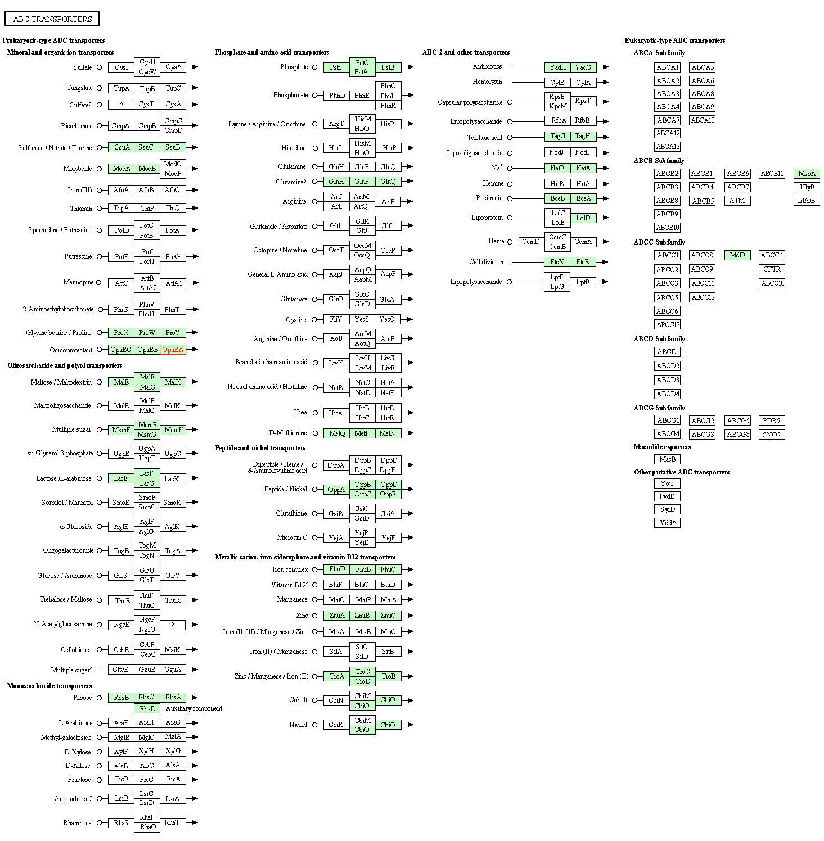
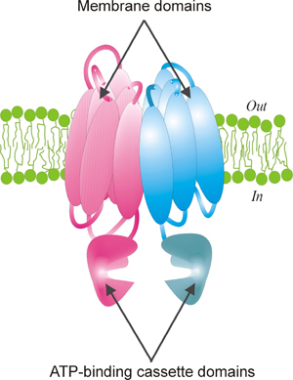
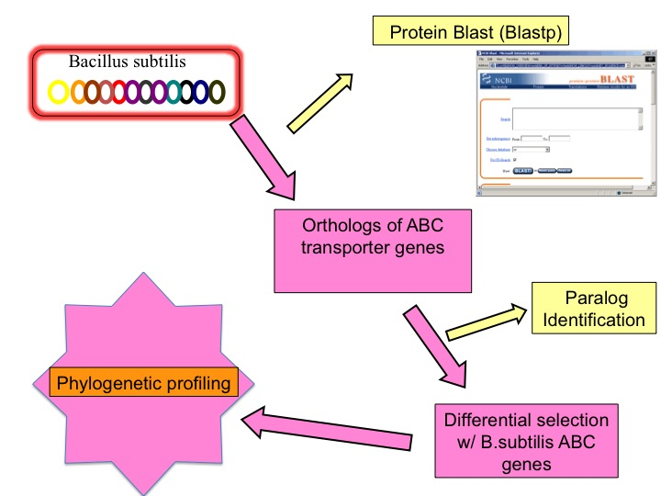
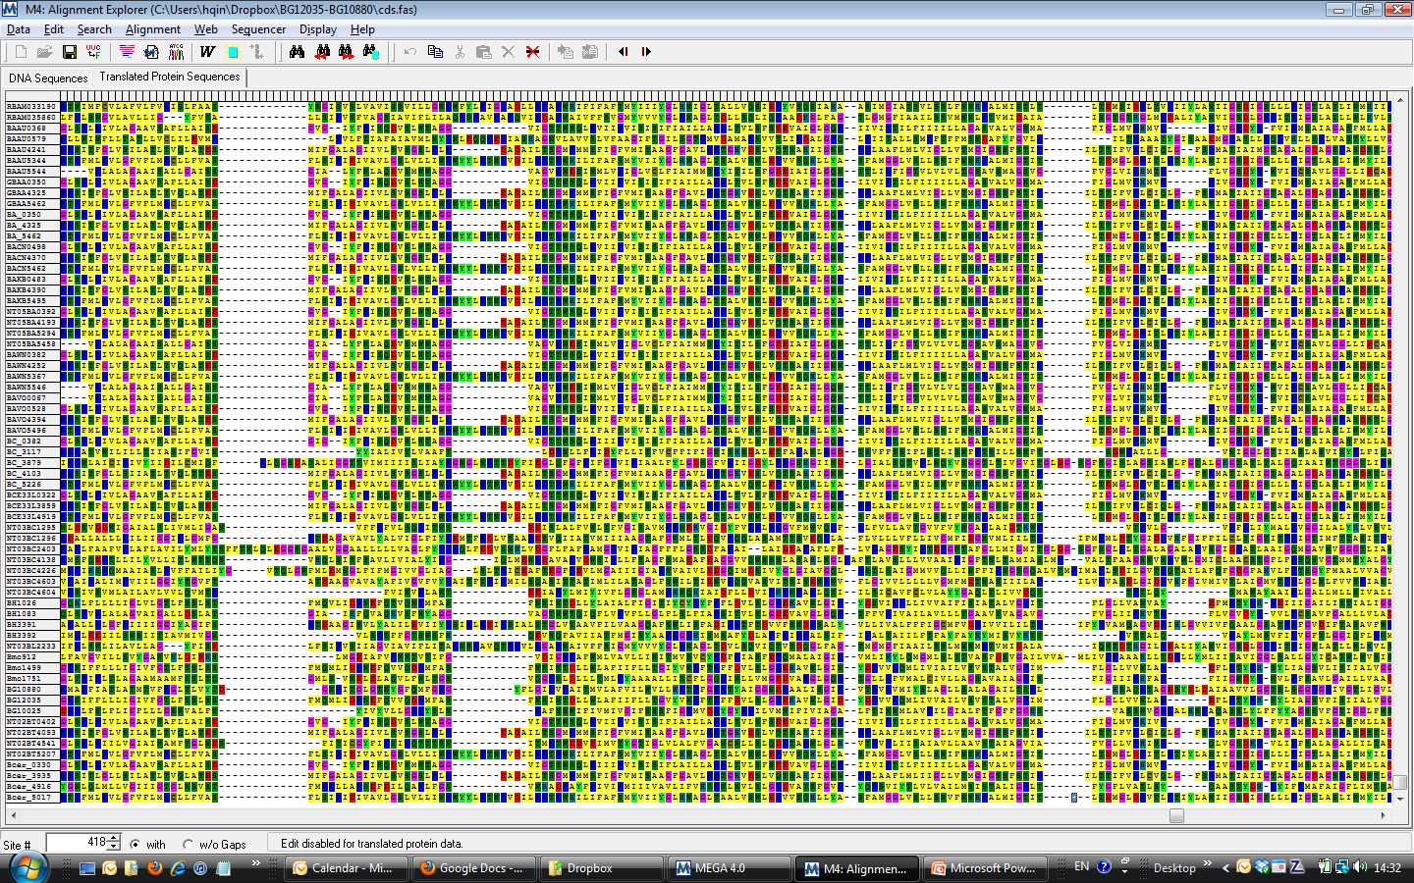
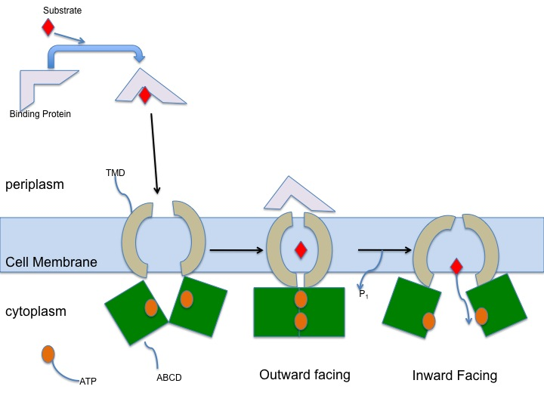
Molecular Evolution in Bacillus ABC Transporter Genes
Joi Gaddy, Hong Qin, Spelman College
Abstract
ABC genes in Bacillus subtilis
Methods and Materials
Our purpose is to compare the molecular evolution of ABC genes to identify the paralogs and orthologs linked. ABC systems (ATP-binding cassette systems) are subfamilies of transmembrane proteins responsible for the transportation of molecules throw a cellular membrane. There are approximately three hundred and twenty four well-researched ABC system genes in Bacillus subtilis. The occurrence of disease and multidrug resistance in ABC systems is explained through the association of paralogs and orthologs to a genome sequence. Closely related orthologs show commonalities and likelihood in DNA sequences. Identifying the close characteristics in ABC systems within orthologs will help complete a taxonomic classification and phylogeny tree for ABC transporter genes in Bacillis subtilis. All sequenced ABC genes are collected from KEGG (Genes Database). NCBI Blastp program compares the protein sequences with the NCBI protein database to find related paralogs and orthologs. Through a computer software program called PAML (Phylogentic Analysis by Maximum Likelihood), we will study the molecular evolution of ABC systems in Bacillus subtillis. PAML will provide for phylogenetic analysis of protein sequences by using maximum likelihood for comparison, while also taking into account the changes in a sequence due to synonymous and nonsynonymous substitution rates. Grasping the molecular evolution of ABC genes will assist in the comprehension of ABC systems, and in turn discover more about the multidrug resistance and related-diseases.
Figure 3
Figure 4
Sequences
We analyzed ATP binding cassette transporter genes in the Bacillus subtilis genome to discover the likelihood of three ABC genes; BG10880, BG10025, and BG12035. Figure 4 displays the analyzed ABC genes in Bacillus subtilis to observe their comparisons to each other. rRNA sequences were aligned based on structural information using the Ribosomal Database Project II (http://rdp.cme.msu.edu/).
Orthologus Identification
For othologous identification, we performed BLASTP to find the potential homologs. An E-value cutoff of 1/5000 was used to identify the false positives in the bacterial genome. We anticipate there to be one false positive per bacterial genome. Through Markov clustering, we were able to identify potential orthologs. Orthologs and paralogs were distinguished through comparing the joining branches of the candidate ortholog to the species trees and its alternative trees. The alternative species trees are chosen by the AU-test in CONSEL. A topological comparison of species trees was completed by the ‘treedist’ in MEGA.
Implementation
Statistical analysis and data visualization were performed in the R language and environment. Phylogenies were created by neighbor-joining and evaluated by joining branches of ‘treedist’ in MEGA. Visualization of phylogeny was done using MEGA. Nested model tests on adaptive changes were produced by using PAML. Initial clustering of sequence was done using PERL and MCL scripts. Protein statistics were calculated by pepstats from EMBOSS. Handling of the sequences and automation were controlled through the Python software.
Figure 4 represents the Phylogeny of a ferrichrome permease family.
ABC Transporter Protein
Results
Figure 1
Figure 5
Figure 7: Simulated diagram of research methods
Introduction
Figure 1:www-medchem.ch.cam.ac.uk
ATP-binding cassette systems (ABC systems) are a family of proteins responsible for the transportation of molecules across a cellular membrane found in prokaryotes, eukaryotes, and archea. They contain periplasmic-binding proteins, membrane transporter, and ATP-hydrolyzing proteins. ABC systems use ATP (adenosine triphosphate) to import and export organic compounds such as sugars and amino acids, as well as inorganic compounds such as sulfate, phosphate, lipids, and sterols through the cell. The transportation of these proteins are vital because they regulate cellular lifestyle, survival, nutrients. ABC systems are represented in all non-extinct phyla, making them one of the largest protein superfamilies. The proteins in ABC systems are transmembrane proteins; they extend through the entire cellular membrane. These proteins are linked with multidrug resistance and diseases. Understanding these proteins and their functions on a molecular basis serve as a foundation for drug therapies and treatments.
ABC transporters have a usual high affinity for substrates of the periplasmic-binding proteins, explaining their potential for substrate binding even in low concentrations. Through energy yielded from ATP, periplasmic-binding proteins works with the membrane transporter protein to transport the bound substrate. These hydrophilic substrates are protected by ABC transporters from destruction via lipids in the bilayer membrane.
The transportation of substrates across a given membrane is very important due to the necessity of the molecule. Transporter proteins are vital in cell survival because they provide the cell with everything that they need and maintain substrate equilibrium within the cell.
Figure 5 is a screen-captured photo of the sequence alignment for ABC systems. The purpose of sequence alignment is to show regional similarities in DNA, RNA, proteins, genes, amino acids. This figure displays the sequence alignment for ABC transporter amino acids for the genes BG10880, BG10025, BG12035. Specifically, it shows the largest amount of shared amino acids. Understanding aligned sequences between related species can show structural, functional, evolutionary similarities.
Discussion
The purpose of this research is to compare the molecular evolution of associated ABC transporter genes in Bacillus subtilis. Our results proved that there was no significant difference between the homogeneous evolution and heterogeneous evolution. Though our research proved the similar relationship between the associated ABC transporter genes, computational errors could have occurred yielding a small possibility for variation within the results. Alignment with so many genes may have poor quality which blur the differences between homogenous and heterogeneous evolutionary models. Ortholog identification is done by Markov Clustering methods, with a relatively less stringent criteria. So, maybe there are too many false positives in the orthologs that we identified. Markov Clustering is designed to compare group parameters. There is also the possibility that heterogeneous evolution occur in some lineages that we have not considered.
 | Log Likelihood
H0 (Homogenous evolution) | -44204.33
H1(Hetrogeneous evolution) | -44204.29
Figure 6
Figure 6 shows the Log Likelihood for Homogeneous evolution (H0) and Heterogeneous evolution (H1). Log Likelihood explains the statistical model and its parameters. It explains the probability that a set of values based on observed outcomes will equal the actual values. This is a method of estimating the parameter for a set of statistics. The closely related log likelihood values shows the similarity between homogenous and heterogeneous evolution; they are almost identical. The p-value for these parameters are are unnecessary because the value would be extremely close to zero.
References
Summary
1. Chang, et al . "Structure of MsbA from E.coli: A Homolog of the Multidrug Resistance ATP Binding Cassette (ABC) Transporters." Scence 293 (2001): 1793-800.
2. Davidson, et al . "Structure, Function, and Evolution of Bacterial ATP-Binding Cassette Systems." Microbiology and Molecular Biology Reviews 2nd ser. 72 (2008): 317-64.
3. Jones, P. M., and A. M. George. "The ABC Transporter Structure and Mechanism: Perspectives on Recent Research." Cellular and Molecular Life Sciences 61 (2004): 682-99. Springerlink. Web.
4. Tusnady, Gabor, Eva Bakos, Andras Varadi, and Balazs Sarkadi. "Membran Topology Distinguishes a Subfamily of ATP-binding Cassette (ABC) Transporters." FEBS Letters 3rd ser. 402.1 (1997). Web.
How ABC Systems Work:
In summary, after comparing the amino acid sequences of three ABC transporter genes BG10880, BG10025, an BG 12035, we were able to identify the molecular evolution of these genes. Understanding the molecular evolution will display the ortholog and paralogs of related genes. The orthologs and paralogs can be used to observe functional, structural, and evolutionary similarities between ABC transporter genes. We did not detect significant difference between homogenous evolution and heterogeneous evolutionary models.
Figure 2
Acknowledgements
Spelman College ASPIRE Seed Grant
Spelman College Biology Department
Dr. Hong Qin, Spelman College

