Slide 1
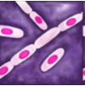

Phylogenomic insights on the Bacillus spore coat
Hong Qin
March 2009

Slide 2
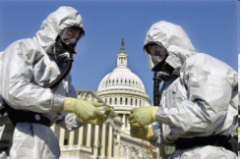
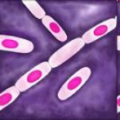


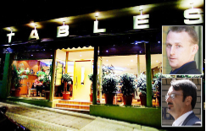


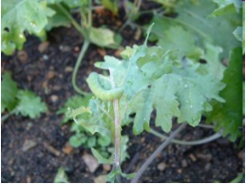
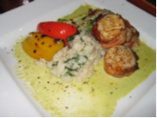
Motivations
Biodefense
B. anthracis
Cell Biology
B. subtilis
Food Safety
B. cereus
Environment, Agriculture
B. thuringiensis
Notes:
Fish of the day sauce a killer
Posted on June 30, 2008 by Doug Powell
The Sydney Morning Herald reports that coroner Jane Culver has found that a Sydney restaurant served asparagus sauce contaminated with bacteria in January last year, leading to the death of William Hodgkins, 81, because of slack procedures in its handling of the sauce.
http://images.google.com/imgres?imgurl=http://barfblog.foodsafety.ksu.edu/asparagus.cream.sauce.jpg&imgrefurl=http://barfblog.foodsafety.ksu.edu/tags/bacillus-cereus/&usg=__c_kt9h5hKE7ew59Xr_ACP34uhDI=&h=768&w=1024&sz=85&hl=en&start=13&um=1&tbnid=JZNXLZN1kYlxQM:&tbnh=113&tbnw=150&prev=/images%3Fq%3Dbacillus%2Bcereus%2Bfood%26um%3D1%26hl%3Den%26client%3Dfirefox-a%26rls%3Dorg.mozilla:en-US:official%26sa%3DG

Slide 3
Outline
Bacillus spores and their coat structure
Phylogenomic views of the spore coat
  Ortholog identification by phylogeny
  Overall patterns
  Inner and outer coat
  Evolutionary rate of the coat proteins
  Difference between the subtilis and cereus clades
  Adaptive changes
Summary
Notes:
Ecological niche and life style
Implication on anthrax

Slide 4
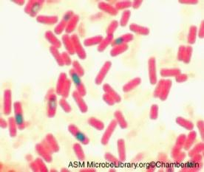
Bacillus
  A genus of bacteria
  Spore-forming
  Ubiquitous
  Major groups:
    Bacillus subtilis group
    Bacillus cereus group
    Others

Slide 5

Species groups in Bacillus
  B. subtilis group
B. subtilis, B. licheniformis, B. pumilus,
B. amyloliquefaciens, B.mojavensis
  B. cereus group
B. cereus, B. anthracis, B. thuringiensis,
B. weihenstephanesis
  Others
B. halodurans, B. clausii
Nice guys
Nice guys
Bad guys
Bad guys
Bad guys
Strange guys
Strange guys
Strange guys

Slide 6
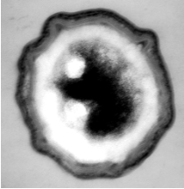

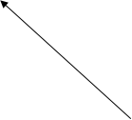

Wonder of the microbial world ― the spores
Toxic small molecules, microbial predation, toxic large molecules
Coat
Spore of B. subtilis
Heat, organic solvents, osmolarity
Heat, destructive chemical reactions, pH, ionic strength
Notes:
When NASA send land rovers to MARS, they were afraid that bacillus spores could potentially pollute the planet of Mars.

Slide 7

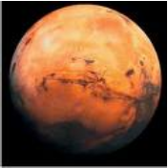

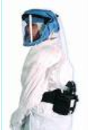

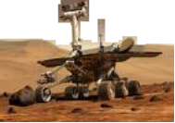
Spores can survive space travel.
I want to go to Mars.
No, you can’t.
Notes:
How could spores do that?
Spores shown to survive the acceleration, shock, and heating of simulated impact mediated launch (Horneck et al. 2001, Mastrapa et al. 2001, Burchell et al. 2004) and years of exposure to the space environment in low-Earth orbit (Horneck 1993, Rettberg et al. 2002)

Slide 8



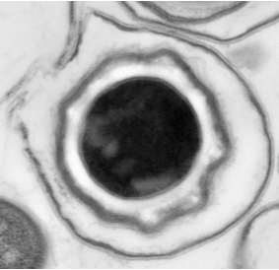
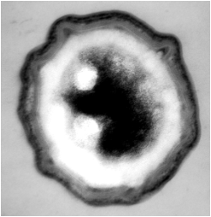

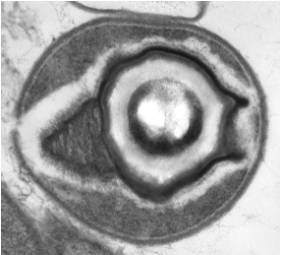

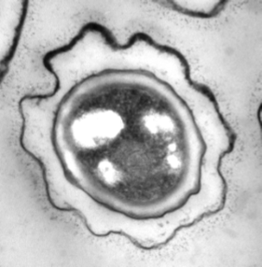

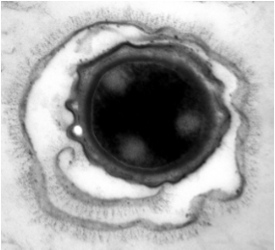

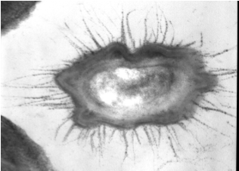
Morphological diversity of Bacillus spores
Exosporium
Coat
B. subtilis
B. odysseyi
Br. laterosporus
B. cereus
B. anthracis
B. clausii
Notes:
Exosporium are not found in the B. subtilis group.
Go over reviews.
Brevibacillus laterosporus

Slide 9

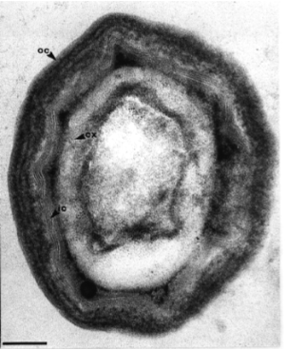






Structure of the B. subtilis spore
Outer Coat
Core
Cortex
Inner Coat
Notes:
Add label to the right.

Slide 10


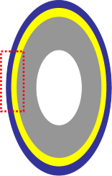

Protein composition of the inner and outer coat
Outer coat
Inner coat
CotH
CotG
CotC
CotO
CotW
CotZ
CotA
CotU
CotI
…
YutH
CotJ
CotO
SafA
CotD
CotO
YisY
YmaG
YbhI
…
CotB
CotE
SpoIVA
Coat proteins mediate the interaction between spore and its environment, but function of coat proteins are difficult to study experimentally.
Kim et al 2005 Molecular Microbiology
Notes:
We need computational analyses and inferences.

Slide 11
Why do we study the evolution of the coat protein?
  Evolution ~ ecological niches and life styles.
    Pathogenic life style of the B. cereus group
    Adaptive changes ~ unique ecological niches
  Evolution of coat proteins may shed lights on the organization of the spore coat.
    Inner and outer coat; scaffolding; regulation etc.
  Provide new directions for experimental biologists.

Slide 12
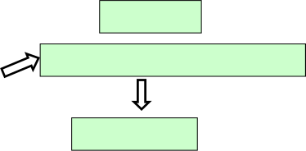

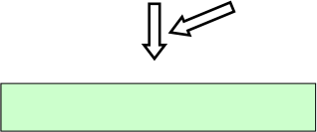


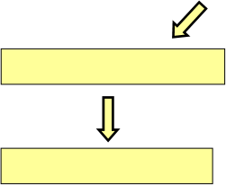
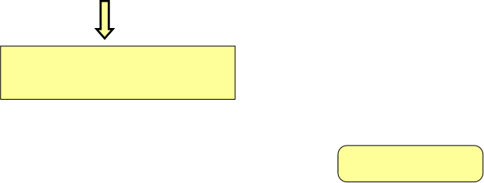
The Plan
16s rDNA
subtilis group
Orthologs of essential genes
outgroup
cereus group
Species tree
Orthologs of coat genes
Adaptive changes
Phylogenetic profiling
Evolutionary rates
Genome-wide comparison
Differential selection
b/w subtilis and cereus clades
Inner and outer coat
Main Findings

Slide 13
Outline
Bacillus spores and their coat structure
Phylogenomic views of the spore coat
  Ortholog identification by phylogeny
  Overall patterns
  Inner and outer coat
  Evolutionary rate of the coat proteins
  Difference between the subtilis and cereus clades
  Adaptive changes
Summary
Notes:
Ecological niche and life style
Implication on anthrax

Slide 14
How to infer species tree?
  Ribosomal RNA approach.
Not powerful in bacteria
  Multi-locus approach.
    Concatenated gene approach
      Recommended by Rannala & Yang 08
    Consensus tree approach
      Problematic due to heterogeneous rates

Slide 15
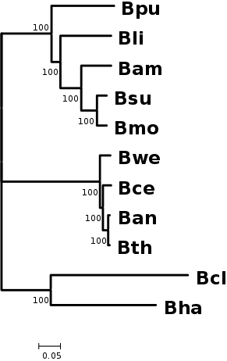
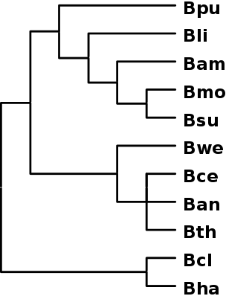

Species trees for Bacillus genomes
Concatenated 34 essential genes
Resolved, 100% bootstrap support.
Partially resolved 16s rRNA tree
Notes:
11302aa in the multi-locus tree

Slide 16
Orthologous identification
  What are orthologs?
Genes in different species that share the same the same gene in their common ancestral species (Fitch, 2000).
  Why orthologs?
    Orthologs likely share similar functions.

Slide 17









Identification of Orthologs
Pairwise BLASTP
of 11 genomes
Reciprocal best hits
Reciprocal best hits
MCL
MCL
16s rDNA and
Concatenated essential Genes
Combined hits
Neighbor-joining trees
of coat protein sequences
Species tree
(NJ,MP,ML, bootstrap)
Bootstrap
Tree comparison
Remove inconsistent hits
Orthologous groups
Notes:
Enlarge, different colors, hightlights

Slide 18
Why bother with phylogeny?

Slide 19

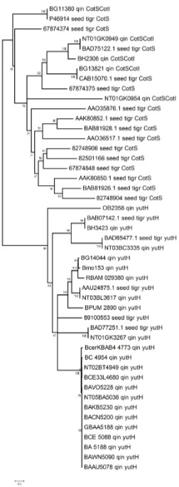


Correction of annotation errors for CotS-yutH family
CotS
yutH
Annotated as CotS in NCBI and TIGR

Slide 20
Outline
Bacillus spores and their coat structure
Phylogenomic views of the spore coat
  Ortholog identification by phylogeny
  Overall patterns
  Inner and outer coat
  Evolutionary rate of the coat proteins
  Difference between the subtilis and cereus clades
  Adaptive changes
Summary
Notes:
Ecological niche and life style
Implication on anthrax

Slide 21
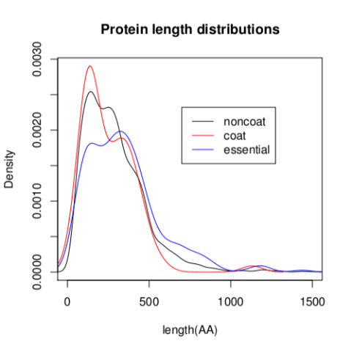
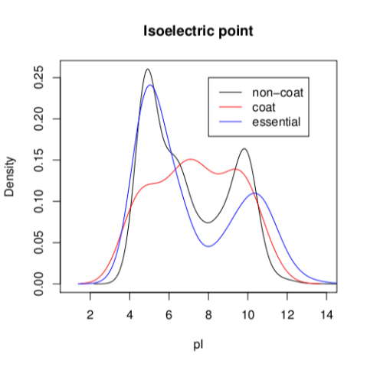


General characteristics of coat proteins
Shorter in length
More neutrally-charged
Notes:
Coat genes are shorter in length (wilcoxon test, p 0.05)
Distribution of pI in of proteins in B. subtilis. The density is calculated using a Gaussian kernel. The non-coat and essential proteins show a bi-modal pI distribution, whereas pI distribution of the coat proteins is more complicated.

Slide 22
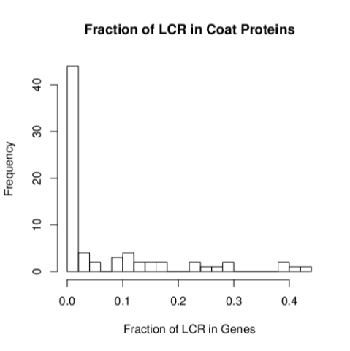
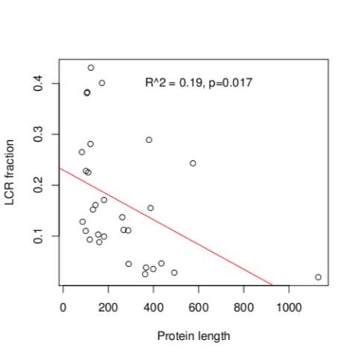


General characteristics of coat proteins
Coat proteins have many repeats
More repeats in shorter proteins

Slide 23
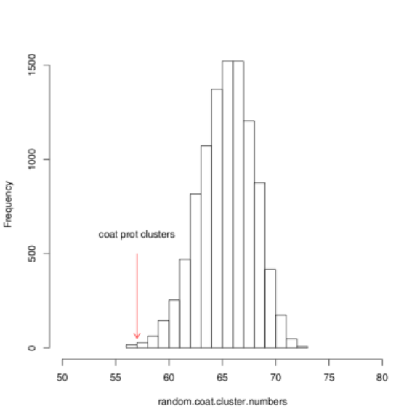
Coat proteins tend be encoded in gene clusters.
p-value=0.0015
Notes:
Test by permutation. This is B. subtilis genome.

Slide 24
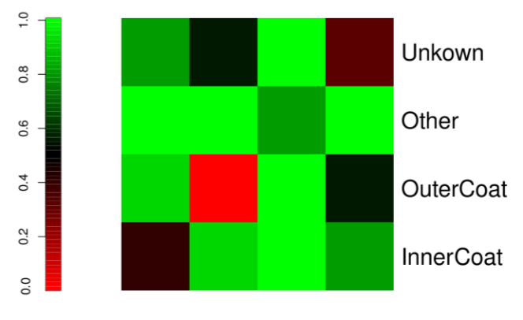
Proteins in outer coat tend to be in the same clusters.
p-value
Notes:
B. subtilis genome. P-values are calculated from 10K permutations.

Slide 25
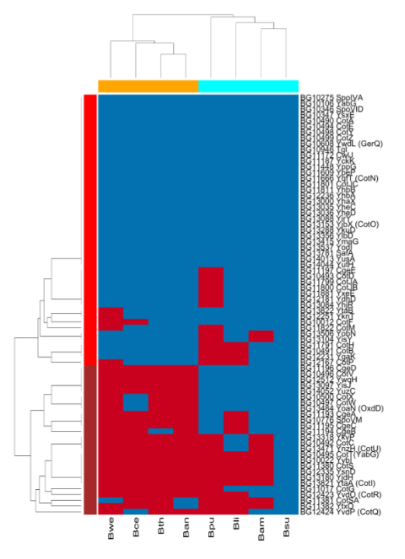

Phylogenetic profiles of coat proteins
Conserved coat proteins
Hit
No Hit
Labile coat proteins

Slide 26
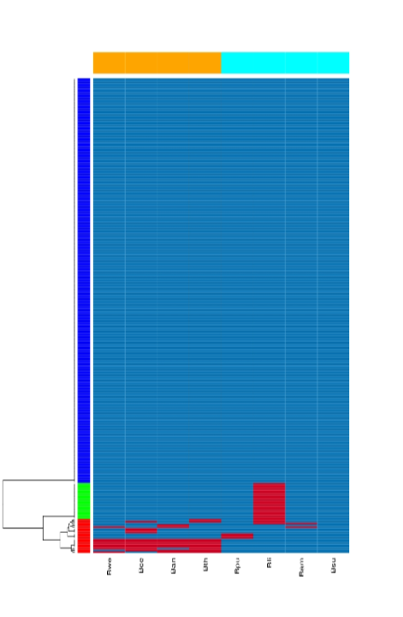
Phylogenetic profiles of essential genes
Hit
No Hit

Slide 27
Outline
Bacillus spores and their coat structure
Phylogenomic views of the spore coat
  Ortholog identification by phylogeny
  Overall patterns
  Inner and outer coat
  Evolutionary rate of the coat proteins
  Difference between the subtilis and cereus clades
  Adaptive changes
Summary
Notes:
Ecological niche and life style
Implication on anthrax

Slide 28
Do inner and outer coat evolve differently?
Are orthologous profiles associated with protein locations in the spore coat?
Notes:
Are orthologous profiles associated with protein locations in the spore coat?

Slide 29

Inner coat is more conserved than the outer coat.
Table Orthologous hits of the B. subtilis coat proteins in the cereus group.
Comparison
Inner Coat
Outer Coat
p-value
Bsu vs Ban
Hits
18
11
0.097
(Fisher’s exact test)
No-Hits
5
9
Bsu vs Bwe
Hits
18
8
0.012
(Fisher’s exact test)
No-Hits
5
12
Bsu vs Bth
Hits
17
10
0.096
(Fisher’s exact test)
No-Hits
6
10
Bsu vs Bce
Hits
17
14
0.52
(Fisher’s exact test)
No-Hits
6
6
Bsu vs
the cereus group
Mean # of Hits
3.1 ± 1.7
2.1 ± 1.8
0.039
(t-test)
Notes:
What if we use the ‘labile” group? Smaller p?

Slide 30
Conserved proteins tend to be in the inner coat, and labile proteins tend to be in the outer coat.
Proteins
Inner Coat
Outer Coat
Conserved in the cereus group
17
8
Labile in the cereus group
6
12
Subtotal
23
20
Table Locations of the evolutionarily conserved and labile proteins
Fisher’s exact test, p-value = 0.025
Notes:
What if we use the ‘labile” group? Smaller p?
What are “conserved” and “labile” coat proteins?

Slide 31



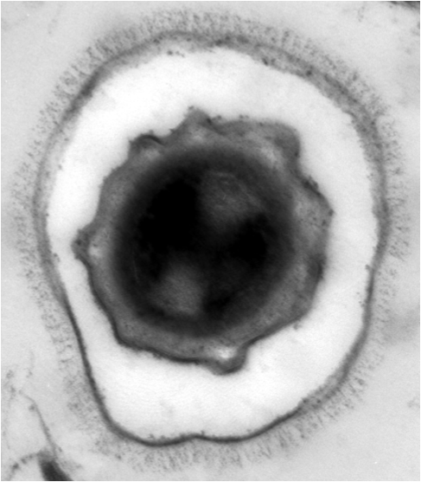

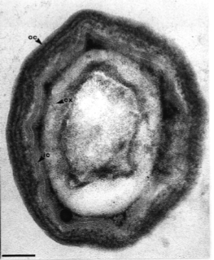

B. anthracis
Exosporium
B. subtilis
Coat

Slide 32
Outline
Bacillus spores and their coat structure
Phylogenomic views of the spore coat
  Ortholog identification by phylogeny
  Overall patterns
  Inner and outer coat
  Evolutionary rate of the coat proteins
  Difference between the subtilis and cereus clades
  Adaptive changes
Summary
Notes:
Ecological niche and life style
Implication on anthrax

Slide 33
Do coat proteins evolve differently?
Changes in selection pressures may be associated with functional changes.
Notes:
Ecological niche and life style
Implication on anthrax

Slide 34
Measure of selection pressure in protein-coding genes
  Synonymous substitutions
Nucleotide changes that do not change amino acids.
A proxy of mutation background.
  Nonsynonymous substitutions
Nucleotide changes that also change the amino acids.
Notes:
Ecological niche and life style
Implication on anthrax
Proxy of mutation rate

Slide 35

Positive and negative selections
Positive: non-synonymous rate > synonymous rate
Neutral: non-synonymous rate = synonymous rate
Negative: non-synonymous rate < synonymous rate
Positive selection requires “new” sequences (mutations);
Negative selection preserves “old” sequences.
Notes:
Ecological niche and life style
Implication on anthrax

Slide 36


Selection can influence the chance of mutation be observed (fixed).
selection
50%
50%

Slide 37
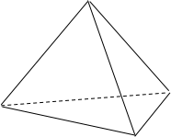
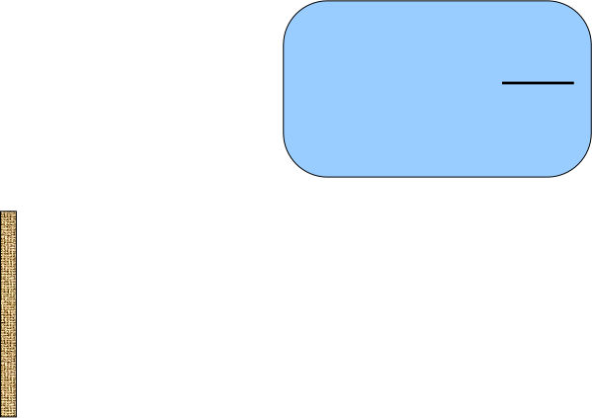

Selection can influence the chance of mutation be observed (fixed).
C
dN
T
Selection
pressure
ω =
A
dS
G
50%
50%
Positive selection
Synonymous
Nonsynonymous
dS
dN
Negative selection

Slide 38
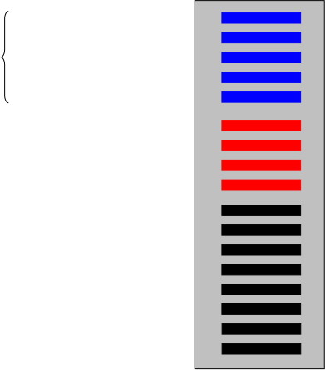

Whole-genome pairwise gene comparison
Coat
Genes
dN
ω =
Essen.
Genes
dS
Noncoat
Genes
Genome A
Genome B

Slide 39
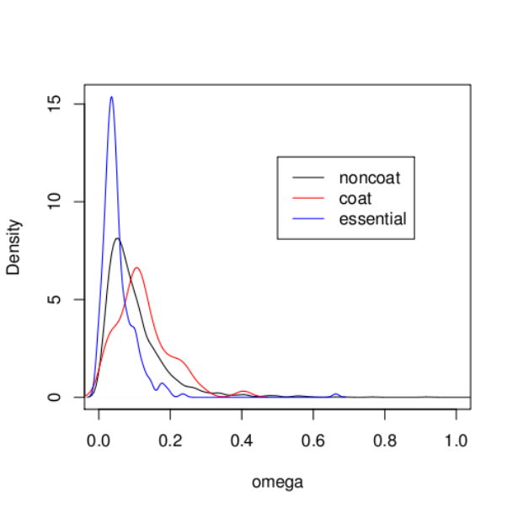

Coat protein evolves faster that others
― Comparison between B. subtilis and B. amyloliquefaciens
p=0.0007

Slide 40
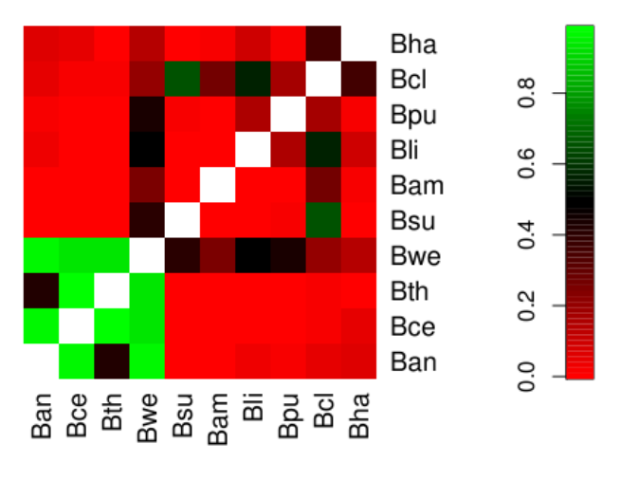
Pairwise comparisons of 10 complete genomes:
Coat proteins evolves faster in subtilis clade but slower than average in the cereus clade.
Slow
p-value
Fast
Notes:
B. subtilis group
B. subtilis, B. licheniformis, B. pumilus, B. amyloliquefaciens, B.mojavensis
B. cereus group
B. cereus, B. anthracis, B. thuringiensis, B. weihenstephanesis
Others
B. halodurans, B. clausii

Slide 41
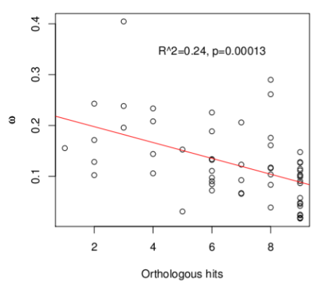
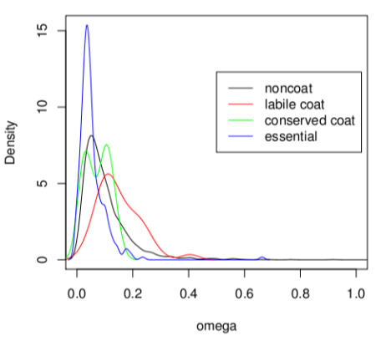


Evolutionarily labile genes largely account for higher omegas of coat genes in the subtilis clade.
Comparison between B. subtilis and B. amyloliquefaciens
Notes:
― Comparison between B. subtilis and B. amyloliquefaciens

Slide 42
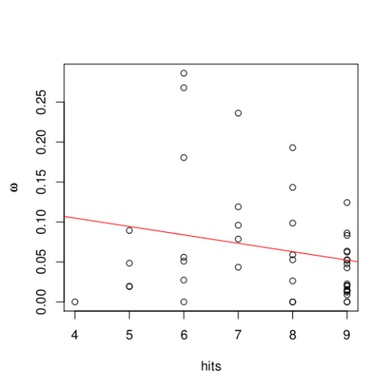
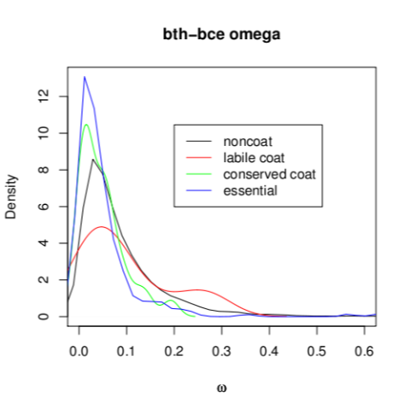

Conserved coat genes largely account for lower omegas in coat genes in Bth-Bce comparison

Slide 43
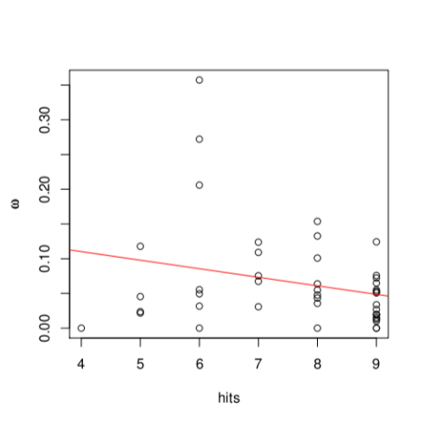
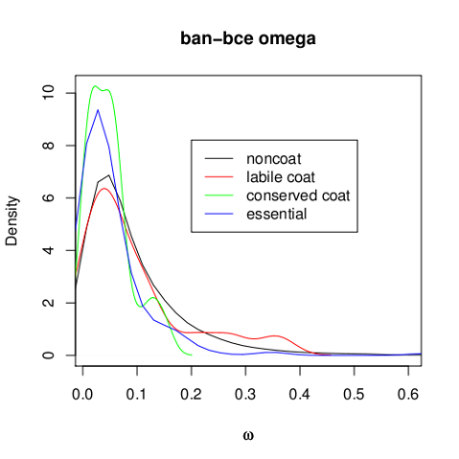

Conserved coat genes largely account for lower omegas in coat genes in Ban-Bce comparison
R²=0.067 p=0.086

Slide 44
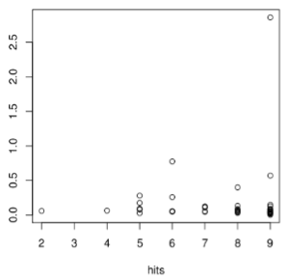
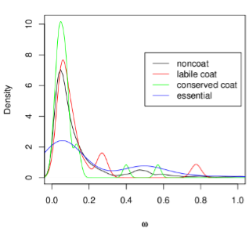


Faster genome evolution may account for the slower coat evolution in Bwe.
YhaX
noncoat
Comparison between Bce and Bwe.
Notes:
weihenstephanesis

Slide 45
Outline
Bacillus spores and their coat structure
Phylogenomic views of the spore coat
  Ortholog identification by phylogeny
  Overall patterns
  Inner and outer coat
  Evolutionary rate of the coat proteins
  Difference between the subtilis and cereus clades
  Adaptive changes
Summary
Notes:
Ecological niche and life style
Implication on anthrax

Slide 46
Do genes evolve differently between the subtilis and cereus clades?
Likelihood ratio test of nested models

Slide 47

Nested Branch-models (I)
ω_{S}
ω_{S}
ω_{S}
ω_{S}
ω_{S}
H0: ω_{O}= ω_{S} = ω_{C}
ω_{S}
ω_{O}
ω_{S}
H1c: ω_{O}= ω_{S} ≠ ω_{C}
ω_{C}
H1s: ω_{O}= ω_{C} ≠ ω_{S}
ω_{C}
ω_{C}
ω_{C}
H2: ω_{O}≠ ω_{S} ≠ ω_{C}
ω_{C}
ω_{C}
ω_{C}

Slide 48




Significant difference of between subtilis and cereus clades: Likelihood ratio tests (FDR=0.05)
H2: ω_{O}≠ ω_{S} ≠ ω_{C}
107 conserved genes
3 coat genes
17 essential genes
d.f.=1
d.f.=1
H1c: ω_{O}= ω_{S} ≠ ω_{C}
452 conserved genes
6 coat genes
41 essential genes
H1s: ω_{O}= ω_{C} ≠ ω_{S}
464 conserved genes
9 coat genes
54 essential genes
d.f.=1
d.f.=1
H0: ω_{O}= ω_{S} = ω_{C}
1327 conserved genes
20 coat genes
196 essential genes
Notes:
Bonferroni correction gave similar results.

Slide 49
Outline
Bacillus spores and their coat structure
Phylogenomic views of the spore coat
  Ortholog identification by phylogeny
  Overall patterns
  Inner and outer coat
  Evolutionary rate of the coat proteins
  Difference between the subtilis and cereus clades
  Adaptive changes
Summary
Notes:
Ecological niche and life style
Implication on anthrax

Slide 50


Where did positive selection occur?
YhaX ω=2.7
?
?
Bce
Bwe
Notes:
Coat Gene YhaX BG13000

Slide 51

Nested Branch-models (II)
ω_{O}
H0:
ω_{O}= ω_{OC} = ω_{C} = ω_{bce}= ω_{bwe}
ω_{O}
ω_{O}
ω_{O}
ω_{O}
ω_{O}
H1c:
ω_{O}= ω_{OC} = ω_{C} = ω_{bwe} ≠ ω_{bce}
ω_{O}
ω_{O}
ω_{bwe}
ω_{O}
ω_{bce}
H1w:
ω_{O}= ω_{OC} = ω_{C} = ω_{bce}≠ ω_{bwe}
ω_{OC}
ω_{C}
ω_{C}
ω_{C}
H2Cw:
ω_{O}≠ ω_{OC} = ω_{C} = ω_{bce} = ≠ ω_{bwe}

Slide 52
Adaptive change of YhaX in the Bwe lineage
lnL
-5636.2
-5635.4
-5632.8
-5632.8
H0:
ω_{O}= ω_{OC} = ω_{C} = ω_{bce}= ω_{bwe}
H1c:
ω_{O}= ω_{OC} = ω_{C} = ω_{bwe} ≠ ω_{bce}
H1w:
ω_{O}= ω_{OC} = ω_{C} = ω_{bce}≠ ω_{bwe}
p=0.0099, df=1,
ω_{bwe}=[63.5, 589.6] 95% CI
H2Cw:
ω_{O}≠ ω_{OC} =ω_{C} = ω_{bce} ≠ ω_{bwe}
Notes:
Need to redo this with Bha only as outgroup.
Bmo is included in the subtilis group. Any homologous PDB structures?

Slide 53


Which sites are under selection?
―Sites models and Branch-site models on YhaX
Branch models
ω varies in branches
Sites models
ω varies at sites
Notes:
M2a, M1a, NSites models significants:
BG13781, SafA (alignment unreliable due to repeats)
BG14044, YutH, p=0.045

Slide 54

Sites189Glu and 215Ser in YhaX are under relaxed negative selection or positive selection in Bwe.
189Glu
215Ser
Bwe
M1a: Nearly neutral model lnL = -2002.6
ModelA with fixed omega lnL = -1995.9
ModelA Branch-site model lnL = -1995.4

Slide 55

Potential sites are located in loops.
Notes:
BweYhaX are built using homology modeling (SWISS model) based on 1NRW (THE STRUCTURE OF A HALOACID DEHALOGENASE-LIKE HYDROLASE FROM B. SUBTILIS)
Try I-tasser

Slide 56
Outline
Bacillus spores and their coat structure
Phylogenomic views of the spore coat
  Ortholog identification by phylogeny
  Overall patterns
  Inner and outer coat
  Evolutionary rate of the coat proteins
  Difference between the subtilis and cereus clades
  Adaptive changes
Summary
Notes:
Ecological niche and life style
Implication on anthrax

Slide 57
Summary
  Inner coat is more conserved than the outer coat, a novel insight on cellular structure obtained by computational analysis.
  coat proteins evolve faster in B. subtilis clade but relatively slower than average in B. cereus clade.
  Selection pressure vary between the B. subtilis and the B. cereus clades.
  We detected adaptive changes in 3 coat proteins in certain lineages.
Notes:
Ecological niche and life style
Implication on anthrax

Slide 58
Future directions for this project
  Genome-wide branch-site model to detect positive selected genes and residues (but we need more genomes).
  White paper to sequence more Bacillus species.
  Evolution of exosporium and implication on the life style of B. anthracis.
  When did B. anthracis become aggressively virulent? A population based study.
Notes:
Ecological niche and life style
Implication on anthrax

Slide 59

Future directions
When did B. anthracis become aggressively virulent?
Translational selection and codon bias
Cost of premature
terminations
Selection pressure
on codon bias
Codon positions
Selection pressure
Codon positions
Qin et al, Genetics 2004
Notes:
Ecological niche and life style
Implication on anthrax

Slide 60



Future directions
Small effective population size of B. anthracis implies that mutation and genetic drift overweight selection in its genome.
Ancestral state of the cereus clade
Selection pressure
Codon positions
How long does it take?
B. anthracis
Selection pressure
Codon positions
Notes:
Ecological niche and life style
Implication on anthrax

Slide 61
Acknowledgements
  Adam Driks and members of his lab at the Loyola University Medical Center at Chicago
  NSF Award #0837075 to H Qin
  NSF Award #0411464 to Tuskegee University
Notes:
Ecological niche and life style
Implication on anthrax

Slide 62
Thank you.

Slide 64
Candidate projects
  Natural variation in life span and genomic instability in S. cerevisiae
    QTL study
    Pleiotropic effects of longevity genes through gene network and pathways
  Epistasis and gene/protein networks
    Phenotypic capacitors and network buffering
    Yeast and human gene/protein networks
  MicroRNA polymorphism and targeted genes in African American prostate cancer patients
    Preliminary microarray data show some miRNA candidates with differential expression between Caucasian and African-American males.
    In collaboration with other PIs at UC, Clayton Yates and Timothy Turner at Tuskegee University.

