Slide 1
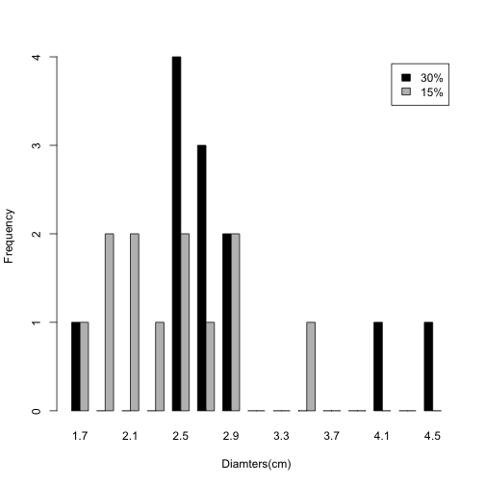
Distribution of the halo Rings in measured yeast strains.
Black/gray are 30% and 15% H2O2 treatment, respectively.
Overview/Introduction
why oxidiative stress->cellular aging
why natural vartions, informative on genetic mechasim of oxfidative stress regulation /life span
Goals: Develop a simple and effective assay, halo ring assay, to measure oxidative stress responses in yeast strains.
Experimental design (Add a diagram to explain your procedures).
Conclusions: 1) Halo ring assay is an effective way to measure oxidative stress responses in yeast cells
2) There are considerable plasticityies of oxidative respones in yeast strains.
Discussion and future direction( look for links with life span)
discussion, it appears that responses depends on the concerations of H2O2.
Add images of plates

