Slide 1






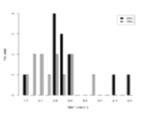




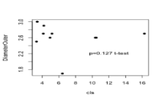



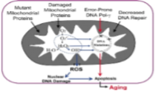

Natural variation in oxidative stress response in Saccharomyces cerevisiae
Dominique Parker, Alisha Caliman, Meighan Parker, and Erin Jackson
Hong Qin
Biology Department
Objective:
To develop a simple and effective assay, halo ring assay, to measure oxidative stress responses in yeast strains.
Results:
Introduction:
Reactive oxidative species is considered a cause of cellular aging. The generation of hydrogen peroxide impinges on the integrity of mitochondria that lead to loss of cell function, apoptosis, and cellular aging. We are studying oxidative stress responses in Saccharomyces cerevisiae, a model organism of cellular aging. Understanding natural variation is informative on the genetic mechanism of oxidative stress regulation and life span.
Mitochondrial DNA damage and aging
Sensitive to H2O2
Materials and Methods:
  Grow parent strain in 5ml YPD overnight
  Prepare yeast plates
  Prepare hydrogen peroxide solutions
  Add H2O2 solutions to the center of each plate
  Take measurements
Distribution of the halo rings in measured yeast strains. Black/gray are 30% and 15% H2O2 treatment, respectively.
Resistant to H2O2
Scattered plot of halo assay which shows that tolerance to H2O2 may be associated with long chronological life span.
Acknowledgements:
NSF award 1022294, RIMI seed grant
Conclusion:
-Halo ring assay is an effective way to measure oxidative stress responses in yeast cells.
-Plasticities of oxidative responses is likely associated with aging in yeast.
References:
Loeb, L.A., Martin, G.M., Wallace, D.C. (2005). The mitochondrial theory of aging and its relationship to reactive oxygen species damages somatic mtDNA mutations. PNAS, vol 102 no.52, 18769-18770.
Loeb L A et al. PNAS 2005;102:18769-18770

