Slide 1
Study the Link between Oxidative Stress and the Aging Process in Yeast

Slide 2
Oxidative stress in involved in heart failure, Parkinson’s disease, Alzheimer’s disease and chronic fatigue syndrome
Oxidative stress is an imbalance between production and detoxification of oxidative substances (Schafer & Buettner 2001)
A buildup of these free radicals can lead to damage in parts of the cell

Slide 3
Oxidative stress is also known to be involved with aging
The lifespan of Yeast can be measured using two mechanisms
Replicative Life Span is the number of times one cell can divide before is senesce (Fabrizio & Longo 2003)
Chronological life span is how long a cell can live without dividing, (Lai & Jazwinski 2002)

Slide 4
The specific mechanism of Cellular Aging has yet to be discovered
SIR2, TOR1 and SCH9 are known to be involved in aging
Sir2 is involved in an organisms' response to stress (Kaeberlein & Guarente 1998)
TOR1 controls growth by regulating transcription and translation (Zheng & Schreiber 1997, Beck & Hall, 1999)
SCH9 is involved in the G1 phase (Toda 1988, Crauwels 1997)

Slide 5
Hypothesis
Is there a correlation between resistance to oxidative stress and variation in life span and life-history traits?
Is there a correlation between oxidative stress and chronological life span?

Slide 6
Experimental Design
Use 12 strains of yeast whose life span have been characterized in details (Qin & Lu 2006, Qin, Lu & Goldfarb 2008)
Measure their resistances to Oxidative stress using Hydrogen Peroxide
Linear regression analysis of oxidative stress resistance and life span.

Slide 7
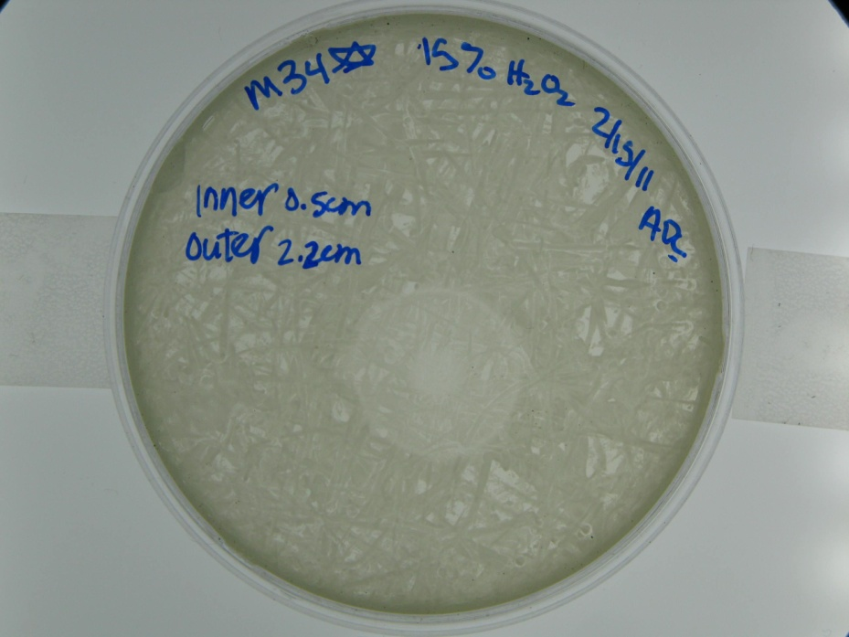
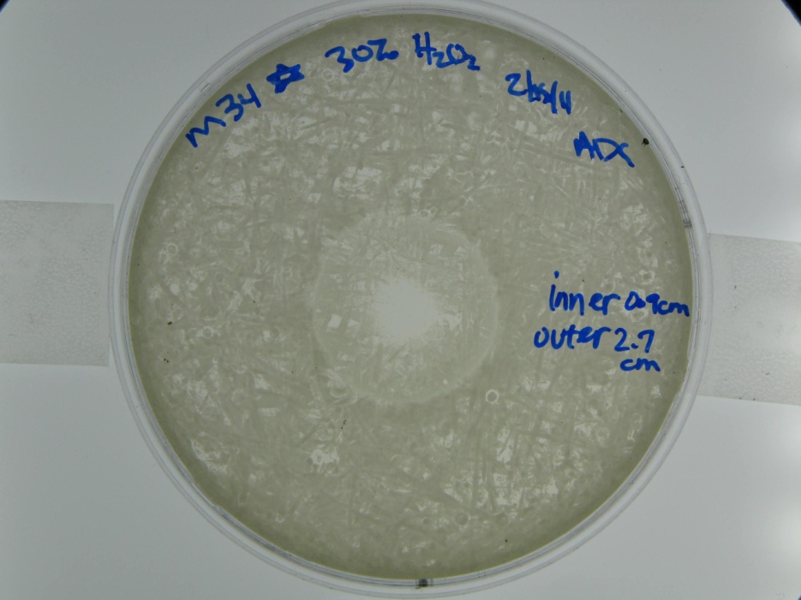
Results

Slide 8
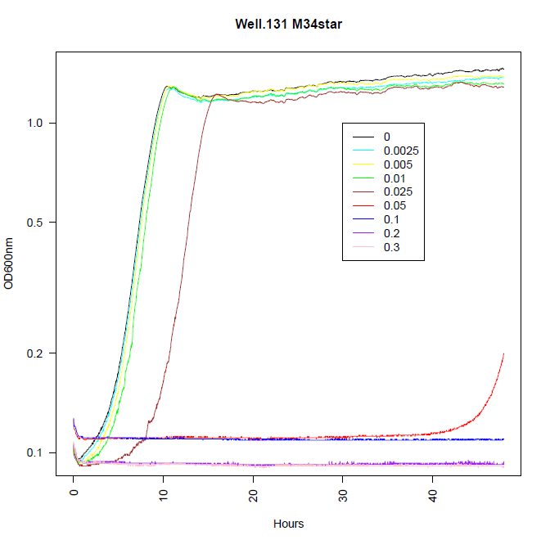

Slide 9
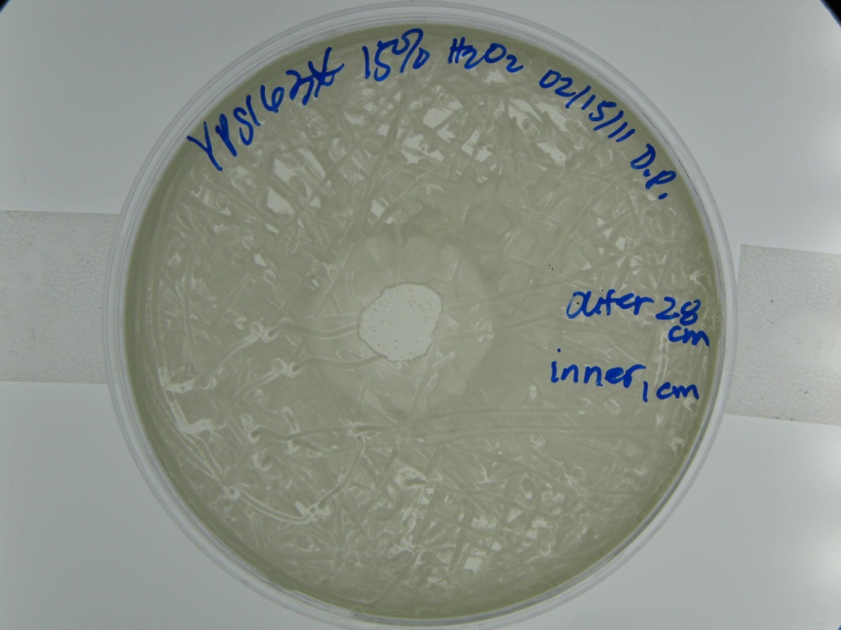
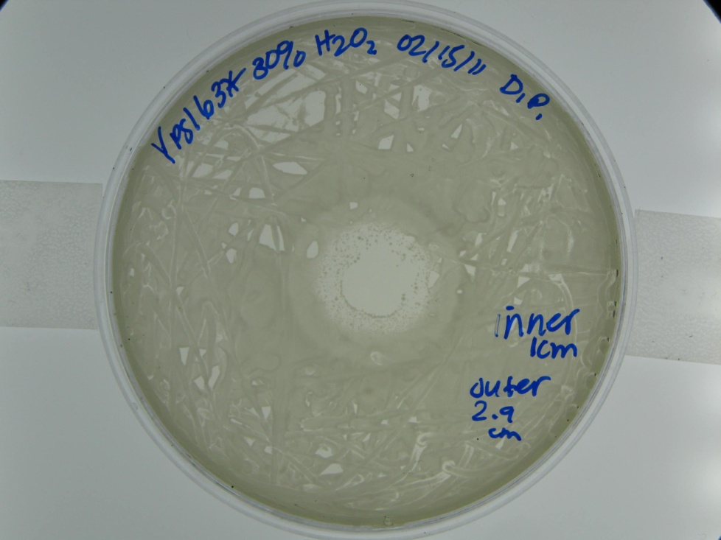

Slide 10
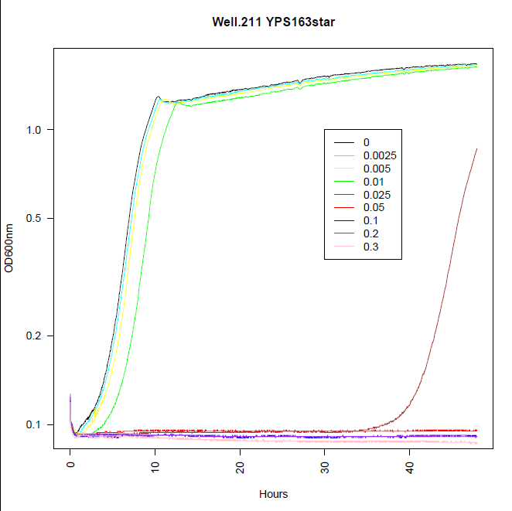

Slide 11
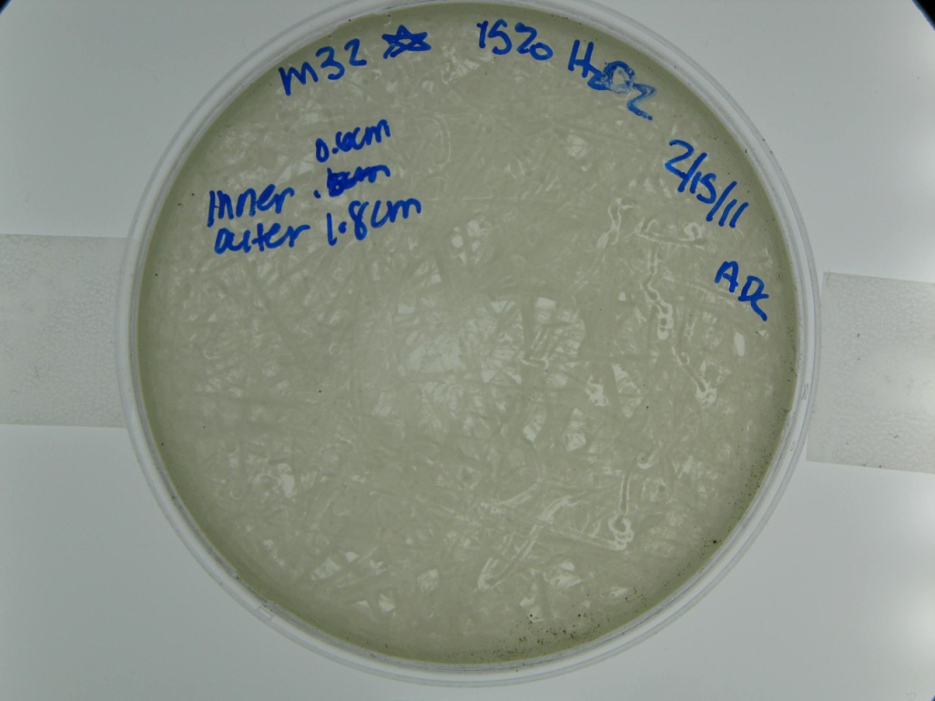
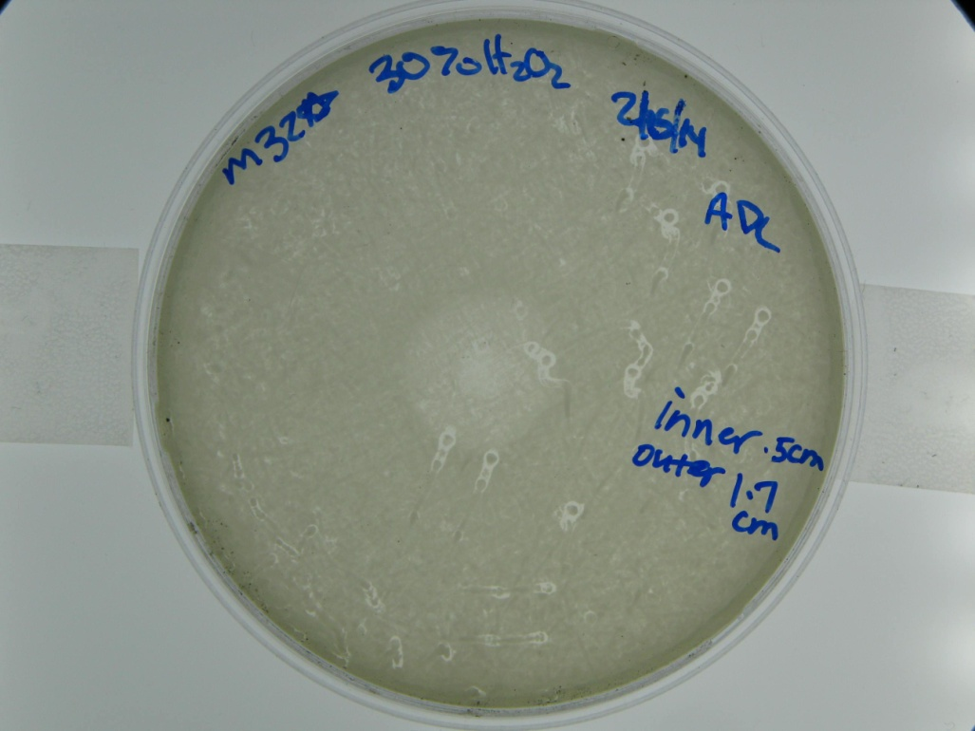

Slide 12
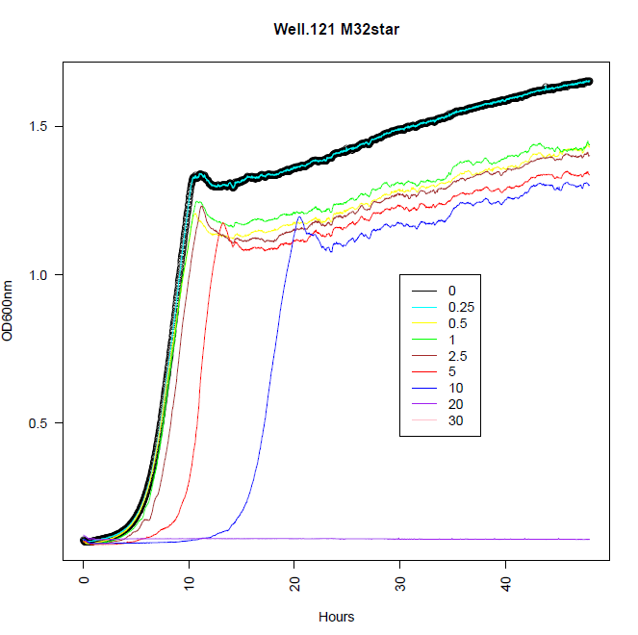

Slide 13
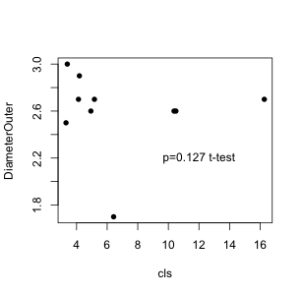
Chronological life span vs. Outer Diameter

Slide 14
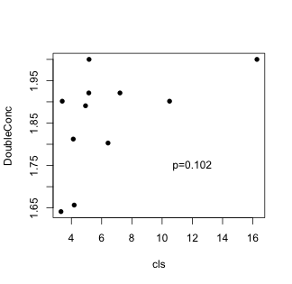
Chronological life span vs. Hydrogen Peroxide Concentration

