Slide 1


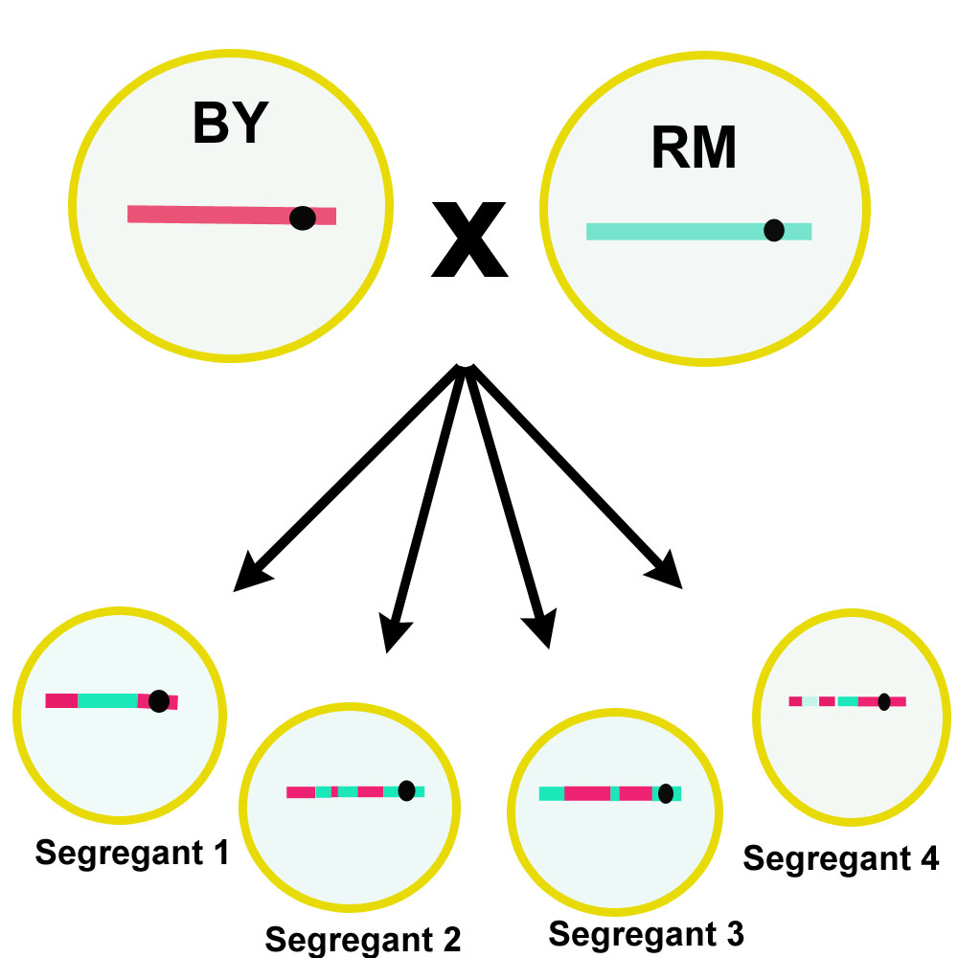
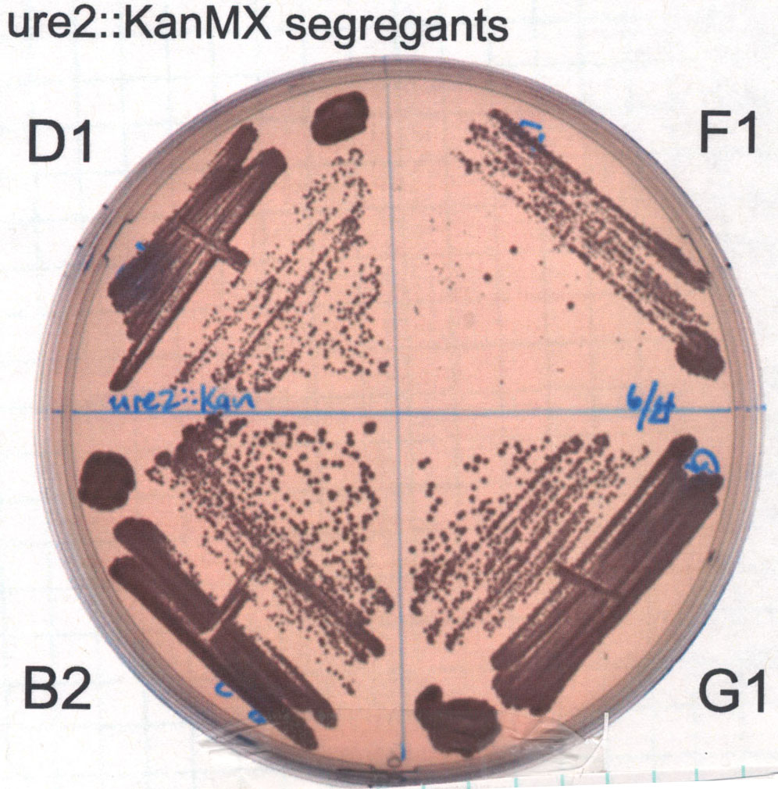
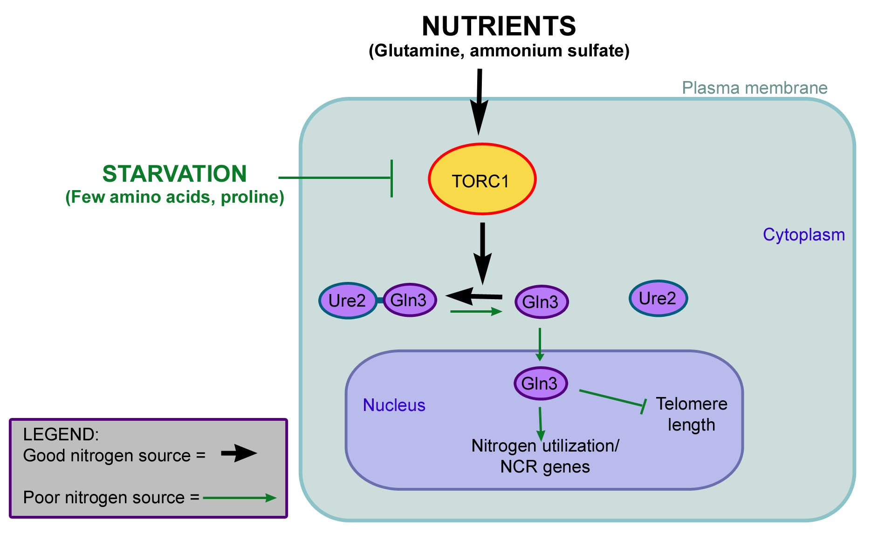
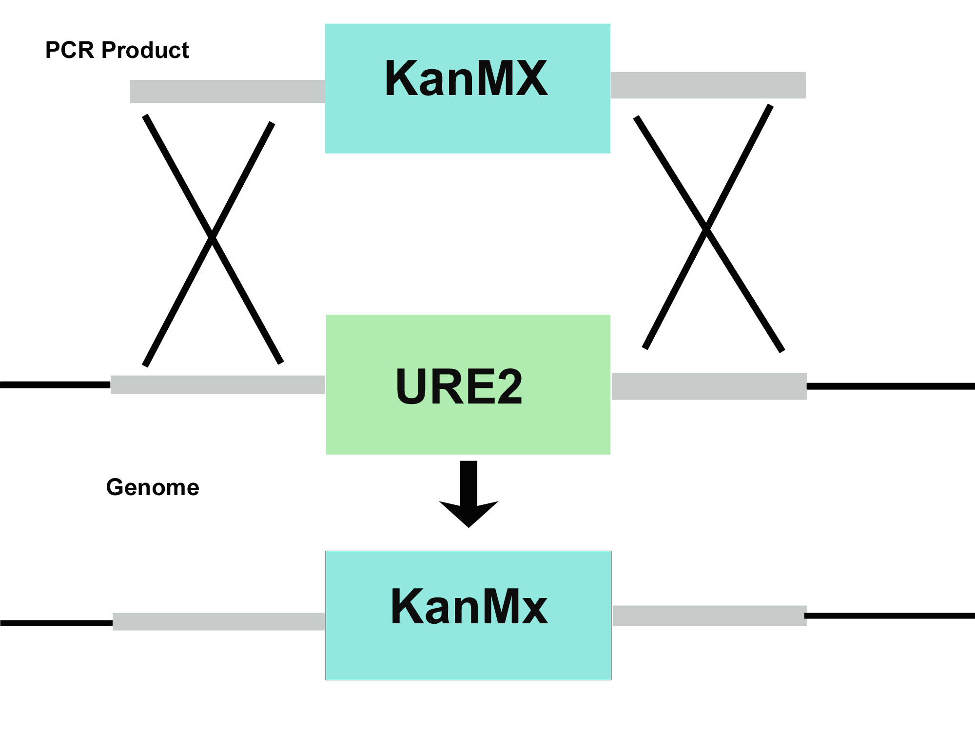
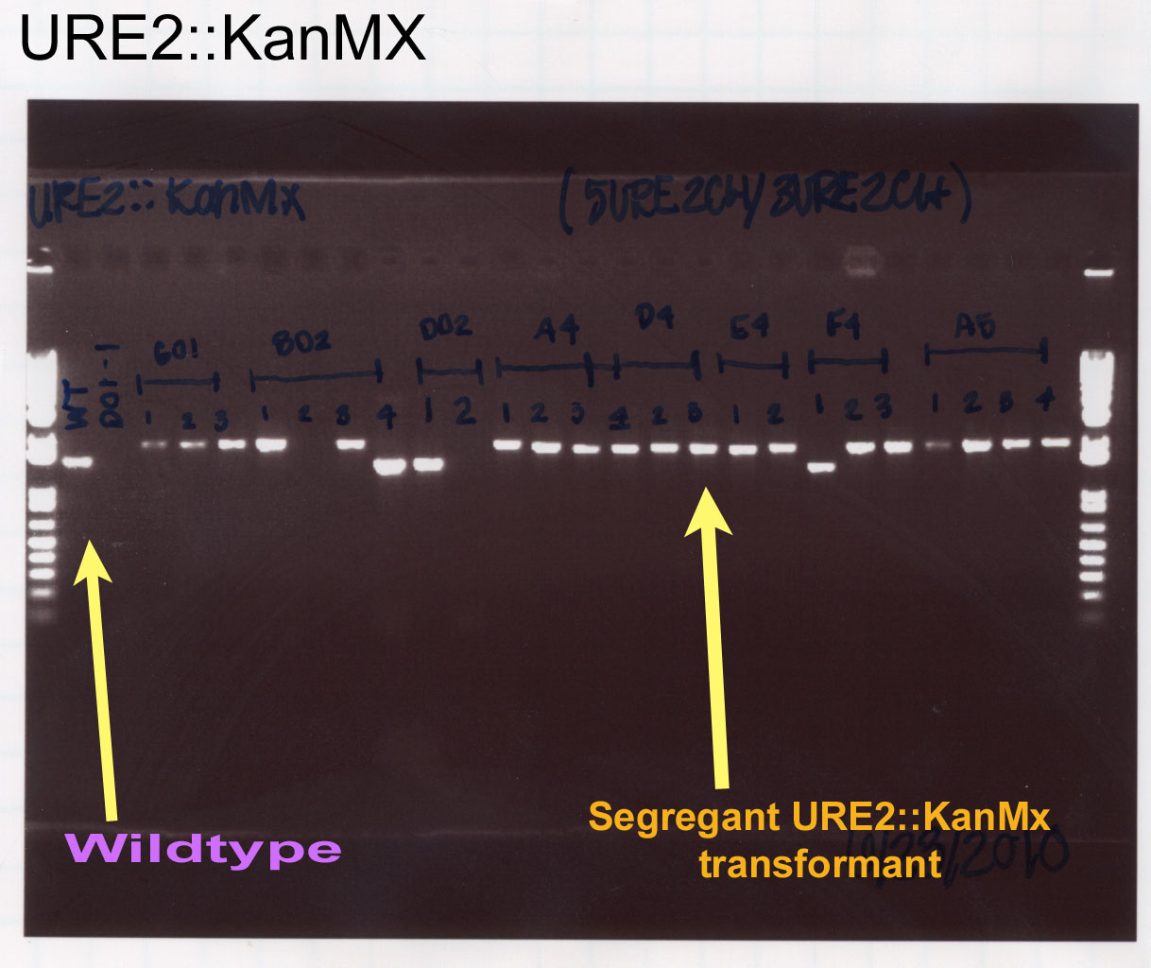
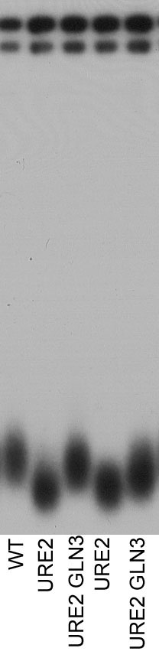
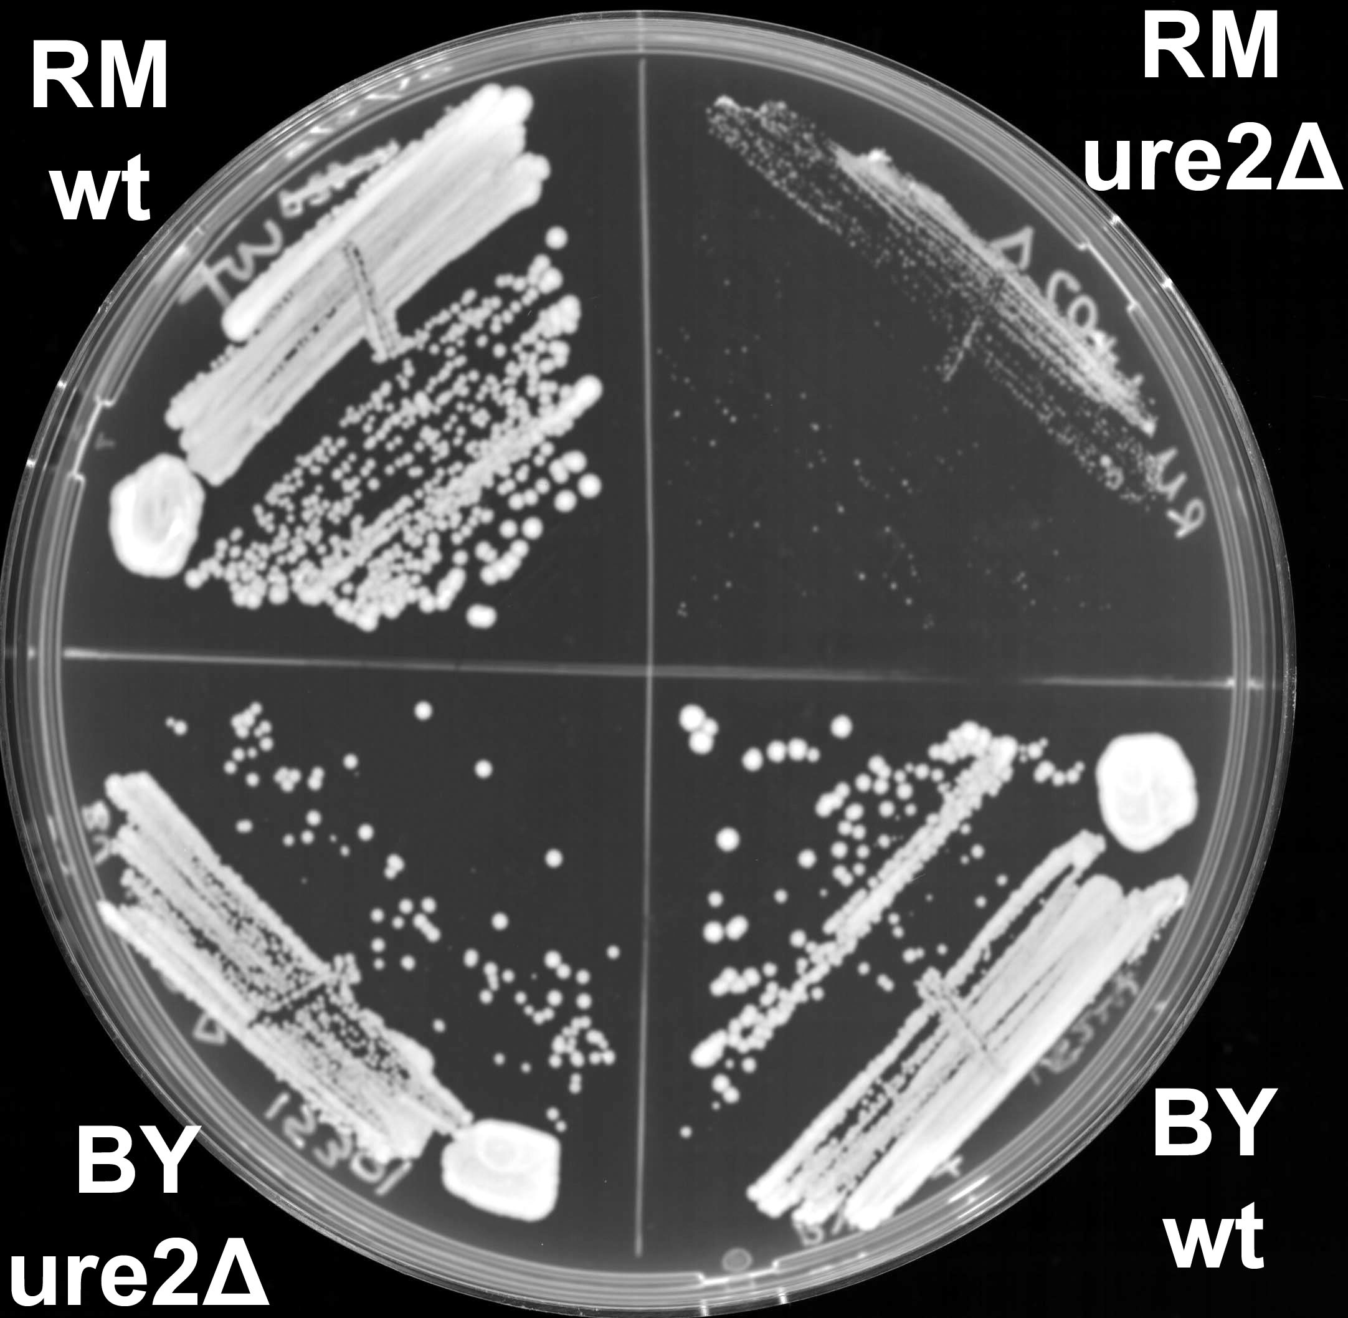
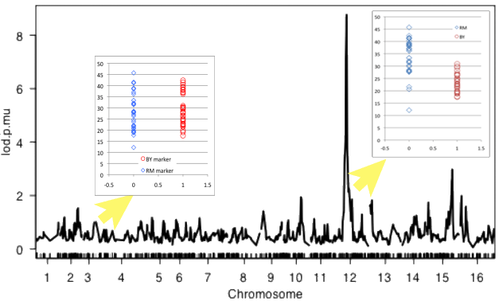
Search for the Genetic Basis of Differential Growth in URE2 Mutants Meighan Parker ^{1,2}Elizabeth Kwan³Antonio Bedalov³ ¹Summer Undergraduate Research Program ²Spelman College ³Fred Hutchinson Cancer Research Center Seattle, WA 98109
Abstract
What causes aging? This ancient question seems to be the basis of cancer research, since incidences of cancer increase exponentially with age. The yeast, Saccharomyces cerevisiae, is a model organism utilized to study age-related phenotypes, such as telomere length, which has been found to reflect cell age. Several genes in the yeast nitrogen regulation and growth network (e.g. URE2, GLN3, and TOR1) have been found to influence both telomere length and yeast longevity. How this nitrogen regulation mediates telomere length is unknown, but may be analogous to stress-accelerated telomere attrition in humans. We have observed that deletion of URE2 yields a significant phenotypic growth difference between wild type and vineyard strains. We hypothesize that a single gene mediates the difference in growth and that this gene will also influence telomere length. My research aims to use quantitative trait mapping to identity the gene responsible for the drastic growth difference. My results will hopefully uncover genes under the control of Ure2 in the TOR pathway and how Ure2 affects growth responses.
.
^{Methods}
Results
Figure 1
…..
The RM/BY segregant library was generated by crossing BY (laboratory) and RM (vineyard) strains
Background
Figure 2
I have successfully transformed 20 yeast segregant with colony sizes ranging from normal to small. Genetic linkage mapping can be performed after more variation among segregant transformants is found.
Figure 3
Future Directions
Perform ure2 deletion yeast transformation on 40 more segregants from the segregant library. Then, use quantitative trait analysis to identify gene responsible for the combination of telomere shortening and growth defect in the vineyard strain.
Genome
References
McMurray, M.A. and Gottschling, D.E., 2003, An Age-Induced Switch to a Hyper-Recombinational State, Science 1908-1911
Ornish, D., Lin, J., Daubenmier, J., Weidner, G., Epel, E., Kemp, C., Magbanua, M.J., Marlin, R., Yglecias, L., Carroll, P.R., Blackburn, E.H., 2008, Increased telomerase activity and comprehensive lifestyle changes: a pilot study, The Lancet 1048-1057, (August 5, 2010)
Spel, E.S., Blackburn, E.H., Lin, J., Dhabhar, F.S., Alder, N.E., Morrow, J.D. Cawthon, R.M.2004, Accelerated telomere shortening in response to life stress. Proceedings of the National Academy of Sciences of the United States of America 17312-17315, (August 5, 2010)
In yeast and humans, the TOR pathway controls cell growth in response to nutrient availability. In this pathway, Gln3 is a transcription factor that controls nitrogen starvation responses. When cells are grown on a preferred nitrogen source, Ure2 sequesters Gln3 into the cytoplasm; however, on a poor nitrogen source, Ure2 releases Gln3 to the the nucleus, allowing transcription of nitrogen starvation response genes.
The genomic copy of URE2 was replaced with the KanMX drug resistance gene in 40 yeast segregants.
PCR product from segregants were compared to wild type to identify transformants. URE2 PCR gives a 1.6 kB product. KanMx gives a 2 kB product.
Figure 4
Acknowledgements
Special thanks to the Fred Hutchinson Cancer Resarch Center, Dr. Antonio Bedalov, Dr. Julian Simon, Dr. Katie Peichel, Dr. Hong Qin, Ms. Jennifer Anderson, Elizabeth Kwan, Uyen Lao, Vid Leko, Naz Taskin, Gemma Park, and Sumit Mahajan, and Jack Lionberger.
Genetic Linkage Mapping example: Segregants are separated by RM/BY allele inheritance at each genetic loci. (Left) Segregants with similar phenotypes yields no linkage. (Right) Segregant populations with different phenotypes yields a strong linkage to chromosome 12. The x-axis is genomic location, and the y-axis is strength of linkage.
The Bedalov lab previously found cells without URE2 have short telomeres and that the vineyard (RM) strain grows poorly without URE2. These growth defects and observed telomere shortening may be connected to genomic instability.

