Slide 1
Genomic Integrity is Influenced by Oxidative Stress in Yeast Natural Isolates
Meighan Parker
Spelman College Research Day
Dr. Hong Qin
April 15, 2011

Slide 2
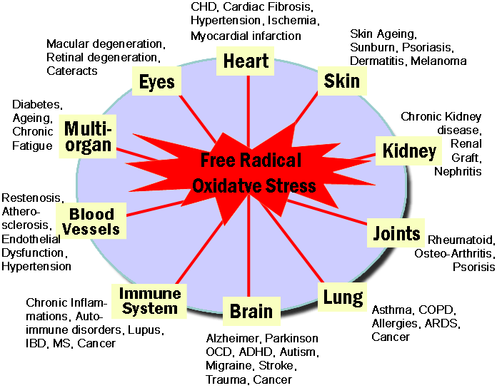
Background
A major characteristic of genomic instability is oxidative stress
What is oxidative stress?
Oxidative stress is an imbalance between production and detoxification of oxidative substances. (Schafer and Buettner 2001)
A buildup of the effects from oxidative stress contribute to aging and various illnesses.
http://www.nutritionalhealthsciences.com/images/oxidative-stress-wheel.gif

Slide 3
Hypothesis
Is there a decoupling between viability and mutation rate, caused by oxidative stress?

Slide 4
Experimental Design
1st aim: Study whether increased concentration of hydrogen peroxide will lead to more loss of heterozygosity (LOH)
2nd aim: Investigate whether hydrgoen peroxide effects are associated with life span variation
Notes:
Used 12 strains: nature of variation to see linear regression

Slide 5


Detection of H2O2 damages to yeast genome
Cells in water
H2O2
No mutation
MET15^{+/-}
MET15^{+/+}
Mother Cells
Mutation
met15^{-/-}
First mitosis
Mutation
1st generation
Notes:
During aging, there is accumulation of oxidative damages in mother cells. Mother cells tend to keep these damages within themselves. Ideally, daughter cells should be born free of damages. Hence, the partition of cellular components is asymmetric.
The ratio of half blacks over full blacks measure how much oxidative damages are passed to the next generation.
This direction is related to DNA repair pathways.

Slide 6
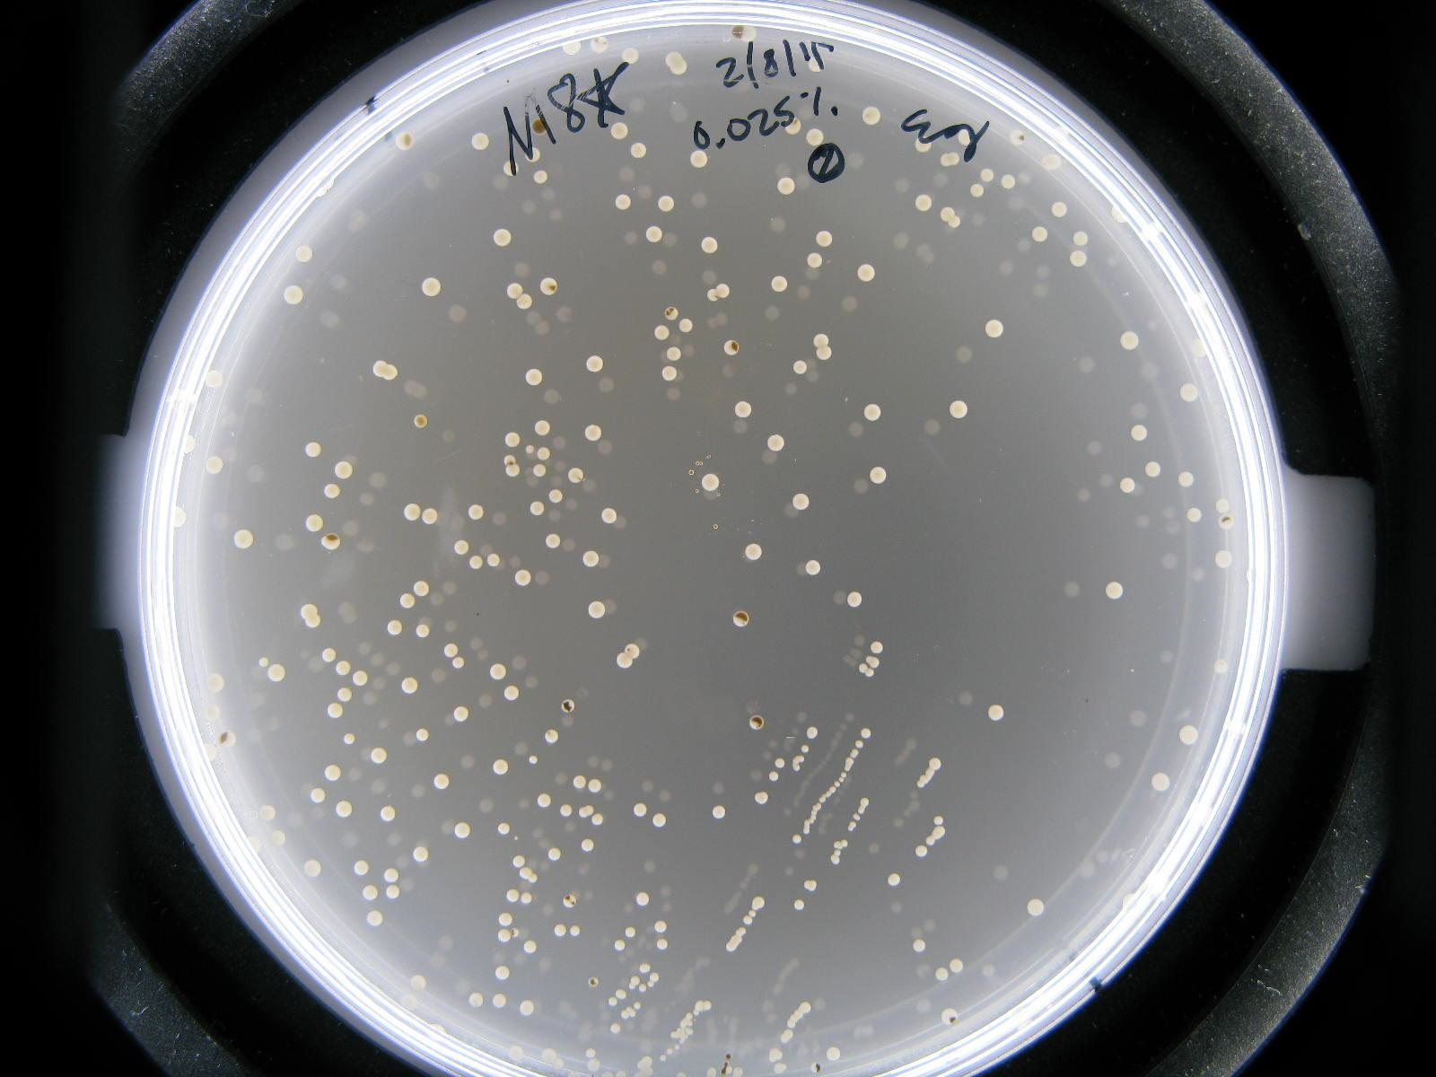
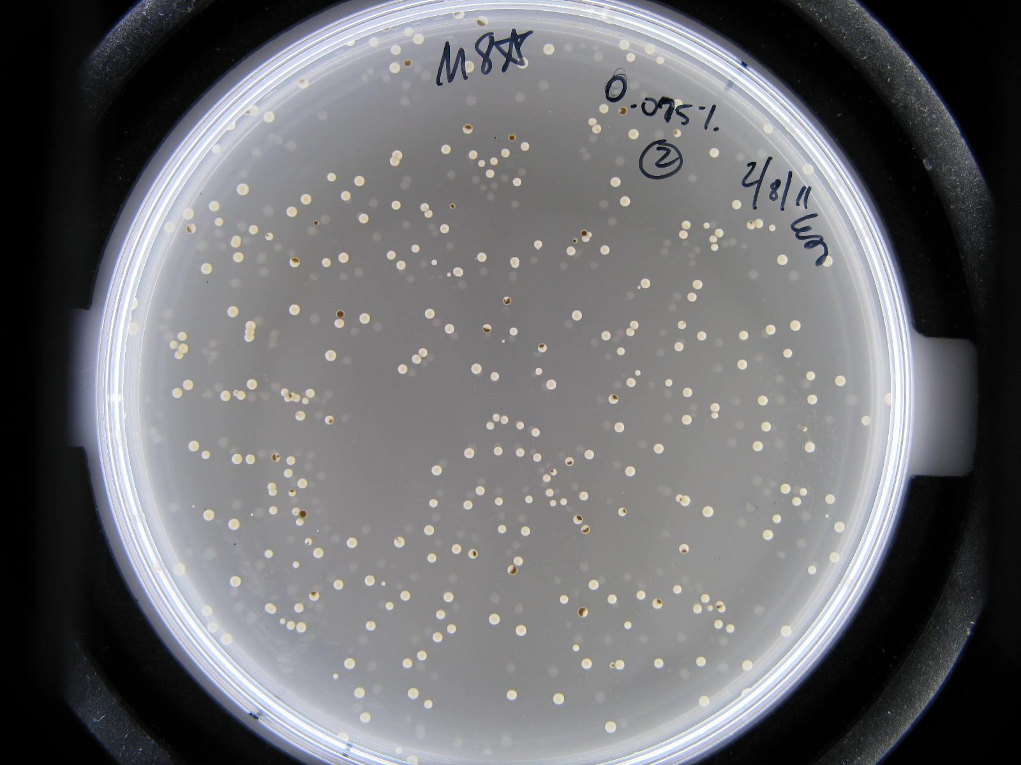
Results- M8* Strain
0.025% Hydrogen Peroxide
Concentration
0.075% Hydrogen Peroxide
Concentration

Slide 7
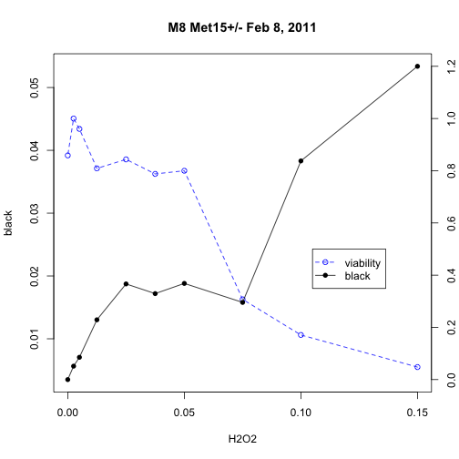
Significance of the hydrogen peroxide rate is evaluated using Linear Regression Analysis.

Slide 8
Conclusion
Hypothesis: Is there a decoupling between viability and mutation rate, caused by oxidative stress??
Yes, there is a decoupling effect at a moderate level of oxidative stress.

Slide 9
Future Directions
We hypothesize that cells’ tolerance to hydrogen peroxide is associated with their ability to counter oxidative damages during aging and ought to be correlated with life span variation.
Results can be used to better understand genomic instability and how it contributes aging and cancer.

Slide 10
References
Aguilaniu, H., L. Gustafsson, et al. (2003). "Asymmetric inheritance of oxidatively damaged proteins during cytokinesis." Science 299(5613): 1751-1753.
Giorgio, M., E. Migliaccio, et al. (2005). "Electron transfer between cytochrome c and p66Shc generates reactive oxygen species that trigger mitochondrial apoptosis." Cell 122(2): 221-233.
Barros, M. H., B. Bandy, et al. (2004). "Higher respiratory activity decreases mitochondrial reactive oxygen release and increases life span in Saccharomyces cerevisiae." J Biol Chem 279(48): 49883-49888.
Harris, N., V. Costa, et al. (2003). "Mnsod overexpression extends the yeast chronological (G(0)) life span but acts independently of Sir2p histone deacetylase to shorten the replicative life span of dividing cells." Free Radic Biol Med 34(12): 1599-1606.

