Slide 1



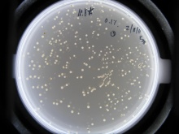
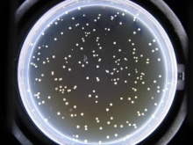
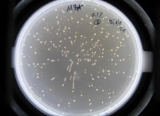
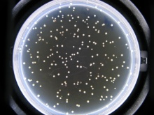
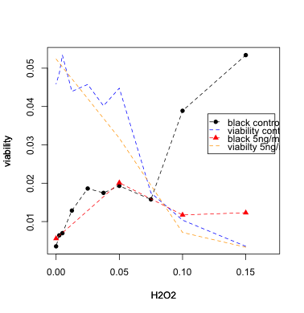
The Effect of Rapamycin on Genomic Instability due to Oxidative Stress
Brittni Wilson, Hong Qin, PhD, Biology Department
Introduction
results
summary
Rapamycin is an immunosuppressant drug first discovered on the mythological land of Easter Island. Since its first discovery, it has commonly been used to suppress the immune system of organ transplant patients. More recently, researchers have discovered its ability to lengthen the life span of a mouse by 9%-14%. (Yong) As mice and other organisms age, molecular functions deteriorate due to oxidative stress, which can include toxins in the air that inhibit regular function, thus causing diseases and death. However, Rapamycin may be the modern day “fountain of youth” that prolongs the oxidative stress effects. In this study, hydrogen peroxide is the oxidative stress that induces genomic instability in the test subject, Saccharomyces cerevisiae. The impact of Rapamycin is measured by observing how many black spots can be seen from the different yeast colonies. The results are change in mutations in Rapamycin treated plates versus the mutations in the non Rapamycin treated plates .
Rapamycin has been proven to increase the lifespan of mice, so researchers want to test this immunosuppressant drug on Saccharomyces cerevisiae to investigate whether or not it will have similar effects. The aging in mice is equivalent to the oxidative stress, hydrogen peroxide. Therefore, yeast is exposed to both hydrogen peroxide and Rapamycin. This experiment is compared to an experiment where yeast is only exposed to hydrogen peroxide. Both sets of plates were incubated and observed. Mutations are distinguished by the black areas seen in the tan colored yeast colonies. After given time to grow, the Rapamycin treated plate did have fewer mutations than the non Rapamycin treated plate. These results indicate a reduction in mutation rates as the Rapamycin concentrations increased, consequently supporting the hypothesis that Rapamycin inhibits genomic instability.
M8* with 0.1% H202
M8* with 5ng/ml Rapamycin and 0.1% H202
Calorie Restriction
Active
TORC1
TORC1
Rapamycin
TORC1
M8* with 0.1% H202
M8* with 5ng/ml Rapamycin and 0.1% H202
Rapamycin
Life Span
Calorie Restriction
Active
Inactive
Inactive
TORC1
HYPOTHESIS
Rapamycin can mitigate the effect of oxidative stress on genomic stability in Saccharomyces cerevisiae.
Reactive Oxygen Species
(cause of aging)
DNA Damage (mutations)
materials
P value < .001
Aging
Yeast strain: M8 Met15+/-
Rapamycin
Hydrogen Peroxide
Yeast plate containing lead ions
References
methods
Yong, Ed. "Rapamycin - the Easter Island Drug That Extends Lifespan of Old Mice : Not Exactly Rocket Science." ScienceBlogs. 8 June 2009. Web. 11 Apr. 2011. <http://scienceblogs.com/notrocketscience/2009/07/rapamycin_-_the_easter_island_drug_that_extends_lifespan_of.php>.
These are pictures of a Rapamycin treated and non Rapamycin treated plate. Both plates contain .1% of H2O2. The dark circles represent the genetic mutations.
Rapamycin Treatment
(5ng/ml)
H2O2 Treatment
(0%, 0.1%, 0.2%, 0.3%)
Grow yeast cells in YPD
conclusion
Acknowledgements
No Rapamycin
Treatment
H2O2 Treatment
(0%, 0.1%, 0.2%, 0.3%)
Rapamycin significantly counter the mutational effects of the oxidative stress induced by hydrogen peroxide but not the toxic effort on viability in Saccharomyces cerevisiae.
Howard Hughes Medical Institute : G5200613
NSF RUI: 1022294

