Slide 1
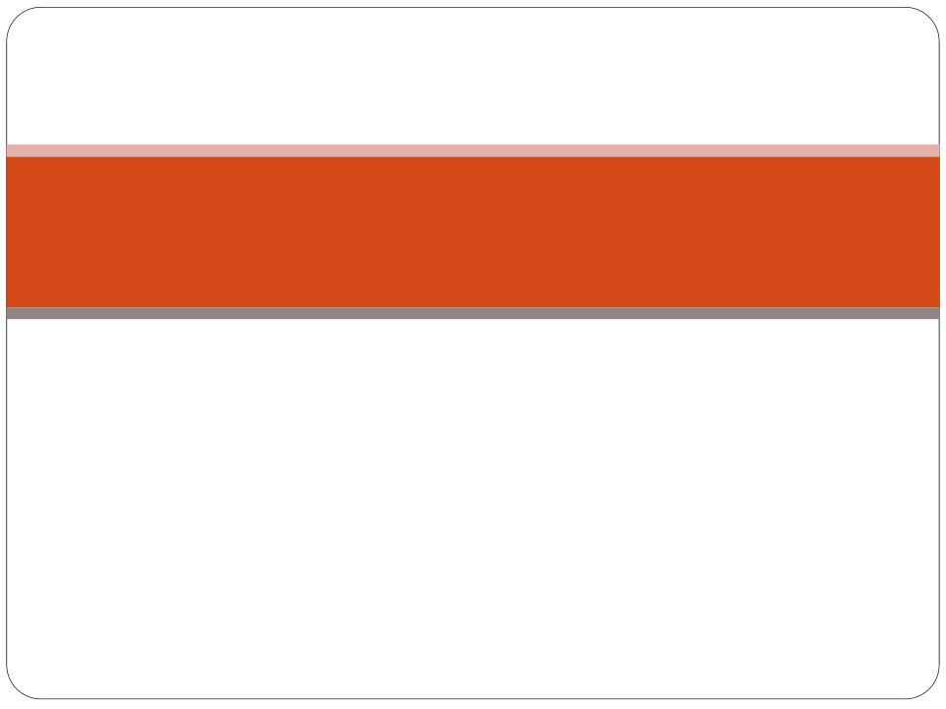
Study the Link between Oxidative Stress and the Aging Process in Yeast
Alisha Caliman
Dr. Hong Win

Slide 2

Order of Presentation
  Background
    Oxidative Stress
    Cellular Aging
    Yeast as a Model for Cellular Aging
  Research Question
  Experimental Design

Slide 3
Oxidative Stress
  Oxidative stress is an imbalance between production and detoxification of oxidative substances
  Oxidative Stress can cause an increase in cancer
  Oxidative stress in involved in heart failure, Parkinson’s disease, Alzheimer’s disease and chronic fatigue syndrome
Notes:
Reactive imbalance between production and use of oxigen containing species. The imbalance of redox is toxic to the cell and can contribute to aging. Can cause DNA damage, and can induce apoptosis,

Slide 4
Dangers of Oxidative Stress
  The cells are in a reducing environment as they use energy
  Peroxides and free oxidative radicals that are produced can damage the DNA of the cell
  This can cause the cell to undergo apoptosis or necrosis

Slide 5
Yeast as a Model for Aging
  The lifespan of Yeast can be measured using two mechanisms
  Replicative Life Span is the number of times one cell can divide before is senesce
  Chronological life span is how long a cell can live without dividing
  Several genes involved with aging have been discovered in yeast

Slide 6
Cellular Aging in Yeast
  The specific mechanism of Cellular Aging has yet to be discovered
  SIR2, TOR1 and SCH9 are known to be involved in aging
  Sir2 is involved in an organisms' response to stress
  TOR1 controls growth by regulating transcription and translation
  SCH9 is involved in the G1 phase

Slide 7
Relationship between Oxidative Stress and Aging
  Oxidative Stress is known to be involved in the aging process
  The mechanism relating the two has not yet been discovered

Slide 8
Main Hypothesis
  Is there a correlation between resistance to oxidative stress and variation in life span and life-history traits?

Slide 9
In other words
  What is the relationship between the strain of yeast and life span?

Slide 10
Experimental Design
  Use 12 strains of yeast whose life span have been characterized in details (Qin & Lu 2006, Qin, Lu & Goldfarb 2008)
  Measure their resistances to Hydrogen Peroxide
  Linear regression analysis of oxidative stress resistance and life span.

Slide 11
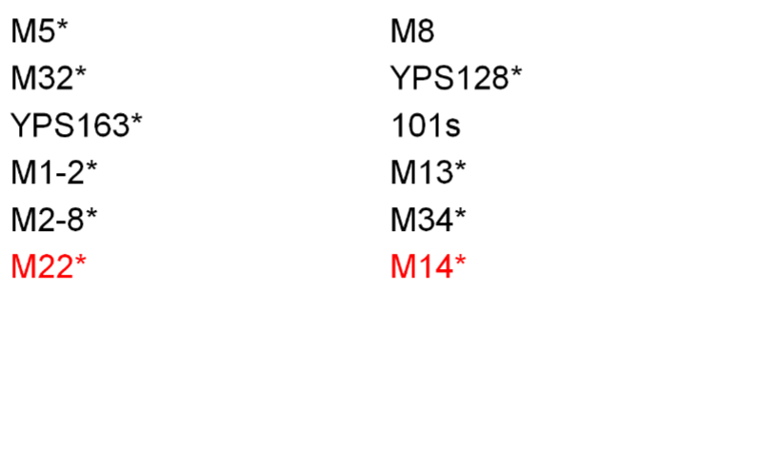
Yeast Strains

