Slide 1
These slides are provided as references only. You must modify and make necessary changes in your presentations. – Hong Qin

Slide 2
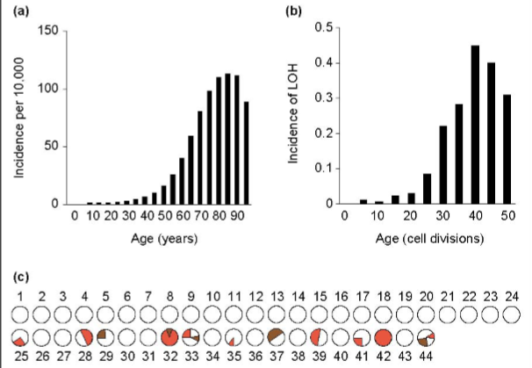
Yeast as a model of age-dependent increase of genomic instability, measured by loss of heterozygosity (LOH).
Cancer
LOH
McMurrary & Gottschling, 04
Notes:
Gottschling’s review

Slide 3
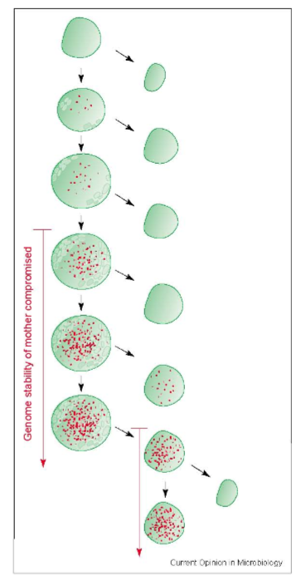
Mitotic asymmetry and hypothesized cause of LOH in aging:
  Asymmetric partition of genotoxic damages between during mitosis.
  Accumulation of Reactive oxygen species (ROS) over time.
M. A. McMurray & D. E. Gottschling, 2004

Slide 4


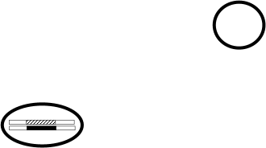


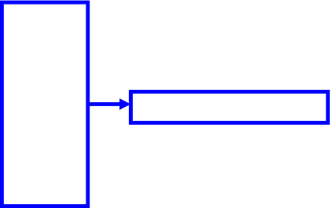










Detection of aged-dependent change of genomic instability in yeast aging: Loss of heterozygosity at the MET15 locus
Cells in water
Transfer to plates
No LOH
MET15^{+/-}
MET15^{+/+}
Mother Cells
LOH
met15^{-/-}
First mitosis
Mitotic asymmetry
Single LOH
Second mitosis
1st generation
Single LOH
1st + 2nd generation
2nd generation
Notes:
During aging, there is accumulation of oxidative damages in mother cells. Mother cells tend to keep these damages within themselves. Ideally, daughter cells should be born free of damages. Hence, the partition of cellular components is asymmetric.
The ratio of half blacks over full blacks measure how much oxidative damages are passed to the next generation.
This direction is related to DNA repair pathways.

