Slide 1



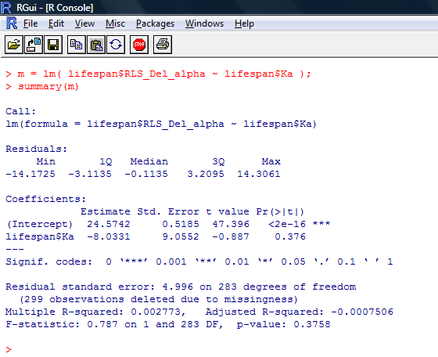
The interconnection of molecular evolution, gene network, and cellular aging Alice Story, Charita Montgomery, and Hong Qin
Biology Department, Spelman College, Atlanta, GA 30314
OVERVIEW
Pleiotropic traits, such as cellular aging, are shaped by gene networks which channeled the molecular evolution of individual genes into phenotypic manifestations. We hypothesize that cellular aging is an emergent property of gene networks, and the characteristics of the aging process are linked to network robustness and gene interaction patterns. In this study, we aim to investigate the interaction among evolutions of genes, their roles on cellular robustness, and life-history traits in Saccharomyces cerevisiae.
We used the model organism Saccharomyces cerevisiae to understand the mechanism of life span regulation and robustness. The life span of yeast cells is defined by the number of cell divisions that occur prior to senescence – the so called replicative life span (RLS). Our goal is to identify the casual factors that directly influence life span. Several proxies of cellular robustness are present in the analysis which include network connectivity, plasticity ,mutational robustness, morphological robustness measured, and growth fitness . We conduct multiple regression to investigate the causal relationships in the R statistical environment. Principal component analysis is used to address correlated factors. Robustness is a fundamental concepts in biology, therefore, our study can influence a broad range of biological questions.
RESULTS
Faster
SUMMARY
Figure 1: YPD vs. Lifespan
Figure 2: YPE vs. Lifespan
More cell divisions
(longer replicative lifespan)
G2
M
S
G1
Faster growth rate
(Better growth fitness)
Conclusions
There is significant positive association between growth fitness and lifespan.
There is no statistical association between evolutionary rate and lifespan.
Discussion and Future Directions
Faster growth rate leads to more cell division which results in longer lifespan for YPD and YPE.
Yeast cells and human cells are similar in regards to structure and function to understand the mechanisms of cellular aging.
In continuing our studies, several proxies of cellular robustness ,network connectivity, plasticity ,mutational robustness, morphological robustness measured, and growth fitness will be analyzed.
Figure 3: Evolutionary Rate
Script 1: R command to determine the correlation between YPD and lifespan.
> #match fit$YPD to lifespan
> lifespan$YPD= fit$YPD[match( lifespan$ORF,fit$orf )];
> summary (lm(lifespan$RLS_Del_alpha ~lifespan$YPD))
MATERIALS AND METHODS
Lifespan measures of yeast strains were obtained from Managbanag et al. 2008, PLoS ONE 3(11): e3802.
We used nonsynomous substitutation rates (Ka) between S. cerevisiae and S. paradoxus as the evolutionary distances.
Protein interaction data were collected from the Database of Interaction Proteins (http://dip.doe-mbi.ucla.edu).
Growth fitness data were obtained from http://www-sequence.stanford.edu/group/yeast_deletion_project/
To understand the mechanism of cellular aging we investigate the statistical association of evolution distance, growth fitness and protein interaction to life span. Performed multiple regression analysis to compare the protein robust factors to cellular aging. These results were each plotted for further analysis.
All of the regression test and plots were conducted using the computer program R 2.12.1.
ACKNOWLEDGEMENTS
We would like to thank Spelman RIMI for seed grant and NSF award #1022294 for support.
AS thanks Minority Biomedical Research Support-Research Initiative for Scientific Enhancement (MBRS-RISE) for support.
Notes:
Changes to be made:
Correct grammar errors in abstract and introduction.
Remove inappropriate statements in abstract.
Conflicted conclusions are found in abstract and Fig 5.
Introduction contain inappropriate statements, wrong citations. The Intro is not smooth.
M & M:
The statement about comp biology is trivial and meaningless.
Statements on p and q are incorrect
Robustness calculation calculation is inappropriate
Figure 1 is incomplete. Fig2, 3,4 lacks R-squared. Fig 3 lacks regression. Regression lines in figures are colored inconsistently.
Figure 5 legend is inappropriate.
Conclusions: Grammar errors, font, and format issues
Inconsistency between morphology robustness to the title of protein network robustness
Ack is inappropriate.
Reference misquoted and inconsistent with the body of the poster.
Need to add a R logo.
Need to add a Spelman CHDRE logo.

