Slide 1
Microarray expression analysis
Transcriptome analysis or global analysis of gene expression studies the expression of genes by a genome both qualitatively and quantitatively.

Slide 2
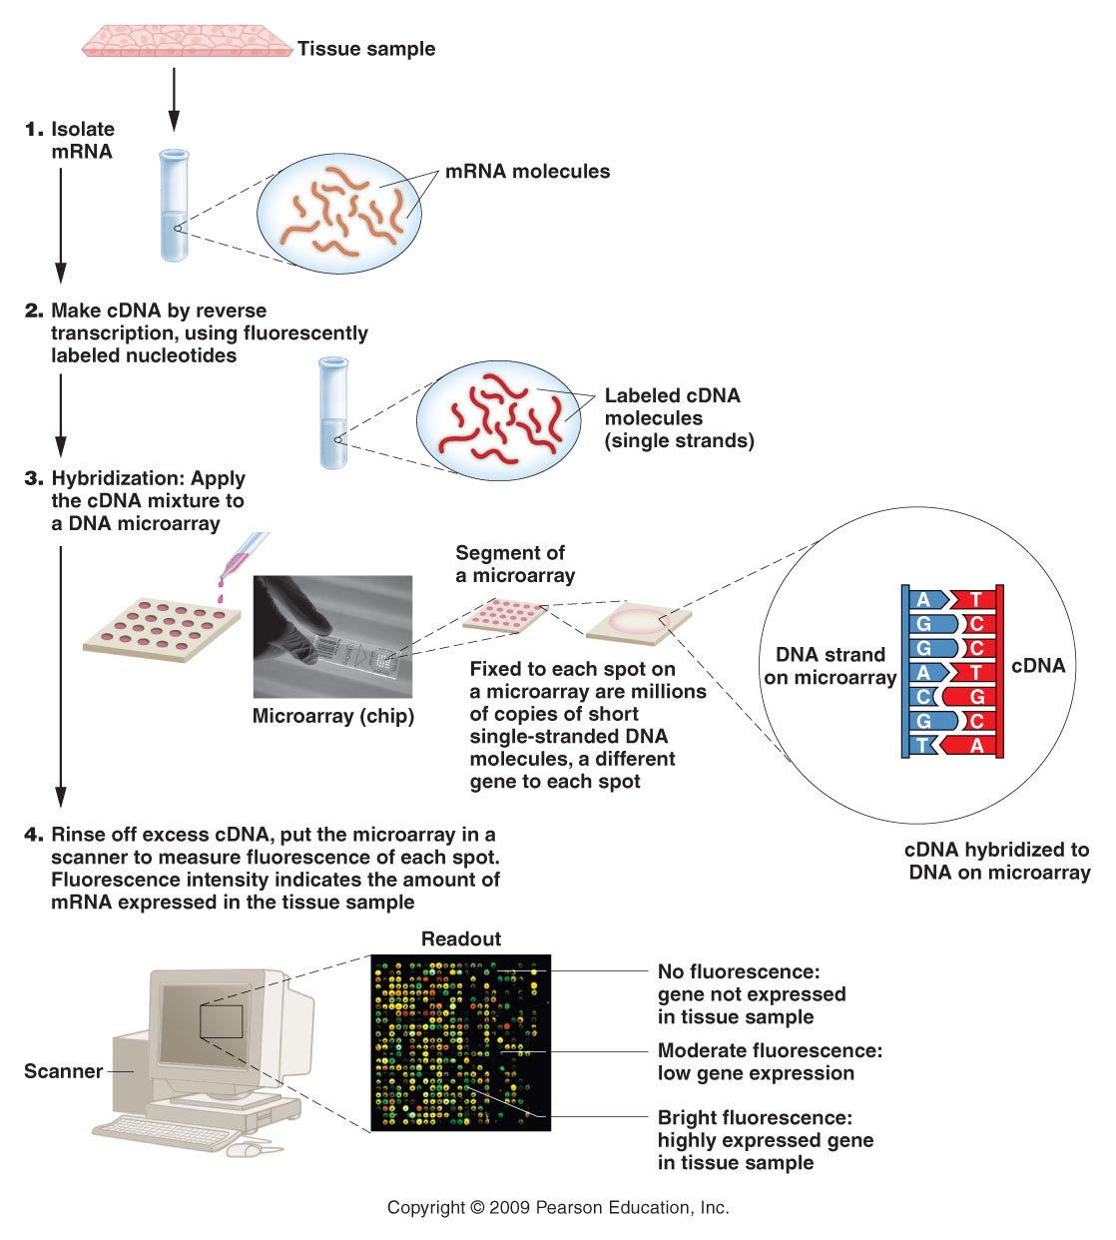
Notes:
Figure 20-15 Human chromosome 21 (left) and chimpanzee chromosome 22 (right). The two chromosomes are similar in size (33.12 Mb for human chromosome 21 and 32.7 Mb for chimpanzee chromosome 22) and gene content (284 for human chromosome 21 and 272 for chimpanzee chromosome 22). The chromosomes share 179 genes with coding sequences of identical length and similar intron-exon boundaries. These shared genes have an average nucleotide and amino acid identity of 99.29% and 99.18% respectively, providing evidence for the close evolutionary relationship between the two species.

Slide 3
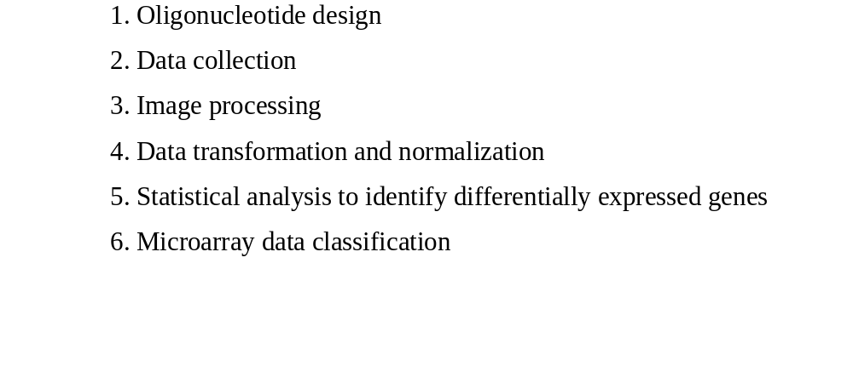
Procedure of DNA Microarray Experiments

Slide 4
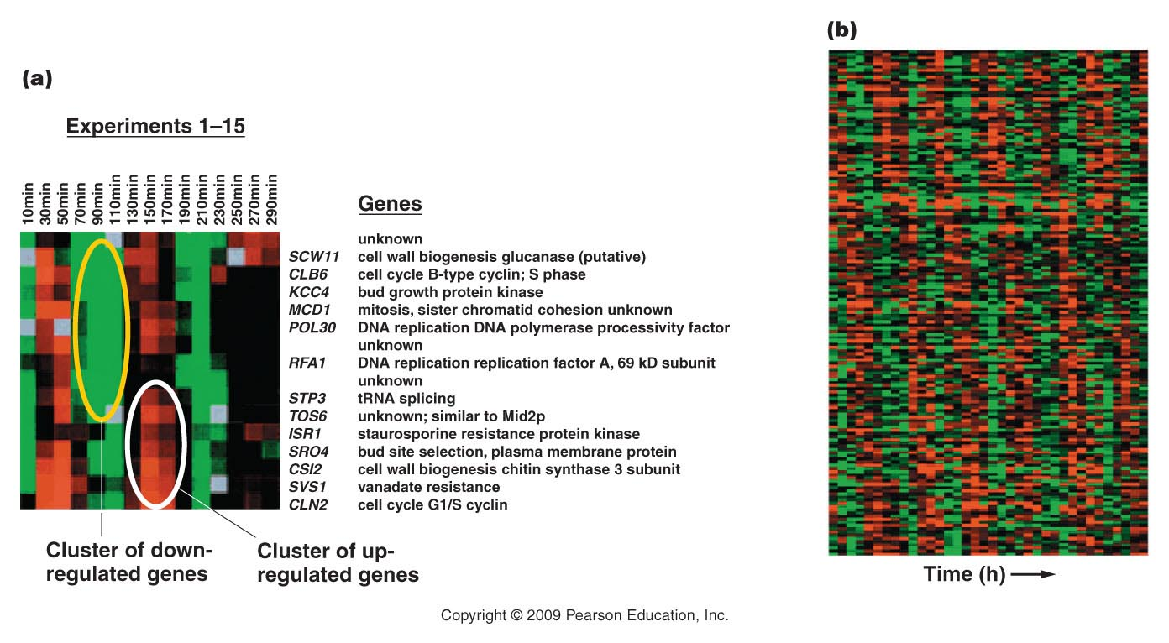
Figure 21.21
Notes:
Figure 20-16 Gene density in the long arms of human chromosomes 21 and 22 (genes per Mb of DNA). In chromosome 21, the region in the dark staining band is relatively gene-poor, and the region near the distal tip is gene-rich. On chromosome 22, there is a small region near the chromosome tip that is gene-poor and two other regions, closer to the centromere that are relatively gene poor.

Slide 5
Procedure of DNA Microarray Experiments

Slide 6
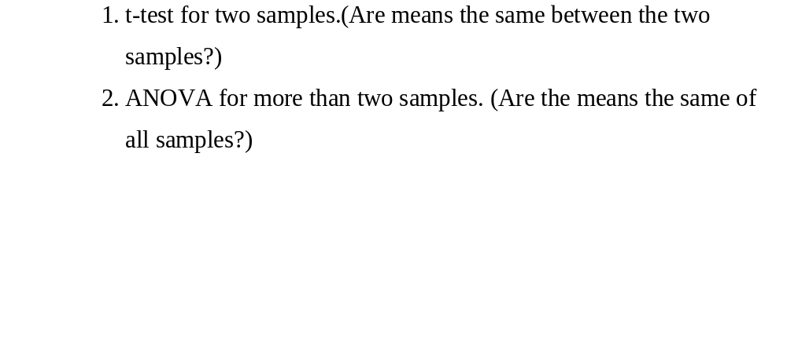
Statistical analysis to identify differentially expressed genes

Slide 7
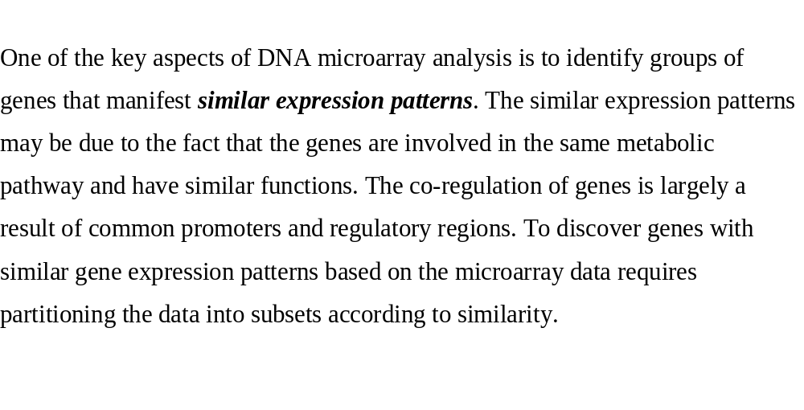
Microarray Clustering Analysis

Slide 8
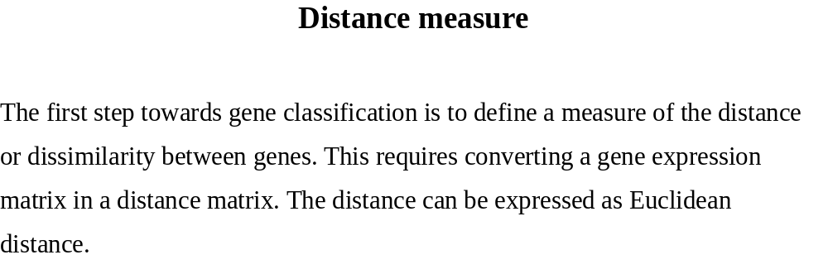
Distance measure

Slide 9
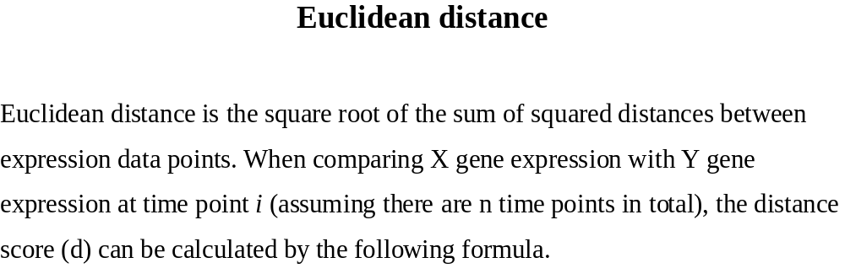
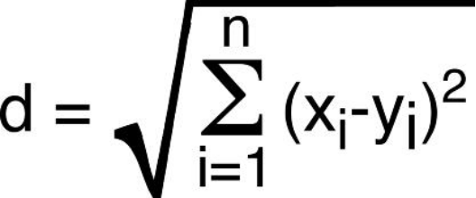
Euclidean distance

Slide 10
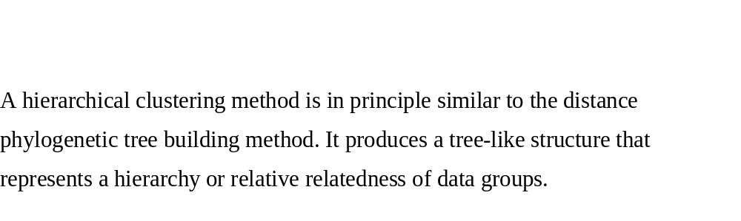
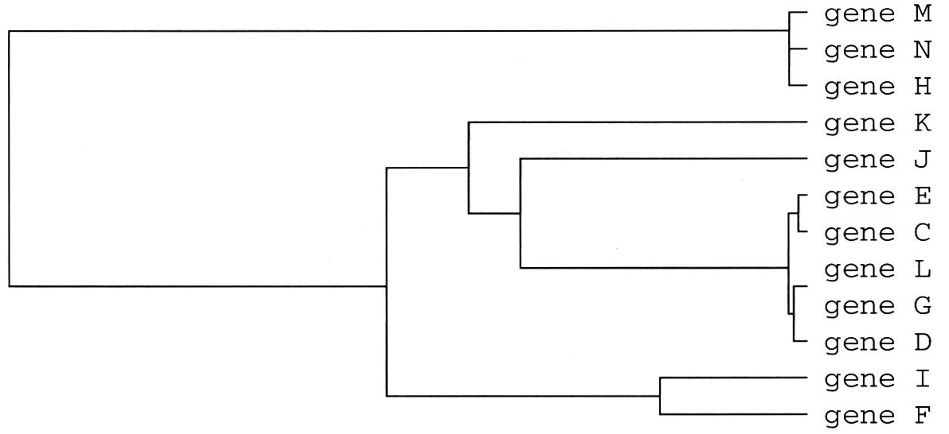
Hierarchical clustering

Slide 11
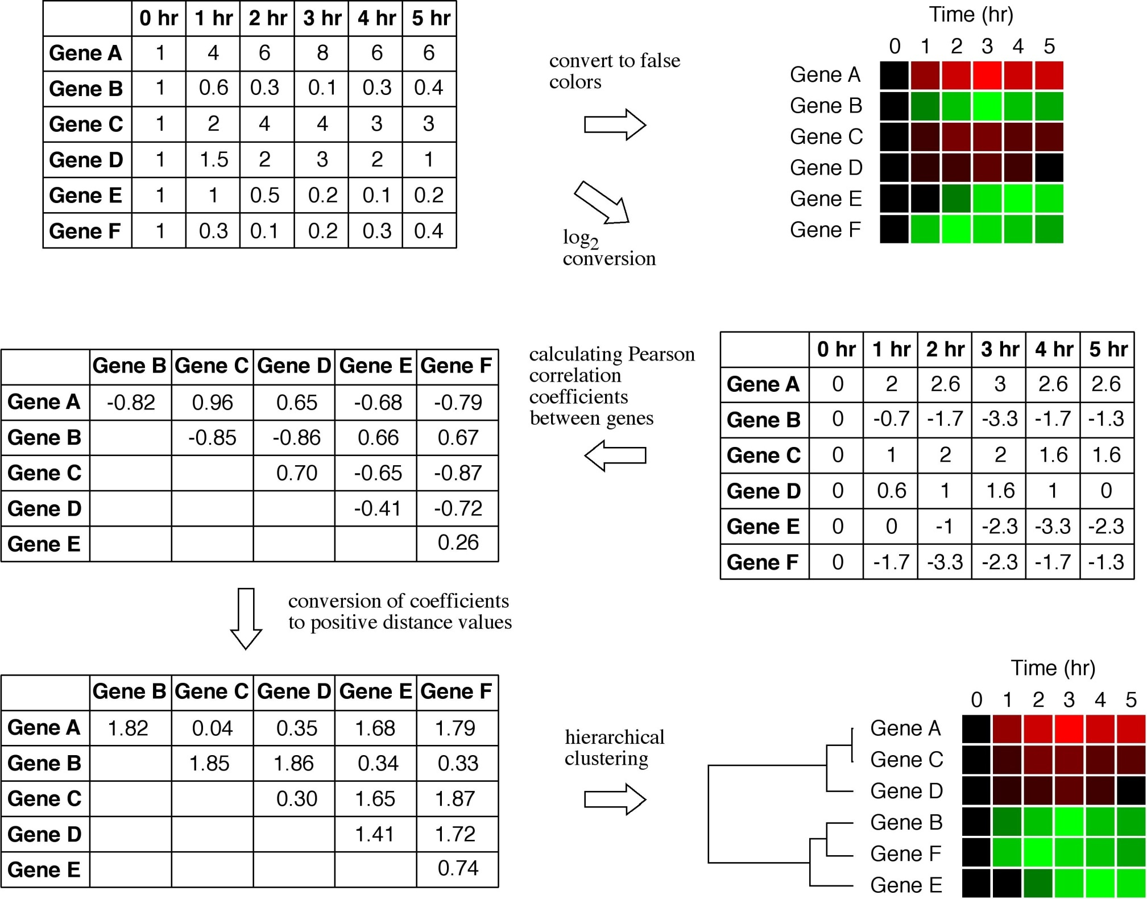
Diagram of Array analysis

Slide 12

A Distance Matrix

Slide 13
Diagram of Array analysis

Slide 14



Another example of clustering analysis
Original
Shuffled by rows
Clustered by rows

Slide 15
Example of R on Five genes.

Slide 16
Analysis of Gene Expression from Prostate Cancer Patients

Slide 17

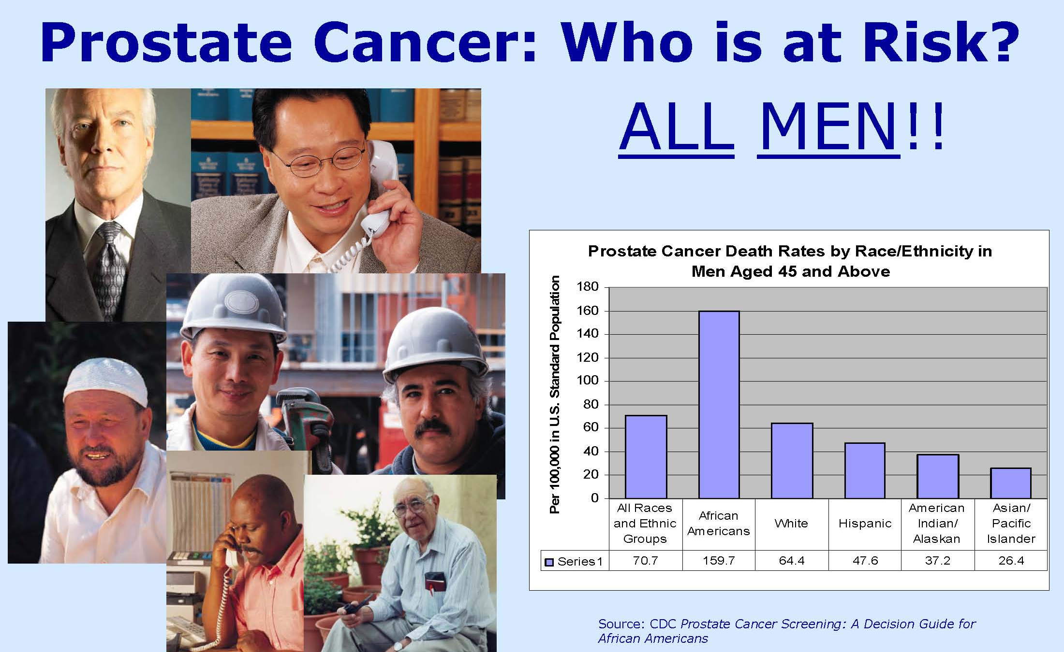
Analysis of Gene Expression from Prostate Cancer Patients

Slide 18
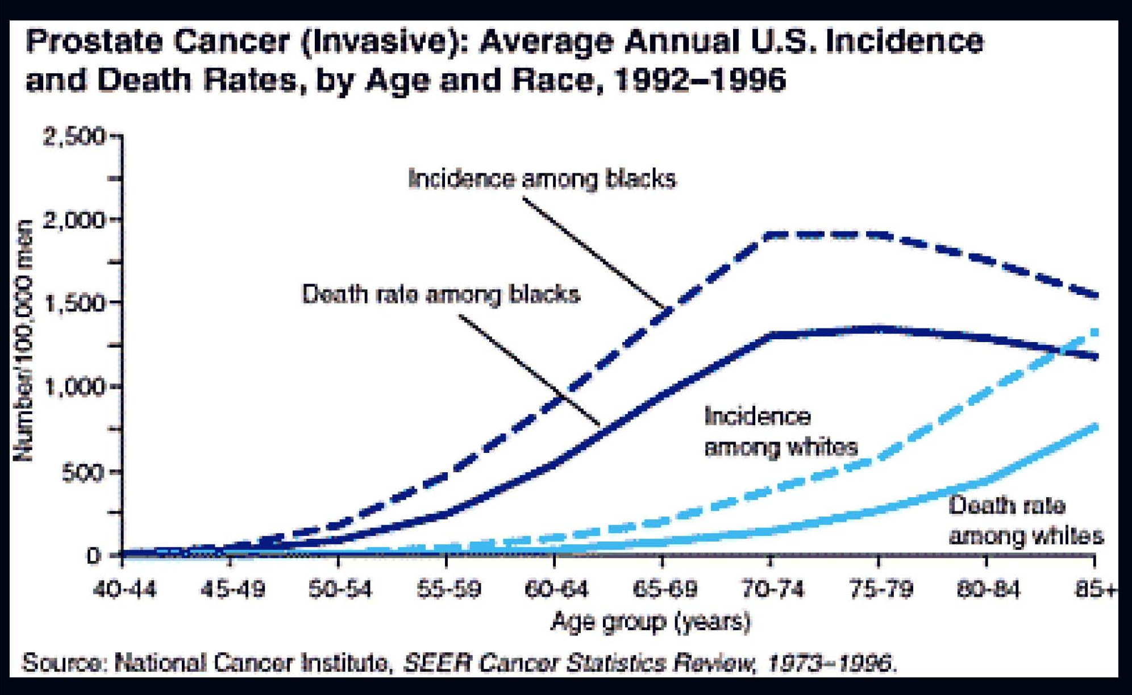
Incidence of invasive prostate cancers

Slide 19
Overview
Most common type of cancer in American men.
There are 230,000 case in 2004 with 30,000 deaths.
1 in 6 men will have prostate cancer in their life time.
1 in 32 men will die of this disease.

