Slide 1







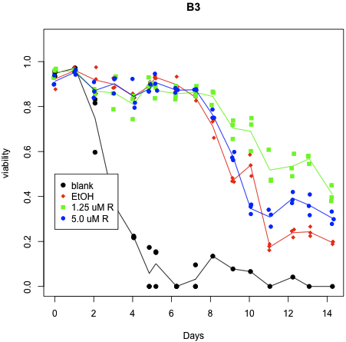

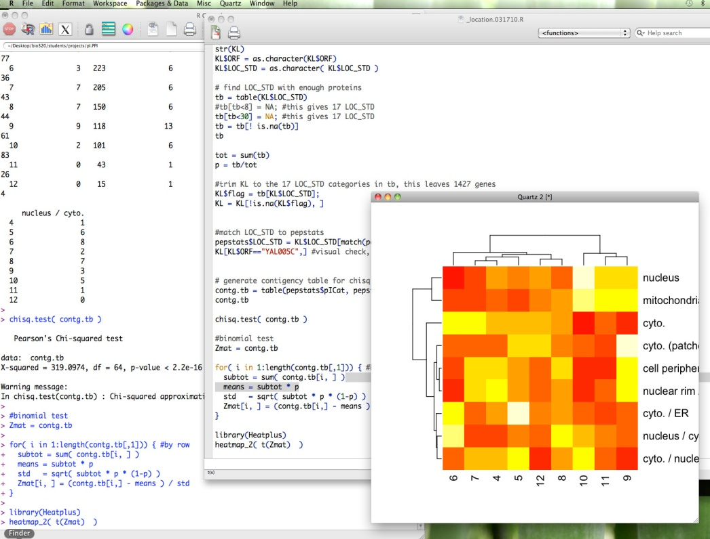
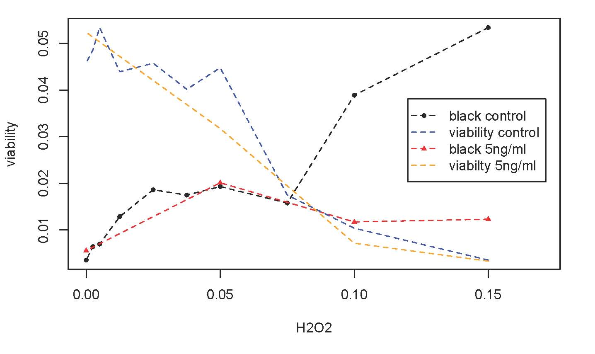
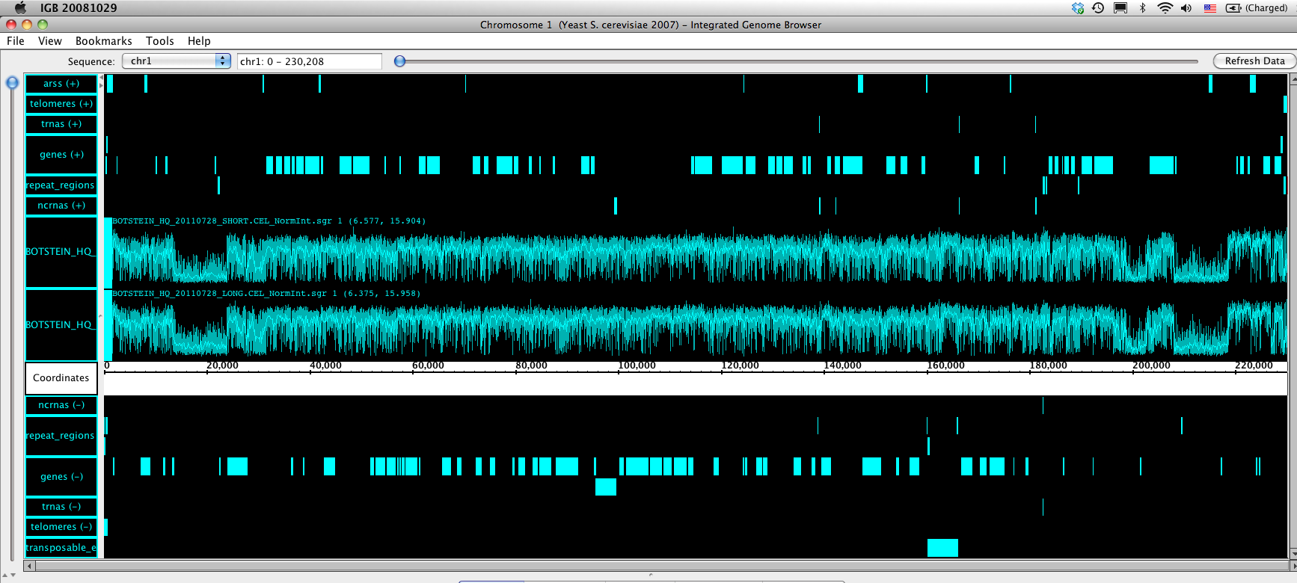
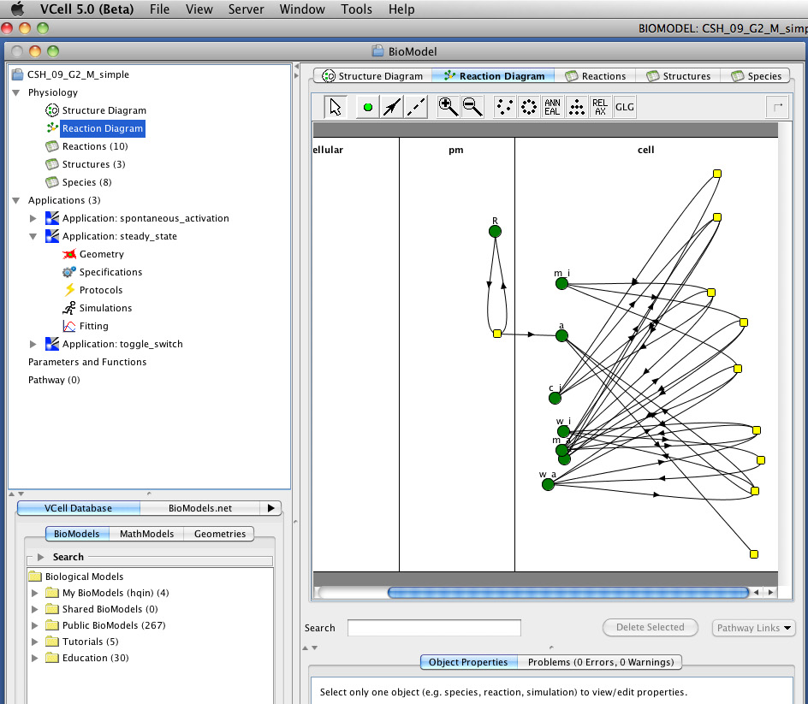
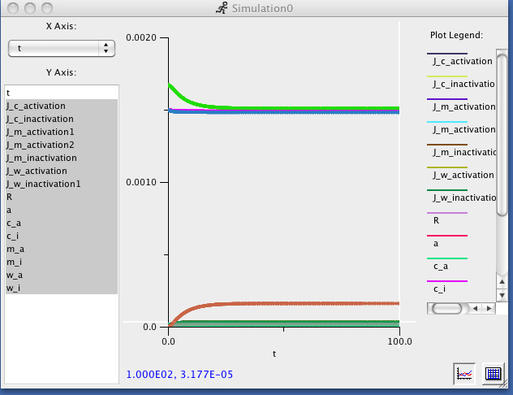
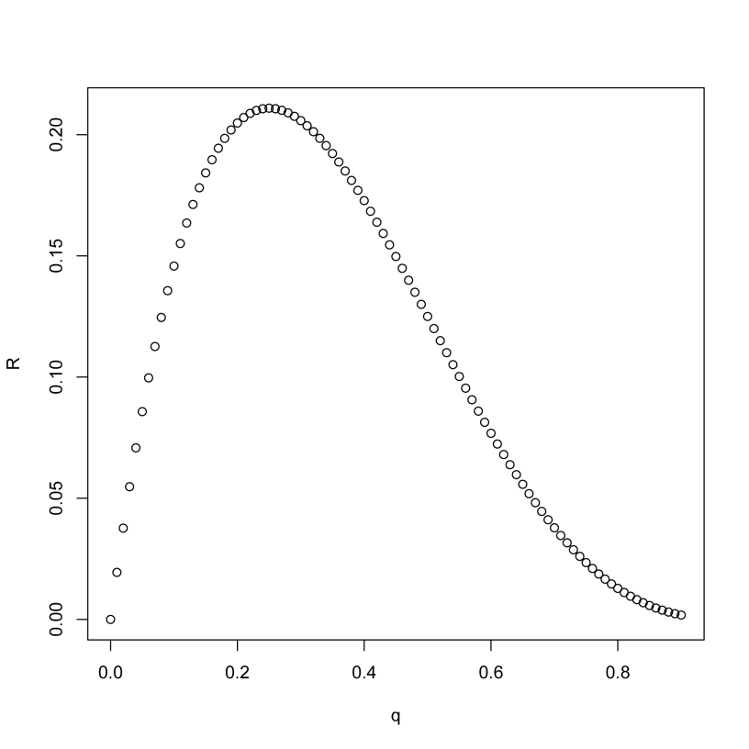
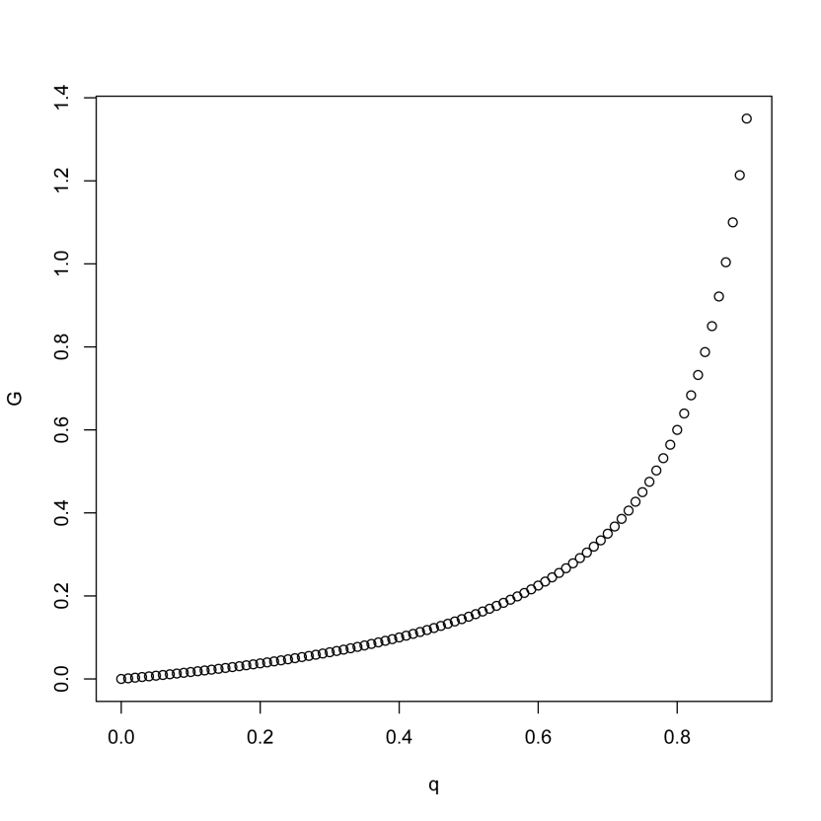
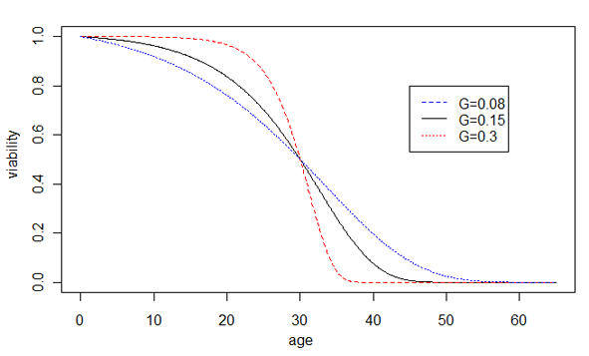
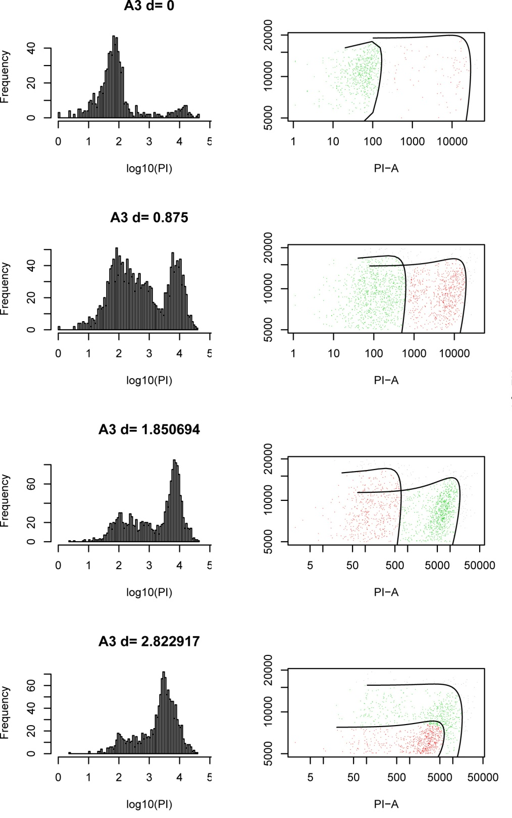
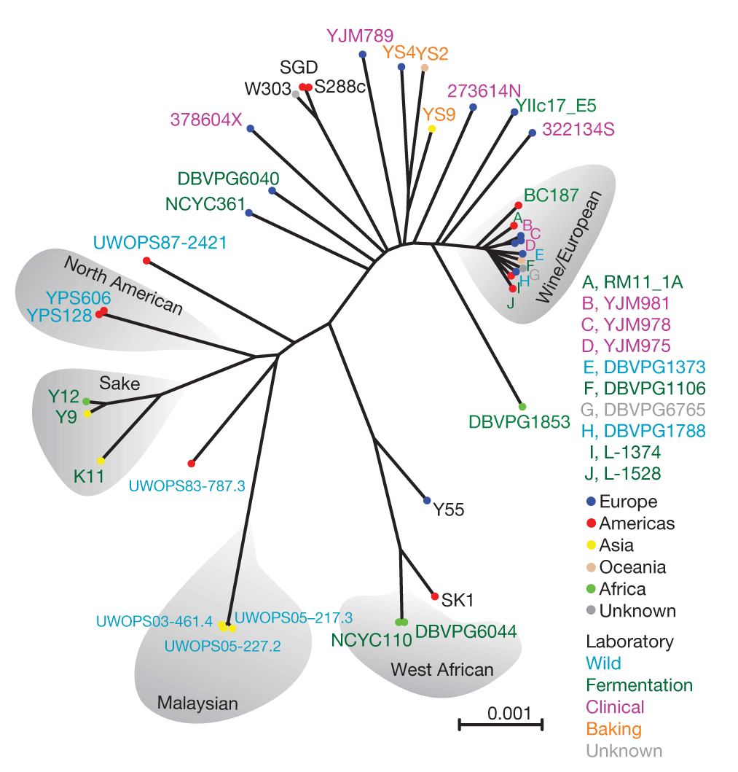

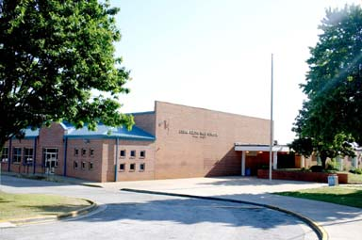
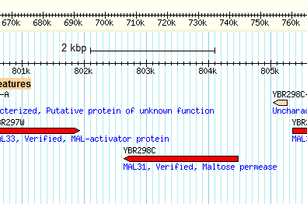
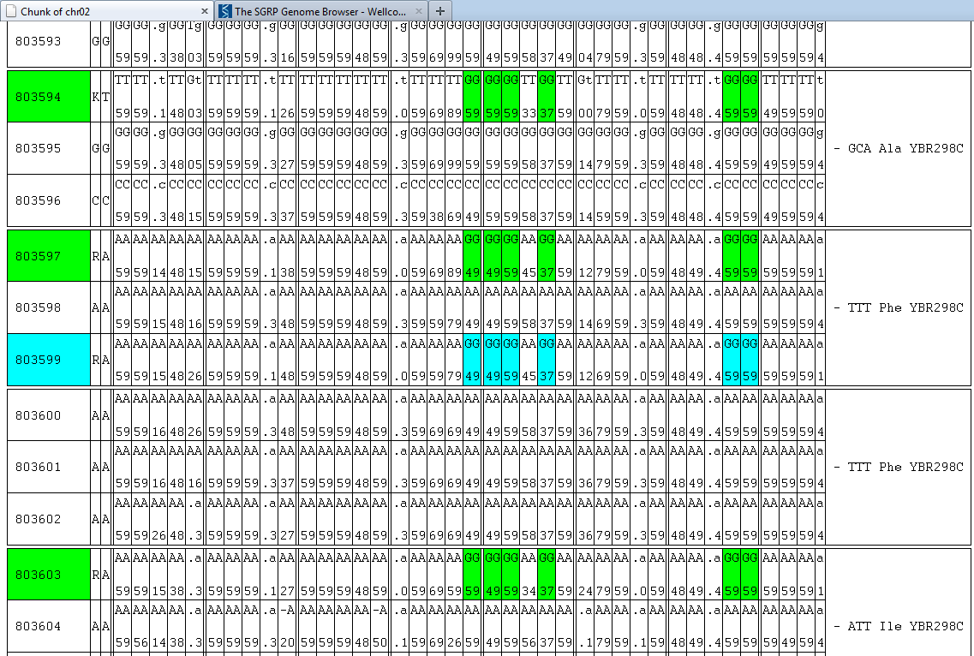
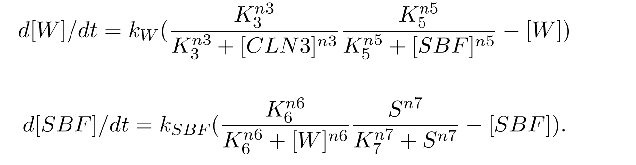
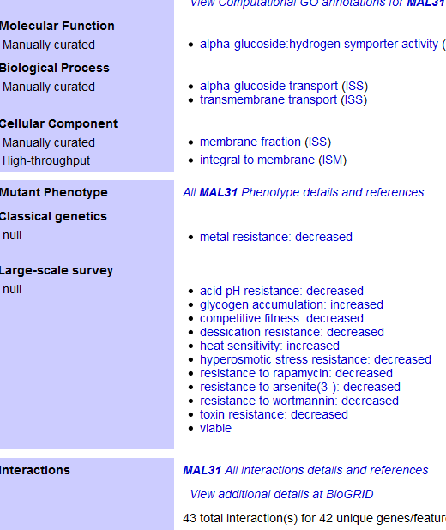
Emergence of Cellular Aging from Gene Networks
Hong Qin
Biology Department, Spelman College, Atlanta, GA 30314
Theoretic Component
Empirical Component
Educational Component
Abstract
What is aging? Why would a homozygous population of cells live to different ages? To understand the fundamental mechanisms of aging, we propose a mathematical model of cellular aging based on gene interaction network. This model network is made of only non-aging components, and interactions among genes are inherently stochastic. Death of a cell occurs in the model when an essential gene loses all of its interactions. The key characteristic of aging, the exponential increase of mortality rate over time, can arise from this model network with non-aging components. Hence, cellular aging is an emergent property of this model network. The model predicts that the rate of aging, defined by the Gompertz coefficient, is proportional to the average number of interactions per gene and that stochastic heterogeneity is an important factor in shaping the dynamics of the aging process. Preliminary experimental results to test the model predictions will then be presented. Finally, We also developed a prototype cell cycle based model of cellular aging that has the potential to connect nutrient sensing pathways to the non-proliferation model of cellular aging.
Testing the predicted connections between cellular aging and network robustness. Diploid versus haploid genomes Connection between genetic capacitors and cellular aging Oxidative stress and cellular aging Uncover genetic mechanisms underlying natural life span variation by genome-wide association study.
Undergraduate-based interdisciplinary research. The project provides intensive training on mathematical biology, genomics, genetics, cell biology, and computing. Integration interdisciplinary research into courses Develop computer labs on gene networks. Outreach to high-schools: Collaboration with teachers to develop interdisciplinary STEM curriculum. The lab will host a high-school teacher and students over the summer. Outreach to children’s summer camps: Science is cool.
Testing predictions
Radicicol effect on CLS
Table Aging rate is faster in diploid BY4743 than in haploid strains based on nest model tests.
Models | lnL
H0 R_{BY4741} = R_{BY4742} = R_{BY4743}, G_{BY4741}= G_{BY4742}= G_{BY4743} | -952.7
H1_{g2} R_{BY4741} = R_{BY4742} = R_{BY4743}, G_{BY4741}= G_{BY4742}≠G_{BY4743} | -946.1
H1_{i2} R_{BY4741} = R_{BY4742} ≠R_{BY4743}, G_{BY4741}= G_{BY4742} = G_{BY4743} | -939.4
H2_{ig2} R_{BY4741} = R_{BY4742} ≠ R_{BY4743}, G_{BY4741}= G_{BY4742}≠G_{BY4743} | -937.2
H3_{i3ig2} R_{BY4741}≠ R_{BY4742}≠ R_{BY4743}, G_{BY4741}= G_{BY4742}≠G_{BY4743} | -929.3 | Best parsimonious model p-value=3.6x10⁻¹⁰ (chi-square, df=3) G_{BY4741}= G_{BY4742} = 0.0653 G_{BY4743} = 0.0786
H6 R_{BY4741}≠R_{BY4742}≠R_{BY4743}, G_{BY4741}≠G_{BY4742}≠G_{BY4743} | -929.3
P-value = 0.027
Interdisciplinary training of students
A Stochastic Network Model on Cellular Aging
Hydrogen peroxide can induce LOH and its effect can be mitigated by rapamycin pre-treatment.
Tiling array to compare long- and
short-lived segregants.
?
?
?
?
?
?
?
?
m: the number of modules
n: the number of links per essential gene (essential module)
k: exponential decay rate (constant aging rate)
q: the chance of a link to be functional ( q = avg func links/ n)
c: a normalization constant
Gene network simulation in VCell
Model Predictions
Sequenced Sanger Strains
(200K SNPs)
Increased robustness
Decreased robustness
CLS by PI and Flow Cytometry
Partition strains to short, average, long-lived groups
Fisher’s exact test
(pop structure is ignored)
Outreach
Cell Cycle Based Aging Model
37K SNPs with q<=0.1
Growth
CLN3
(CycD)
WHI5
(Rb)
SBF
(E2F)
Senescence: arrest in good growth conditions
Quiescence: arrest in the poor growth conditions
Kaleidoscope Kids Camp of GA (Math & Science Enrichment for Youth ages 5-17)
Cedar Grove High School,
Ellenwood, GA
Aging effect
Long lived strains have
many nonsynonymous substitutions in MAL31
Support
NSF RUI 1022294
QEM/PDM 2011-13
NSF CCLI 0837075
Princeton Summer Program
FHCRC Summer Residence Program
Spelman College
Spelman Students
Shyla Hardwick
Janella Wynter
Erin Jackson
Alice Story
Meighan Parker
Domminique Parker
Ericka Dommond
Alisha Caliman
Megan Magee
Brittni Wilson
Corin White
Charita Montgomery
Kenee Daffin
Implications The reliability model predicts a negative correlation between R0 and G. Increase of network robustness/redundancy leads to smaller R0 and higher G. The G parameter is a proxy of gene network robustness. Heterogeneity and stochasticity are important features of life.
Rochester
David Goldfarb
Meng Lu
Virginia Tech
John Tyson
Chun Chen
Buck Inst
Brian Kennedy
WUstl
Justin Fay
Fred Hutchinson
Maxine Linial
Katie Peichel
Suzannah Rutherford
Antonio Bedalov
Dan Gottschling
Princeton
David Botstein
Alison Gammie
Sandy Sliverman
Mark Hickman
Christina DeCoste
Members of the Botstein lab, Kruglyak lab, and Broach lab.
Yale
Jeff Townsend
U Washington
Matt Kaeberlein
L'Université Paris Descartes
François Taddei
Ariel Lindner

