Slide 1

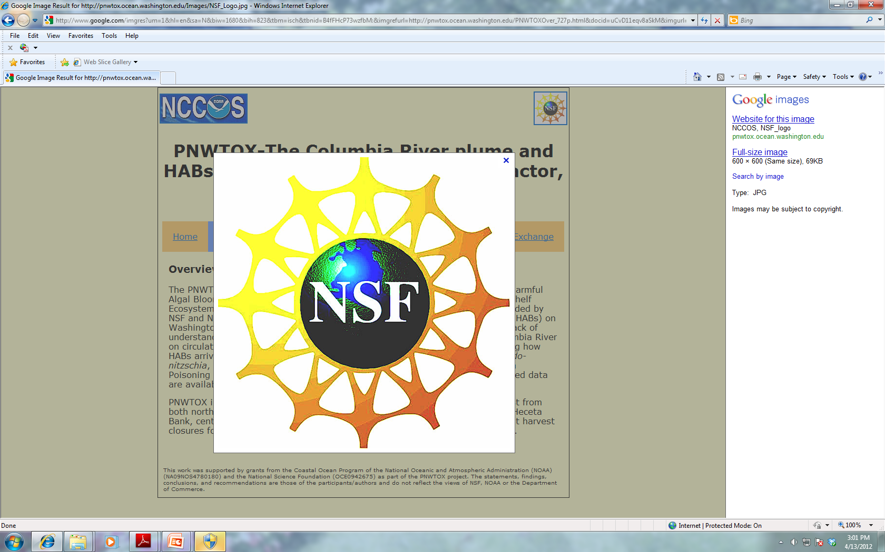
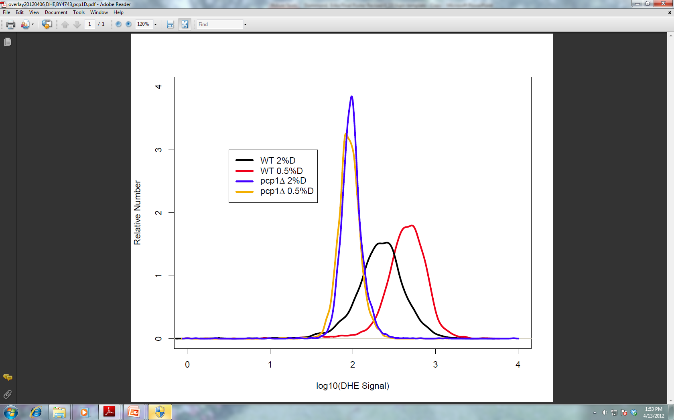
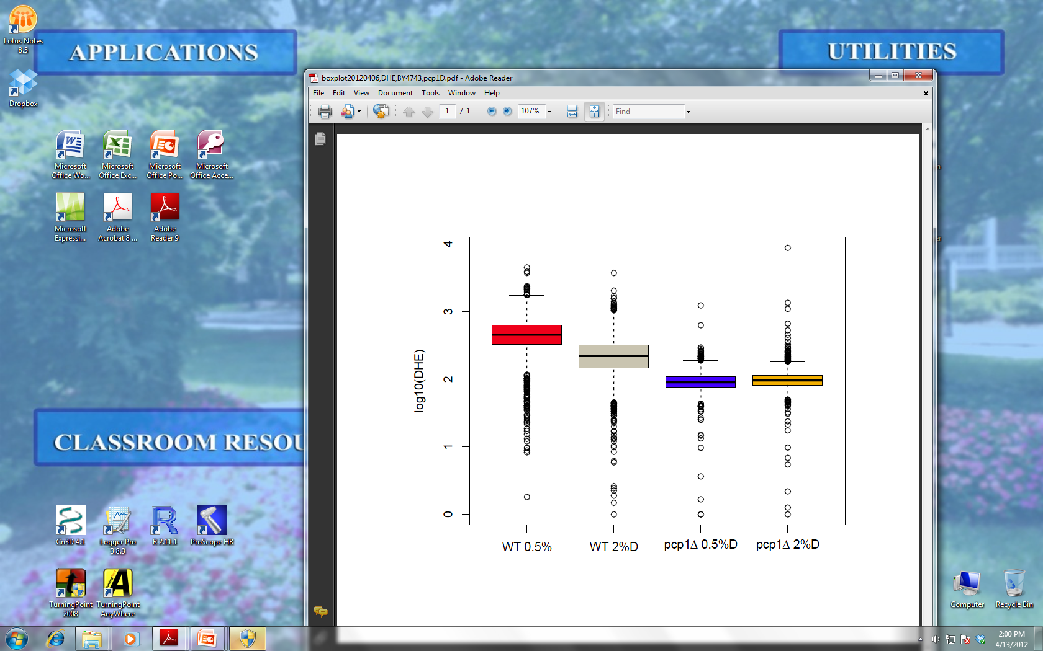
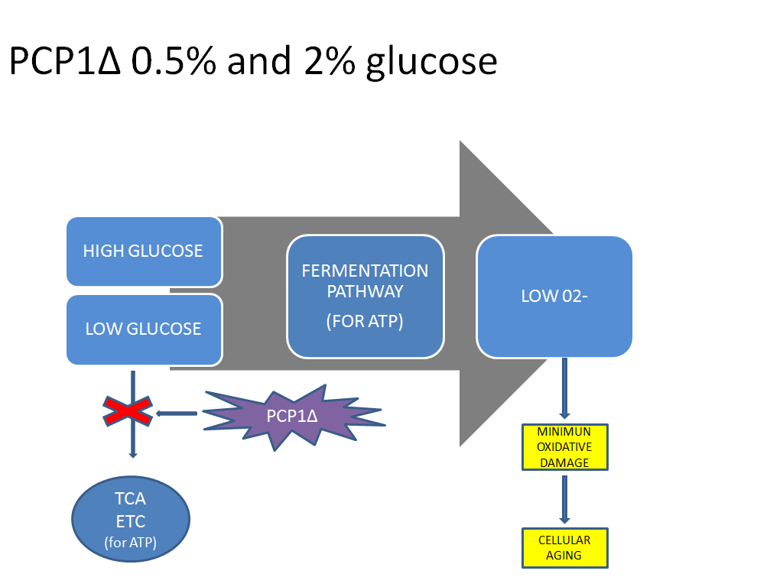
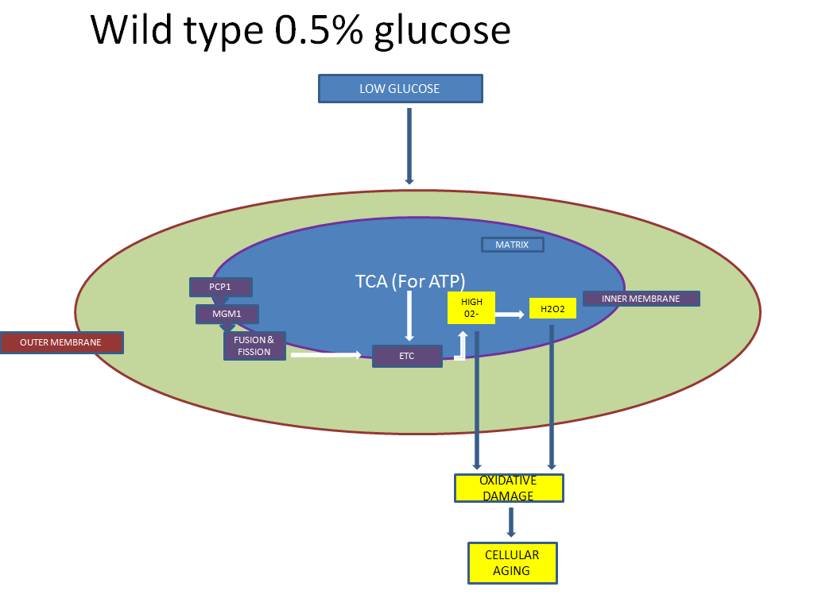
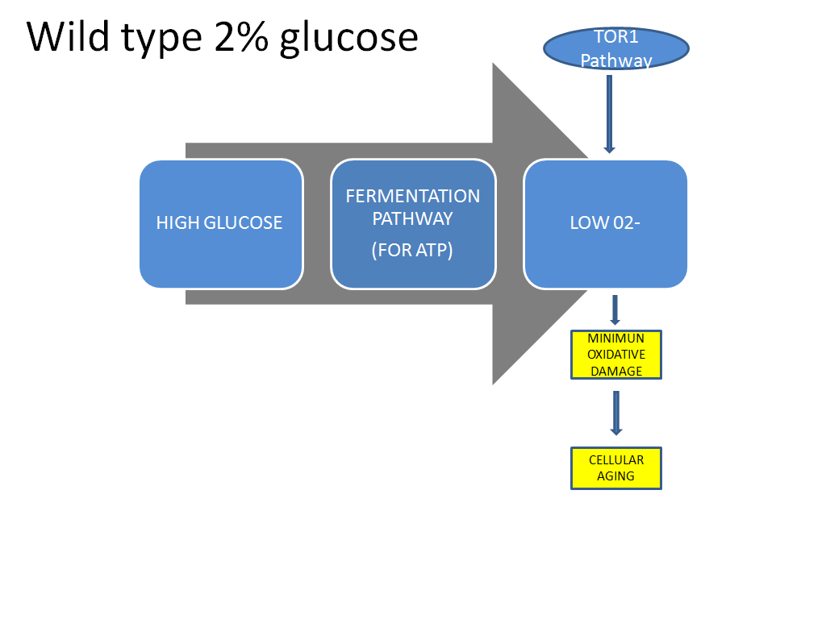
Mechanism of the long life span of yeast PCP1 null mutant Yamisha Rutherford, Nilin Gupta, Hong Qin Biology Department
Abstract
Mitochondria play a central role in life span extension effects of calorie restriction (CR). PCP1, a mitochondrial rhomboid serine protease, participates in mitochondrial dynamics and the processing of MGM1 a dynamin- like GTPase involved in mitochondrial fusion, fission and cristae formation. Deletion of PCP1 leads to extended replicative life span (RLS) and lower growth fitness. Therefore, we focused on the role of PCP1 to better understand the role of mitochondria in CR. We hypothesize that the effect of PCP1 on life span is due to its influences on the endogenous levels of superoxide anions. We test this hypothesis by comparing the superoxide levels between cells grown in normal conditions and calorie-restricted media, and then monitored the superoxide levels by dihydroethidium staining. Using flow cytometer, we found that CR induced higher superoxide levels in wild type cells during exponential growth. In contrast, cells of PCP1 deletion mutant show extremely low superoxide levels in both normal and CR media. These preliminary results suggest that the long RLS of pcp1∆ is due to its role in hindering the Citric Acid Cycle’s (CAC) ability to oxidize glucose and generate energy which then eliminates their healthy contribution to the production of high levels of O₂⁻ . Results also suggest that CR would have no effect on the lifespan of pcp1∆. This study can potentially lead to more insights on ageing-related diseases in humans.
Method & Results
Conclusion
Exposed pcp1∆ and BY4743 cells to 2% glucose and 0.5% glucose (CR).
Add PBS and DHE dihydroethidium to each sample.
Intracellular superoxide anions were measured via dihydroethidium DHE (Molecular Probes) signals using a FACSCaliber2 flow cytometer (BD-Biosciences) with a 488-nm excitation laser. Signals from 25,000 cells/sample were captured in FL3 (>670 nm) at a flow rate of 5,000 cells/s.
In this step DHE is oxidized by the superoxide anions into ethidium. Ethidium can then bind to DNA which allows for the red fluoresce to be visualized.
When pcp1∆ cells are in 0.5% glucose media they would normally use the CAC to convert glucose into energy but deleting PCP1 seems to impair the function of the mitochondria. Deleting PCP1 inhibits the processing of MGM1 which disturbs the structure of the inner member of the mitochondria where the CAC and ETC is.
Consequently the CAC can not produce energy or (O₂⁻) and so even under low glucose conditions the cell is forced to use fermentation to produce energy instead. Without a functional mitochondria CR does not work. When the pcp1∆ cells are in normal nutrient conditions deleting PCP1 is of no importance because the energy producing pathway is fermentation and so superoxide anion levels are low as well. In retrospect deleting PCP1 increases the longevity of the cells under calorie restricted conditions because it forces the cell to oxidize glucose by a pathway that produces less superoxide anions opposed to more.
When comparing the BY4743 wild type cells grown in normal medium 2% glucose and 0.5% glucose there are higher DHE signals in those cells exposed to CR conditions. Contrarily pcp1∆ has low DHE signals regardless of glucose concentration which indicates that CR does not work in pcp1∆ cells.
Figure A) The wild type cell BY4743 under calorie restricted conditions (0.5% glucose ) uses the CAC and Electron transport chain (ETC) to oxidize and convert glucose into energy. The goal is to compensate for the energy output when there is a low level of glucose. The CAC coupled with the ETC is effective in producing 36 to 38 ATP per molecule of glucose. Although this pathway generates more ATP it contributes more (O₂⁻) which is detrimental to the cells lifespan.
Figure B) The wild type cell exposed to normal nutrient (2% glucose) partakes in the fermentation pathway to convert glucose into useful energy. The fermentation pathway produces 2 ATP per molecule of glucose which is sufficient when glucose is in abundance. When comparing this pathway to the CAC fermentation contributes very little to the (O₂⁻) content.
Discussion
References
Ralf J. Braun and Benedikt Westermann. “Mitochondrial dynamics in yeast cell death
and aging.” Biochemical Society Transactions 39 (2011): 1520-1524
Martin Weinberger. “Growth signaling promotes Chronological aging in budding yeast by inducing superoxide anions that inhibit quienscence.” AGING 2 (2010): 709-726
Targeting essential mitochondrial proteins such as PCP1 and evaluating their roles in mitochondrial functions is imperative because it gives researchers the opportunity to put efforts toward manipulating the results of specific pathways. By knocking out PCP1 we were able to achieve lower endogenous ROS levels in yeast cells exposed to caloric restricted conditions by tampering the performance of the CAC. These finding are significant because superoxide anions are known to be the causative agents of cellular protein, lipid, and DNA damage as well as fragmentation of the mitochondria i.e. cellular aging. In future studies we would like to analyze how CR, pcp1∆ and tor1∆ (*TOR1 is a protein kinase and rapamycin target that controls growth in response to nutrients) act in concert to combat high superoxide anion levels.
Acknowledgements
Funding: We would like to give our thanks and appreciation to NSF award #1022294 and support of Spelman ASPIRE program.

