Slide 1


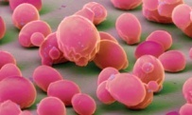
Live Long and Prosper The Yeast Way
Hong Qin
Bio-seminar, April 14, 2011
4pm, Sci 134

Slide 2
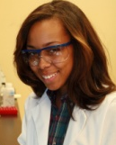
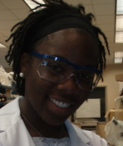
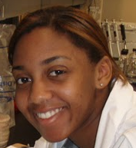
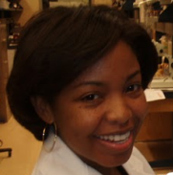



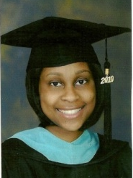
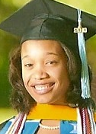
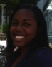

We study the life history of yeast cells
Chronological lifespan
Reproductive lifespan
Age-dependent changes
Fitness
Mutation rate, genome integrity
Oxidative stress responses
Metabolic states

Slide 3
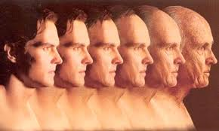
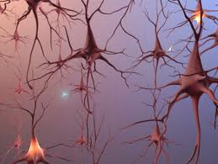
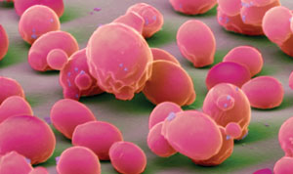
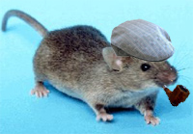
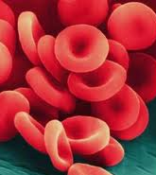
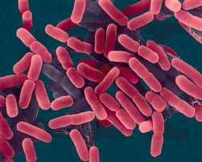
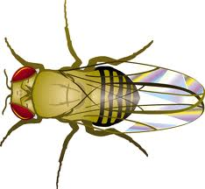
Yeast is a model to study cellular aging.

Slide 4
Question: What are regular practices that can help people live longer?

Slide 5
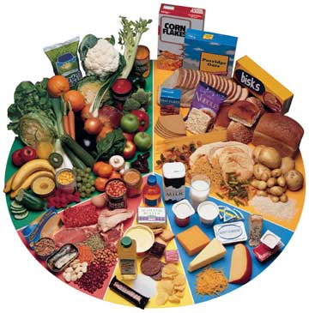

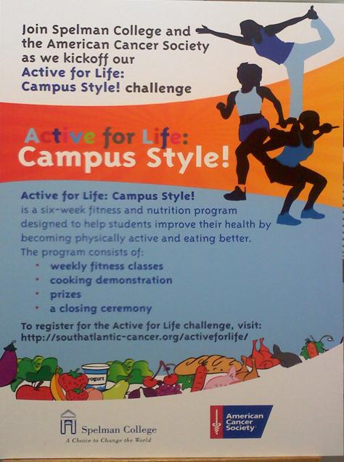
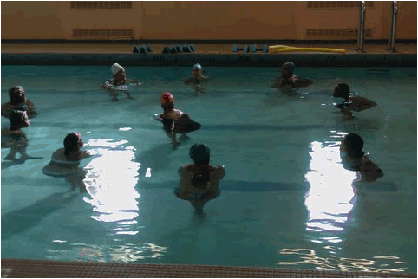
Exercise & Healthy Diets
Notes:
Add a yeast cell exercising picture!

Slide 6
Can someone draw a cartoon of this for yeast cells?
Exercise & Healthy Diets
Mitochondria
Reactive Oxygen Species
Damages to DNA, Protein, RNA

Slide 7
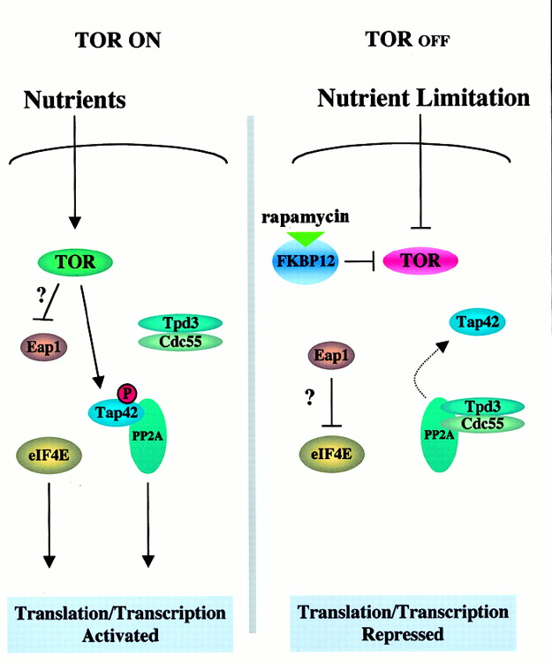
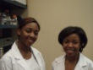
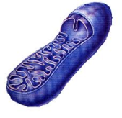
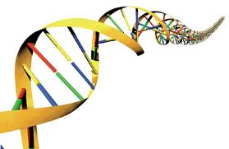
Reactive Oxygen Species is a cause of aging: How do we study this in yeast?
H2O2
Notes:
Add student pictures

Slide 8


Detection of H2O2 damages to yeast genome
Cells in water
H2O2
No mutation
MET15^{+/-}
MET15^{+/+}
Mother Cells
Mutation
met15^{-/-}
First mitosis
Mutation
Notes:
During aging, there is accumulation of oxidative damages in mother cells. Mother cells tend to keep these damages within themselves. Ideally, daughter cells should be born free of damages. Hence, the partition of cellular components is asymmetric.
The ratio of half blacks over full blacks measure how much oxidative damages are passed to the next generation.
This direction is related to DNA repair pathways.

Slide 9

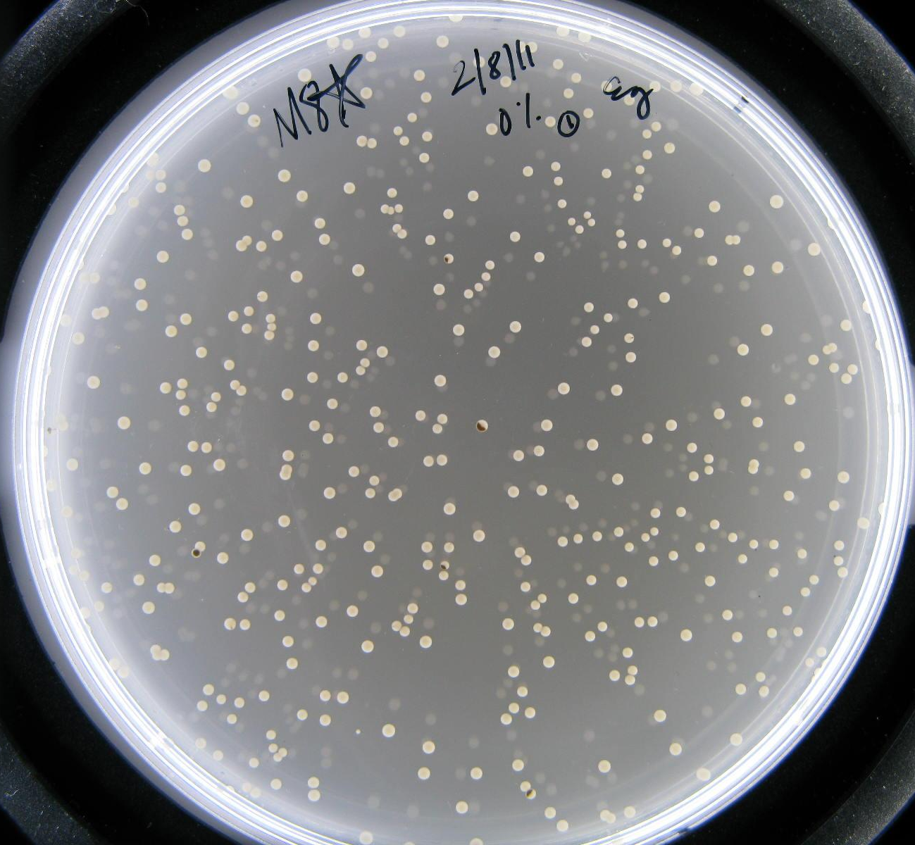
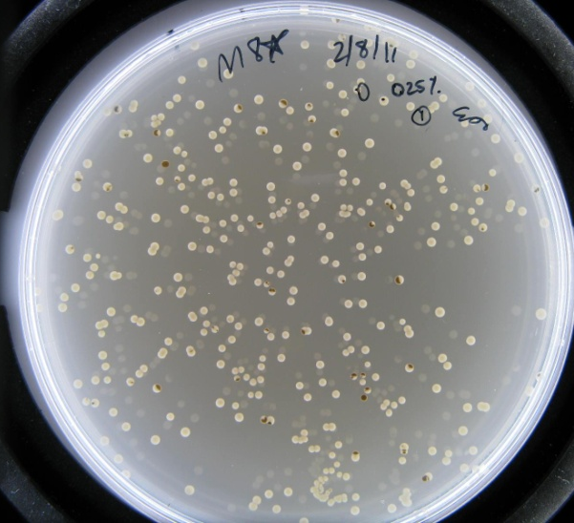
Mutation of Met15^{+/-} can be detected on plates.
Old cells
Young cells

Slide 10
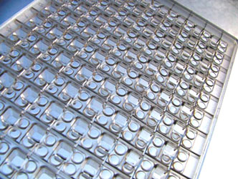

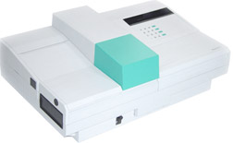
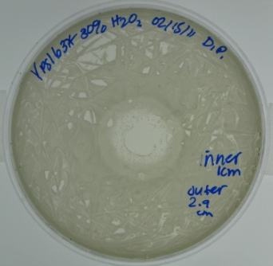
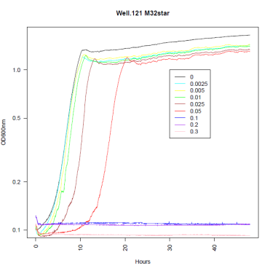
Measuring resistance to oxidative stress
Yeast Plate
Yeast
Add Hydrogen Peroxide
Notes:
Use 12 strains of yeast whose life span have been characterized in details (Qin & Lu 2006, Qin, Lu & Goldfarb 2008)

Slide 11
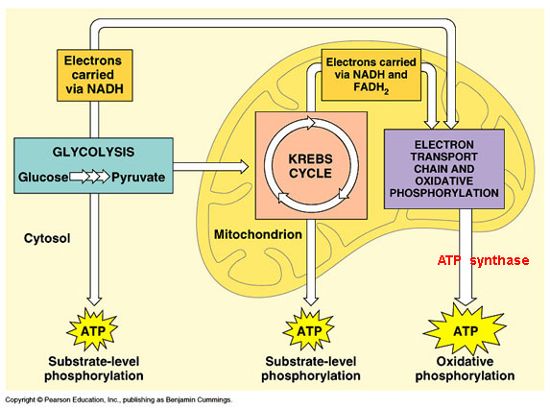
Study the role of mitochondria ― Yeast cells on ‘healthy’ diets
GLUCOSE
ETHANOL
H2O2

Slide 12
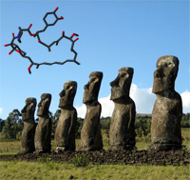
Rapamycin: A miracle drug to mimic dietary effect
Rapamycin and Rapa Nui
Rapamycin can extend the lifespan of yeast and mice.
Notes:
http://scienceblogs.com/notrocketscience/2009/07/rapamycin_-_the_easter_island_drug_that_extends_lifespan_of.php

Slide 13

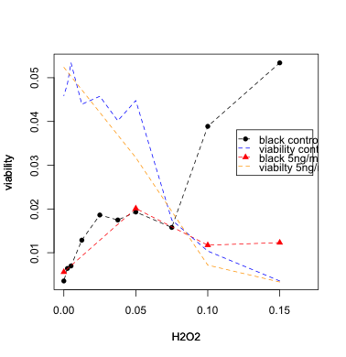
Does rapamycin improve resistance to oxidative stress?
Active
TORC1
Rapamycin
Inactive
TORC1
Reactive Oxygen Species
(cause of aging)
DNA Damage (mutations)

Slide 14
Questions What is biological aging?
Why do biological aging differ from machine aging?

Slide 15
Our unique hypothesis Cellular aging is an emergent property of gene networks.
?
?
?
?
?
?
?
?
m: the number of modules
n: the number of links per essential gene (essential module)
k: exponential decay rate (constant aging rate)
q: the chance of a link to be functional ( q = avg func links/ n)
c: a normalization constant
Modular network with
stochastic links

Slide 16
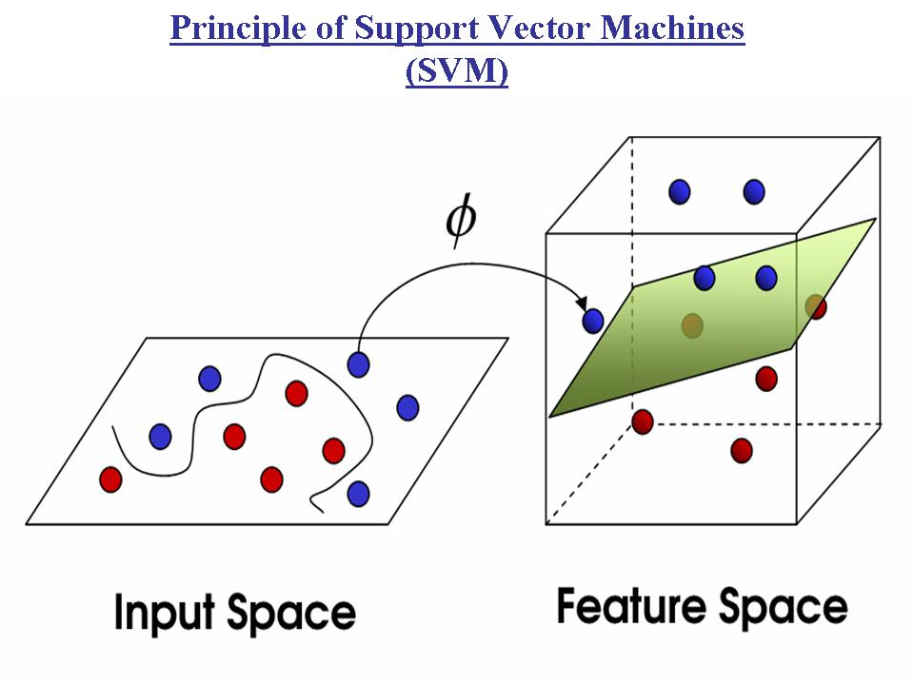

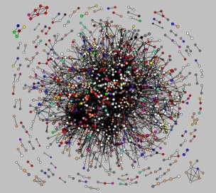
Computational and mathematical study on network and aging

Slide 17
Other students and their projects
Computational genomics
Joi Gaddy
Simulation of infectious diseases
L. Patrice McGahee, Courtney Dill, Kiara Brown

Slide 18
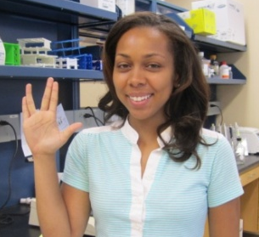
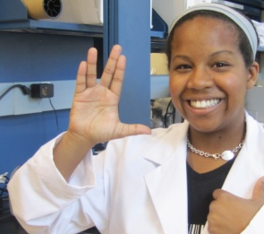
Announcements
A full-time research technician position is open.
Student research positions available in 2011-2012.
Genome-wide association mapping of longevity genes.
Quantitative genetics on yeast aging.
Mid-school and high-school teachers interested in bring genome biology concepts to classrooms.
Simple experiments using yeasts
Sequence analysis computer exercises
Protein structure modeling

