Slide 1
Study the Link between Oxidative Stress and the Aging Process in Yeast

Slide 2
Reactive Oxygen Species is a hypothesized cause of aging
Oxidative stress in involved in heart failure, Parkinson’s disease, Alzheimer’s disease and chronic fatigue syndrome
Oxidative stress is an imbalance between production and detoxification of oxidative substances (Schafer & Buettner 2001)
A buildup of these free radicals can lead to damage in parts of the cell
Build-up of Free Radicals
Oxidative Stress
Apoptosis
Inflammation
ADHD
Cancer
Heart Disease
Aging
Alzheimer's
Parkinson’s
Notes:
Oxidative stress is also known to be involved with aging
Reactive oxidative species

Slide 3
Notes:
Reactive Oxidative Species

Slide 4
The lifespan of Yeast can be measured using two mechanisms
Replicative Life Span is the number of times one cell can divide before is senesce (Fabrizio & Longo 2003)
Chronological life span is how long a cell can live without dividing, (Lai & Jazwinski 2002)
Notes:
(Yeast as Model to study cellular aging in oxidative stress)

Slide 5
Hypothesis
Is there a correlation between resistance to oxidative stress and variation in life span and life-history traits?
Is there a correlation between oxidative stress and chronological life span?

Slide 6
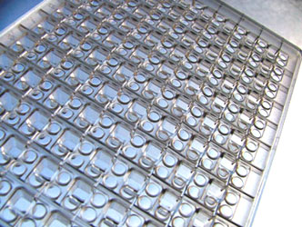

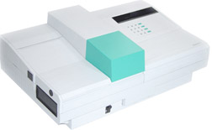
Experimental Design
Use 12 strains of yeast whose life span have been characterized in details (Qin & Lu 2006, Qin, Lu & Goldfarb 2008)
Yeast Plate
Yeast
Add Hydrogen Peroxide
Measure amount of Damage
in Plate using Ruler
Measure Oxidative Stress
Using Linear Regression Analysis

Slide 7
 | Inner Circle at 15% (cm) | Inner Circle at 30% (cm) | Outer Circle at 15% (cm) | Outer Circle at 30% (cm) | Death H202 %
M5* | 0.5 | 0.7 | 2.1 | 2.6 | 5
M32* | 0.6 | 1.8 | 0.5 | 1.7 | 10
YPS163 | 1.0 | 1.0 | 2.8 | 2.9 | 2.5
M1-2* | 0.5 | 0.6 | 2.0 | 2.6 | 5
M2-8* | 0.5 | 0.7 | 2.0 | 2.7 | 5
M22 | n/a | n/a | 3.5 | 4.5 | 2.5
YPS128 | 1.0 | 1.0 | 2.3 | 2.5 | 5
M34* | 0.5 | 0.9 | 2.2 | 2.7 | 5
M8* | 1.0 | 0.8 | 2.5 | 2.6 | 5
101s* | 0.8 | 0.9 | 3.0 | 3.0 | 5
M13* | 1.9 | 1.2 | 2.5 | 2.7 | 5
M14 | n/a | n/a | 3.0 | 4.1 | 2.5

Slide 8
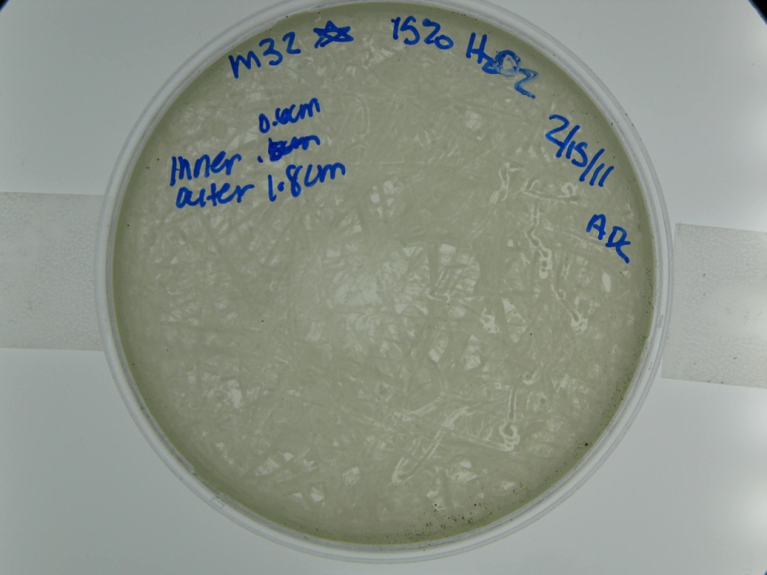
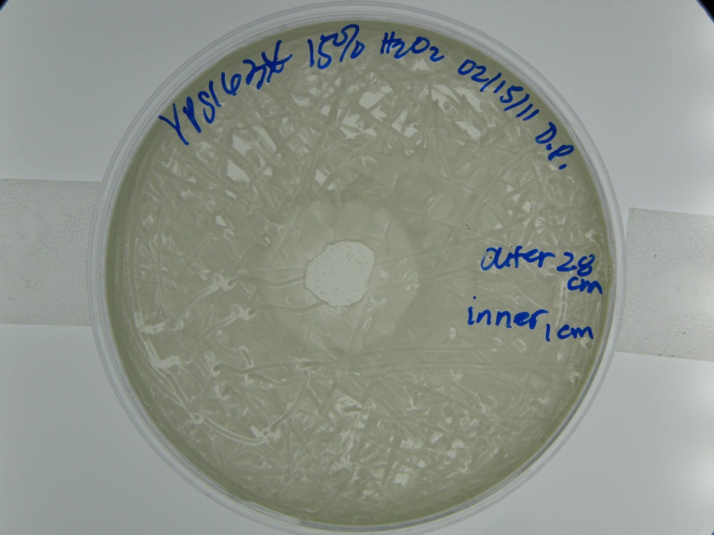
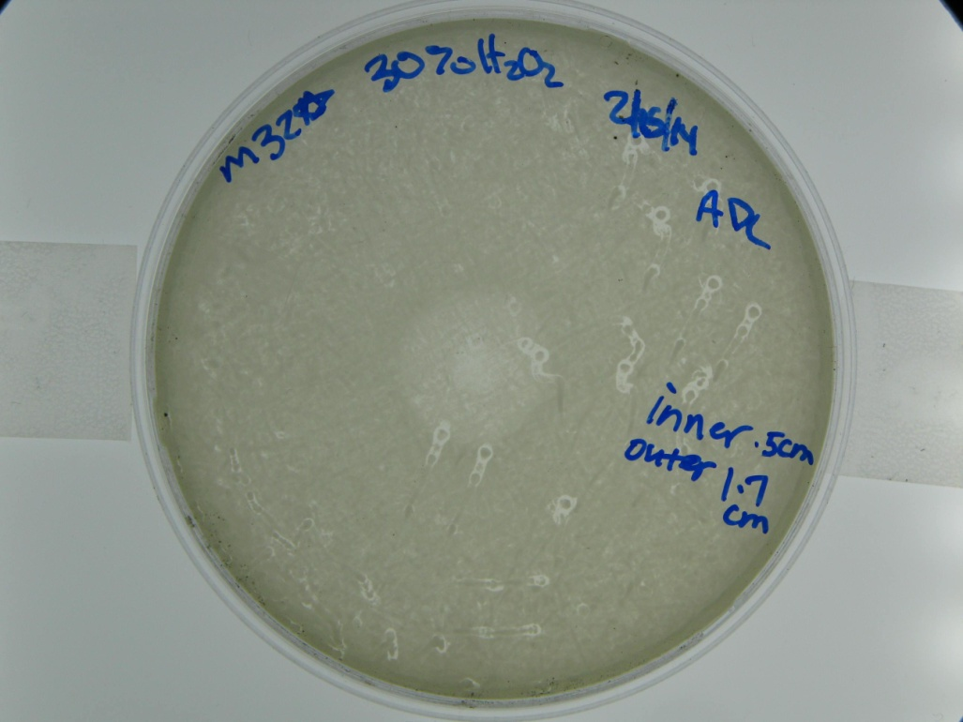
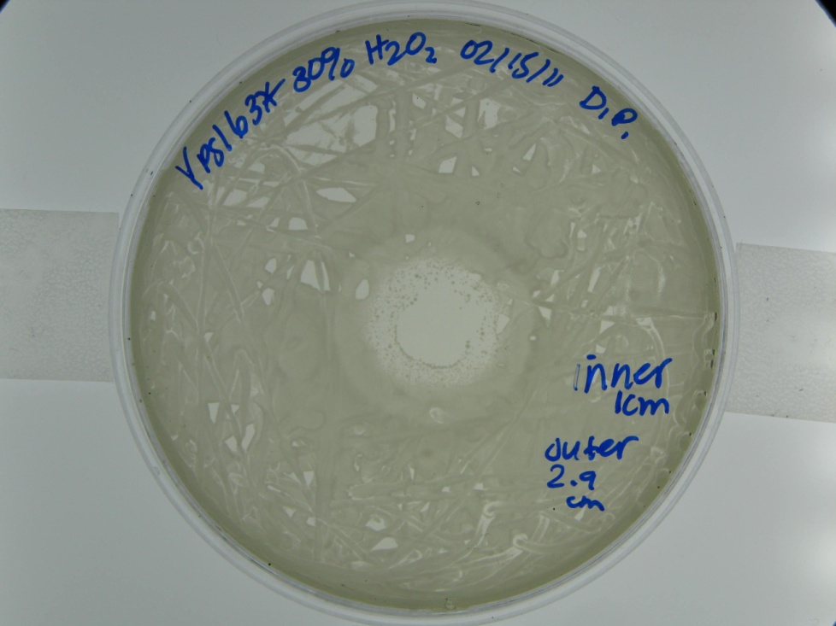
With an increase in Hydrogen Peroxide Concentration, there is an increase in oxidative damage
Notes:
Arrow

Slide 9
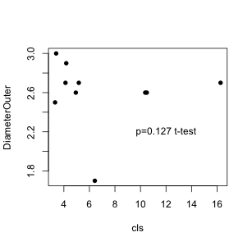
Chronological life span vs. Outer Diameter

Slide 10
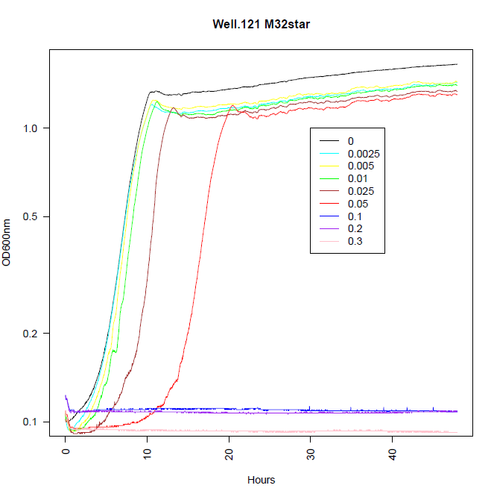
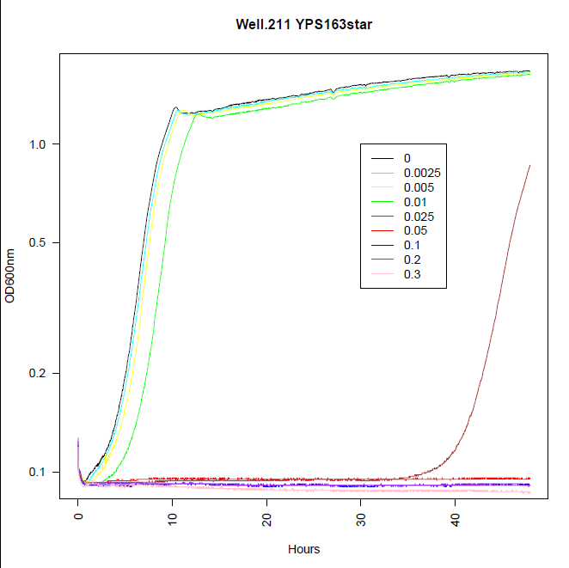

Slide 11
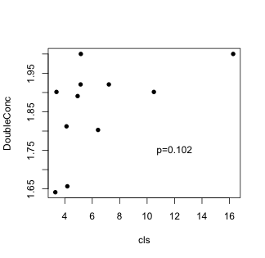
Chronological life span vs. Hydrogen Peroxide Concentration

Slide 12
(Future Directions)
The specific mechanism of Cellular Aging has yet to be discovered
SIR2, TOR1 and SCH9 are known to be involved in aging
Sir2 is involved in an organisms' response to stress (Kaeberlein & Guarente 1998)
TOR1 controls growth by regulating transcription and translation (Zheng & Schreiber 1997, Beck & Hall, 1999)
SCH9 is involved in the G1 phase (Toda 1988, Crauwels 1997)
Notes:
correlated

