Slide 1

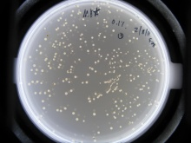
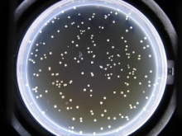
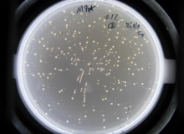
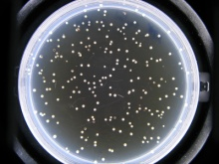
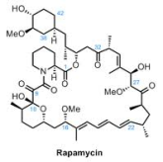

The Effect of Rapamycin on Genomic Instability due to Oxidative Stress
Brittni Wilson, Hong Qin, Biology Department
Introduction
Results
These are pictures of a Rapamycin treated and non Rapamycin treated plate. Both plates contain .3% of H2O2. The dark spots represent the genetic mutations.
Rapamycin is an immunosuppressant drug first discovered on the mythological land of Easter Island. Since its first discovery, it has commonly been used to suppress the immune system of organ transplant patients. More recently, researchers have discovered its ability to lengthen the life span of a mouse by 9%-14%. As mice and other organisms age, molecular functions deteriorate due to oxidative stress, which can include toxins in the air that inhibit regular function, thus causing diseases and death. However, Rapamycin may be the modern day “fountain of youth” that prolongs the oxidative stress effects. In this study, hydrogen peroxide is the oxidative stress that induces genomic instability in the test subject, Saccharomyces cerevisiae. The impact of Rapamycin is measured by observing how many black spots can be seen from the different yeast colonies. The results are change in mutations in Rapamycin treated plates versus the mutations in the non Rapamycin treated plates .
M8* with 0.1% H202
M8* with 5ng/ml Rapamycin and 0.1% H202
M8* with 0.1% H202
M8* with 5ng/ml Rapamycin and 0.1% H202
M8* with 0.1% H202
M8* with 5ng/ml Rapamycin and 0.1% H202
M8* with 0.1% H202
M8* with 5ng/ml Rapamycin and 0.1% H202
Active
TORC1
Active
TORC1
Rapamycin
Rapamycin
Inactive
Calorie Restriction
Calorie Restriction
TORC1
conclusion
Summary
Inactive
TORC1
Reactive Oxygen Speices
(A cause of aging)
Aging
Damages mutations)
Rapamycin does counteract the effects of the oxidative stress, hydrogen peroxide in Saccharomyces cerevisiae. With this in mind, one must wonder what effects it can have on other forms of oxidative stress, specifically those involved in diseases of the human body.
Rapamycin has been proven to increase the lifespan of mice, so researchers want to test this immunosuppressant drug on Saccharomyces cerevisiae to investigate whether or not it will have similar effects. The aging in mice is equivalent to the oxidative stress, hydrogen peroxide. Therefore, yeast is exposed to both hydrogen peroxide and Rapamycin. This experiment is compared to an experiment where yeast is only exposed to hydrogen peroxide. Both sets of plates were incubated and observed. Mutations are distinguished by the black areas seen in the tan colored yeast colonies. After given time to grow, the Rapamycin treated plate did have fewer mutations than the non Rapamycin treated plate. These results indicate a reduction in mutation rates as the Rapamycin concentrations increased, consequently supporting the hypothesis that Rapamycin inhibits genomic instability.
Life Span
objectives
methods
To study the effects of Rapamycin on the genomic stability of Saccharomyces cerevisiae.
Rapamycin Treatment
(5ng/ml)
H2O2 Treatment
(0%, 0.1%, 0.2%, 0.3%)
materials
No Rapamycin
Treatment
H2O2 Treatment
(0%, 0.1%, 0.2%, 0.3%)
Yeast strains: M8 Met15+/-.
Rapamycin
Hydrogen Peroxide
Yeast plate with lead ions.
Grow yeast cells in YPD
Grant numbers: 5200613 and NSF RUI 1022294

Slide 2
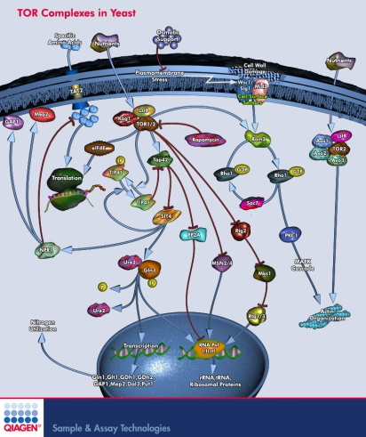
Active
TORC1
Rapamycin
Inactive
TORC1
Calorie Restriction
Life Span
Reactive Oxygen Speices

Slide 3
Active
TORC1
Rapamycin
Calorie Restriction
Inactive
TORC1
Life Span
Active
TORC1
Rapamycin
Calorie Restriction
Inactive
TORC1
Reactive Oxygen Speices
(A cause of aging)
Damages mutations)
Aging

