Slide 1
The Interconnection Between Cellular Aging and Robustness
Presented by
Amanda Alexander
Research Advisor: Dr. Hong Qin
Mathematics Dept. & Biology Dept.
Spelman College
April 19, 2013

Slide 2
Overview
Background
Hypothesis
Methods
Results
Conclusions
Future Directions

Slide 3
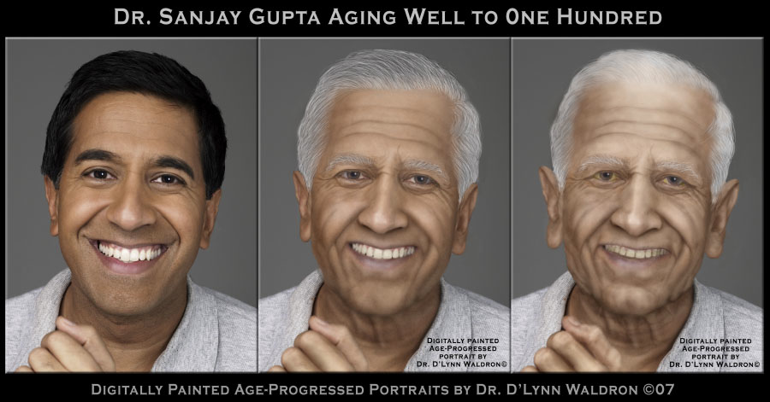
Cellular Aging
Aging- the process of progressive deterioration of cellular functions due to modifications of proteins and protein pathways
Reduction in protein activity, specificity, and longevity.
Preliminary research suggests that the rate of cellular aging is proportional to robustness.
Notes:
Cell aging is a product of detrimental protein modifications that lead to consequential inefficiency in associated cellular networks and overall increased sensitivity to stochastic variations.
http://www.immortalhumans.com/a-new-hint-into-cellular-aging-has-been-identified-by-biologists/

Slide 4
Robustness
The ability to withstand mutational, environmental or stochastic variation.
Mechanisms of robustness may have developed to protect cells from harmful mutations or environments.
Correlates of robustness – fitness, evolutionary distance, morphological plasticity, degree of protein interactions, and degree of genetic interactions.
Notes:
Fitness = the capacity of a cell to survive and reproduce relative to other cells in the same stem cell niche
Evolutionary Distance = measures the genetic divergence between populations within a species (yeast)
Morphological plasticity = the ability of an organism to change its phenotype in response to environmental perturbations
Degree of protein interactions = quantifies the protein-protein interactions that take place in a yeast cells (protein interaction networks carry out and regulate cellular processes)
Degree of genetic interactions = quantifies gene interaction networks in the yeast cells (gene interactions carry out and regulate cellular processes)

Slide 5


Robustness
Luxury cars provide a much smoother ride that does not make your comfort contingent upon road conditions.
In a vehicle such as a bus, you are totally subject to experience the road as it is- you will be very aware of every pothole you run over.
Notes:
http://classifieds.uplog.org/ads/mercedes-benz-slr-mclaren/
http://www.tirebalancingbeads.com/school-bus-fleet-saves-money-balancing-tires/

Slide 6
Robustness and Cellular Aging
Robustness
Fitness
Degree of protein interactions
Cellular Aging
Replicative lifespan (RLS)
Evolutionary Distance
Morphological plasticity
Degree of gene interactions

Slide 7
Gene Networks
Cells have internal networks, gene networks and protein networks, which allow for the communication of the molecules inside of the cell.
The expression of genes necessary for survival will affect the adaptability of the organism to different environments.
Notes:
Networks regulate the cells response to different environments, which affects the cells ability to adapt.
Do I need this slide?

Slide 8
Hypothesis
Robustness enables cells to withstand environmental, mutational, and stochastic variation and thus will positively correlate with replicative lifespan.
Replicative Lifespan
Genetic Interactions
Fitness
(YPE)
Morphological Plasticity
Evolutionary Distance
Protein Interactions
Notes:
Arrow between fitness and protein interactions

Slide 9
Materials & Methods
Yeast model of cellular aging; clear quantification of aging, easily genetically manipulated.
R statistical programming environment for data analysis.
Linear regression analysis to understand relationships among factors of robustness and replicative lifespan in yeast.
Notes:
Yeast (Kaeberlin 2007)
Linear regression: p-value < 0.05 will be considered significant
Need to add more information about linear regression and p-value (in case audience

Slide 10
Significant Relationship between Fitness and Cellular Aging

Slide 11
Insignificant Relationship between Evolutionary Distance and Cellular Aging
Notes:
Should I change title to “Insignificant Relationship…”???

Slide 12
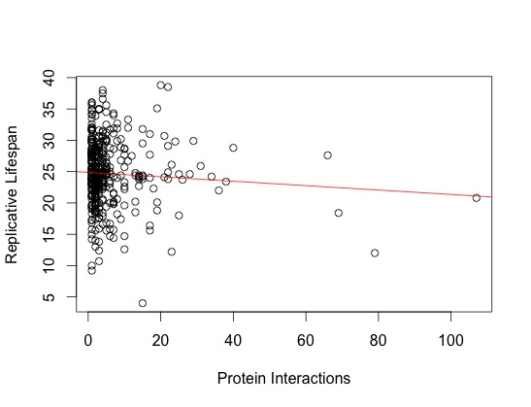
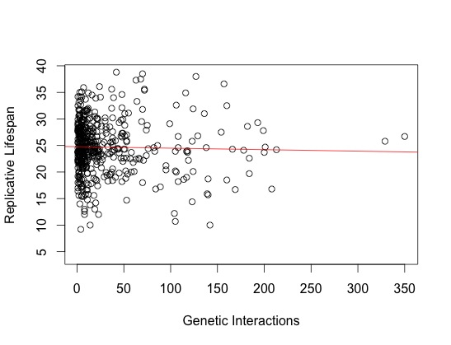
Protein Interactions and Genetic Interactions are not Significantly Correlated with Cellular Aging
P-value = 0.1759
R² = 0.004564
P-value = 0.5641
R² = 0.0006784

Slide 13
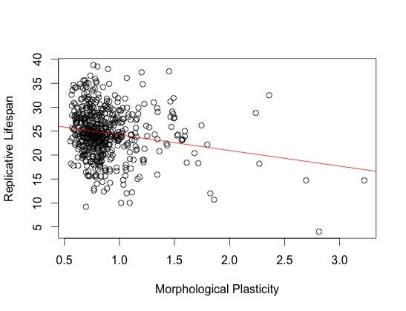
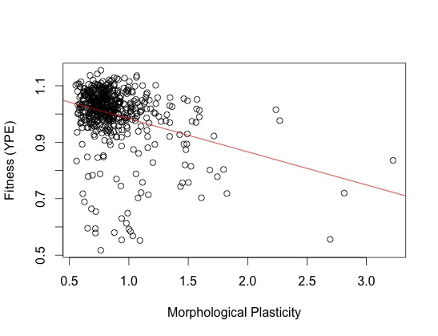
Morphological Plasticity : Factored into Cellular Aging and Fitness
P-value = 1.08 x 10⁻¹³
R² = 0.09902
P-value = 1.349 x 10⁻⁵
R² = 0.03431
Notes:
Negative (inverse) correlation between morphological plasticity and fitness
Negative (inverse) correlation between morphological plasticity and replicative lifespan

Slide 14
Morphological Plasticity : Factored into Cellular Aging and Fitness
Individual p-values displayed in parentheses
Notes:
Add RLS vs Morphological Plasticity graph instead of tables?
Highlight significant p values

Slide 15
Fitness: Factored into Genetic Interactions, Protein Interactions, and Replicative Lifespan

Slide 16
Replicative Lifespan, Morphological Plasticity, and Fitness (YPE)
P-value = 1.349 x 10⁻⁵
P-value = 2.58 x 10⁻⁵
Replicative Lifespan
Morphological Plasticity
P-value = 1.045 x 10⁻⁵
P-value = 0.01488
P-value = 1.08 x 10⁻¹³
P-value = 0.383
Fitness (YPE)

Slide 17
Summary
The growth fitness in ethanol medium has the strongest correlation with lifespan, suggesting that respiratory metabolism is most informative to lifespan.
There is a significant negative correlation between replicative life span and morphological plasticity, which is inversely correlated with robustness.
There is a significant correlation between growth fitness and the number of protein and genetic interactions.
There is an interesting connection between morphological plasticity, fitness, and replicative lifespan
Notes:
Confused about 2nd bullet point
Improve 4th bullet – take to separate slide (summary part 2)
Draw a diagram (find funny visual)

Slide 18
Results
+
Replicative Lifespan
_
Genetic Interactions
Fitness
(YPE)
Morphological Plasticity
_
_
+
+
Evolutionary Distance
Protein Interactions
_

Slide 19
Conclusion
Significant relationships were established between several proxies of robustness and replicative lifespan which confirms our hypothesis. Robustness positively correlates with replicative lifespan, suggesting that the cellular robustness increases replicative lifespan.

Slide 20
Future Directions
Perform a permutation analysis of protein deletion mutants to determine the effects on lifespan as a measure the functional similarity between proteins.
Analysis of relationship between robustness and chronological life span
Perform Q test to determine accuracy of the results
Notes:
Update this slide

Slide 21
References
Dhami, S. P. S.,N. Mittal, S. C. Janga, and R. Nilanjan, 2011 Comparative analysis of gene expression and regulation of replicative aging associated genes in S. cerevisiae. Molecular BioSystems 7: 403–410.
Nehaniv, C L. Self-replication, evolvability and asynchronicity in stochastic worlds. In Stochastic Algorithms: Foundations and Applications, volume 3777 of Lecture Notes in Computer Science, pages 126–169. Springer, 2005.
Macneil LT, Walhout AJ. Gene regulatory networks and the role of robustness and stochasticity in the control of gene expression. Genome Res. 2011;21:645–657.
Saccharomyces Cerevisiae Morphological Database, 30 Mar. 2005. Web. Apr. 17 2012. http://scmd.gi.k.u-tokyo.ac.jp/datamine/
Gasch AP, Spellman PT, Kao CM. et al. Genomic expression programs in the response of yeast cells to environmental changes. Mol Biol Cell. 2000;11(12):4241–4257.
Costanzo, M., Baryshnikova, A., Bellay, J., et al. The Genetic Landscape of a Cell 22 Jan 2010. Web. 17 Apr 2012. www.sciencemag.org/cgi/content/full/327/5964/425/DC1
Notes:
Update this slide??

Slide 22
Acknowledgements
Dr. Hong Qin
NSF-DMS #1045557
Math RaMP directors: Dr. Inniss, Ms. Wilson, Dr. Bozeman
Research Day Committee

Slide 23
Questions?

