Slide 1
Kilometers or miles: Should it matter?
Anique Thompson
Biology Department, Spelman College, Atlanta, GA 30314, U.S.A.

Slide 2
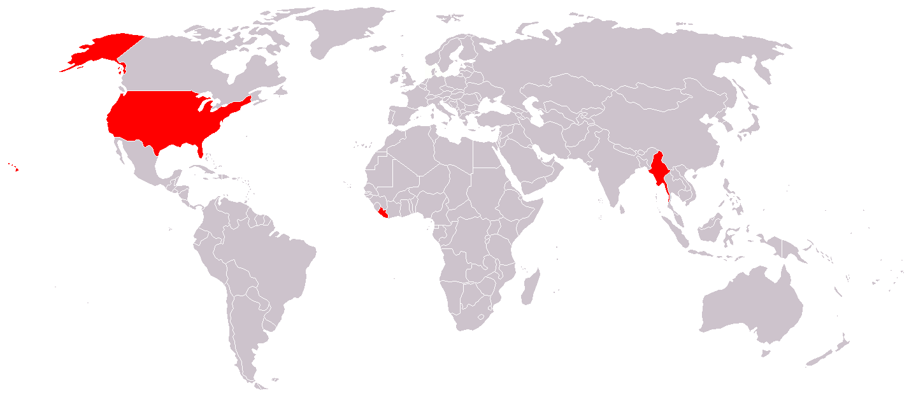
Background
Background
The U.S., Liberia, and Myanmar (Burma) are the only three countries that use customary units opposed to the metric system
Americans struggle to relate the metric system to everyday life
SI units or the metric system is the primary system of weights and measurements in science
Notes:
1. The CIA World Factbook
2. 1866-US legalized use of the metric system

Slide 3
Hypotheses
Hypothesis
?
Attitude toward Science
Metric Proficiency
?
Scientific literacy
Notes:
This partition of daily life and scientific understanding hinders the scientific literacy of the American population and imposes a negative connotation on science as a whole.
There is a connection between one’s understanding of the metric system, their attitude toward science, and their understanding of scientific concepts.

Slide 4
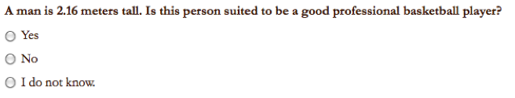
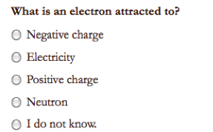
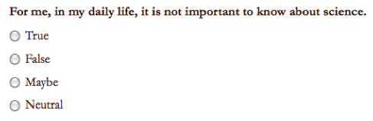
Methods: Survey Design
Methods
Three sets of problems:
Proficiency with the metric system
Scientific literacy
Attitude and acceptance toward science
Notes:
Demographic information: age, sex, country in where the participant grew up, and level of education
NSF Survey of college students performed in the mid 90’s that examined the relationship between scientific knowledge and attitudes toward science.
Distributed online (people interested in science) and via hard copy (mostly Spelman students)

Slide 5
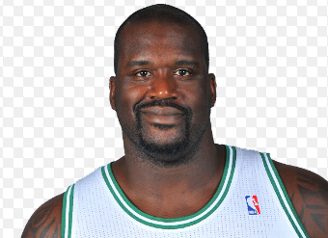
Method: Scoring and Analysis
Method
The survey data was quantified as follows:
Used linear regression to analyze all the factors.
Correct Answer | 1
I don’t know | 0.5
Incorrect answer | 0
Notes:
Attitude toward science questions: 1= answer favors science, 0.5= neutral, 0= does not favor science
R^2 value measures how the linear model fits the data p-value (significance value)

Slide 6
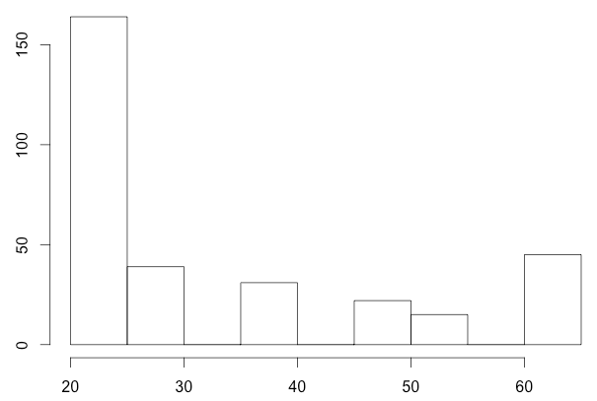
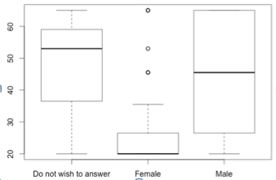
Results: 300 participants
Results
Participants In Age Categories
Ages by Gender
Number
Age
Do not wish
to answer
Female
Male
Age

Slide 7
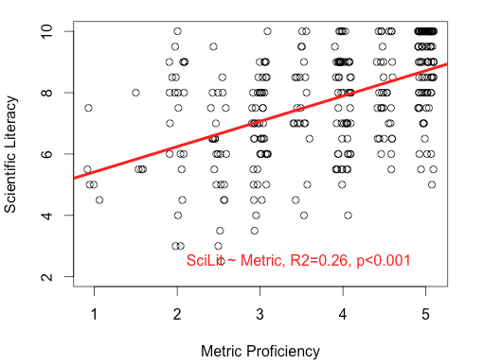
Metric proficiency correlates with scientific literacy.
Results
Notes:
Significant positive correlation

Slide 8
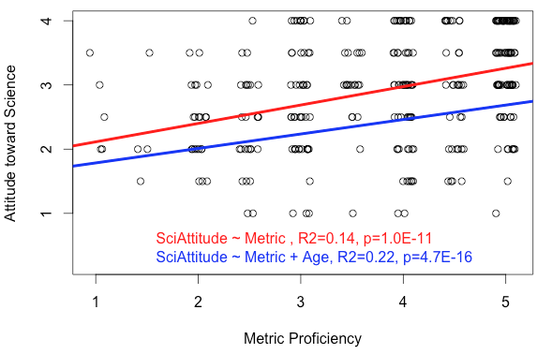
Metric proficiency correlates with attitude toward science.
Results
Notes:
Significant positive correlation

Slide 9
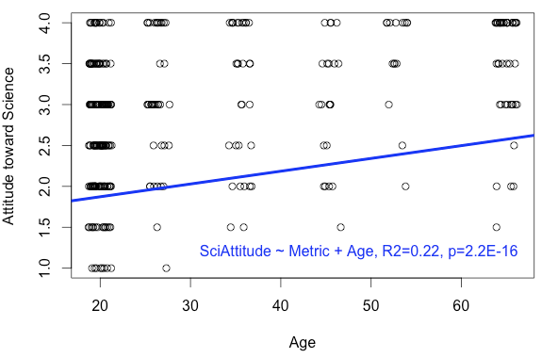
Attitude toward science is influenced by age.
Results
Notes:
1. Controls for educational degree, excluding participants with Ph.Ds
2. Bias: People who participated in the online survey tend to be more inclined toward science. On-campus survey were often done by papers, and target students that are not interested in science.

Slide 10
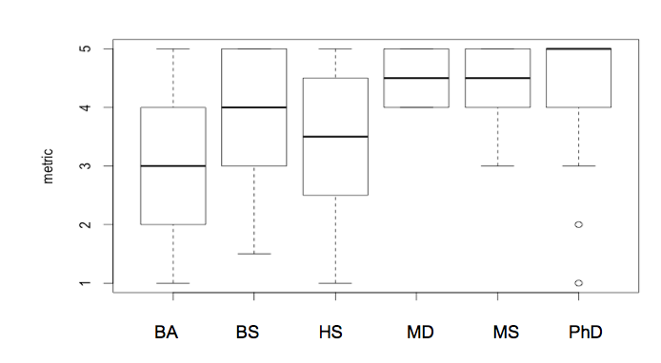
Metric proficiency correlates with education.
Results
Metric Score

Slide 11
Conclusion
Conclusions
Metric proficiency correlates with scientific literacy and attitude toward science.
Metric proficiency is most significantly influenced by education.
Attitude toward science is also influenced by age.
Notes:
Future Analysis: increase sample size,

Slide 12
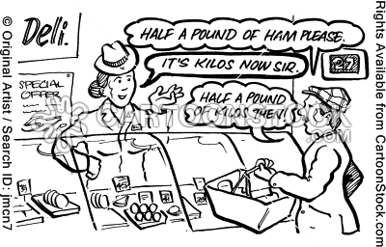
Implication about education
Implications
We found that education is the most significant factor affecting metric proficiency.
Education can improves metric proficiency and may thereby lead to more positive attitude toward science.

Slide 13
References
References
"A Brief History of Measurement Systems." NASA.gov. National Aeronautics and Space Administration, n.d. Web. 10 May 2013.
Champagne, A. Newell, S. Directions for research and development: alternative methods of assessing scientific literacy. Journal of Research in Science Teaching, 29 (8), 1992.
Delgado, Cesar. Units of length: a notational system for conceptual understanding of size and scale. Proceedings of the 9th International Conference of the Learning Sciences. 2010.
Evans, G. Durant, J. The relationship between knowledge and attitudes in the public understanding of science in Britain. Public Understanding of Science, 4 (1). 1995.
Impey, C., Buxner, S., Antonellis, J. Johnson, E., King, C., A twenty-year survey of science literacy among college undergraduates. Journal of College Science Teaching, 40 (4), 2011.
International. Organization for Economic Cooperation and Development (OECD). National Center for Education and Statistics. Participation in PISA by Year. Program for International Student Assessment (PISA), n.d. Web. 01 May 2013.
Scearce, Carolyn. "Scientific Literacy." Proquest. Discovery Guides, Sept. 2007. Web. 05 May 2013.

