Slide 1

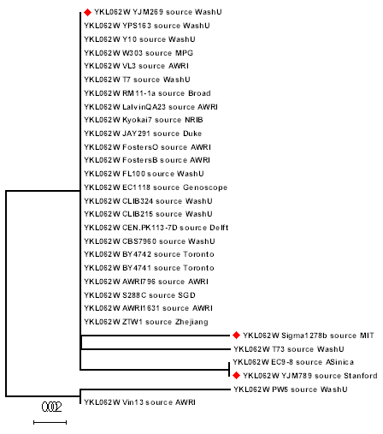
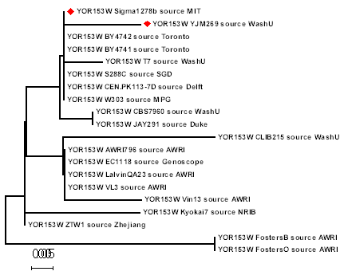
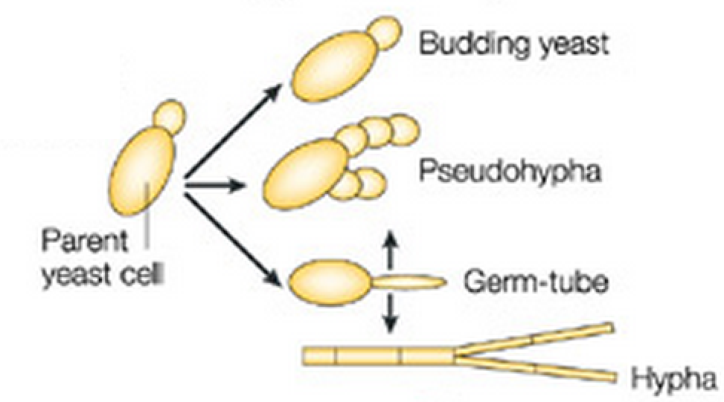
Investigation of Genes Associated with Pathogenicity in Yeast
Deja Heckard, Kaitlyn Jackson
Abstract
Actin Cytoskeleton
Conclusion
Saccharomyces cerevisiae is a single cell organism that is historically used in bread making and brewery. Recently, it has been reported that some strains of S. cerevisiae, including YJM789, YJM222, and YJM308, are opportunistic pathogens. We hypothesized that mutational changes in chaperone proteins contribute to the pathogenicity in the virulent strains because our body temperature is 37⁰C, higher than the temperature that yeast cells typically survive in. In this study, we will compare the cis-regulatory and coding sequences of heat shock pathways, such as Hsp60, Hsp70, Hsp90, and Hsp104 in virulent and non-virulent strains. Furthermore, we studied the sequence variation of gene SSD1 which regulates yeast cell wall structures. Sequence variations that were enriched in the pathogenic strains but not in the non-pathogenic strains are likely to be involved in the genetic mechanisms leading to the emergence of virulence.
Due to the high volume of genes involved with virulence in this species, we were unable to definitively determine all of the specific gene(s) that are responsible for making some strains of yeast pathogenic. However, there is evidence that there are multiple genes that regulate virulence. We believe this shows that pathogenic yeast have been subjected to a number of mutations that provide them with all the traits of pathogenicity.
Through research, meta-analysis and the use of genetic sequencing databases, such as GenBank, we were able to find the following information. The six genes listed were genes that we recognized frequently as being mentioned as components of the genetic information of pathogenic yeasts. But, after researching them further, we found that of the six, only two of the genes provided us with enough information to come to a conclusion. Actin is known to alter the shape of the pathogenic yeast cells. Another gene that we found to be relevant was pdr5, which is responsible for the resistance of the pathogenic yeast to drugs. The other genes listed were also researched, but we could not find enough information on them to support this experiment.
Genes Researched | Informative Genes | Uninformative Genes
CISC44 COX1 COX2 ATP6 PDR5 Actin | Actin PDR5 | CISC44 COX1 COX2 ATP6
Objective
0.002
The objective of this study was to find and compare the genetic sequencing of examples of virulent and non-virulent yeast strains. Through this study, and the information used, the group hoped to find similar genes that make different strains of yeast pathogenic.
PDR5 Drug transporter
Methods
This research project was conducted through meta-analysis. The group utilized information about the morphologies of each gene that had already been found and published in other articles and on databases. BLAST was also used to compare the genomes of the different strains of yeast. Then, once the group knew what the differences in genetic sequencing were in said strains of both pathogenic and non-pathogenic Saccharomyces cerevisiae, MEGA was used in order to create a three-dimensional rendering of the genetic information and single out the specific genetic difference in each strain. Finally, databases, such as GenBank and the Saccharomyces Genome Database were used to find the specific functions of each of the genes that were discovered.
Treatment
Altered PDR5
Pathogenic yeast
PDR5 selected
patient
PDR5
Non-pathogenic yeast
0.005
References
Data and Results
Engel , S. R., & Cherry, J. M. (2013). The new modern era of yeast genomics: community sequencing and the resulting annotation of multiple saccharomyces cerevisiae strains at the saccharomyces genome database . (Master's thesis)Retrieved from http://database.oxfordjournals.org/content/2013/bat012.full
McCusker, J. H., Clemons, K. V., Stevens, D. A., & Davis, R. W. (1993). Genetic characterization of pathogenic saccharomyces cerevisiae isolates. (Master's thesis)Retrieved from http://www.genetics.org/content/136/4/1261.full.pdf html
McCusker, J. H., Wei , W., Hyman, R. W., & Jones , T. (2007). Genome sequencing and comparative analysis of saccharomyces cerevisiae strain yjm789. (Master's thesis)Retrieved from http://www.pnas.org/content/104/31/12825.full.pdf html
Klingberg, T. D., Lesnik, U., Arneborg, N., Raspor, P., & Jespersen, L. (2008). Comparison of saccharomyces cerevisiae strains of clinical and nonclinical origin bymolecular typing and determination of putative virulence traits. (Master's thesis)Retrieved from http://www.ncbi.nlm.nih.gov/pmc/articles/PMC2430332/pdf/fyr0008-0631.pdf
Based on a comparison of genes between the pathogenic and non-pathogenic strains of yeast, we found that there are multiple genes that contribute to the virulence of the yeast. For example, there are multiple genes associated with the ability of pathogenic yeast to live at higher temperatures than normal. Contrary to our original belief, this ability of pathogenic yeast is not merely the result of differences in the proteins of heat shock pathways.

