Slide 1
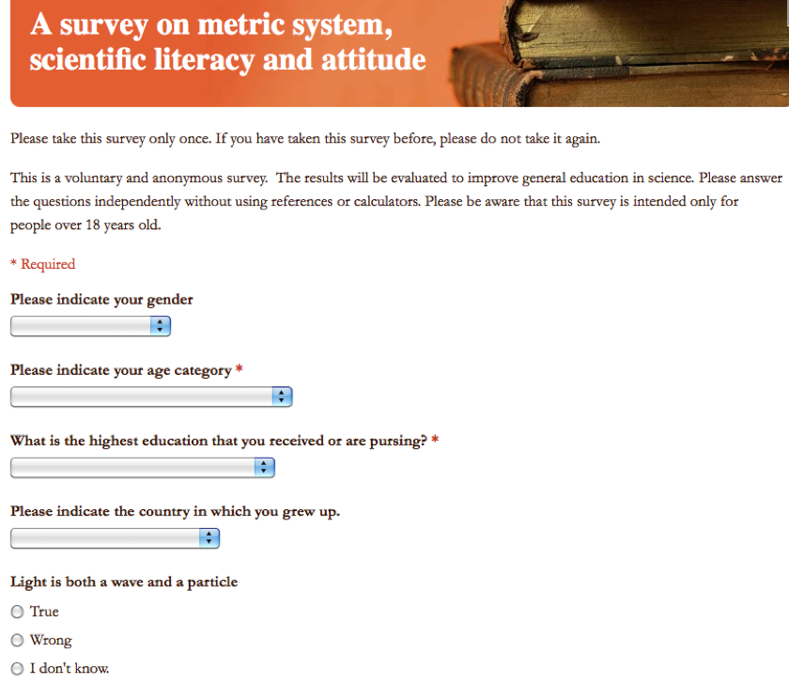
Learning R using an example
R Code: ‘metric.R’
Link to the online Survey

Slide 2

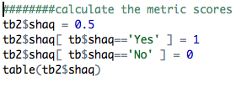

Convert answers to numerical scores

Slide 3
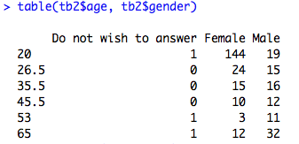
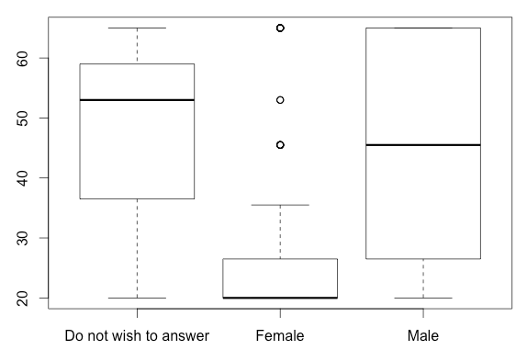

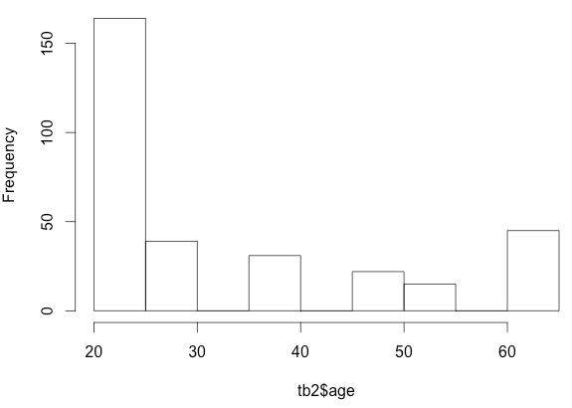
Plotting the data

Slide 4


Three categories of questions

Slide 5
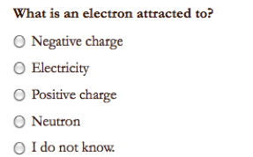
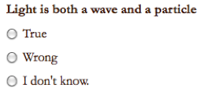


Sample Questions

Slide 6

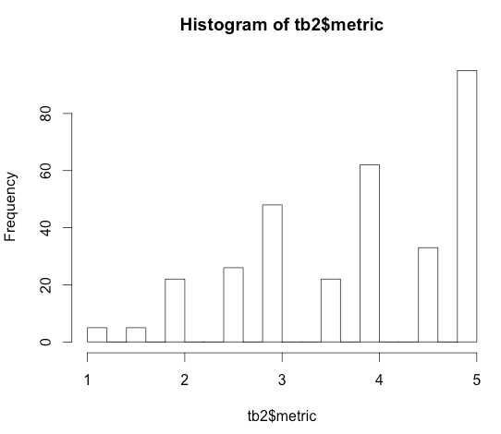

Score for Metric Proficiency

Slide 7
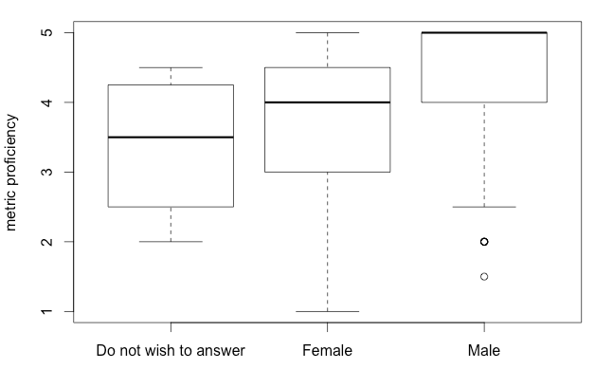
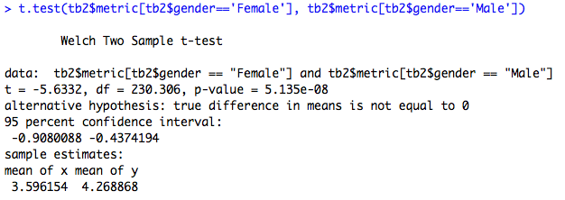
Do females tend to be less proficient in metric usage?

Slide 8
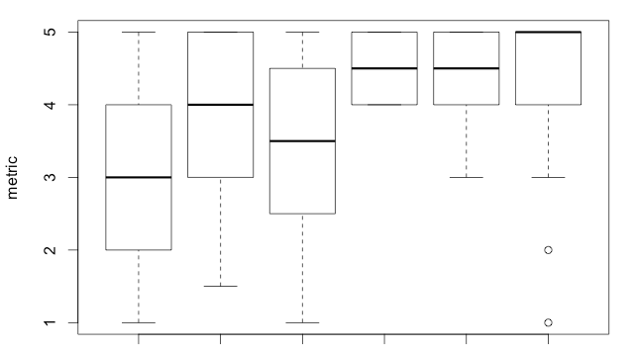
Education is a confounding factor.
BA BS HS MD MS PhD

