Slide 1

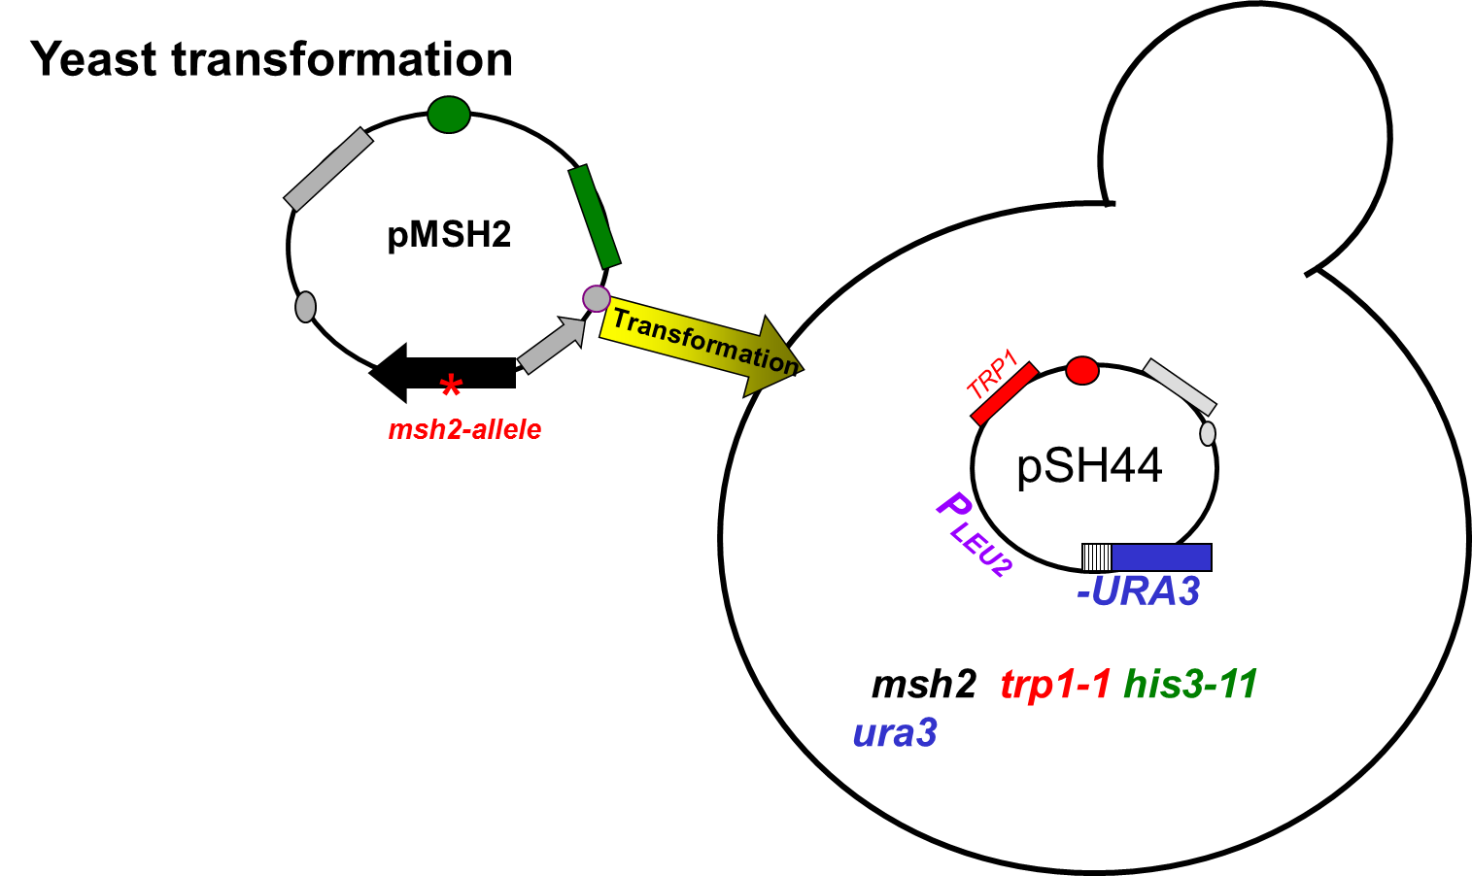
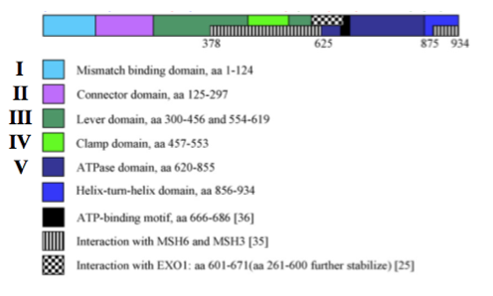

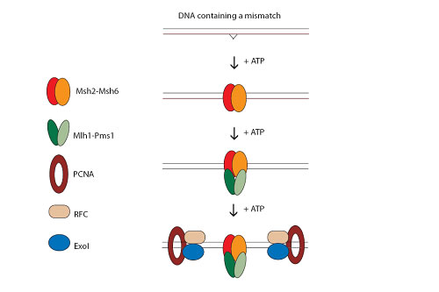
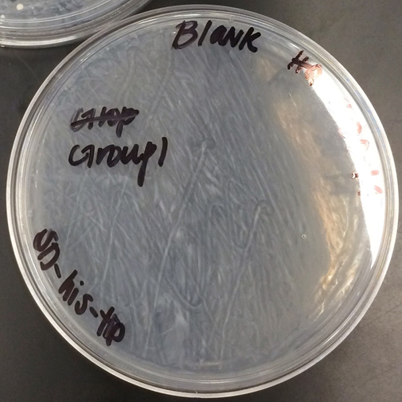
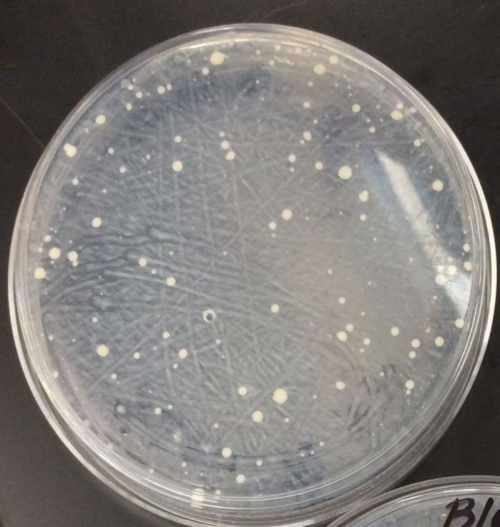
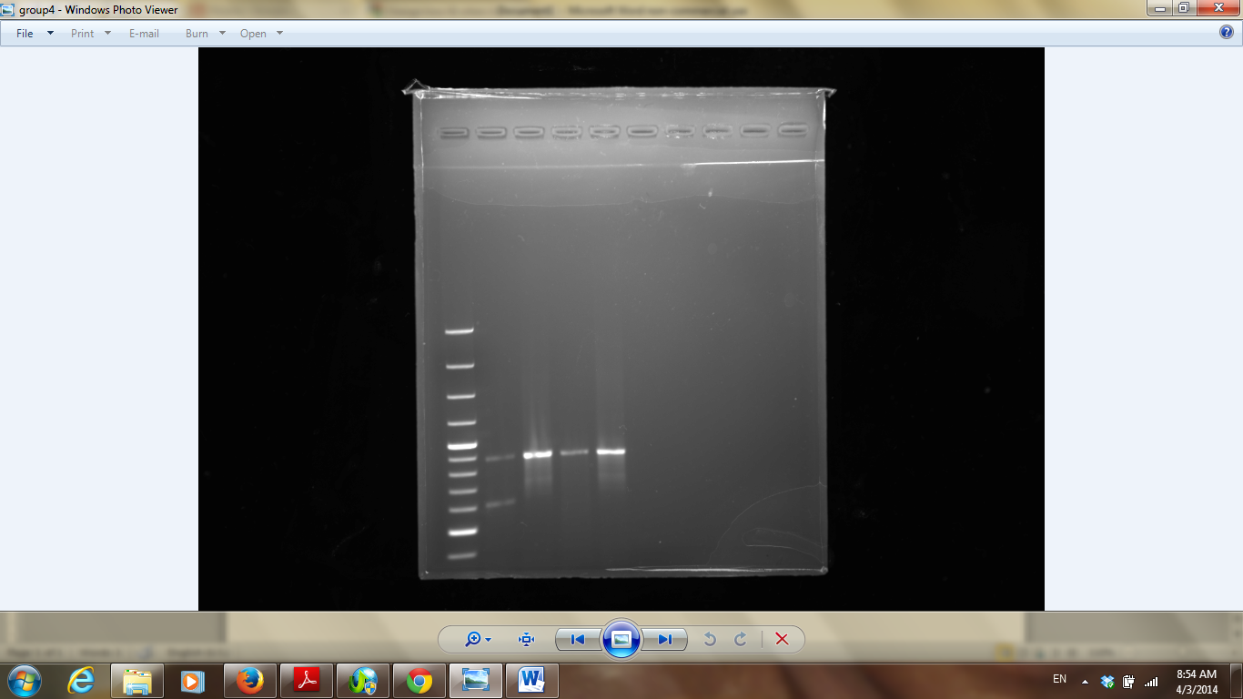
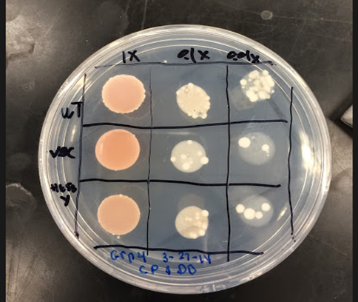
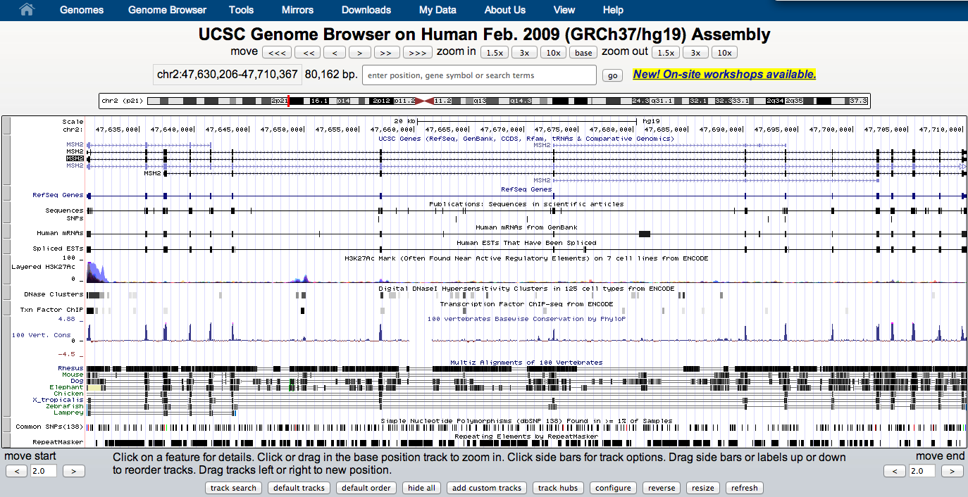
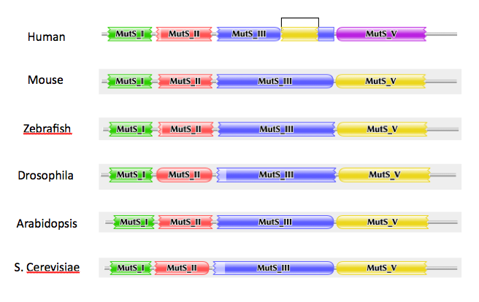
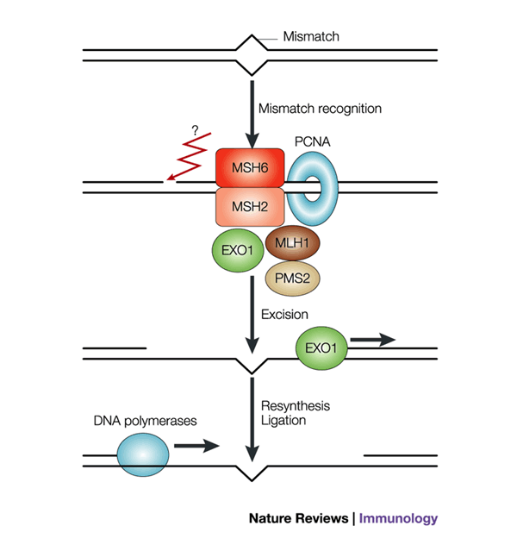



Functional Studies of the Human MSH2 Missense Mutations in Yeast Provide
Insight to Hereditary Nonpolyposis Colon Cancer
Dominique Djedjro, Chezlyn Patton
^{Advisor: Dr. Hong Qin}
Department of Biology, Spelman College, Atlanta, GA 30314
Abstract
Materials and Methods
Summary and Conclusion
One of every twenty Americans will be affected with Colorectal Cancer (CRC) with Hereditary Non-Polyposis Colorectal Cancer being the most common (HNPCC). This type of cancer is a hereditary gene caused by a missense mutation on the 2nd chromosome of the human DNA. To conduct our research, we used Saccharomyces cerevisiae cells, specifically the msh2 strain. These yeast cells serve as a model for understanding human MSH2 mutations, which is a tumor suppressor. The purpose is to manipulate the yeast MSH2 gene to determine which missense mutation is likely to be benign or pathogenic. We examined the defects at a molecular level to determine what MSH2 variants are dysfunctional by using a DNA mismatch pair and the reporter plasmid, pSH44, fused with URA3. The mismatch repair efﬁciencies were determined qualitatively using the 5-ﬂuororotic acid monohydrate (FOA) dinucleotide instability plate assays resulting in the formation of 5-FU. With the occurrence of 5-FU, the yeast cells should die; however, the ability of yeast cells to survive in the presence of 5-FOA reveals a dysfunction in mismatch repair. Defining the consequences of missense mutation within the MSH2 gene could result in the development of biomarkers for early detection of HNPCC.
Results
PCR and Restriction
Analysis
Transformation of MSH2
5’ TCCCGTTCATCCAGT 3’ WT Histidine
3’ AGGGCAAGTCGGTCA 5’
SD-HIS-TRP
Introduction
5’ TCCCGTTTACCCAGT 3’ Mutant, Tyrosine
3’ AGGGCAAATGGGTCA 5’
Implication in Human MSH2 Mutations
Colorectal cancer is the second leading cause of death in the United States. 2-7% of colorectal cancer cases are due to an inherited form of the the disease called hereditary nonpolyposis colorectal cancer.This cancer is associated with defects in DNA mismatch repair. One of the main mismatch repair system genes is MSH2, which is highly conserved in both prokaryotes and eukaryotes. Approximately 30-31 percent of all cases of hereditary nonpolyposis cancer are results of mutations in MSH2. The purpose of this experiment is to examine the effect of mismatch repair systems on human mutations in the MSH2 gene, through yeast MSH2. Strains of Saccharomyces cervisiae, a budding yeast was used because it is possible to test for MSH2 function and the similarity of its mismatch repair system to humans.
BmrI
Size Ladder mutant WT cut Mutant WT V.cut V.Uncut
cut uncut uncut
Fig2. PCR fragments generated after confirmation of the mutagenized MSH2 by digestion with RE BmrI. BmRI only cuts the mutagenized plasmid which helps distinguishing between mutant allele and the wild type.
Fig1. PCR fragments generated after confirmation of the mutagenized MSH2 by digestion with RE BmrI. BmRI only cuts the mutagenized plasmid which helps distinguishing between mutant allele and the wild type.
.
Assessment of mutation in URA3 using FOA plates
Fig3. Because the cells survived and their frequency is approximately the same throughout the grid, There may be a mismatch repair defect. MSH2 is then not functional. But, there may be experimental error. The vector and wild type lanes may have been switched. The vector should contain more cells due to the absence of MSH2 which provides MMR-
References
Gammie, A. E., and N. Erdeniz. “Characterization of Pathogenic Human MSH2 Missense Mutations Using Yeast as a Model System: A Laboratory course in Molecular Biology.” Cell Biology Education 3.1 (2004): 31-48. Print
Gammie, A. E., and N. Erdeniz. “Functional Characterization of Pathogenic Human MSH2 Missense Mutations in Saccharomyces Cerevisiae.” Genetics 177.2 (2007): 707-21. Print.
chromosome: msh2Δ
trp1-1
his3-11,15
chromosome: msh2Δ
trp1-1
his3-11,15
TRP1/ARS
pSH44
TRP1/ARS
HIS3
P_{LEU2}
CEN11
pSH44
mutagenized
(GT)_{16.5}-URA3
HIS3
P_{LEU2}
CEN11
*
X
mutagenized
(GT)_{16.5}-URA3
Experimental Objective
Msh2-H658Y
X
X
MSH2
mismatch repair
Acknowledgements
The objective of this experiment is to determine if the study
of human MSH2 mutation in yeast provides insight to HNPCC
5FOA
FU
5FOA
FU
Dr. Hong Qin, Dr. Stephen Kioko, and all of our classmates for being of great help and support throughout the semester.

Slide 2
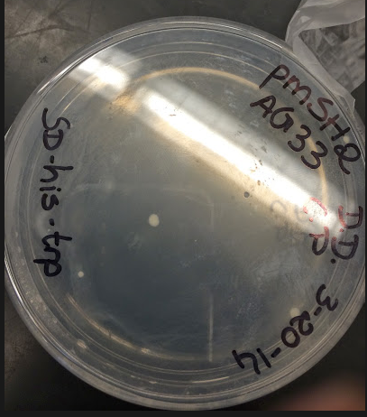
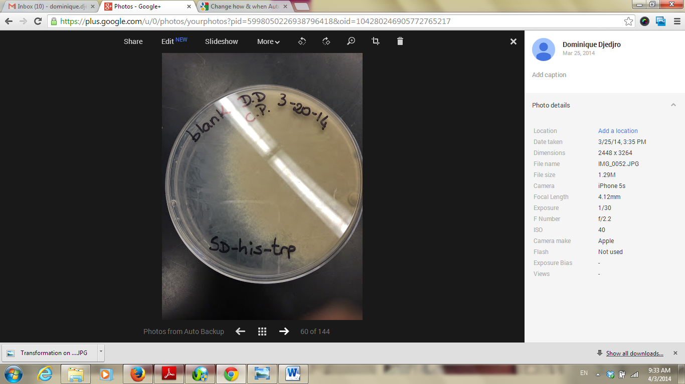
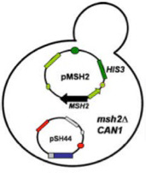
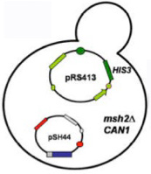
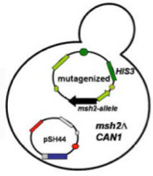
Understanding Hereditary Nonpolyposis Colon Cancer through Functional assay of Human MSH2 Missense Mutations in Yeast
^{Meigan Bryant,} ^{Tonia Iwule}
^{Advisor: Dr. Hong Qin}
Department of Biology, Spelman College, Atlanta, GA 30314
Abstract
Materials and Methods
Summary and Conclusion
One of every twenty Americans will be affected with Colorectal Cancer (CRC) with Hereditary Non-Polyposis Colorectal Cancer being the most common (HNPCC). This type of cancer is a hereditary gene caused by a missense mutation on the 2nd chromosome of the human DNA. To conduct our research, we used Saccharomyces cerevisiae cells, specifically the msh2 strain. These yeast cells serve as a model for understanding human MSH2 mutations, which is a tumor suppressor. The purpose is to manipulate the yeast MSH2 gene to determine which missense mutation is likely to be benign or pathogenic. We examined the defects at a molecular level to determine what MSH2 variants are dysfunctional by using a DNA mismatch pair and the reporter plasmid, pSH44, fused with URA3. The mismatch repair efﬁciencies were determined qualitatively using the 5-ﬂuororotic acid monohydrate (FOA) dinucleotide instability plate assays resulting in the formation of 5-FU. With the occurrence of 5-FU, the yeast cells should die; however, the ability of yeast cells to survive in the presence of 5-FOA reveals a dysfunction in mismatch repair. Defining the consequences of missense mutation within the MSH2 gene could result in the development of biomarkers for early detection of HNPCC.
The different band pattern between cut and uncut enzyme shows difference in fragment size. Restriction enzyme digestion was successful. (Figure 1)
The difference in band pattern between mutant and wild type MSH2 suggests primer mutagenesis was also successful. (Figure 1)
In the complementation assay with 5-FOA we anticipated to see growth identified by formation of colonies in the sections containing yeast transformed with the empty vector, while there should be no growth on the section of the plate spotted with yeast transformed with the wild type MSH2 gene. That is because functional MSH2gene would repair the MMR function allowing for expression of URA3 gene in the pSH44. Functional URA3 enzyme would metabolize 5-FOA to the toxic 5- fluorouracil which would kill the yeast cells and prevent formation of colonies. If mutant MSH2 allele is able to restore the function of MMR system we would not see yeast colonies. Since there are yeast cells visible in the wild type, mutant, and vector potions of the 5-FOA plate there is a strong possibility that the strains were mislabeled . (Figure 2)
Results
PCR Restriction Analysis
Size Ladder mutant WT cut Mutant WT V.cut V.Uncut
cut uncut uncut
Introduction
Colorectal cancer is the second leading cause of death in the United States. 2-7% of colorectal cancer cases are due to an inherited form of the the disease called hereditary nonpolyposis colorectal cancer.This cancer is associated with defects in DNA mismatch repair. One of the main mismatch repair system genes is MSH2, which is highly conserved in both prokaryotes and eukaryotes. Approximately 30-31 percent of all cases of hereditary nonpolyposis cancer are results of mutations in MSH2. The purpose of this experiment is to examine the effect of mismatch repair systems on human mutations in the MSH2 gene, through yeast MSH2. Strains of Saccharomyces cervisiae, a budding yeast was used because it is possible to test for MSH2 function and the similarity of its mismatch repair system to humans.
In subsequent experiments we will evaluate the MSH2 protein levels isolated from the wild type MSH2 transfected yeast to determine whether the mutation in the MSH2 affects expression of the gene.
Discussion
Enzyme restriction analysis revealed differences in band pattern between the wild type and the MSH2 gene indicating that the primer directed mutagenesis was successful and the mutation is present in the mutant MSH2 gene. The transformation of the yeast with pSH44 plasmid and with plasmids containing MSH2 alleles was successful as indicated by the growth of yeast colonies on the selective SD-his-trp plates. In the 5-FOA complementation assay major growth was observed in the wild type and the least amount of growth was observed in the vector. This was the opposite of what we expected to occur, so we have attributed this to a labeling error in our samples.
Yeast can be used to evaluate DNA mutations in human MSH2gene, and suggest preventive treatment.
Fig1. PCR fragments generated after confirmation of the mutagenized MSH2 by digestion with RE BmrI. BmRI only cuts the mutagenized plasmid which helps distinguishing between mutant allele and the wild type.
Transformation of MSH2
References
Gammie, A. E., and N. Erdeniz. “Characterization of Pathogenic Human MSH2 Missense Mutations Using Yeast as a Model System: A Laboratory course in Molecular Biology.” Cell Biology Education 3.1 (2004): 31-48. Print
Gammie, A. E., and N. Erdeniz. “Functional Characterization of Pathogenic Human MSH2 Missense Mutations in Saccharomyces Cerevisiae.” Genetics 177.2 (2007): 707-21. Print.
Experimental Objective
Using yeast MSH2 to study the molecular mechanism
of the pathogenic human MSH2 mutations.
Acknowledgements
H658Y
Dr. Hong Qin, Dr. Dongfang Wang, and Dr. Stephen Kioko for helping us in the laboratory this semester.
MSH2
Vector

