Slide 1



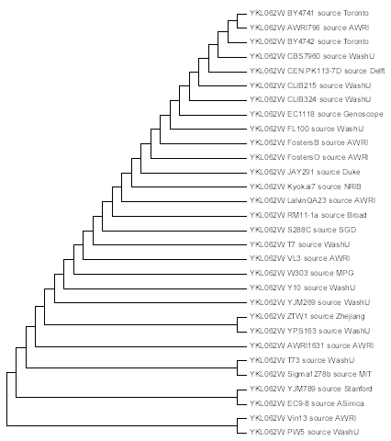
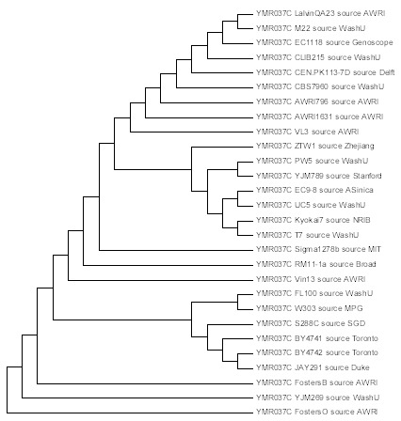
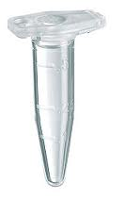
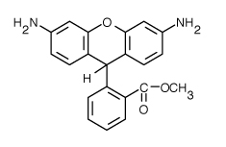
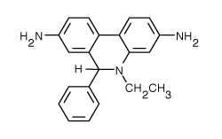
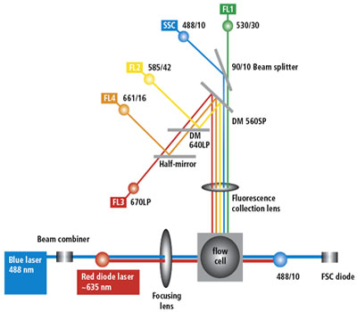




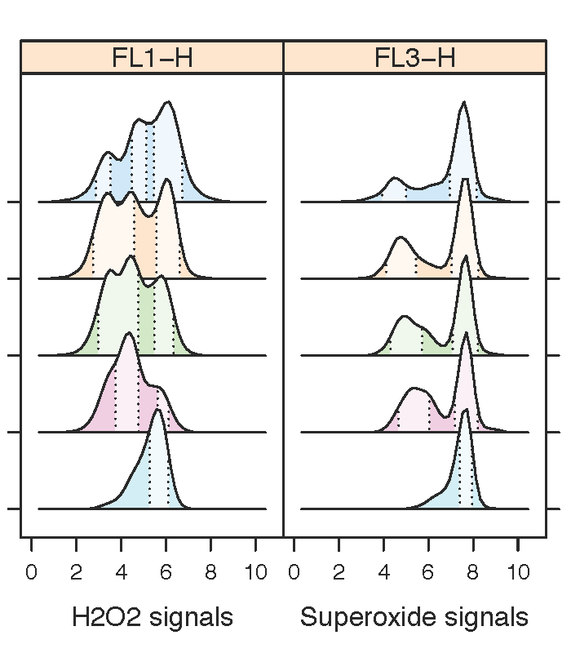
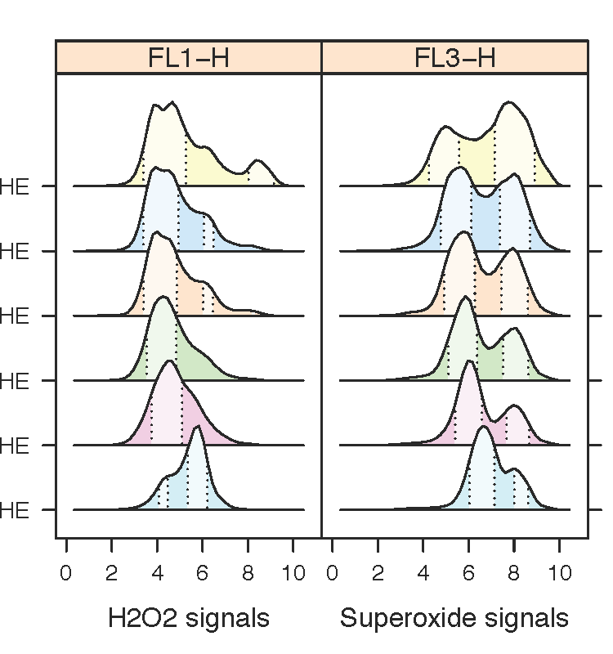
Studying the Genetic Variations in Oxidative Stress Response Pathways
Ashlee Beverett; Jayden Le Blanc; Nilin Gupta; Hong Qin
Department of Biology, Spelman College, Atlanta, GA 30314
Abstract
Studying
Experimental Design
Results
Ectopic hydrogen peroxide treatment
Genetic variation of transcription factors regulating
oxidative response pathways.
H₂O₂
0%
0.01%
0.025%
0.05%
0.1%
0.15%
Dihydrorhodamine 123
(DHR)
Dihydroethidium
(DHE)
Summary
Introduction
Materials and Methods
H2O2
Reactive oxygen species (ROS) cause cellular and physiology aging.
Different yeast strain types were grown, the cells were restaged, a hydrogen peroxide treatment was performed, a DHR and DHE labeling was performed, then DHR and DHE were both labeled in calibur. FACS data were analyzed using R package flowCore and flowClust available at bioconductor.org.
Superoxide dismutase (SOD)
H₂O₂
Mitochondria, peroxisomes, other cellular metabolic processes
Superoxide
Hydroxy radical
Macromolecule Damage (DNA, Protein, RNA)
Cellular aging
Heart Disease
Cancer
Increase in probability of developing age-related diseases
Alzheimer’s Disease
AGING
Conclusions
In conclusion, from investigating how extracellular hydrogen peroxide influences the balance of intracellular hydrogen peroxide and superoxide in a collection of natural isolates, we found out that hydrogen peroxide treatment can induce more heterogeneity in most natural isolates.
Results
H2O2 increases CV and decreases robustness
Concept of Robustness
Strain YPS163
Strain BY4743
Robustness = Ability of cells to maintain homeostasis in the presence of genetic, environmental, and stochastic variations.
Robustness can be measured by coefficient of variation (CV).
H₂O₂
0.2%
0.1%
0.075%
0.05%
0.025%
0%
H₂O₂
0.2%
0.1%
0.075%
0.05%
0.025%
0%
CV = Standard deviation / Mean
References
1. Martin Weinberger. “Growth signaling promotes Chronological aging in budding yeast by inducing superoxide anions that inhibit quienscence.” AGING 2 (2010): 709-726
2. Qin H, Lu M, Goldfarb DS, 2008 Genomic Instability Is Associated with Natural Life Span Variation in Saccharomycescerevisiae. PLoS ONE 3(7):
Smaller CV
Larger CV
Acknowledgement
Funding: We would like to give our thanks and appreciation for a seed grant from the Spelman CHDRE Award from the NCMHD (Grant number 5P20MD000315-05), NSF RUI 1022294.
Less noise
More robust
More noise
Less robust
Hypothesis
Oxidative stress contributes to cellular aging by decreasing cellular robustness .

