Slide 1


What is a Leu⁻ mutant?
Leu⁻
Leu synthesis gene
Leu synthesis gene
Leucine making enzyme
Leucine making enzyme
Can make an enzyme to produce Leu in absence of the amino acid.
Can NOT make an enzyme to produce Leu in absence of the amino acid
WT GROWS on Leu deficient plate
Mutant DOES NOT GROW on Leu deficient plate

Slide 2
Plasmid to the rescue!
Leu synthesis gene
Leu⁻
Plasmid
Leu synthesis gene
Plasmid
Can make an enzyme to produce Leu in absence of the amino acid.
RESCUED Mutant
GROWS on Leu deficient plate

Slide 3
What if we only had an empty vector?
Leu⁻
Empty Vector
Leu synthesis gene
Plasmid
STILL CANNOT make an enzyme to produce Leu in absence of the amino acid.
Mutant Will Not
GROW on Leu deficient plate

Slide 4
Chart of Research Project
DISEASE (HNPCC)
MOLECULAR GENETICS
MSH2 GENE
CLONING INTO EXPRESSION VECTOR (E coli)
SITE DIRECTED MUTATION OF MSH2 GENE
CLONING OF MUTANT INTO EXPRESSION VECTOR (E coli)
Transformation into Yeast Cells
FUNCTIONAL ANALYSIS EXPRESSIONAL ANALYSIS

Slide 5
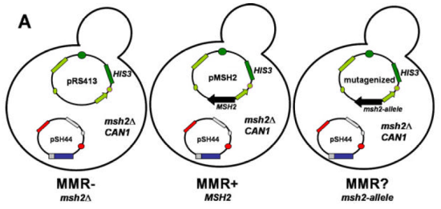
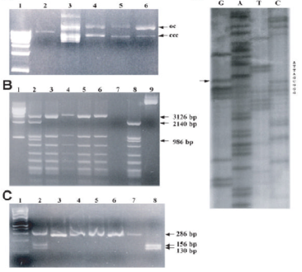
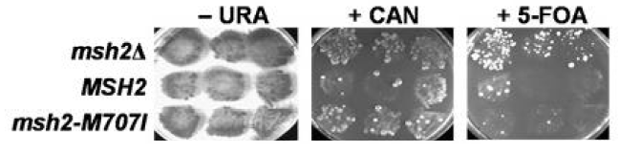
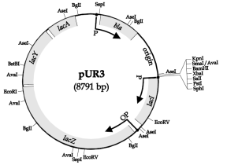
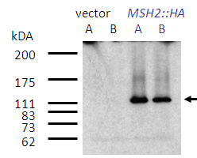
PCR
and
Plasmid Constructs
CEN/ARS
Molecular Biology
Genomics
β-lactamase
amp^{r}
HIS
ColE1 ori
pMSH2
9325 bp
F1(+)
MSH2::HA
lacZ
MSH2 Gene
Plasmid Constructs

Slide 6
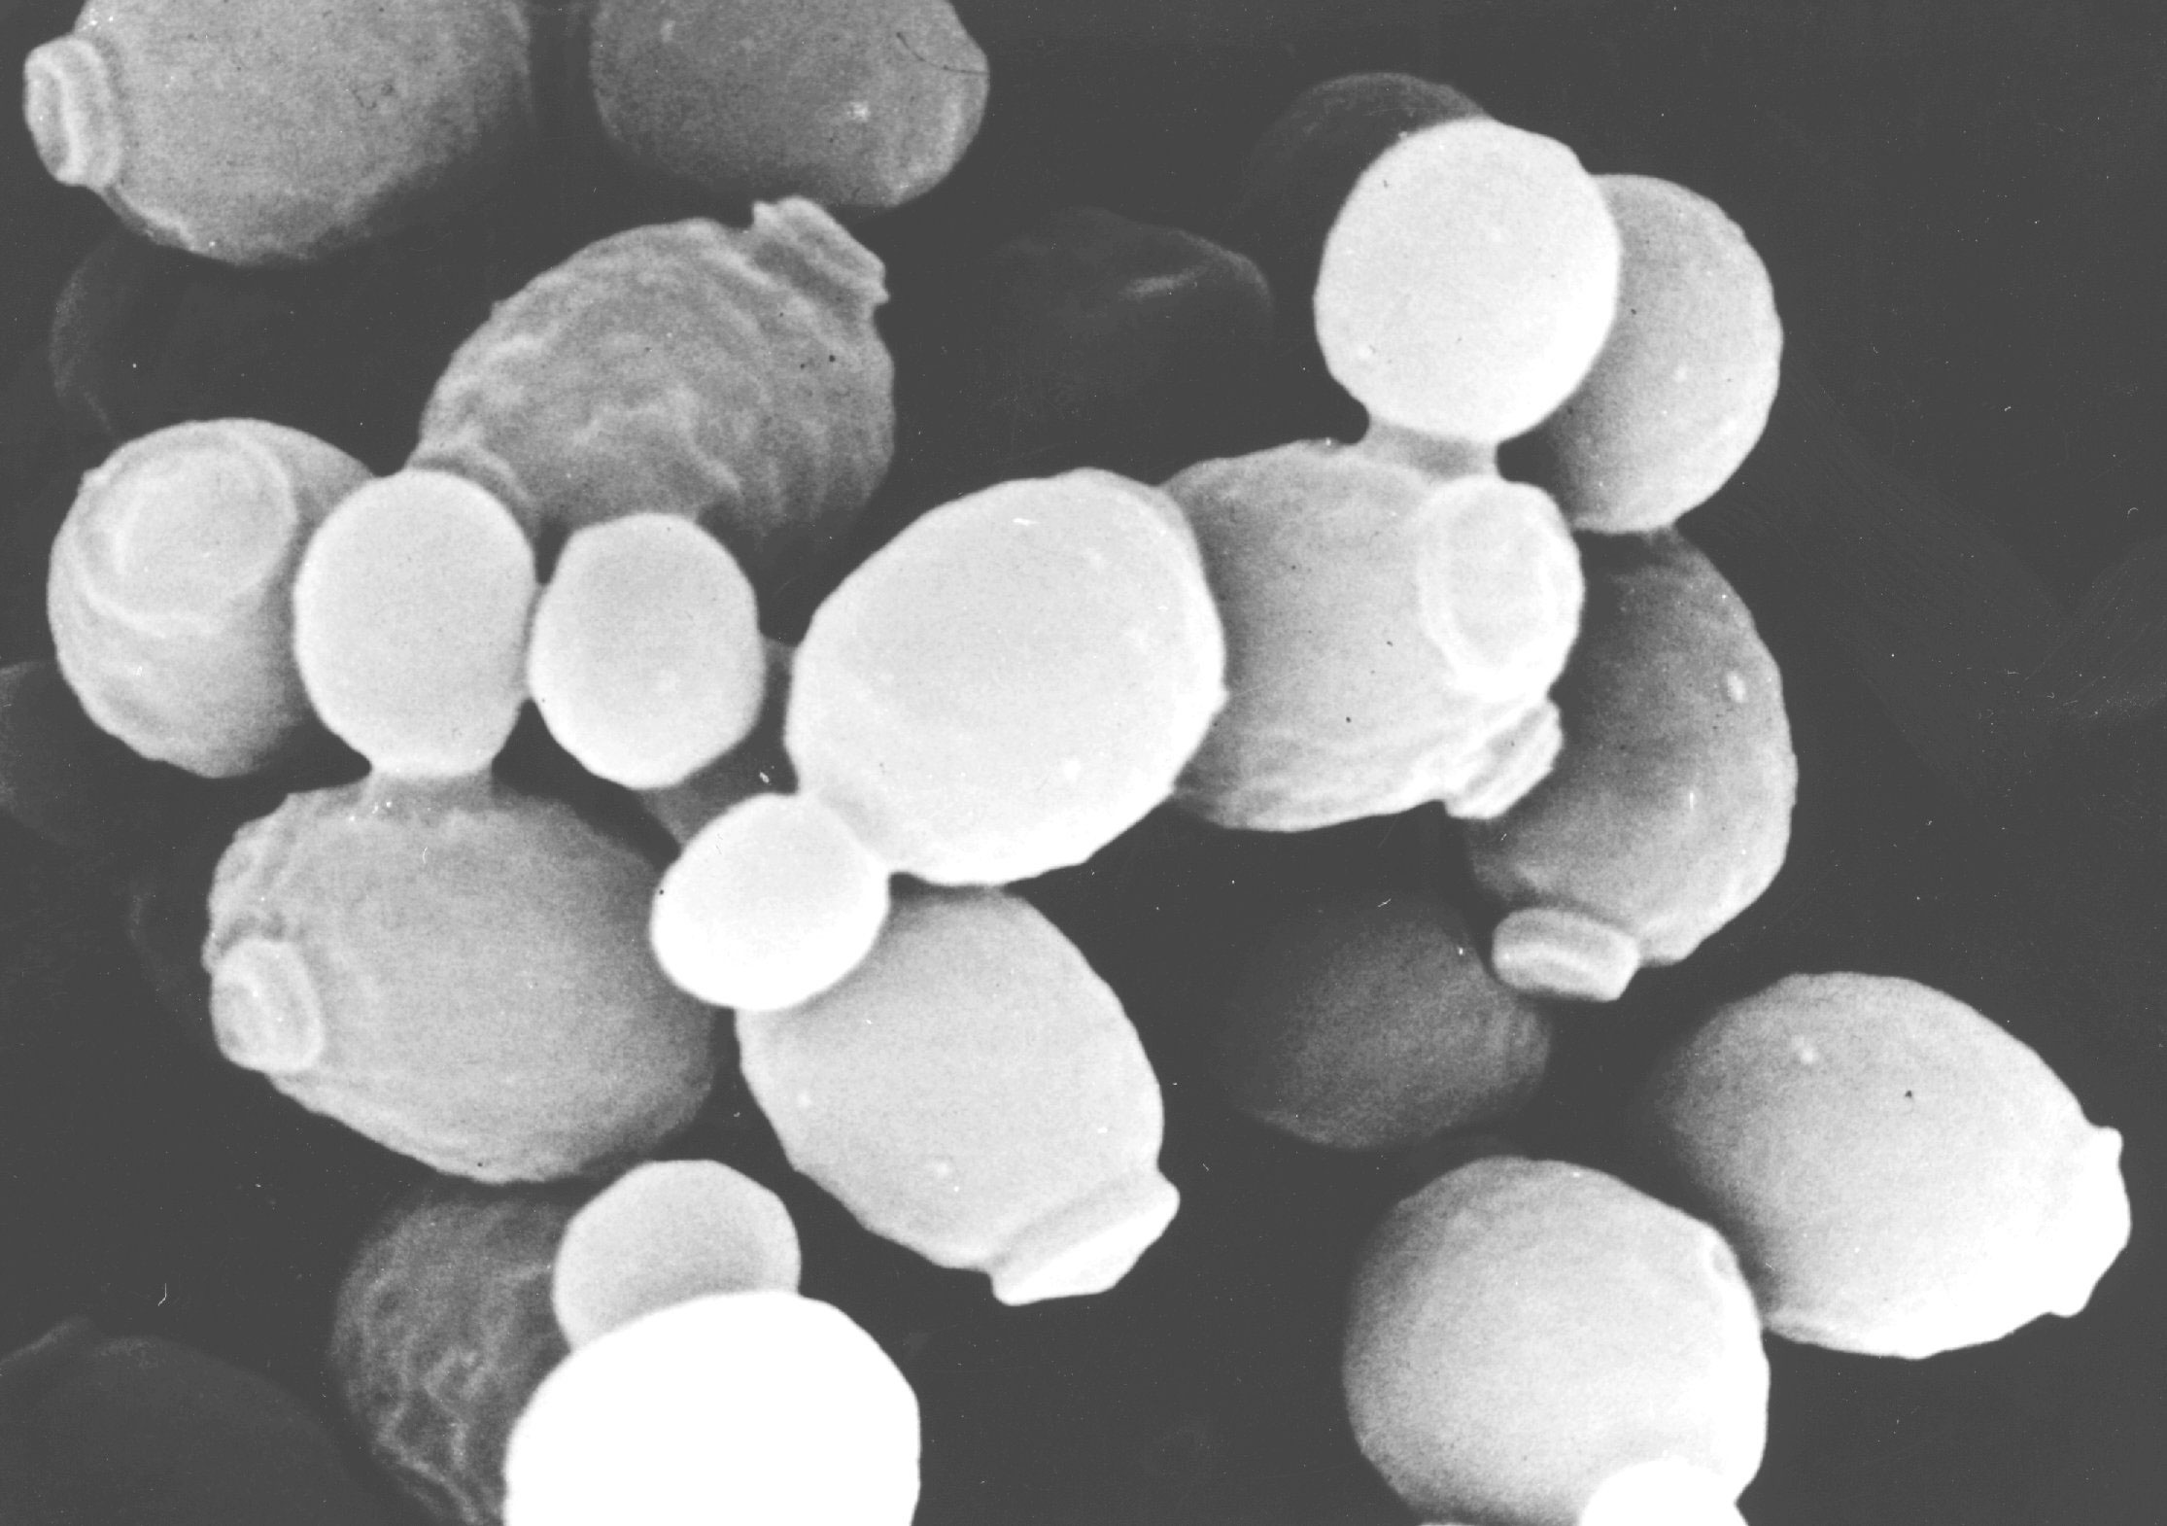
Yeast transformations to initiate the functional tests
introducing the mutagenized miniprep DNA and the controls into the Saccharomyces cerevisiae reporter strain
Saccharomyces cerevisiae
CEN/ARS
HIS3
miniprep
msh2-allele
image from Tufts and Dunn (University of Kent)

Slide 7
Genetic complementation in yeast
MSH2
Nuclear copy
Single copy of functional gene is sufficient in a haploid strain to support WT phenotype
wildtype growth phenotype

Slide 8
Genetic complementation in yeast
msh2
Nuclear copy
Gene deletion in a haploid strain results in a knockout mutant that displays a corresponding mutant phenotype!
mutant phenotype

Slide 9
Genetic complementation in yeast
msh2
Nuclear copy
MSH2
Plasmid copy
Reintroduction of the gene on a plasmid may rescue or complement the mutant phenotype
Rescue mutant phenotype?

Slide 10
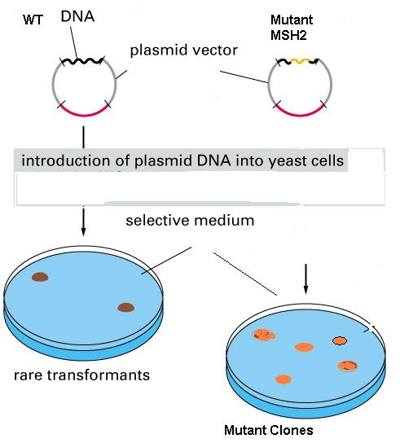
Can we use any random
Strain of YEAST?
and
Why do we need selective
Media?

Slide 11
Genotype of the yeast strain used for the functional assays
his3-11,15 allows for selection of the mutagenized MSH2 plasmids (HIS3)
trp1-1 allows for selection of the reporter construct (pSH44)
ura3-1 allows for assaying the URA3 gene product from the reporter construct
msh2Δ
the strain must be lacking the wild-type MSH2 gene; the strain must be Leu⁺, to allow for activation of the reporter gene promoter
MSH2
MSH2 (wild-type locus) MSH2⁺
msh2Δ (msh2 deletion) msh2⁻
This strain of yeast DOES NOT HAVE MSH2 gene
and
cannot grow without the media being supplemented with His and Trp.

Slide 12
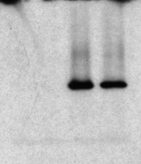
Taking a closer look at our plasmid, pMSH2
MSH2 construct for mutagenesis and functional assays
CEN/ARS
amp^{r}
HIS3
pMSH2
9325 bp
ColE1 ori
lacZ
MSH2::HA
hemagglutinin epitope in the MSH2 coding region
-produces a protein product of the expected molecular weight
vector
MSH2::HA
kDA
A
B
A
B
200
175
111
Msh2 “HA-tagged”
83
73
62
-complements msh2Δ defects, therefore the construct is functional

Slide 13
Haploid yeast strain for the functional assays
pSH44 is the reporter construct for
di-nucleotide stability assay
chromosome:
msh2Δ
trp1-1
his3-11,15
allows for selection
and replication of
the plasmid
pSH44
TRP1
pSH44
P_{LEU2}
CEN11
allows for the stable segregation of plasmid
(GT)_{16.5}-URA3
reporter = in frame fusion between a GT tract and the URA3 gene
leucine responsive promoter (activated when cells grown in media lacking leucine and threonine)

Slide 14
Yeast transformation
Appropriate Conditions for Transformation
HIS3
mutagenized
*
msh2-allele
chromosome: msh2Δ
trp1-1
his3-11,15
TRP1/ARS
pSH44
P_{LEU2}
CEN11
(GT)_{16.5}-URA3

Slide 15
How will we know that both plasmids are in the yeast?
chromosome:
msh2Δ
trp1-1
his3-11,15
Yeast will grow without His in media
pMSH2
MSH2
pSH44
Yeast will grow without Trp in media

Slide 16
MMR Assay in Yeast: Complementation of haploid msh2 test strain
+ pMSH2 + (WT)
Restored WT MSH2 function
msh2
+ pRS413 (vector)
Nuclear copy
No MSH2 function
MSH2
Plasmid copy
+ pMSH2 Mut (?)
MSH2 function ???
We transformed the msh2 test strain with one of the following:
pMSH2 (+)
pRS413 (-)
Mutagenized plasmid (?)
What is the rescue MMR- phenotype?

Slide 17


The haploid yeast strains for the functional assays
LEU2
msh2Δ::LEU2 (msh2 deletion)
vector
msh2Δ
pMSH2
LEU2
mutagenized
pSH44
MSH2
*
msh2Δ
msh2-allele
LEU2
msh2Δ
pSH44
LEU2
pSH44
MutSα/β
NO MutSα/β
altered MutSα/β
MMR +
MMR -
MMR ??

Slide 18

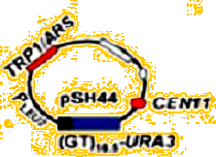
msh2
CEN/ARS
Recombinant
pRS413 plasmid
HIS3
msh2-allele
5-FU toxic to yeasts
5-FOA
REDUCED or NO
YEAST GROWTH
5-FU

Slide 19
Hmmm…what about the my mutant MSH2?
WT MSH2 gene was introduced
Into yeast
Vector was introduced
Into yeast
Fixes problems in microsatelite DNA in reporter construct
Microsatelite DNA errors occur in reporter construct
Reporter URA3 gene can be expressed
Reporter URA3 gene CANNOT be expressed
URA3 metabolizes FOA to
5-FU
FOA is NOT metabolized to
5-FU
5-FU is TOXIC TO THE CELLS
YEAST LIVE
YEAST DIE

Slide 20
Transformation and Functional Test Controls
pMSH2
pRS413
mutant
control for functional tests
+
-
??
control for transformation
+
+
+

Slide 21
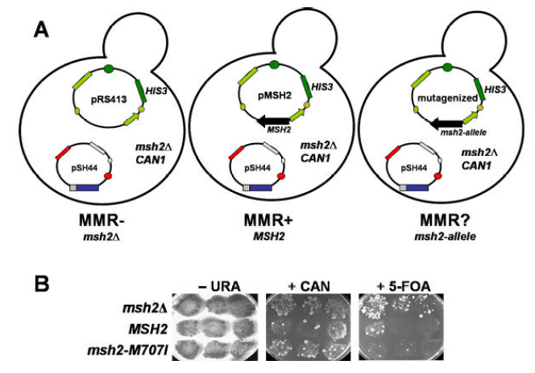
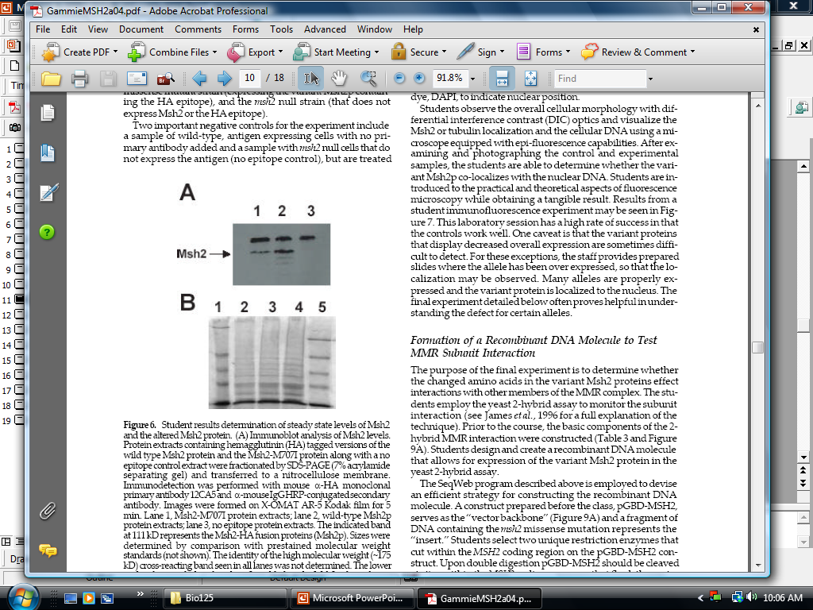
Transformation
Mismatch Repair Functional Assay
No MSH2 gene
Wild Type MSH2
msh2 Mutant
C
Steady State Levels MSH2 Proteins
Modified from Gammie, 2004

Slide 22
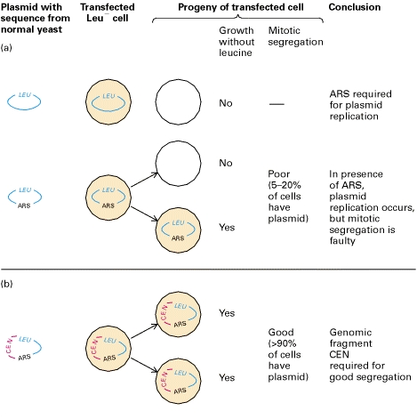

ARS – Autonomously Replicating sequence (Yeast start of replication)
CEN – centromer from yeast chromosomes. Improves the segregation of the plasmid into progeny

