Slide 1


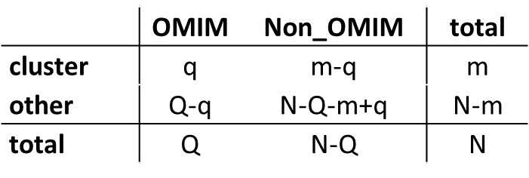
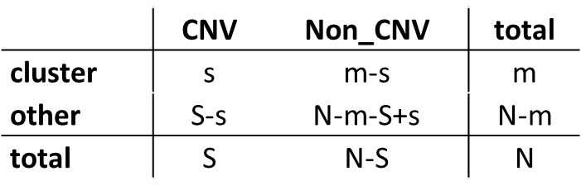
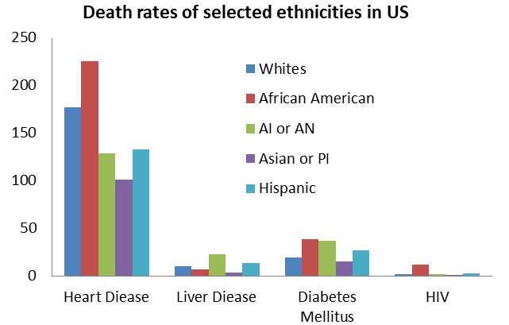
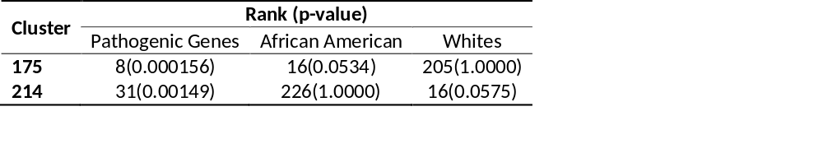
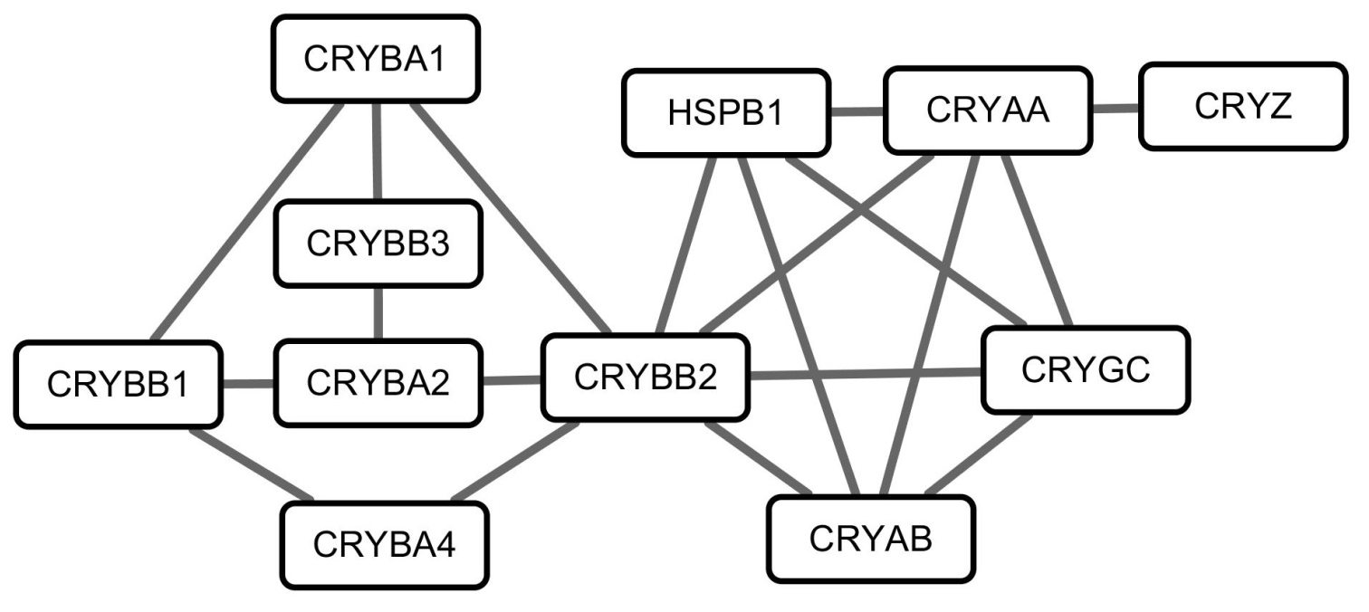
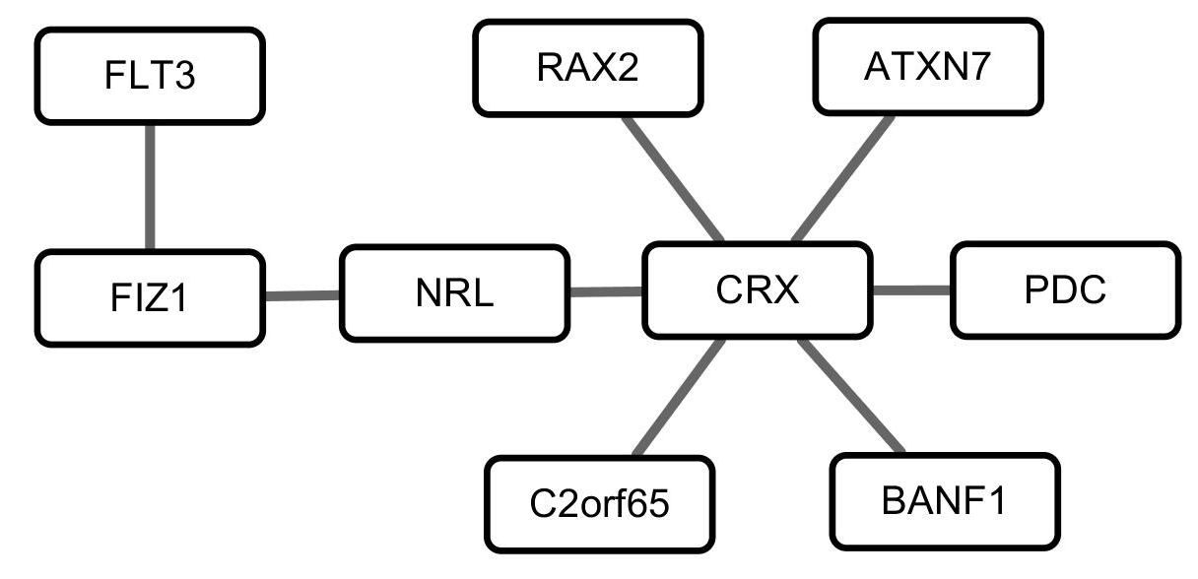
Network based Analysis of Copy Number Variation Related Gene Clusters in Health Disparities
Mislie C Jean-Baptisteª, Yi Jiang^{b}, Li Yang^{b}, Hong Qinª
a Department of Biology, Spelman College,
b Department of Computer Science and Engineering, University of Tennessee at Chattanooga
Abstract
Methods and Materials
Preliminary Results
Substantial health disparities exist between African Americans and Caucasian in the United States. Copy number variations (CNVs) are one form of human genetic variations (HGVs) that have been shown to influence complex diseases and have various occurrence frequencies among African Americans and Whites populations. We first inferred clusters from human protein networks. We then identified two clusters enriched for differential CNV variations between Caucasian and African Americans and enriched for genes with pathogenic associations. These network clusters are candidate network modules that contribute to health disparity.
Human gene network was inferred into gene clusters by using Markov Cluster Algorithm, based on protein-protein interaction data, which was obtained from Human Protein Reference Database (HPRD) [6].
CNV loci were obtained from [5], which includes three sets: A. CNVs only occur in African Americans, B. CNVs only occur in Whites, and C. CNVs occurred in both African Americans and Whites. In set C, CNVs that occurred more frequently by 50% in African Americans or in Whites, were combined with set A or set B, respectively, to form two new loci sets. These selected CNV loci were then searched in the UCSC Genome Database [7] to obtain the associated genes. Obtained genes that are also listed in the HPRD were kept for cluster analysis.
Disease-associated SNPs were retrieved from NCBI dbSNP database [8], and then searched in the UCSC Genome Database. Obtained genes that are also listed in the HPRD were kept for cluster analysis.
Human Protein Network
(HPRD)
Cluster 175:
  GO function enriched in {HSPB1, CRYBB2, CRYAA, CRYBA1, CRYAB, CRYBA2}:
      Identical protein binding (p-value = 1.09E-4)
      OMIM Phenotypes:
  HSPB1: Charcot-Marie-Tooth disease, axonal, type 2F; Neuropathy, distal hereditary motor, type IIB
  CRYBB2: Cataract 3, multiple types
  CRYAA: Cataract 9, multiple types
  CRYAB: Cardiomyopathy, dilated, 1II; Cataract 16, multiple types; Myopathy, myofibrillar, 2; Myopathy, myofibrillar, fatal infantile hypertrophy, alpha-B crystallin-related.
Cluster 214:
GO Process enriched in {PDC, CRX, RAX2, NRL, ATXN7}:
    Visual perception (p-value = 3.1E-8)
    Sensory perception of light stimulus (p-value = 3.54E-8)
    GO Function enriched in {CRX, NRL}:
    Leucine zipper domain binding (p-value = 2.37E-5)
    LRR domain binding (p-value = 7.69E-5)
  OMIM Phenotypes:
  CRX: Cone-rod retinal dystrophy-2; Leber congenital amaurosis-7.
  ATXN7: Spinocerebellar ataxia-7.
  NRL: Retinitis pigmentosa-27; Retinal degeneration.
  RAX2: Cone-rod dystrophy-11; Age-related macular degeneration-6.
Markov Cluster Algorithm
Gene Clusters
Clusters enriched with pathogenic genes
Clusters enriched with genes related to more CNV occurrence in
African-Americans or Whites
Introduction
Predicted Network Clusters involved in Health Disparity
Health disparities refer to differences in the disease distribution and/or health outcomes that exist across racial and ethnic groups. In United States, when African Americans are compared to other ethnic groups, there are significant and apparent evidence for health disparities in life expectancy, death rates, and health measures [1]. Besides social determinants, such as socio-economical status, health care access and cultural practices, human genetic variations (HGVs) play significant roles in health disparities. HGVs can occur at different frequencies in different populations, which lead to different disease susceptibility or resistance.
One commonly used tool to identify diseases-associated genetic variations is Genome-Wide Association Studies (GWAS) [2-3]. Although tens of thousands of disease-associated Single Nucleotide Polymorphisms SNPs have been identified, one fundamental limitation of GWAS is that they only focus on individual SNPs, while common diseases usually has complex genetic causes and involve networks of multiple genes. Gene set analysis (GSA) may help to discover networks of genetic risk factors for complex diseases, by analyzing the association of diseases with all variations in a set of genes [4].
Copy number variations (CNVs) are another form of gene variation, which are due to duplications or deletions of genomic segments and may affect one or more genes. CNVs have been shown to influence complex diseases and occur at various frequencies among African Americans and Whites [5].
The goal of this project is to identify CNV related pathogenic gene clusters for African Americans and Whites, which will help us to understand and thus mitigate health disparities.
In cluster analysis, the number of pathogenic genes and CNV related genes were counted and the corresponding contingency tables were generated for each cluster. Fisher’s exact test was applied to those contingency tables to calculate pathogenic significance and differential significance. Clusters were then ranked by the p-values obtained to get pathogenic ranks and differential ranks.
s: the number of selected genes in the current module; S: the total number of selected genes;
q: the number of pathogenic genes in the current module; Q: the total number of pathogenic genes;
m: the number of genes in the current module; N: the total number of genes in the network.
Clusters that are both ranked high in pathogenic ranking and differential ranking were selected and analyzed by using the GOrilla tool [9] to search for enriched gene ontology (GO) terms. Also, genes in selected clusters were searched in OMIM database to identify related phenotypes.
Reference
National Center for Health Statistics, Health, United States, 2012: With Special Feature on Emergency Care, 2013: Hyattsville, MD.
Hirschhorn, J.N. and M.J. Daly, Genome-wide association studies for common diseases and complex traits. Nat Rev Genet, 2005. 6(2): p. 95-108.
Wang, W.Y., et al., Genome-wide association studies: theoretical and practical concerns. Nat Rev Genet, 2005. 6(2): p. 109-18.
Fridley, B.L. and J.M. Biernacka, Gene set analysis of SNP data: benefits, challenges, and future directions. Eur J Hum Genet, 2011. 19(8): p. 837-43.
McElroy, J.P., et al., Copy number variation in African Americans. BMC Genet, 2009. 10: p. 15.
Keshava Prasad, T.S., et al., Human Protein Reference Database--2009 update. Nucleic Acids Res, 2009. 37(Database issue): p. D767-72.
Karolchik, D., et al., The UCSC Genome Browser database: 2014 update. Nucleic Acids Res, 2014. 42(Database issue): p. D764-70.
Sherry ST, W.M., Kholodov M, Baker J, Phan L, Smigielski EM, Sirotkin K., dbSNP: the NCBI database of genetic variation. Nucleic Acids Res., 2001. 29(1): p. 4.
Eden, E., et al., GOrilla: a tool for discovery and visualization of enriched GO terms in ranked gene lists. BMC Bioinformatics, 2009. 10: p. 48.
Preliminary Results
Genes
Gene-Gene Interaction
Pathogenic Genes
CNV related Genes
Red: more frequently in AA;
Blue: more frequently in Whites
Genes share the same GO term
Cluster 175
Cluster 214
Acknowledgment
Spelman College ASPIRE, NSF 0714553
Spelman CHDRE Pilot grant, NCMHD 5P20MD000215-05.

