Slide 1
Influence of Network Topology on Cellular Aging
Brittany A. Jackson
Spelman College Research Day
April 11, 2014

Slide 2
Outline
Background
Research Objective
Method
Results
Summary and Conclusion
Future Directions
Acknowledgments

Slide 3
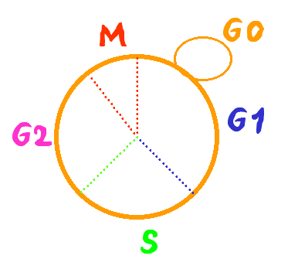
The life span of the budding yeast S. cerevisiae
Replicative life span
The average number of offsprings of single mother cells
dividing cells
Chronological life span
The duration of cells in stationary phase
non-dividing cells
Notes:
As a cellular organism, the life span of yeast can be measured in two different ways. The RLS and the CLS.
How to assay RLS?
S. cerevisize grow by budding out new cells. The new cells are smaller than the old mother cells. This enable us to identify the mother and daughter cells under microscope and separate them by by micro dissection.

Slide 4
What is aging?
Aging- mortality rate increased over time, represented by the equation
m= mortality , S= viability
Background

Slide 5

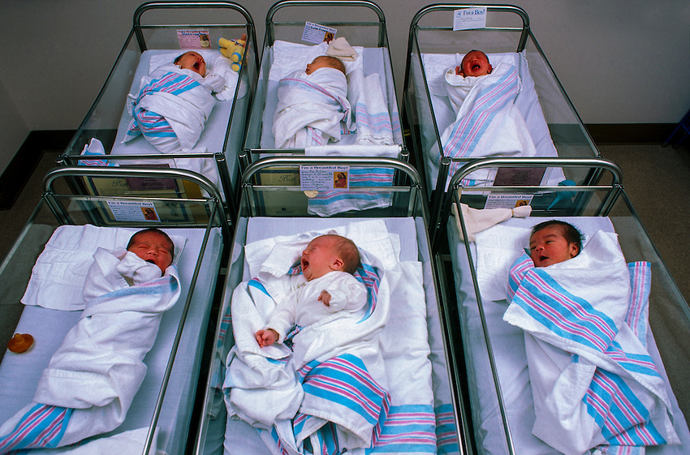
Biological vs. Machine Aging
Background
Heterogeneous systems
Homogeneous systems
Notes:
Homogeneous every component is connected in the same way. Heterogeneous every component is connected differently. However both age differently in their respective systems.

Slide 6
Gene Networks
Aging is an emergent property of gene networks
p
p
p
p
Background
p
p
p
p
Gompertz Model
Weibull Model
Note: Black represents essential nodes
White represents non-essential nodes
Notes:
Theoretical prediction

Slide 7
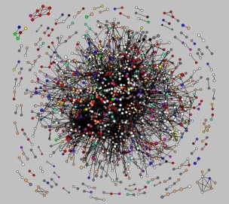
The yeast gene networks
Goal:
Does the yeast gene network configuration
provide some advantage to cells as compared
to random networks?

Slide 8
Reliability of Gene Networks
Reliability is determined by whether the mortality rate is the same once the nodes have been shuffled.
7
8
Research Objective
14
6
24
9
12
Notes:
Define reliability & talk about maximal age in one essential is reliability and minimal age between both is entire reliability

Slide 9

Generating Random Networks
Original Gene Network
Calculated Aging
Method
Permutation Using R
Random Network
Calculated Aging
Notes:
Trying to compare survivorship between original yeast network and random network. Add glimpse of R code.

Slide 10
Permutation of the network in pairwise format.
Original Network
A Long List
A Reshuffled List
A Permutated Network
Gene1, Gene2
Gene2, Gene4
Gene1, Gene5
Gene3, Gene5
Gene3, Gene1
Gene1, Gene2, Gene1, Gene3,
Gene3
Gene2
Gene4
Gene5
Gene5
Gene1
Gene3, Gene1, Gene3, Gene1,
Gene1
Gene5
Gene2
Gene5
Gene3
Gene4
Gene2, Gene5 Gene1, Gene2
Gene3, Gene5
Gene1, Gene3
Gene1, Gene4
2
1
2
1
4
4
3
3
5
5

Slide 11
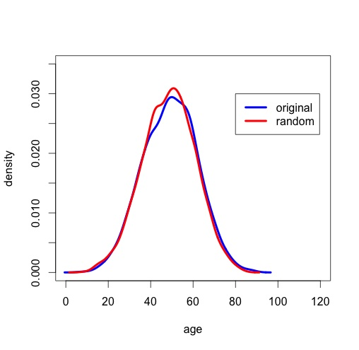
Mean Life Span for Perfect Networks
Results
Notes:
From my results, the original network is more reliable because it has a higher mean life span. This cannot concretely conclude that it is more reliable however because more criteria would need to be researched. Where p is 1.0. More research needs to be done for different p values. Possibly could be because the sample size is not large enough right now population is sampled at 2000.

Slide 12
Summary and Conclusion
The reliability of original versus permuted networks was evaluated using simulated aging.
The permuted random network has a slightly shorter lifespan than the original.
Based on the average lifespan, the original network is more reliable than the random network with p value 0.04.

Slide 13
Future Direction
Compare the original network to 100 permuted networks
Node labels can be shuffled to determine aging
Evaluate yeast gene network aging in different growth conditions
Compare the gene network aging between different tissues in the human body

Slide 14
Acknowledgments
National Science Foundation, Award ID: DMS 1045557, Math Research and Mentoring Program
Research Mentor: Dr. Hong Qin

