Slide 1

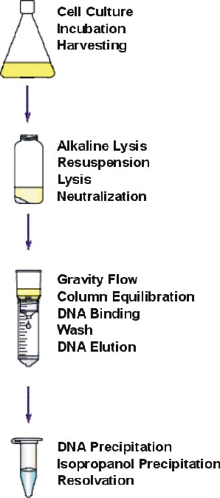
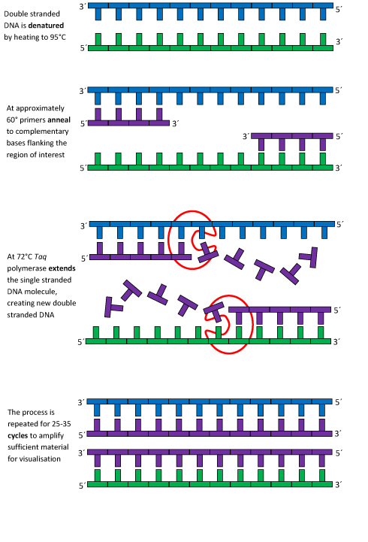
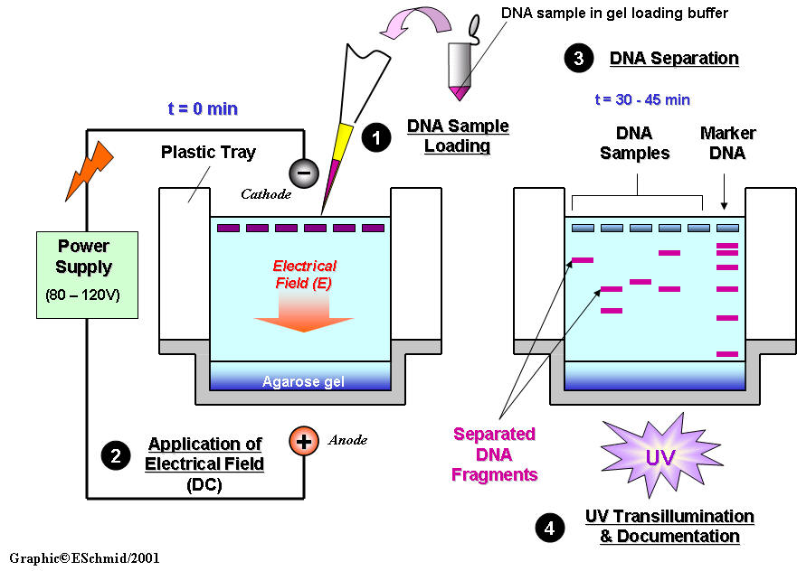
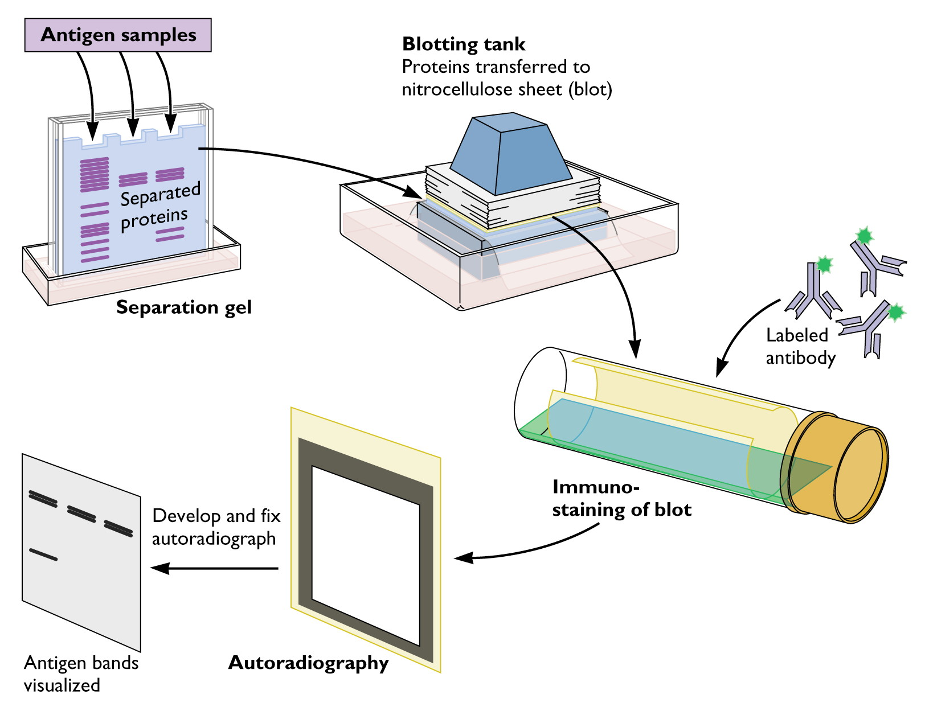
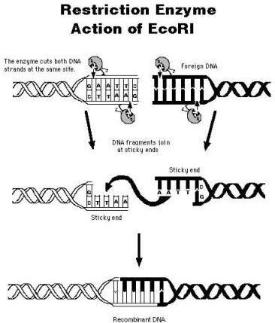
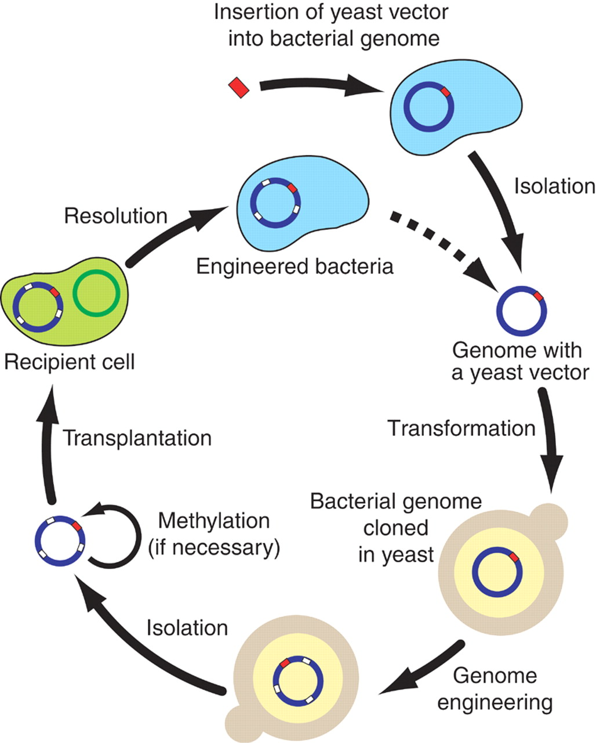
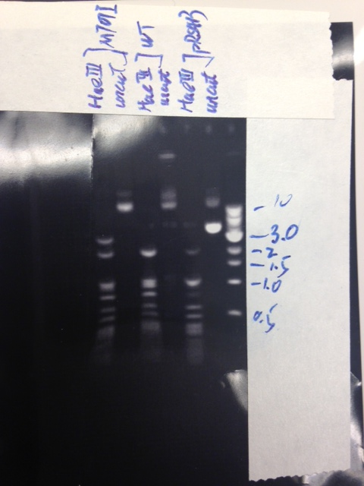
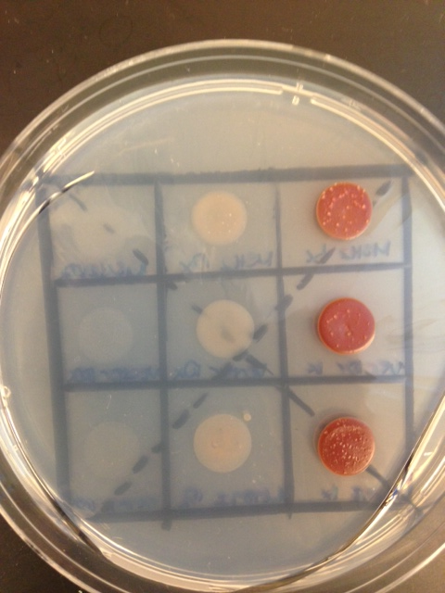
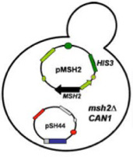
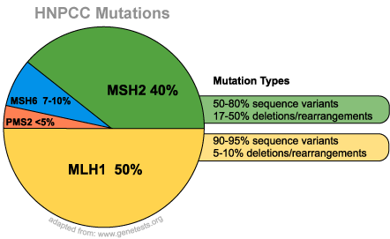
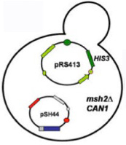
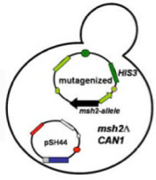
Understanding Hereditary Nonpolyposis Colon Cancer through Functional assay of Human MSH2 Missense Mutations in Yeast
^{Meigan Bryant,} ^{Tonia Iwule}
^{Advisor: Dr. Hong Qin}
Department of Biology, Spelman College, Atlanta, GA 30314
Abstract
Materials and Methods
Summary and Conclusion
MSH2 gene mutation is linked to development of colorectal cancer. Missense mutations account for a majority of the mutations occurring in MSH2. To better understand the pathogenic mechanism of these missense mutations, the human pathogenic mutations are reconstructed at the cognate sites in yeast MSH2, which then enable us to evaluate the functional consequences of these mutations. We focused on two missense mutations M707I and A618V. We examined their efficiency of microsatellite induced mismatch repair using a reporter constructor. We investigated their protein expression levels using Western blot. Our results showed that some mutants have defective mismatch repair, but others have low protein expression levels. These results suggest different approaches should be taken to ameliorate the pathogenic phenotypes of these MSH2 mutations.
Plasmid Extraction
Polymerase Chain Reaction (PCR)
Agarose Gel Electrophoresis
The different band pattern between cut and uncut enzyme shows difference in fragment size. Restriction enzyme digestion was successful. (Figure 1)
The difference in band pattern between mutant and wild type MSH2 suggests primer mutagenesis was also successful. (Figure 1)
In the complementation assay with 5-FOA we anticipated to see growth identified by formation of colonies in the sections containing yeast transformed with the empty vector, while there should be no growth on the section of the plate spotted with yeast transformed with the wild type MSH2 gene. That is because functional MSH2gene would repair the MMR function allowing for expression of URA3 gene in the pSH44. Functional URA3 enzyme would metabolize 5-FOA to the toxic 5- fluorouracil which would kill the yeast cells and prevent formation of colonies. If mutant MSH2 allele is able to restore the function of MMR system we would not see yeast colonies. Since there are yeast cells visible in the wild type, mutant, and vector potions of the 5-FOA plate there is a strong possibility that the strains were mislabeled . (Figure 2)
Western Blot
Introduction
Colorectal cancer is the second leading cause of cancer mortality in the United States. There is an estimated count of 153,000 new cases of colorectal cancer diagnosed each year. Colorectal cancer is the cause of 56,000 deaths each year. Proper functioning MSH2 is used in the cell for mismatch repair. When there is a missense mutation within the DNA, MSH2 is needed to bind with MSH6 or MSH3 to form an active protein complex, which runs along the DNA and recognizes DNA damage. Helicase separates the DNA strands, the damaged sequence is excised, and DNA polymerase is used to rebuild the damaged strand. When the strand of DNA that codes for MSH2 is mutated, there is a possibility that the protein’s function may be either altered or stopped completely. This means that all DNA damage that requires MSH2 would not be corrected, and there would be many errors within the DNA strand. The MSH2 gene has been found to be a frequently mutated locus on the DNA in sufferers of HNPCC. The disability to carry out mismatch repair in the DNA can lead to many negative physical effects, putting patients at a high risk for colon cancer as well as skin, endometrium, ovary, stomach small intestine, and brain cancers.
Yeast Cell Transformation
In subsequent experiments we will evaluate the MSH2 protein levels isolated from the wild type MSH2 transfected yeast to determine whether the mutation in the MSH2 affects expression of the gene.
Discussion
Enzyme restriction analysis revealed differences in band pattern between the wild type and the MSH2 gene indicating that the primer directed mutagenesis was successful and the mutation is present in the mutant MSH2 gene. The transformation of the yeast with pSH44 plasmid and with plasmids containing MSH2 alleles was successful as indicated by the growth of yeast colonies on the selective SD-his-trp plates. In the 5-FOA complementation assay major growth was observed in the wild type and the least amount of growth was observed in the vector. This was the opposite of what we expected to occur, so we have attributed this to a labeling error in our samples.
Yeast can be used to evaluate DNA mutations in human MSH2gene, and suggest preventive treatment.
Results
MSH2 100x
MSH2 10x
MSH2 1x
MSH2
Vector 100x
Vector 10x
Vector 1x
Vector
M707I 100x
M7071 10 x
M707I 1x
References
Gammie, A. E., and N. Erdeniz. “Characterization of Pathogenic Human MSH2 Missense Mutations Using Yeast as a Model System: A Laboratory course in Molecular Biology.” Cell Biology Education 3.1 (2004): 31-48. Print
Gammie, A. E., and N. Erdeniz. “Functional Characterization of Pathogenic Human MSH2 Missense Mutations in Saccharomyces Cerevisiae.” Genetics 177.2 (2007): 707-21. Print.
M707I
Experimental Objective
Figure 1
HaeIII
(Figure 2)
Manipulate the yeast MSH2 gene to determine which human missense mutations are likely to be benign or pathogenic in nature.
Examine the defect at a molecular level to determine why the Msh2 variants are dysfunctional.
MSH2 WT
V G V I S L M A Q I G C F V P C E E A E
2101 gttggtgtgatttctttaatggcccaaattggttgtttcgtaccttgtgaagaagctgaa 2160
MSH2 M707I
V G V I S L I A Q I G C F V P C E E A E
2101 gttggtgtgatttctttaatcgcccaaattggttgtttcgtaccttgtgaagaagctgaa 2160
Acknowledgements
Dr. Hong Qin, Dr. Dongfang Wang, and Dr. Stephen Kioko for helping us in the laboratory this semester.

