Slide 1
Template strand during transcription.

Slide 2
A gene contains 4 exons, and any three exon of them can be retained in its mRNA. How many different proteins can this gene generate?
3
4
5
6

Slide 3
Which sequence can form a hairpin?
a) 5’AGATTACGAGCATTAGA3’
b) 5’AGATTACGAGCTAATCT3’
Notes:
Explain dot plot.

Slide 4
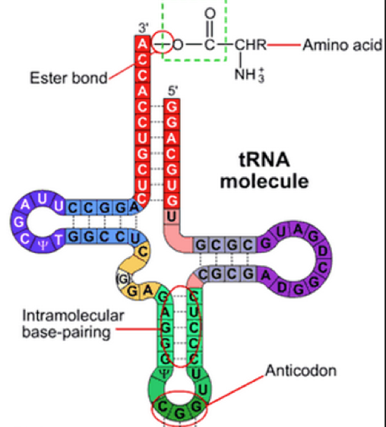
tRNA
Which amino acid will this tRNA carry?
Arg
Gly
Ala
Pro

Slide 5
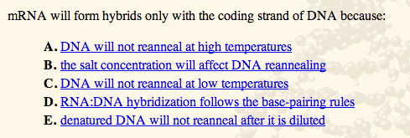

Slide 6
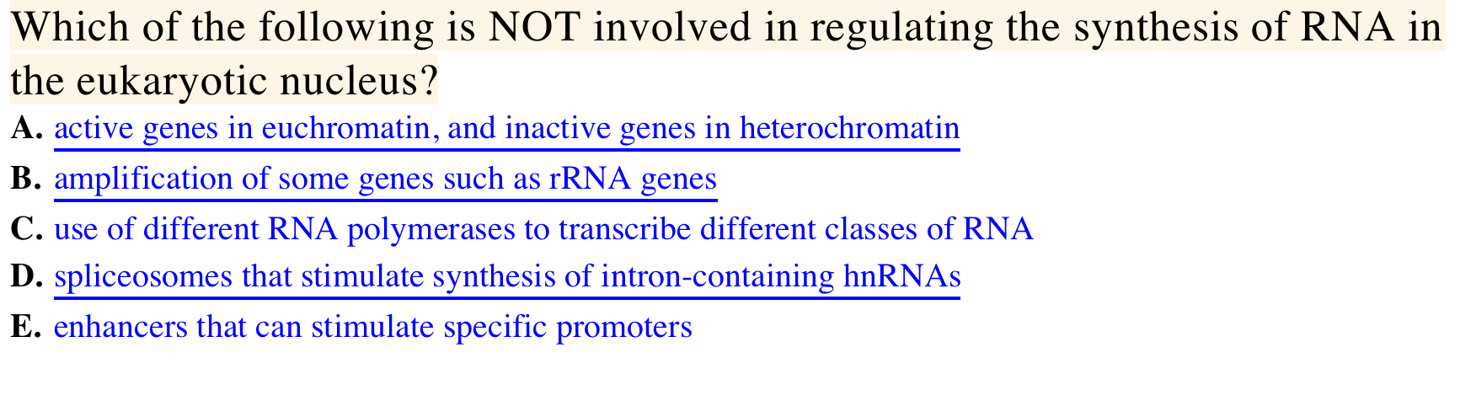

Slide 7
A gene contains 4 exons, and any three exon of them can be retained in its mRNA. How many different proteins can this gene generate?
3
4
5
6

Slide 8
Which sequence can form a hairpin?
a) 5’AGATTACGAGCATTAGA3’
b) 5’AGATTACGAGCTAATCT3’
Notes:
Explain dot plot.

Slide 9
tRNA
Which amino acid will this tRNA carry?
Arg
Gly
Ala
Pro

Slide 10
7.10 RNA Interference (RNAi)
Healthy cells do not contain dsRNA
Presence of dsRNA indicative of RNA virus in cell
RNA interference (RNAi): defense against dsRNA viruses
Cleaves dsRNA
Destroys ssRNA corresponding to targeted dsRNA sequence
Found only in eukaryotes
© 2012 Pearson Education, Inc.

Slide 11
7.10 RNA Interference (RNAi)
RNAi triggered by dsRNA longer than 20 bp (Figure 7.16)
Long dsRNAs cleaved into 21–23 bp by Dicer nuclease
Short interfering RNA (siRNA): 21–23 bp fragments from Dicer
RNA-induced silencing complex (RISC): recognizes and destroys ssRNA corresponding to siRNA
http://en.wikipedia.org/wiki/File:ShRNA_Lentivirus.svg
© 2012 Pearson Education, Inc.

Slide 12
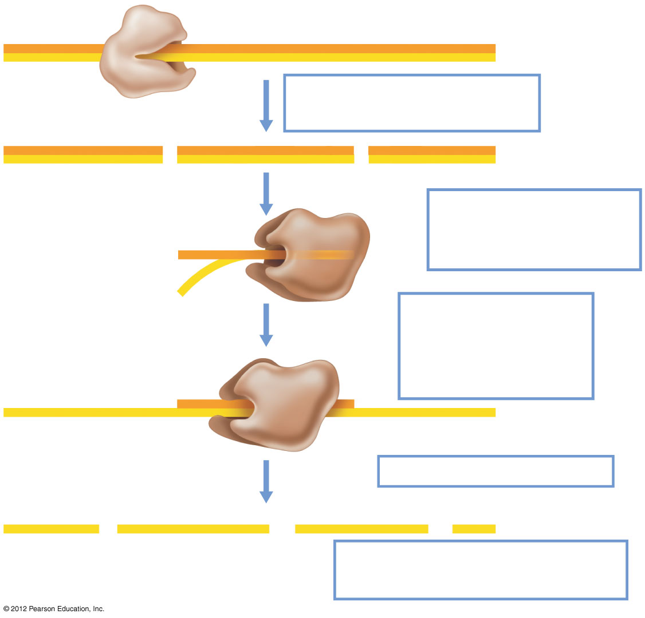
Figure 7.16
Dicer
dsRNA
Dicer cleaves dsRNA into shorter segments
siRNA
RISC
RISC binds siRNA and separates the strands
RISC finds messenger RNA complementary to siRNA
mRNA
RISC cleaves mRNA
RNA fragments degraded by exonuclease
© 2012 Pearson Education, Inc.
Notes:
Figure 7.16 RNA interference.

Slide 13
7.11 Regulation by MicroRNA
MicroRNAs (miRNAs): small dsRNAs that regulate translation in eukaryotic cells (Figure 7.17)
Precursor folds to dsRNA
Cleaved by Drosha (similar to Dicer)
Trimmed by Dicer
Bound to protein complex miRISC
Binds to target on mRNA to block translation or lead to mRNA degradation.
© 2012 Pearson Education, Inc.

Slide 14
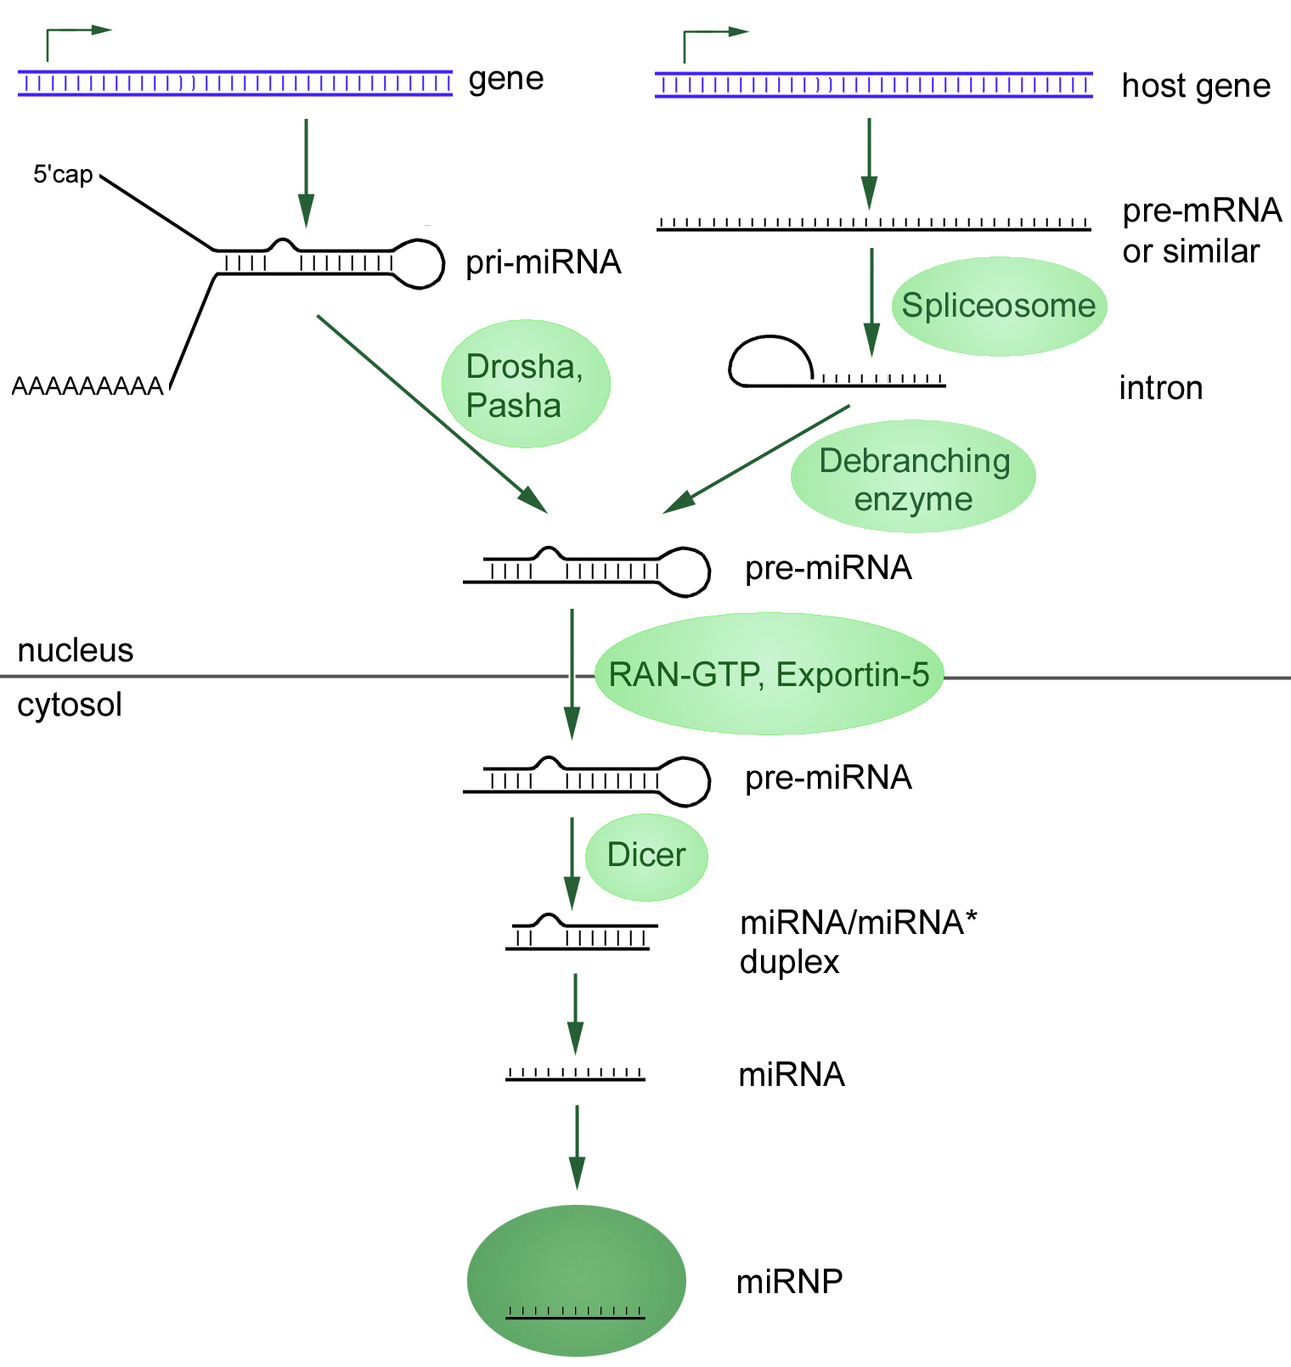

Slide 15
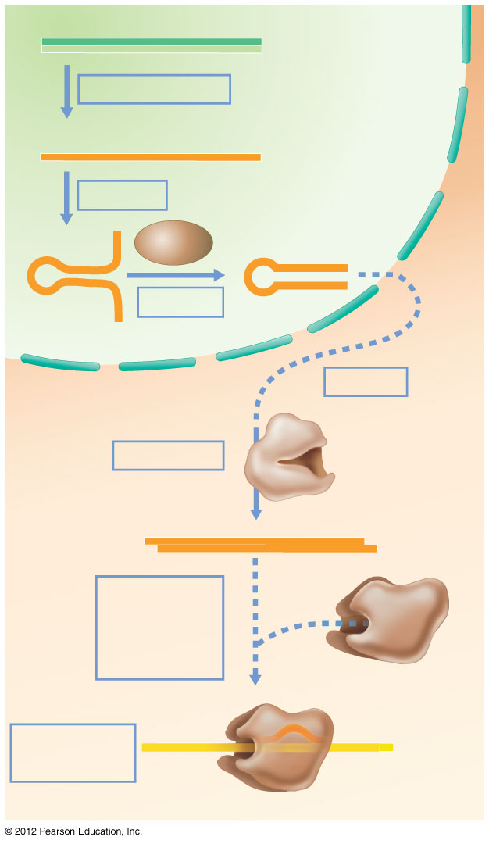
Figure 7.17
DNA
Nucleus
Transcription
RNA
Folding
Drosha
Cutting
Cytoplasm
Export
Dicer
Trimming
miRNA
miRISC
miRISC binding and strand selection
Translation is blocked
mRNA
© 2012 Pearson Education, Inc.
Notes:
Figure 7.17 Mechanism of miRNA action.

Slide 16
Central dogma concept map

