Slide 1
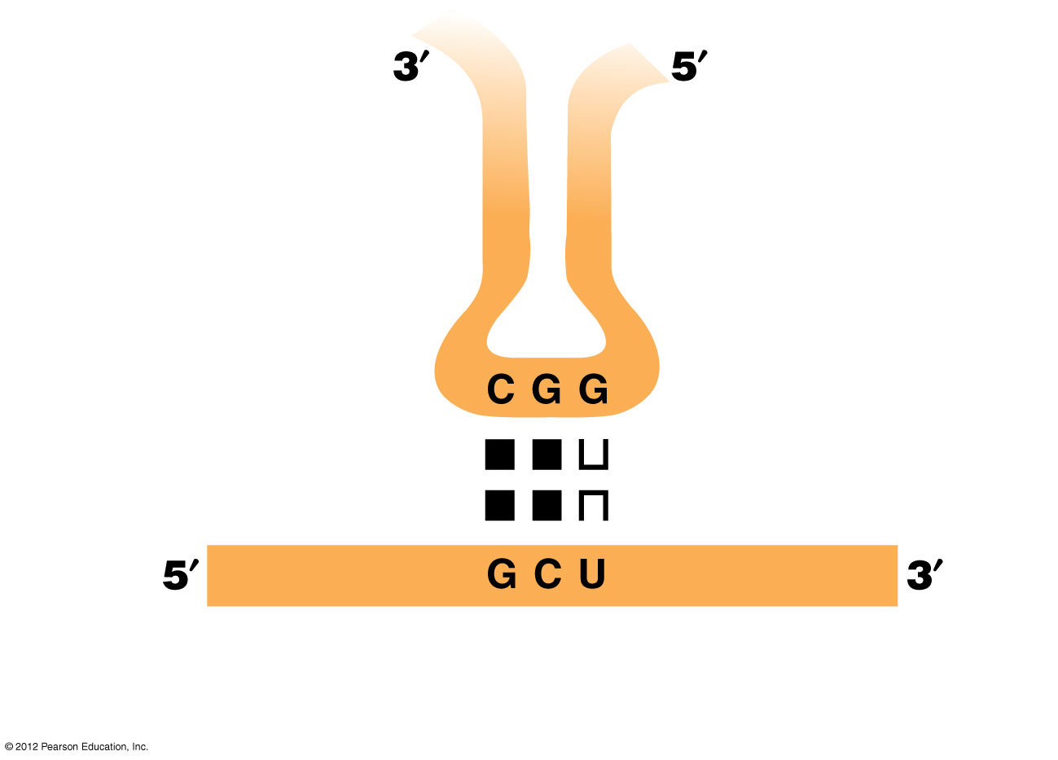
Figure 6.31
Alanine tRNA
Anticodon
Key bases in codon: anticodon pairing
Wobble position; base pairing more flexible here
mRNA
Codon
© 2012 Pearson Education, Inc.
Notes:
Figure 6.31 The wobble concept.

