Slide 1


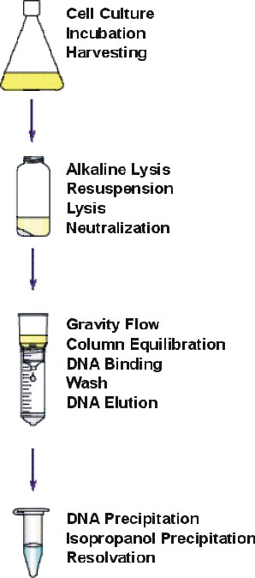
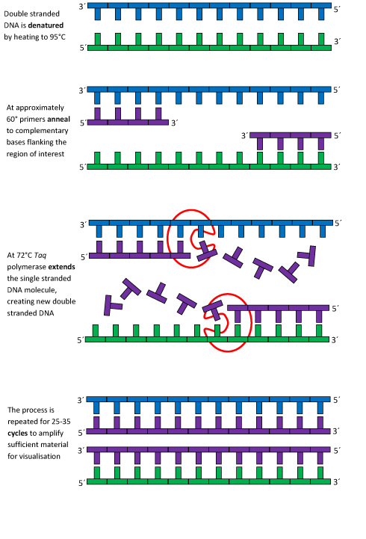
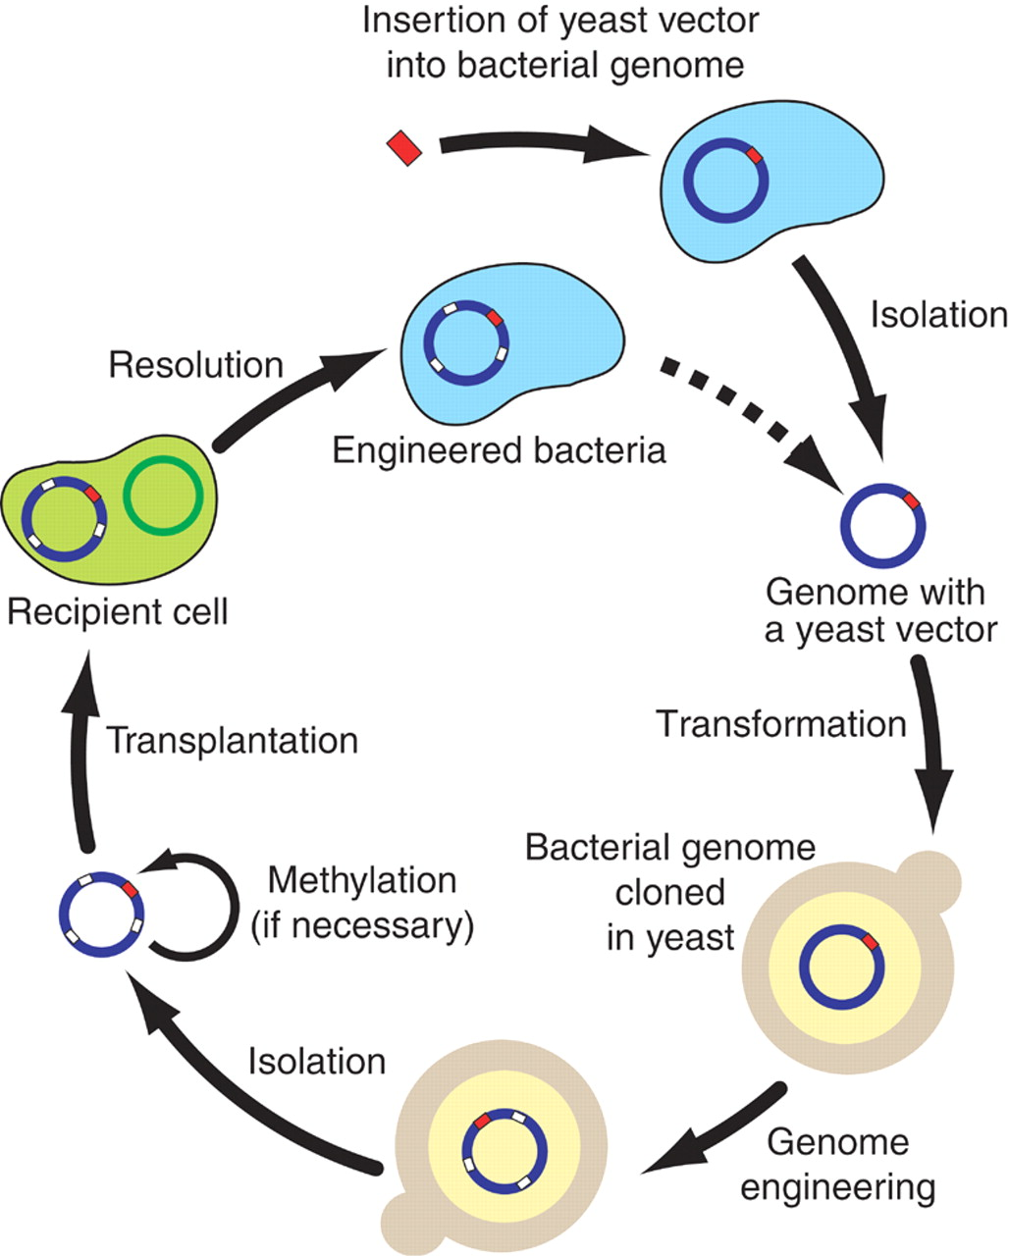
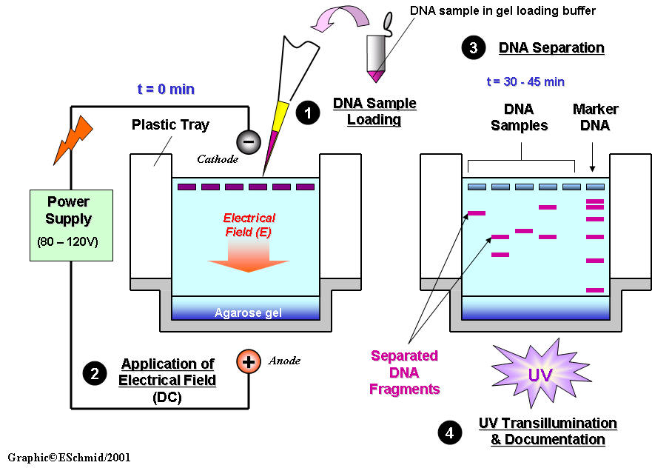
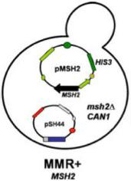
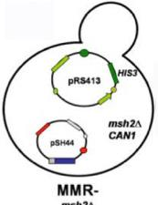
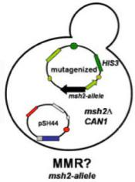
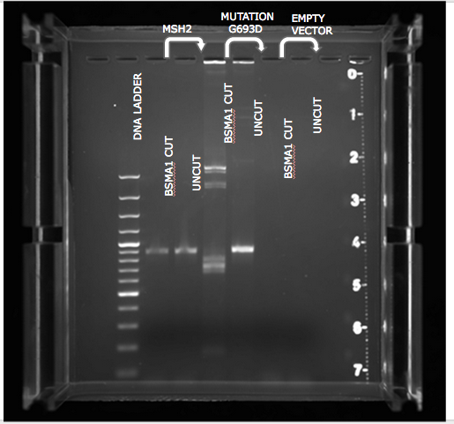
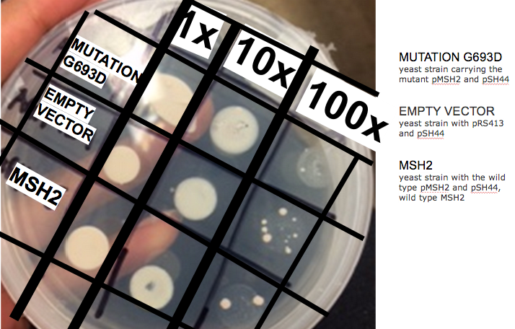
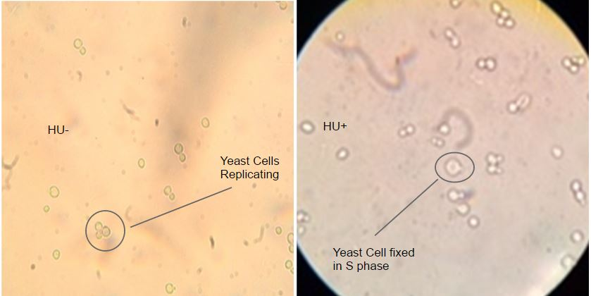
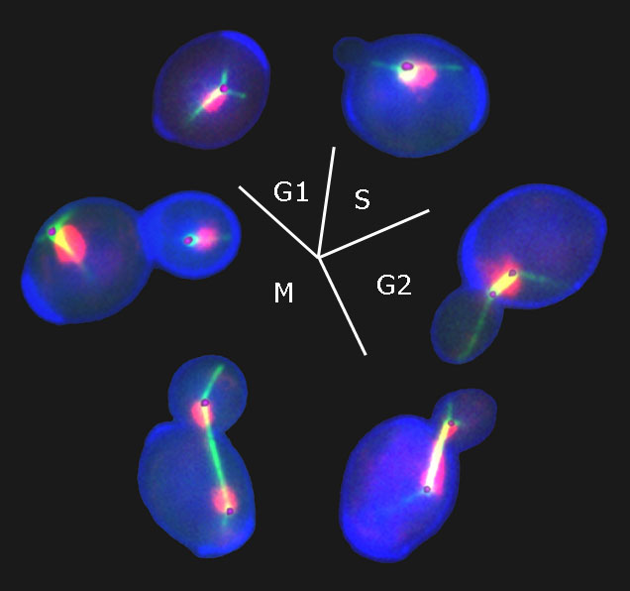
Identification Studies of Missense Mutation on MSH2 Gene Taylor Williams-Hamilton and Akeela Lewis Advisor: Hong Qin Department of Biology, Spelman College, Atlanta, GA 30314
DISCUSSION
abstract
Methods
Restriction enzyme digestion would cause different band patterns between cut and uncut enzyme. Since there was a shown difference in fragment size, this procedure was successful. (Figure 1)
The FOA assay indicates growth by the formation of yeast colonies. In this case, there should be significantly less colonies in the wild type MSH2 gene section because a functional MSH2 gene carries out the mismatch repair function so that the URA3 gene would be expressed. Functional URA3 would transform into toxic fluorouracil, which would kill the yeast cells. Therefore, we should see a high mutation rate and a large number of colonies in the empty vector section, which does not contain MSH2. Results show that there are significantly less colonies are shown in the MSH2 section than the empty vector. However, the mutant yeast had even less colonies than the wildtype. Although the mutant is benign, it should not have a better DNA repair function than the wildtype. Reasons for this could be fluctuating cell numbers from spot to spot since we were not able to count each individual cell. We had to estimate. (Figure 2). The transformation of the yeast with pSH44 plasmid and with plasmids containing MSH2 alleles was successful as indicated by the growth of yeast colonies on the selective SD-his-trp plates.
Hydroxyurea (HU) alters the yeast cell cycle by preventing DNA replication. Therefore, yeast cells treated with HU will be fixed in S phase and not replicate into two full cells. Figure 3 shows cell without HU (HU-) and cells with HU (HU+). As expected, the HU- slide indicates that DNA replication has occurred, while the HU+ slide indicates that cells are suspended in S phase of the cell cycle. Figure 4 shows the normal yeast cell cycle with the cell going through each phase of the cycle.
In this experiment, the MSH2 gene that is linked to HNPCC, a cancer diagnosed in humans was studied. The MSH2 gene is a DNA mismatch repair gene responsible for HNPCC. A mutation in the mismatch repair gene increases mutation rate. The higher the mutation rate, the greater the chance an individual has of being diagnosed with HNPCC. In this case, the amino acid threonine changes to valine. The mutation in this gene, G693D, was studied using budding yeast. The purpose of this experiment is to examine the plasmid (wild type, mutant, and empty vector) carrying the MSH2 insertion in order to identify and locate the mutation that occurred.
isolate plasmid DNAs from three E.coli strains
digest the three PCR products using BsmAI, which can distinguish mutant MSH2 from the wild type MSH2
insertion of
new genetic
material into
yeast cells
run the digested products on agarose gel to determine which plasmid DNA contains the MSH2 insert.
background
Hereditary Nonpolyposis Colorectal Cancer (HNPCC) is a condition driven by genetics because the probability of contracting colorectal cancer is inherited and increased. Colorectal cancer is the second leading cause of cancer mortality in the United States. There is an estimated count of 153,000 new cases of colorectal cancer diagnosed each year. Colorectal cancer is the cause of 56,000 deaths each year
MSH2 was the first gene linked to HNPCC to be sequenced. From this sequencing project, researchers concluded that other mismatch repair genes were involved.
HNPCC is caused by a mutation in either hMSH2, hPMS1, MSH6 (chromosome 2), hMLH1 (chromosome 3), and hPMS2 (chromosome 7).When there is a missense mutation within the DNA, MSH2 is needed to bind with MSH6 or MSH3 to form an active protein complex, which runs along the DNA and recognizes DNA damage. When the strand of DNA that codes for MSH2 is mutated, there is a possibility that the protein’s function may be either altered or stopped completely. This means that all DNA damage that requires MSH2 would not be corrected, and there would be many errors within the DNA strand.
Understanding the role of MSH2 in yeast will help us better understand the role of MSH2 in HNPCC.
measure
mutation rate
results
MSH2-
Wild Type
Empty Vector
G693D-Mutant
conclusions
The overall objective of the MSH2 project was to identify the pathogenic nature between three MSH2 strains in three different plasmid DNA samples based on functionality.
It was determined that the mutation that occurred at G693D was benign in nature.
ACKNOWLEDMENTS
Dr. Hong Qin, Dr. Dongfang Wang, and Dr. Stephen Kioko for helping us in the laboratory this semester.
Figure 1.
Figure 2.
REFERENCES
objectives
Stoffel E, Mukherjee B, Raymond VM, et al.: Calculation of risk of colorectal and endometrial cancer among patients with Lynch syndrome. Gastroenterology 137 (5): 1621-7, 2009. [PUBMED Abstract]
Aretz S, Uhlhaas S, Goergens H, et al.: MUTYH-associated polyposis: 70 of 71 patients with biallelic mutations present with an attenuated or atypical phenotype. Int J Cancer 119 (4): 807-14, 2006. [PUBMED Abstract]
Genetics of Colorectal Cancer (PDQ®). (n.d.). Retrieved February 26, 2015.
Budding yeast and additional cell cycle complexity. Digital image. Web. 10 April 2015. http://people.virginia.edu/~djb6t/cell/dan2_12.htm
Manipulate the yeast MSH2 gene to determine which plasmid samples are likely to be benign or pathogenic in nature.
Examine the defect at a molecular level to determine why the MSH2 variants are dysfunctional.
Figure 3.
Figure 4.

