Slide 1

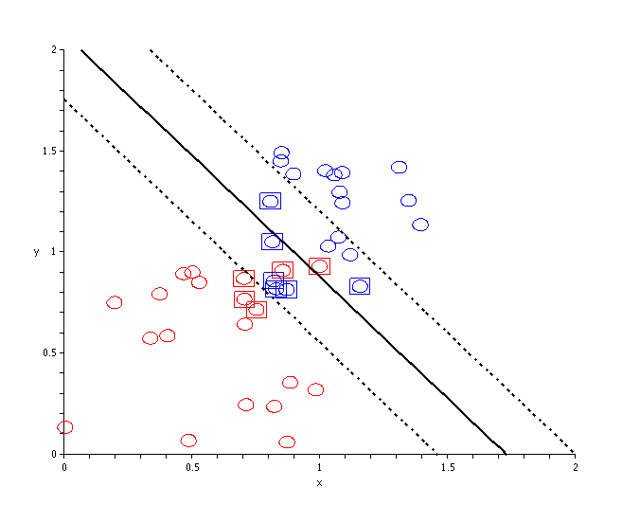
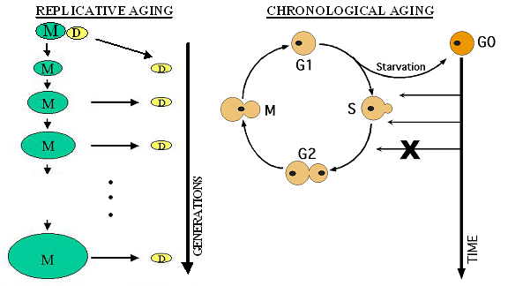
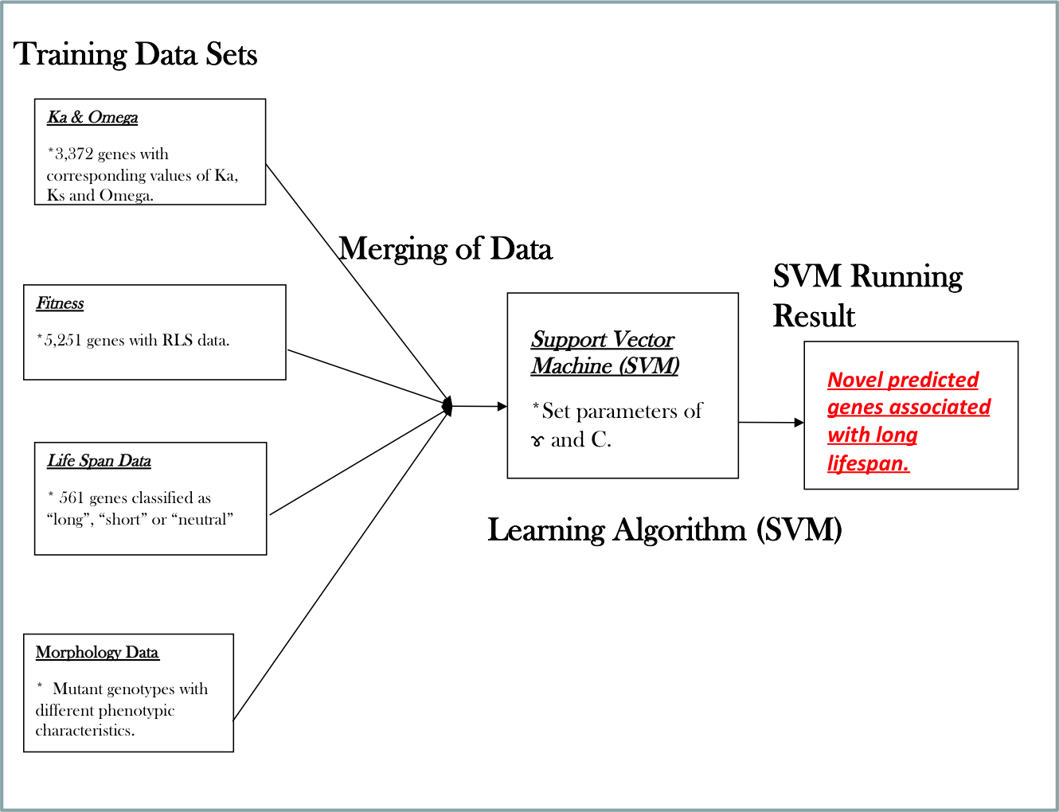
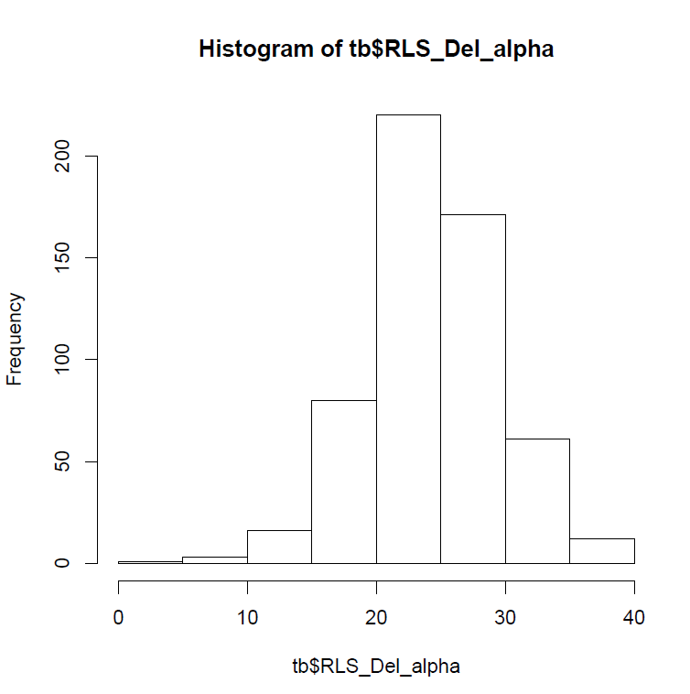
Predicting Novel Candidate Genes Associated with Longevity in
Saccharomyces cerevisiae using Support Vector Machine
DeAndra Jones, Corin V. White, and Hong Qin, Ph.D.
Biology Department, Spelman College, Atlanta, GA 30314
Spelman College
INTRODUCTION
Saccharomyces cerevisiae has arisen as an important model system for genomics, cell biology and molecular genetics. Furthermore, yeast has proven to be an excellent system for studying cellular aging, since some of the most key features of cellular aging were first discovered in yeast. The mechanism of cellular aging has proven to be quite complex as evident by the hundreds of genes that have been identified in multiple species. These genes include the transcriptional repressor Oct-1 and transcriptional factors Hoxa4, Hoxc4 and Sax1. Other genes include a glial cell line gene Gdnf, Fgf11 that encodes a fibroblast growth factor, and Fln that codes for a filamin factor involved in neuronal migration. The genetic manipulation of these genes has given a deeper understanding of the molecular basis of cellular aging and has produced a variety of changes in organism survival. These life span changes have been found to vary significantly across different species, in individuals of the same species and in different cells within the same organism. This study focuses only on genetic features as opposed to protein-gene interactions and aims to consider cellular aging as an emergent property of gene networks. These genetic features included Ka, omega, fitness, morphology and genetic data corresponding to replicative lifespan (RLS) measures.
HYPOTHESIS
  We hypothesize that aging is a system-level property of gene/protein networks. Furthermore, genetic components of this network should be significantly involved in the regulation of RLS. We also expect that SVM (support vector machine) can be used to determine if genomic features can be used to predict aging in yeast (Figure 1a, 1b, & 2).
RESULTS
Table 2: 13 novel yeast genes predicted to be associated with long life span. Genes are shown with their known common name, systematic name, and localization in the cell.
Figure 1a: Support Vector Machine (SVM) with two distinct classes separated by a hyperplane.
Table 1: Results from SVM with RLS data. H₀ (null hypothesis) represents the data from the training data set while H_{A} (alternative hypothesis) is the prediction from our SVM model. The values in the middle of the table represent the SVM running result. A 6.1% false positive rate is observed while 46 genes (true positives) were accurately predicted to be associated with long life span.
Common Name | Systematic Name | Location
 | YBL062W | Unknown
 | YDR333C | Cytoplasm
NKP1 | YDR383C | Kinetochore
 | YER134C | Cytoplasm and nucleus
 | YER156C | Cytoplasm and nucleus
 | YHL045W | Unknown
 | YHR202W | Fungal vacuole
SET4 | YJL105W | SET domain
BUD19 | YJL188C | Unknown
 | YKL071W | Cytoplasm
 | YKR047W | Unknown
TIR4 | YOR009W | Cell wall
 | YPL102C | Unknown
H_{A} vs. H_{O} | Long | Neutral | Short
Long | 46 True positives | 0 False positive | 3 False positives
Neutral | 62 False negatives | 164 True negatives | 58 False
Short | 2 False negatives | 0 False | 46 True negatives
Table 3: A list of 30 novel yeast genes predicted to be associated with long life span. Genes are shown with their known common name, systematic name, localization and function in the cell. Genes shown in red are involved in processes such as the cell cycle that have been identified to be associated with cellular aging.
Figure 1b: Yeast Replicative Aging.
Common Name | Systematic Name | Location | Documented Function
UMP1 | YBR173C | Proteasome core complex | Protein catabolism chaperone activity.
PCL6 | YER059W | Cdk holoenzyme complex | Regulation of glycogen catabolic and biosynthesis. Regulator of cyclin-dependent kinase (cdk) in the cell cycle.
UBX7 | YBR273C | Endoplasmic reticulum. | Ubiquitin-dependent protein catabolic process in the endoplasmic reticulum.
CBS1 | YDL069C | Mitochondrial inner membrane | Protein biosynthesis translation factor activity.
RPP1A | YDL081C | Structural constituent of ribosome cytosolic large ribosomal subunit | Protein biosynthesis.
TPS2 | YDR074W | Trehalose-phosphatase | Response to stress through trehalose-phosphatase activity.
SCS2 | YER120W | Endoplasmic reticulum | Chromatin silencing at telomere and protein binding.
ARC1 | YGL105W | tRNA synthetase complex and the cytoplasm | tRNA binding, translation and ligase regulation.
HIR3 | YJR140C | Cytoplasm | Transcription in mitotic cell cycle and nucleosome assembly.
RMD8 | YFR048W | Cytoplasm | Involved in drug response and sporulation.
AAP1 | YHR047C | Cytoplasm and the nucleus | Aminopeptidase activity, glycogen metabolic process and proteolysis.
MRPL8 | YJL063C | Mitochondria | Ribosome constituent, genome maintenance, translation.
RPL17B | YJL177W | Cytosolic large ribosomal subunit | Ribosome synthesis and translation.
ADO1 | YJR105W | Cytoplasm and the nucleus | Adenosine kinase activity and purine metabolic process.
PCK1 | YKR097W | Cytosol | Phosphoenolpyruvate carboxykinase ATP activity and gluconeogenesis.
ENT4 | YLL038C | Actin cortical patch | Clathrin binding, endocytosis, actin filament organization and protein localization.
MSS51 | YLR203C | Mitochondria | Translation regulator activity and mitochondrial translation.
GFD1 | YMR255W | Nuclear core and the cytoplasm | mRNA transport form the nucleus.
BN15 | YNL166C | Cellular bud neck | Cytokinesis, septin ring assembly.
JJJ1 | YNL227C | Cytosol, mitochondria, cytoplasm and ribosomes. | ATPase activity, endocytosis, cell size regulation and biogenesis of large ribosomal subunit.
CUS2 | YNL286W | U2 snRNP | RNA binding and nuclear mRNA splicing.
EXO1 | YOR033C | Nucleus | Exonuclease and endonuclease activity, telomere maintenance, mismatch repair, DNA double stranded break processing.
WTM1 | YOR230W | Nucleus | Transcriptional repressor, co-repressor and activator, protein import, meiosis regulation.
RFM1 | YOR279C | Nucleus and the histone deacetylase complex | Unfolded protein binding and chromosome silencing.
SGF11 | YPL047W | Nucleus, SAGA complex | Histone deubiquitination and regulation of transcription from RNA polymerase II promoter.
UBP16 | YPL072W | Cytoplasm and the mitochondrial outer membrane | Ubiquitin-specific protease activity and protein deubiquitination.
ELP4 | YPL101W | Cytoplasm and the elongator holoenzyme complex | Regulation of transcription from RNA polymerase II promoter and tRNA wobble uridine modification.
BEM3 | YPL115C | Cellular bud tip and the cytoplasm | Budding , cell growth , the establishment of cell polarity and Rho GTPase activator activity.
SAM3 | YPL274W | Plasma membrane | Putrescine, S-adeno sylmethionine and spermidine transmembrane transporter activity.
MLC2 | YPR188C | Cellular bud contractile ring | Myosin II binding and ring contraction in cell cycle cytokinesis.
Figure 2: Pictorial representation of SVM training data sets and SVM result. Four different data sets were merged in R and used to train the support vector machine (SVM) to allow the prediction of novel genes.
Figure 3: Distribution of 564 haploid genes associated with RLS and the classes of RLS used for SVM prediction.
Histogram of Replicative Lifespan
Frequency
Neutral
Short
Long
DISCUSSION & CONCLUSION
In this study, we provide a list of 43 novel candidate genes associated with the regulation of long life span. This list was generated via training SVM with data from the following genetic features: Ka, omega, morphology, fitness and RLS. Of the 43 novel genes predicted to be associated with long lifespan, 30 had known functions (Table 3) and 13 had unknown functions (Table 2). Of these known functions, only small portion have been previously associated with cellular aging. Several trends were seen in the functions of these novel genes in pathways containing tRNA and the mitochondria. These pathways may be correlated with pathways that have been linked to cellular aging (ribosomal machinery and cell cycle). Studies should be completed to assess the function and level of contribution to cellular aging of the genes presented in Table 2 and 3. Future studies may involve verifying the computational analysis completed in this study by using an alternative predictive method called the Bayesian approach. SVM parameters will be adjusted and cross validation will be done to investigate the possibly of more significant predictions within the same training data.
METHODS
Replicative Lifespan (RLS)
SVM Code: Support vector machine (SVM) was trained to predict novel genes associated with cellular aging and longevity (Figure 2). SVM is a supervised learning algorithm that is used for classification analysis in computational biology. SVM was used in order to minimize error that may be accumulated by other classification techniques such as linear regression or neural network. SVM allows the integration of many predictors of each variable which allows the usage of a multitude of data. Our predictor variable or attributes were used to create training data sets that included the select genomic features. The code for SVM was based on libsvm and written with an R interface implemented in the e1071 and pcurve packages. The appropriate model parameters (γ & C) were based on predetermined quantities of a default SVM program. A radial kernel function was used to map non-linear data into a higher dimension to more accurately handle our nonlinear class labels and predictors.
Training Data Sets: All data sets used for this study were obtained from online Saccharomyces cerevisiae databases. The morphology data contained a list of genes with phenotypical scores associated with genetic mutations and was provided by the University of Tokyo (SCMD). Fitness was a measure of reduction in relative growth rate in consequence of specific genetic deletions or disruptions and contained a list of 5,251 genes. The Ka and Omega data sets contained a list of 3,372 genes with corresponding values. The RLS data was a measure of RLS in response to the deletion of certain genes (561) which was separated into classes as shown in Figure 3.
ACKNOWLEDGEMENTS
We would like to thank Dr. Hong Qin for his mentorship and the members of the Qin lab for their support during this project. We would also like to thank the Nation Science Institute of Health (NIH)- National Center for Minority Health and Health Disparities (NCMHD) Grant for Spelman College Center for Health Disparities Research and Education (CHDRE) for the funding.
REFERENCES
Bahar, R., Hartmann, C.H., Rodriguez, K.A., Denny, A.D., Busuttil, R.A., Dolle, M.E., Calder, R.B., Chisholm, G.B., Pollock, B.H., Klein, C.A., Vijg, J. (2006) Nature. 441:1011-1014.
Fabrizio, P.,Pozza, F., Pletcher, S.D., Gendron, C.M., & Longo, V.D. (2001). Science. 292(5515):288-290.
Finch, C.E., Ruvkun, G.(2001) Annu. Rev. Genomics Hum. Genet. 2:435.
Golden, T.R., Hubbard, A., Dando, C., Herren, M.A., Melov, S. (2008). Aging Cell. 7:850-865.
Imai, S., Nishibayashi, S., Takao, K., Tomifuji, M., Fujino, T., Hasegawa, M. & Takano, T. (1997). MBoC. 8(12): 2407-2419.
Kaeberlein, M., McVey, M. & Guarente, L.(1999). Genes Dev.13(19): p. 2570-2580.
Kaeberlein, M., Powers, R.W., Steffen, K.K. 3RD, Westman, E.A., Hu, D., Dang, N., Kerr, E.O., Kirkland, K.T., Fields, S. & Kennedy, B.K. (2005). Science. 310 (5751):1193-1196.
Kellis, M., Patterson, N., Endrizzi, M., Birren, B., Lander, E.S. (2003). Nature. 423 (6937):241-54.
Lee, C.K., Weindruch, R. & Prolla, T.A. (2000) Nature Genetic.25: 294-297.
Mewes, H.W., Albermann, K., Bahr, M., Frishman, D., Gleissner, A., Hani, J., Heumann, K., Kleine, K., Maierl, A., Oliver, S.G. et al. (1997). Nature. 387:7-65.
Stewart, E. & Taddei, F. (2005). Bioessays. 27(9):983.
SCMD (Saccharomyces Cerevisiae Morphological Database) online database. University of Tokyo. site visited March 23, 2010. < http://yeast.gi.k.u-tokyo.ac.jp/datamine/download.jsp>.
Witten, M.T., Bonchev, D. (2007). Chem & Biodiversity. 4:2639-2654.
Notes:
This poster is a portrait and its dimensions are 38 inches wide by 40 inches long.

