Slide 1

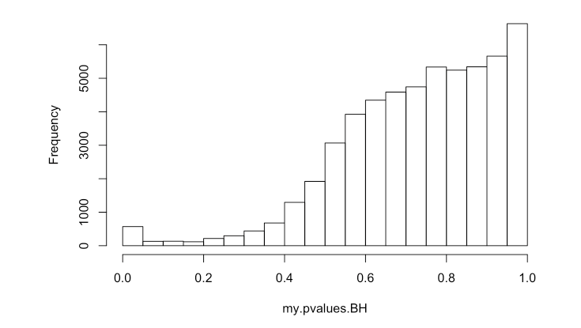
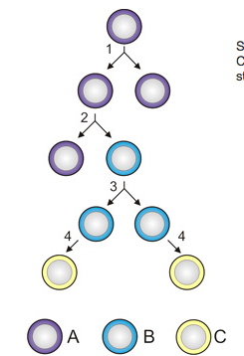
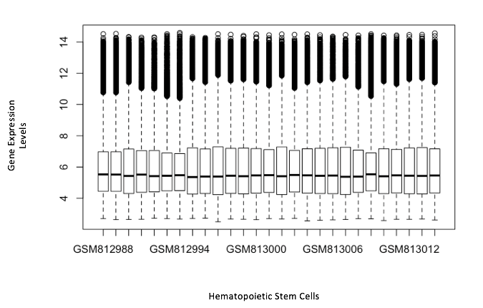
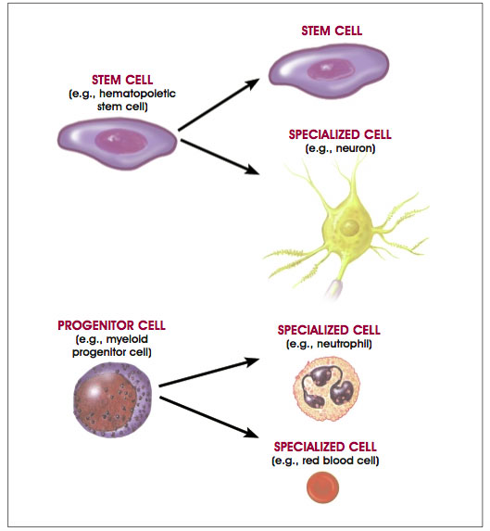
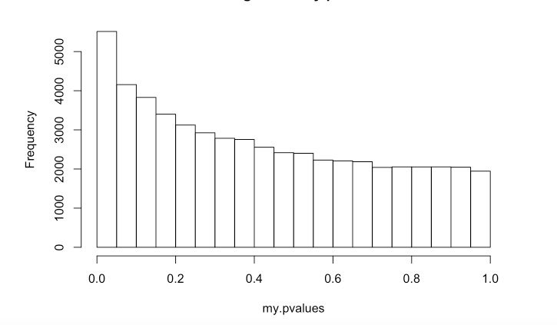
A Look At Aged Hematopoietic Stem Cells
Faith Lyons
Dr. Hong Qin
Biology
Introduction
Although aging is one of the most recognizable characteristics of human biology, it is one of the least understood. The process of aging can be traced down to the cellular level. The body is made up of many different types of specialized cells, which originate from stem cells. A stem cell is a cell that is not yet specialized. Stem cells can be found in embryos or adult tissue, such as brain, bone marrow, blood, blood vessels, skeletal muscles, skin, and the liver. Unique cells that are primarily located in the bone marrow are Hematopoietic stem cells (HSC). HSC generate a number of blood cell types found in the body, implying that HSC circulate in blood. HSC are active in innate immune responses. Since one of the most notable age-related changes is decline of the immune system, it can be hypothesized that aged-HSC predispose contribute to hematopoietic dysfunction.
Objectives
Identify the properties of aged hematopoietic stem cells
Explain how aged hematopoietic stem cells may predispose to age-associated hematopoietic dysfunction
Increase in Aged HSC with Adjustments
In aged individuals, HSC frequency increased
Aged individuals HSC are less dormant
The aged HSC exhibit myeloid-biased differentiation potential compared to young HSC
Conclusion
These finding indicate that there are age-related changes is decline of the immune system. Aging of the immune system is associated with HSC gene expression that reflect quantitative alterations. The research data indicates that increased frequency does not translate to improved function of aged HSC. The increasing longevity of human populations has prompted a keen interest in molecular solutions to aging and age-related medical problems. Future studies that extend and integrate our understanding of stem cell aging will ultimately contribute to increasing the life expectancy of humans, and developing anti-aging therapies and regenerative medicines.
Materials and Methods
Sample data from NCBI GEO database (Pang et al., 2011) accession GSE32719, was loaded into R Studio for data analysis
Using a sample size of 27 HSC, median and mean gene expression levels were normalized in order to clearly compare biological differences between samples of HSC
Regression was used to measure the relationship between the mean expression levels and corresponding age of HSC
Gene analysis conducted using GOrilla to identify classes of genes or proteins that are over-represented in a large set of genes
Figure 1. The cell labeled A represents a stem cell; B represents a progenitor cell; Cell C represents a differentiated cell. At level 1 symmetric stem cell division is occurring; Level 2 depicts asymmetric stem cell division; Level 3 shows progenitor division; Finally, level 4 is terminal differentiation.
(Molecular Diagnostic Services, Inc., 2007)
Results
Gene Expression Levels in Sample
Increasing Frequency of Aged HSC
Acknowledgements
This study was supported by grants from the Howard Hughes Medical Institute 52006314. The author would like to thank Dr. Hong Qin and Dr. Emine Guven for all the help and support
Eran Eden*, Roy Navon*, Israel Steinfeld, Doron Lipson and Zohar Yakhini. "GOrilla: A Tool For Discovery And Visualization of Enriched GO Terms in Ranked Gene Lists", BMC Bioinformatics 2009, 10:48.
Pang WW, Price EA, Sahoo D, Beerman I et al. Human bone marrow hematopoietic stem cells are increased in frequency and myeloid-biased with age. Proc Natl Acad Sci U S A 2011 Dec 13;108(50):20012-7. PMID: 22123971
R Core Team (2013). R: A language and environment for statistical
computing. R Foundation for Statistical Computing, Vienna, Austria.
URL http://www.R-project.org/.
Figure 2. Stem cell can make identical copies of themselves for long periods of time; this ability to proliferate is referred to as long-term self-renewal. Stem cells typically divide again, producing an intermediate cell or progenitor cell. The progenitor cells then give rise to mature cell types that have different shapes and specialized functions. (Winslow & Kibiuk, 2001)

