Slide 1


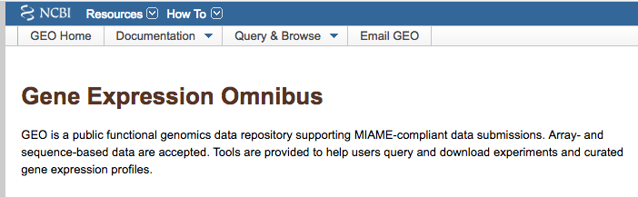




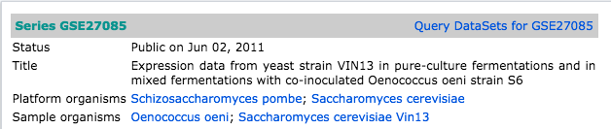
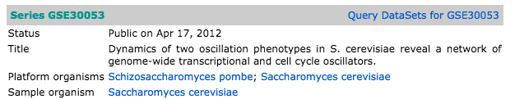
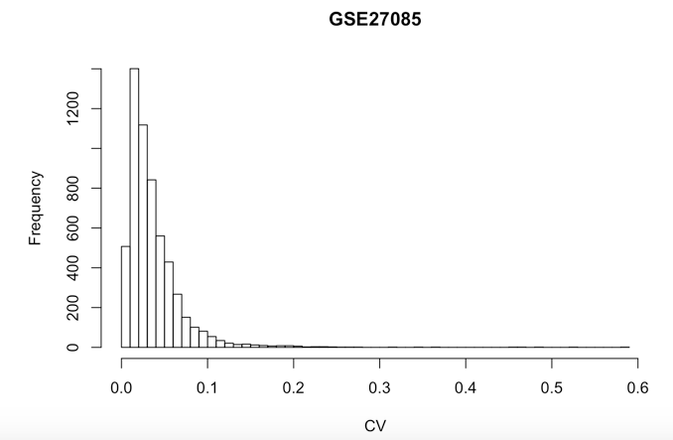
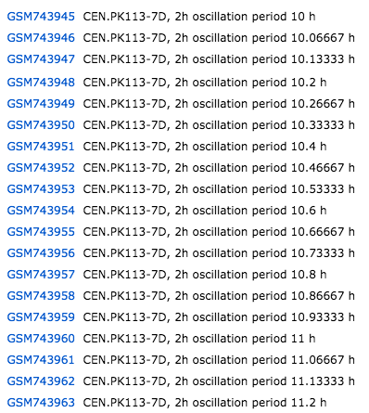
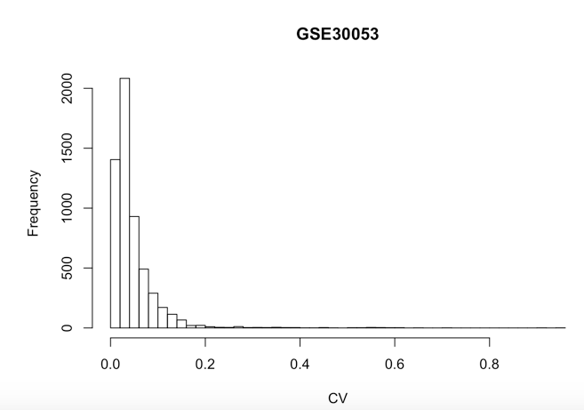
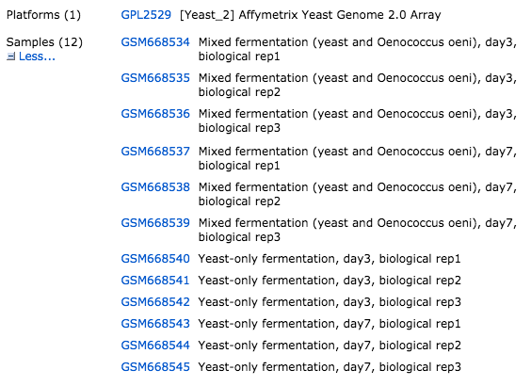
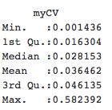
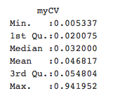
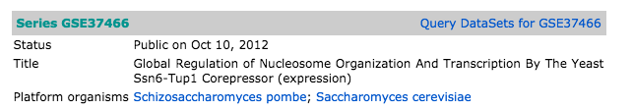
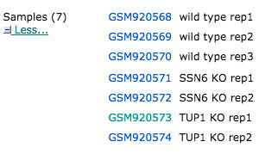
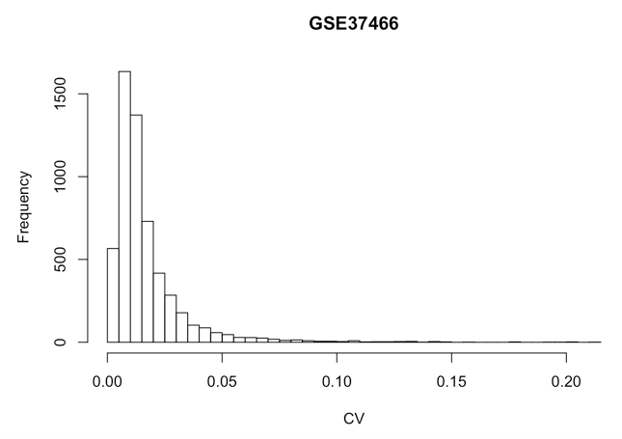
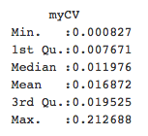
Estimate gene expression robustness from microarray expression data sets in Saccharomyces cerevisiae.
Maya Bryant; Hong Qin, PhD
Department of Biology, Spelman College, Atlanta, GA 30314
Abstract
The robustness of intracellular gene networks reflects cell’s ability to maintain homeostasis in the face of changing environments. One way to measure robustness is the ratio of standard deviation to the mean, known as the coefficient of variation (CV). Large CV indicates a wide range of changes in the internal states of a system and hence less robust. Small CV indicates a narrow range of changes in the internal states of a system and hence a fairly robust system. Here, we focus on the robustness of intracellular gene networks in in the model organism of Saccharomyces cerevisiae. We obtained a number of gene expression data sets from NCBI GEO, and estimate CV for every gene. We found that the distribution of CV by genes is skewed, with majority of genes with very small CV values, but a small number of genes with extremely CV values. Hence, majority of the genes have robust gene expression levels despite environmental changes.
Design of the Study
Materials and Methods
NCBI GEO data base
Retrieve Gene expression data sets (GEO Query)
Calculate CV
Normalized expression
Compare all data sets.
Results
Results
Introduction
Fluctuation of gene expression events in different conditions
Robustness of gene network
Cellular Aging
Results
Concept of Robustness
Conclusions
The distribution of CV are generally long-tailed, skewed to the right.
Most genes have very robust expression profile with very small CV.
Fluctuating environment lead to more flexible gene expression profiles.
Robustness = Ability of cells to maintain homeostasis in the presence of genetic, environmental, and stochastic variations.
Robustness can be measured by coefficient of variation (CV).
CV = Standard deviation / Mean
Smaller CV
Larger CV
Less noise
More robust
More noise
Less robust
References
1. Qin, A network model for cellular aging. http://arxiv.org/abs/1305.5784
2. Davis, S. and Meltzer, P. S. GEOquery: a bridge between the Gene Expression Omnibus (GEO) and BioConductor. Bioinformatics, 2007, 14, 1846-1847
Goal
Estimate the expression robustness of every gene in yeast genome.
Acknowledgement
Funding: We would like to give our thanks to NSF CAREER 1453078 and MCB 1517588 to H Qin, the Department of Biology at Spelman College, the Ethel Waddell Githii Honors Program.
Notes:
Long tail distribution

