Slide 1
Metric Proficiency, Scientific Literacy and Attitude
Kierra Parker

Slide 2

Abstract
This research focuses on..
age, gender, country of education, and highest education
Using..
24 question survey
R studio programming
To determine…
factors that affect metric proficiency scientific literacy and scientific attitude

Slide 3

Importance
-Developing an appreciation for and having an open mindedness for science is a growing concern for those in the science community
- Scientific literacy address the basic science concepts used in everyday life
ttp://us.123rf.com/450wm/radiantskies/radiantskies1212/radiantskies121201863/16720760-abstract-word-cloud-for-scientific-literacy-with-related-tags-and-terms.jpg

Slide 4
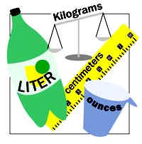
Background (Scientific Literacy)
Scientific Literacy is based on knowledge used by citizens
Daily Common Issues
-matter, energy, forces and motion
-nature of atoms, Earth cycles, basic concepts of cells and evolution
Metric conversion
used everywhere except Burma, Liberia and U.S
is believed to be directly related to country of education
http://madaboutscience.weebly.com/uploads/1/0/6/9/10698734/301024.jpg

Slide 5

Background (Scientific Attitude)
Scientific attitude
Objectivity
Open mindedness
Suspend judgement on personal belief
General positive attitude
Scientific attitude is a growing concern within the scientific community
Exposure to math and science decrease
http://dailyinspirationandgratitude.com/2015/05/12/how-to-stop-being-an-ass-and-keep-an-open-mind/

Slide 6
Methods
200+ participants were given online or in-person survey
24 questions addressing each area of focus
9 questions for scientific literacy
5 questions of metric conversion & scientific attitude
4 background questions
Literacy: “What is an electron attracted to?“ (positive charge)
Attitude: “Do you agree that organic food should be DNA free food?
Metric: 145mm = _____m. (.145)

Slide 7
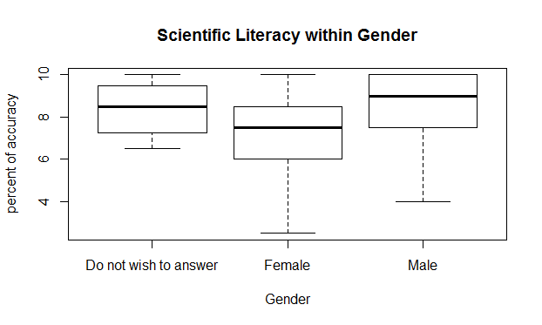
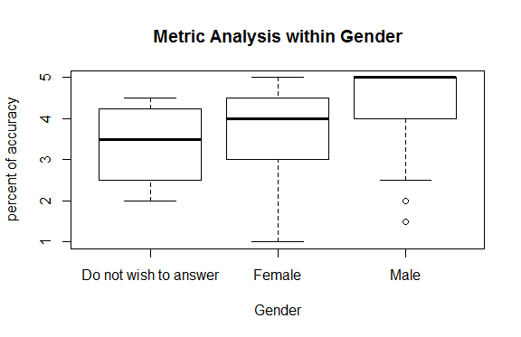
Analysis Within Gender
linear regression 4.413 e-09
linear regression pvalue: 4.763 e-07
Notes:
Why green background on the right?

Slide 8
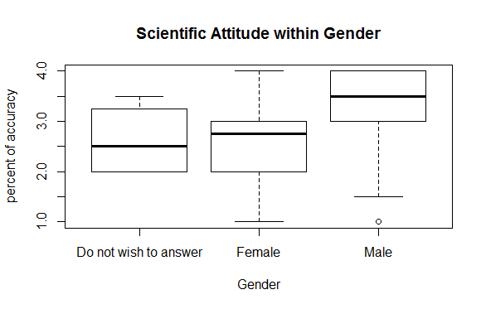
Analysis within Gender (continued)
Because men displayed a greater positive scientific attitude compared to women and higher accuracy in all questions
Men display greater scientific attitude than women
Science attitude = Science literacy
Linear regression p-value:2.49 e-09

Slide 9
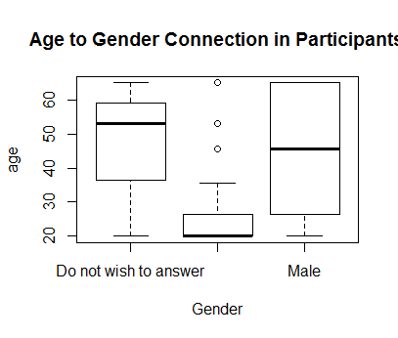
Average age within Population
Male average age is significantly greater than women’s average age

Slide 10
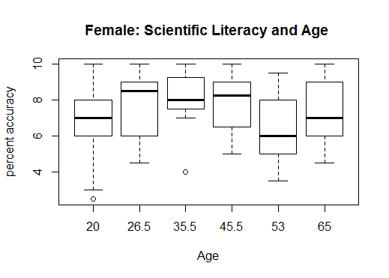
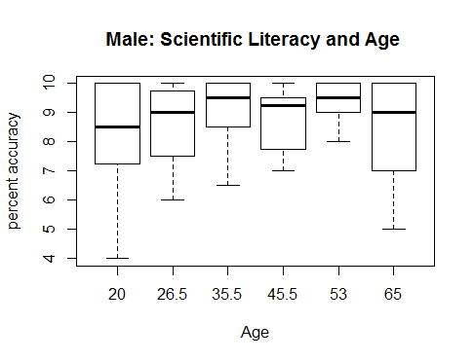
Scientific Literacy Within Gender & Age
- Highest: Women (23-30) and (31-40) Men (31-40) and (51-55)
-Lowest: Women (51-55) and (18-22) Men (18-22)
- Similarities: Women have an overall lower accuracy, and younger ages are in the lower performing section
Group 18-22 (20), 23-30 (26.5), 31-40 (35.5), 41-50 (45.5), 51-55 (53), 65 and older displayed left to right

Slide 11
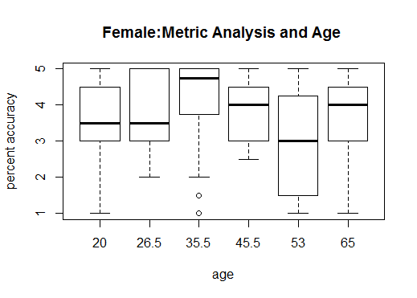
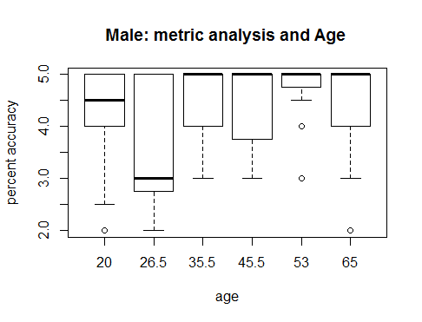
Metric Conversion Within Gender & Age
Highest: Women (31-40) Men (31-65)
Lowest: Women (51-55) Men (23-30)
Similarities: Most age groups have the same scientific attitude (insignificant difference), a young age group has the lowest average
Group 18-22 (20), 23-30 (26.5), 31-40 (35.5), 41-50 (45.5), 51-55 (53), 65 and older displayed left to righ
Linear regression Female pvalue: 3.677 e-06
Linear regression Male p-value .02694
t

Slide 12
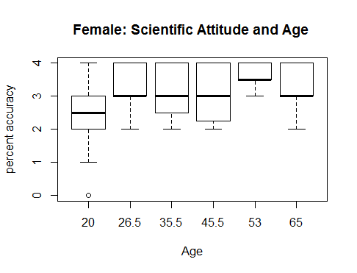
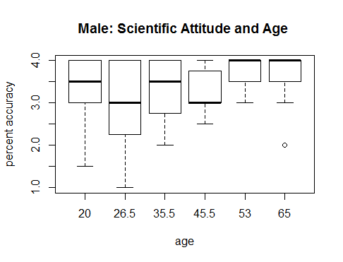
scientific attitude Within GenDer & Age
Highest: Women (31-40) Men (31-65)
Lowest: Women (51-55) Men (23-30)
Similarities: Most age groups have the same scientific attitude (insignificant difference), a young age group has the lowest average
Group 18-22 (20), 23-30 (26.5), 31-40 (35.5), 41-50 (45.5), 51-55 (53), 65 and older displayed left to right
Female Linear Regression p-value : 1148 e-10
Male Linear REgression .006385

Slide 13
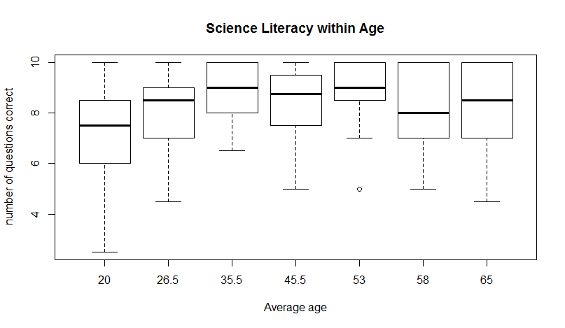
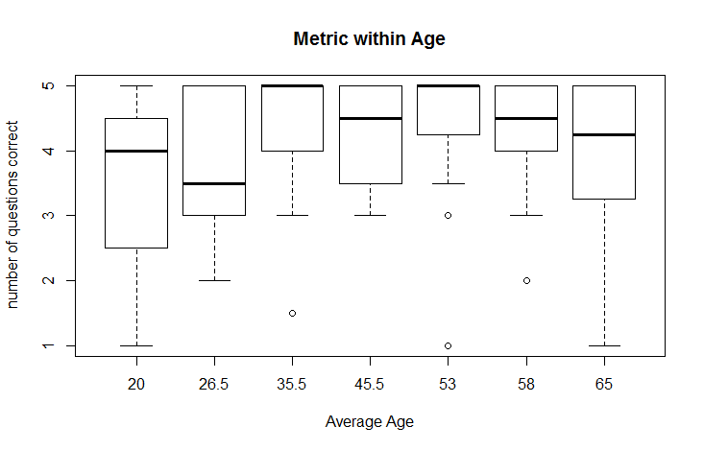
Analysis within Age
Similarities: Younger age groups displays lowest percent accuracy, Middle age and older age groups have relatively high accuracy.
Group 18-22 (20), 23-30 (26.5), 31-40 (35.5), 41-50 (45.5), 51-55 (53),56-64 (58), 65 and older displayed left to right
Linear Regression Scientific Literacy pvalue 7.358 e-06
Linear Regression Metric Within Age 3.667 e-06

Slide 14
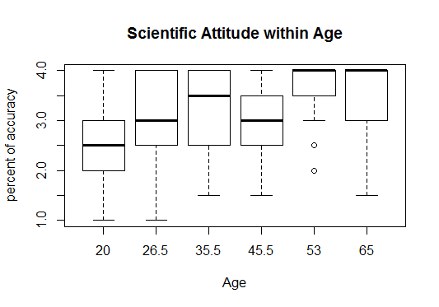
Analysis within age
Older age groups display higher scientific literacy
Youngest age group display lowest scientific literacy
Linear Regression p-value 1.148 e-10

Slide 15
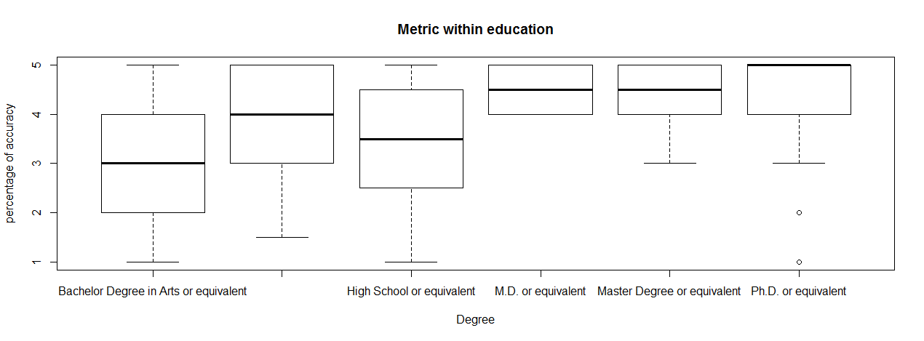
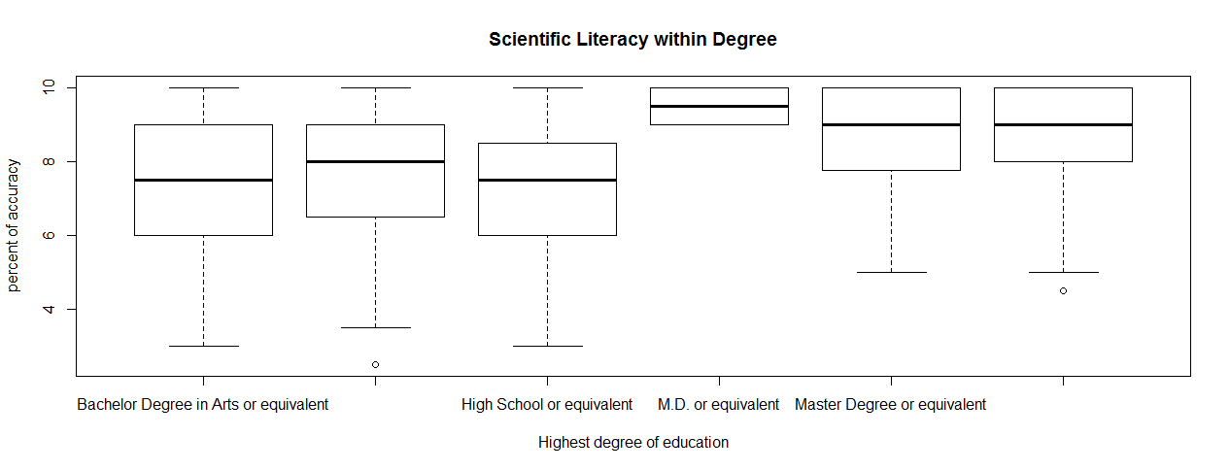
Analysis within Highest Degree
Similarities: Higher degrees result in higher education, B.S. has higher accuracy than B.A
Highest: Metric (PhD), Literacy (M.D.)
Lowest: Metric (High School and B.A., Literacy (High School, B.A.)
PhD, Master, M.D, H.S, B.S. and B.A. displayed right to left
Linear Regression (Metric) p-value 2.197 e-08
Linear Regression (Scientific Literacy) p-value 5.311 e-05

Slide 16
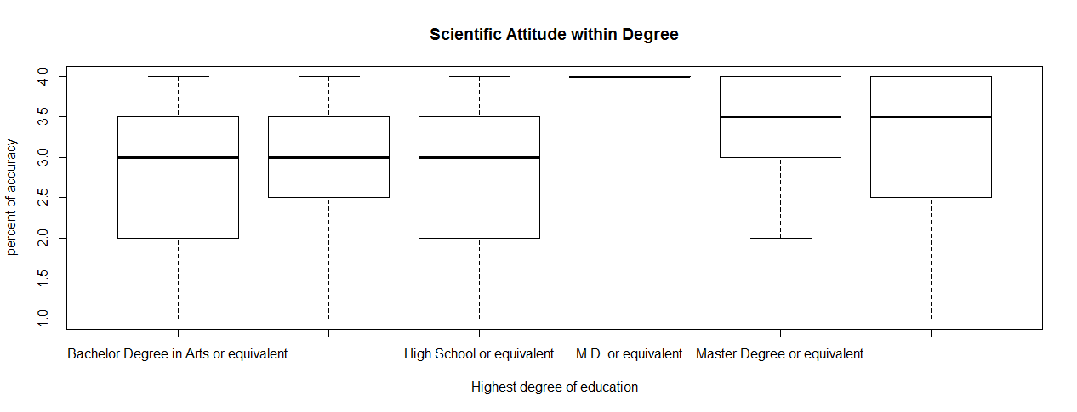
Degree Analysis
Scientific Attitude
Highest score MD (100%)
Higher education has greater scientific attitude
Scientific Literacy
B.S > B.A
Master + PhD > B.A. + B.S + H.S.
Linear Regression p-value .0004279

Slide 17
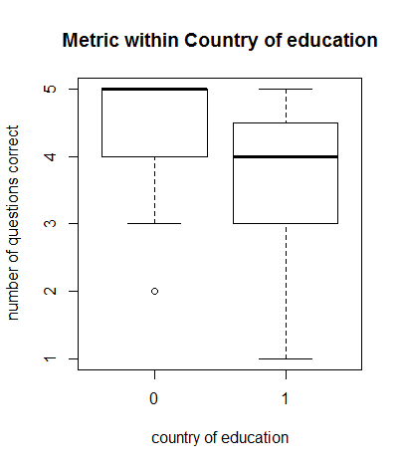
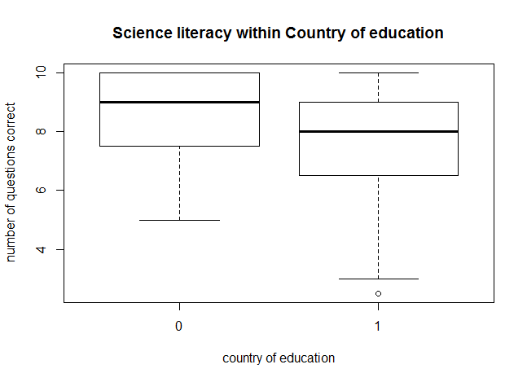
Analysis of Country of Education
Those educated outside of the U.S. have a higher accuracy.
Linear Regression (Metric) p-value .006894
Linear Regression (Scientific Literacy) p-value .00944

Slide 18
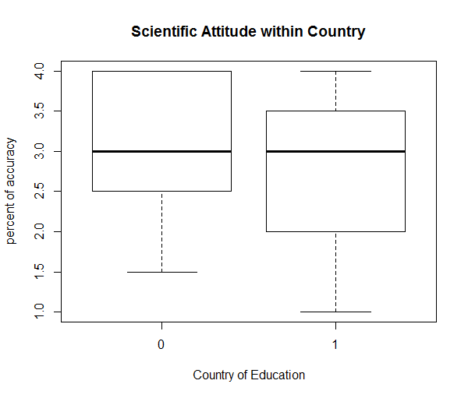
Scientific ATtitude and Country of Education
-No significant difference of scientific attitude and country of education
- Exposure to metric system in everyday life may affect the accuracy
linear regression p-value : .1037

Slide 19
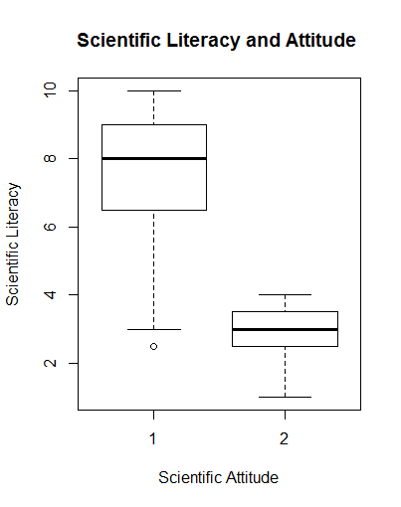
Scientific Attitude and Literacy
-Positive Scientific Attitude (1) shows dramatically higher accuracy in questions of scientific literacy than those who didn’t
-We can conclude there is a direct correlation between scientific literacy and attitude
Linear regression p-value 4.596 e-07

Slide 20
Conclusion…
From Observation of Gender and Gender with Age Controlled...
Because difference in accuracy decrease with age being controlled we can determine that gender is not directly related to scientific literacy or metric conversion
2. From Observation of Age...
Middle aged and older age display higher scientific attitude, younger age groups display lower scientific literacy or metric proficiency.

Slide 21
Conclusion…
3. From Observation of Highest Degree...
a. Education and scientific attitude, literacy and metric conversion are directly related.
i. More education = Higher accuracy + Attitude
b. B.S. has higher accuracy than B.A.

Slide 22
Conclusion…
4. From Observation of Country of Education...
a. Country of education doesn’t affect scientific attitude
b. Those educated outside of the U.S. have higher accuracy in metric conversion, and scientific literacy
5. From Comparison of Scientific Literacy and Attitude...
a. Scientific attitude is directly related to scientific literacy
i. greater positive attitude = greater accuracy

Slide 23
Final Remarks
Further research :
Observe what factors affect comfortability with metric and scientific questions
Determine if metric conversion and scientific literacy is related to career field
Whether education affects metric conversion of those educated out of the U.S.

Slide 24
References
Gauld, Colin. "The Scientific Attitude and Science Education: A Critical Reappraisal." Science Education Sci. Ed. 66.1 (2006): 109-21. Print.
Qin, Hong. "Open Notebook." : Metric Proficiency Is Linked to Scientific Literacy and Attitude. 6 Apr. 2013. Web. 30 Nov. 2015.
Thompson, K. V., K. C. Nelson, G. Marbach-Ad, M. Keller, and W. F. Fagan. "Online Interactive Teaching Modules Enhance Quantitative Proficiency of Introductory Biology Students." Cell Biology Education 9.3 (2010): 277-83. Print.
Trefill, James, and Robert Hazen. "Chapter 4: Scientific Literacy: A Modest Proposal." Science and the Educated American: A Core Component of Liberal Education. American Academy of Arts and Science, 2010. Web. 30 Nov. 2015.

