Slide 1

Introduction to R through a case study
Hong Qin
Notes:
Part of materials are based on Ken Rice and Thomas Lumley’s lecture on R

Slide 2
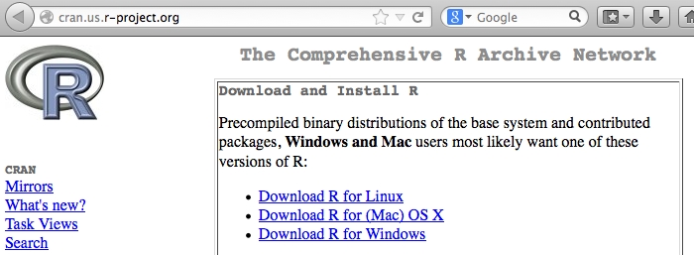
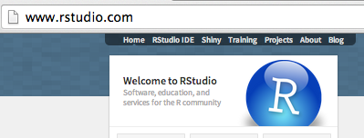
Install R and RStudio
R
  www.r-project.org
Rstudio (a nice GUI IDE for R)
  www.rstudio.com
YouTube
  How to download and install R and Rstudio .

Slide 3
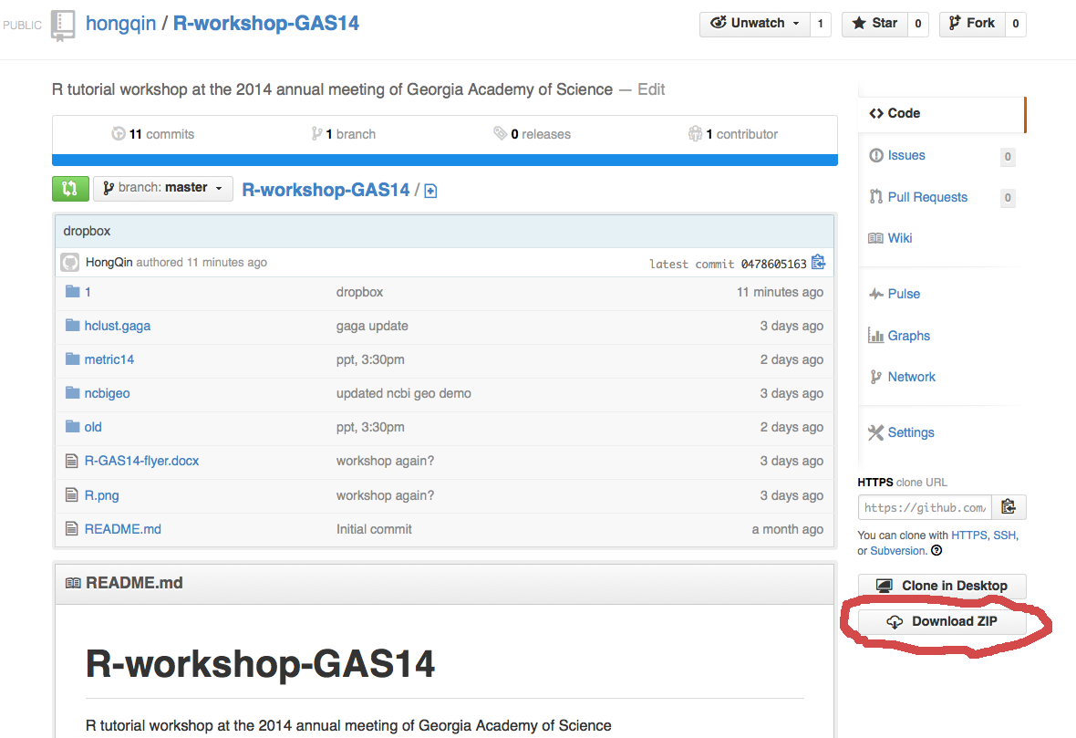
Download workshop materials
Github R GAS14 repository

Slide 4
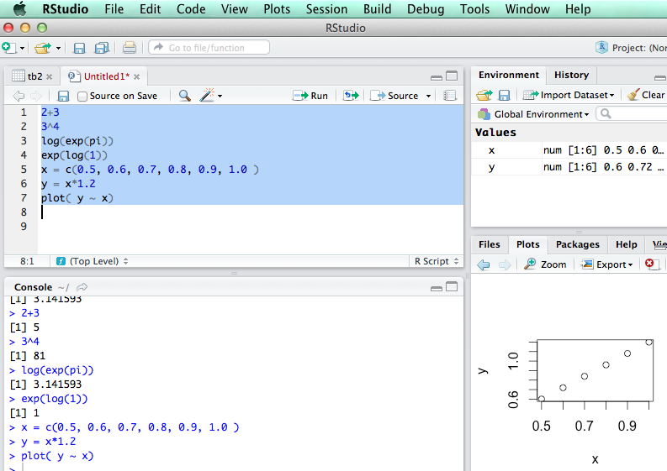
R is an interpretive language

Slide 5
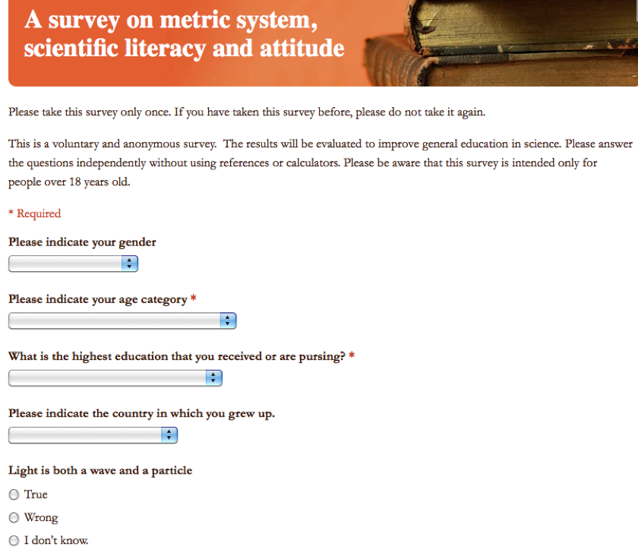
Learning R using an example
R Code: ‘metric.R’
Link to the online Survey

Slide 6
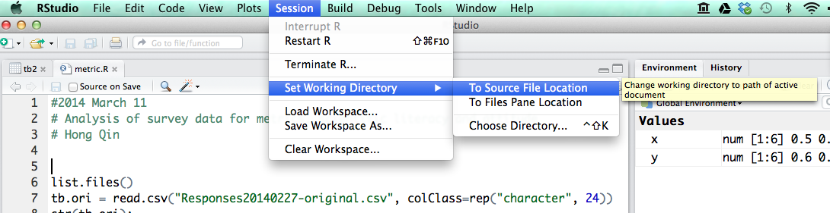
Load data into R
First, change working directory
Then, read.csv()

Slide 7
Explore the data
str()
head()
View()
Change long names to short names.

Slide 8
Table is a dataframe
A dataframe is like a spreadsheet in Excel.
tb[ 1:4, 2:7] #1-4 rows, 2-7 columns

Slide 9
Brackets and parentheses
# barackets are often for variable-access
x[i,j]
y[1];
z[[1]];
# parentheses are often for functions
t.test(x,y)
If (x <0 ) { x = -x; }
#curly parentheses are for other things

Slide 10
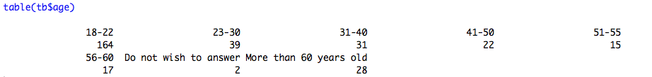


Explore the data

Slide 11
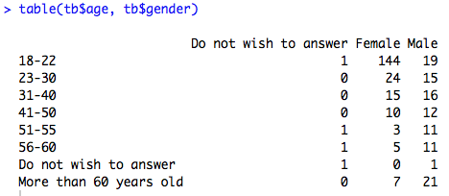
Explore the data

Slide 12
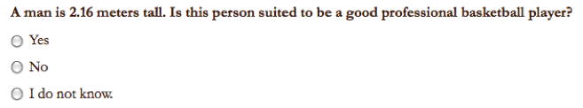
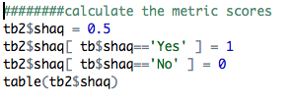

Convert answers to numerical scores

Slide 13
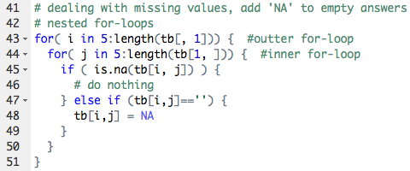
Loops in R

Slide 14
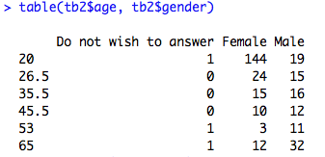
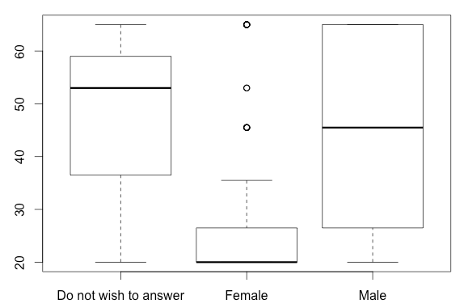

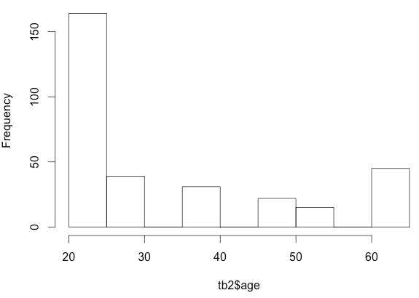
Plotting the data

Slide 15
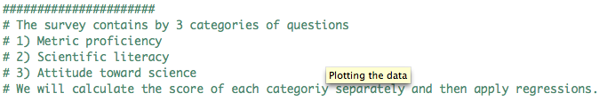
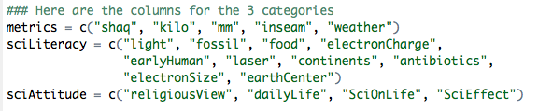
Three categories of questions

Slide 16
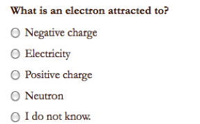
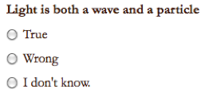
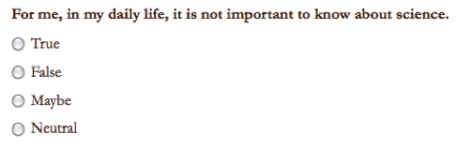
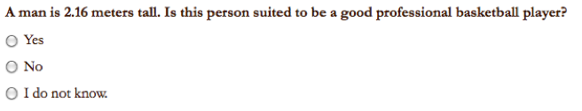
Sample Questions

Slide 17

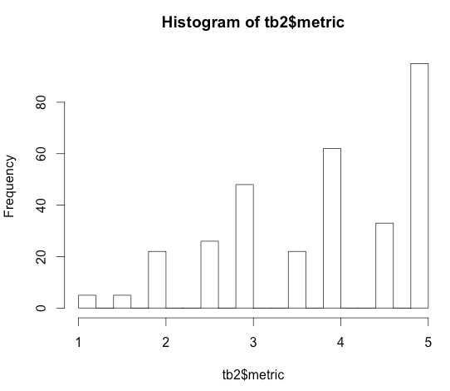

Score for Metric Proficiency

Slide 18
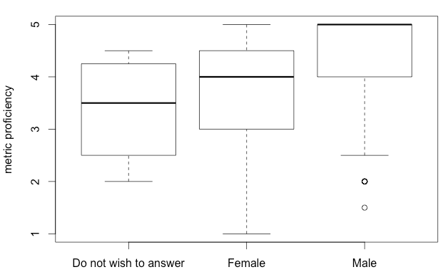
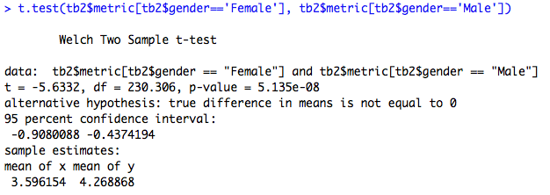
Do females tend to be less proficient in metric usage?

Slide 19
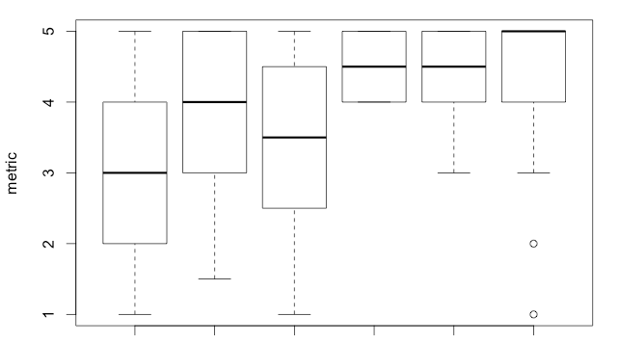
Education is a confounding factor.
BA BS HS MD MS PhD

Slide 20
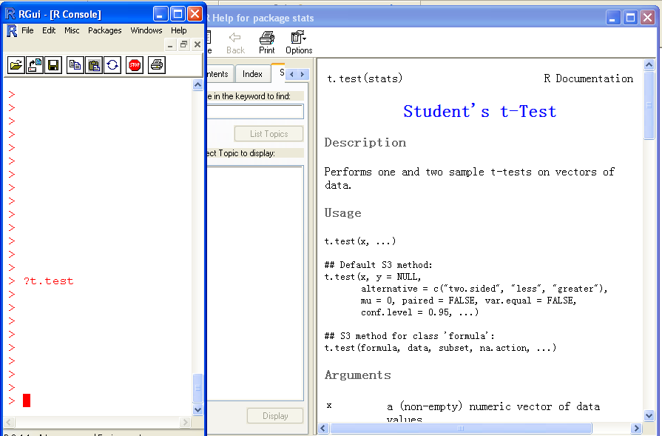
Help!

Slide 21
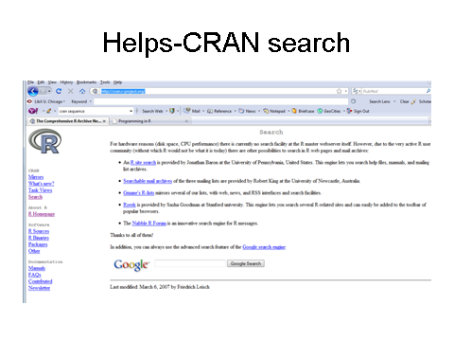
The R card

