Slide 1

Introduction to R through a case study
Hong Qin
Notes:
Part of materials are based on Ken Rice and Thomas Lumley’s lecture on R

Slide 2
Install R and RStudio
R
  www.r-project.org
Rstudio (a nice GUI IDE for R)
  www.rstudio.com

Slide 3
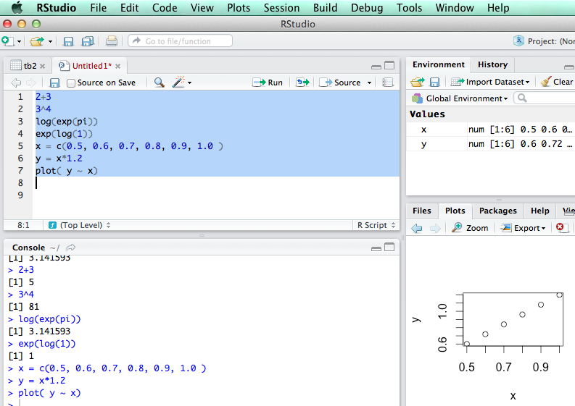
R is an interpretive language

Slide 4
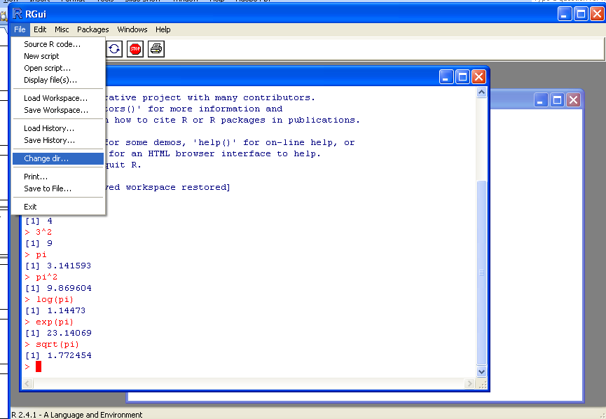
Change to your work directory.

Slide 5


Slide 8
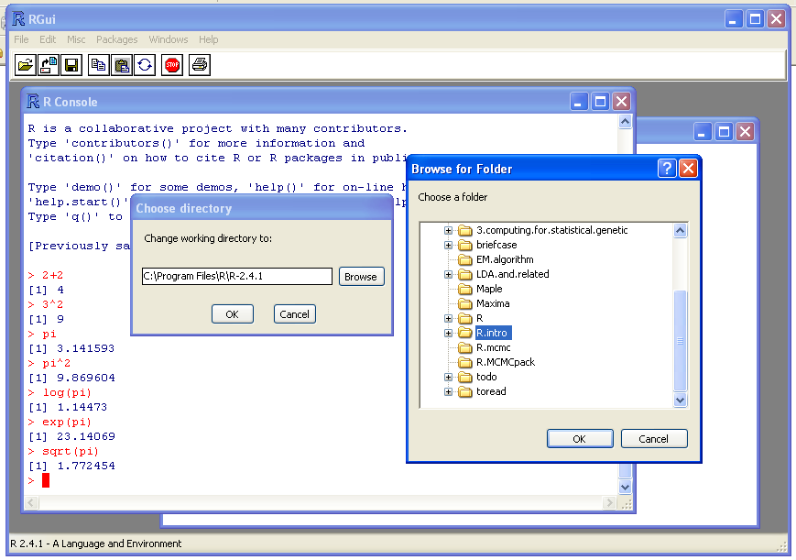
Choose your work directory.

Slide 9
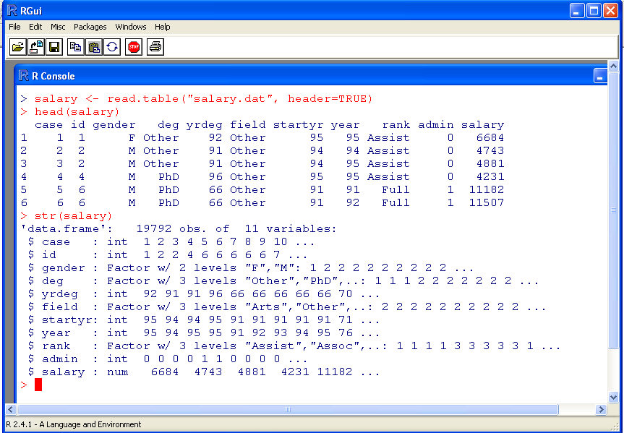
Read in a data file.

Slide 10

Use up-down buttons to look for previous commands.

Slide 11
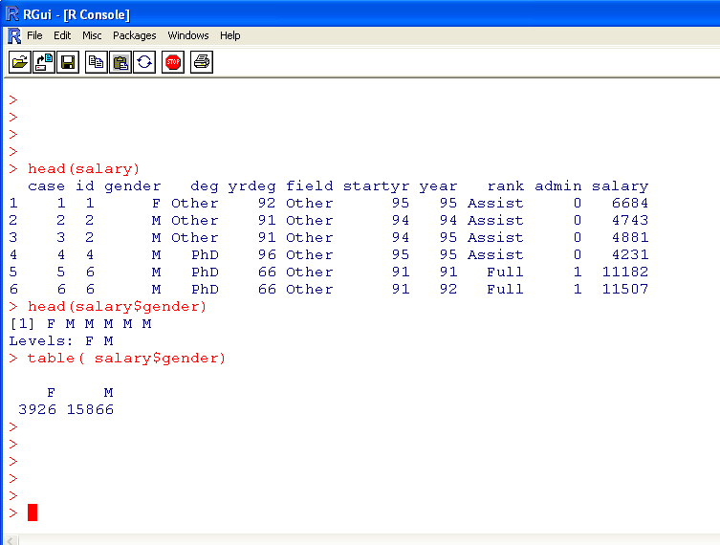
Explore the data
Notes:
There are more men than women in the data.

Slide 12
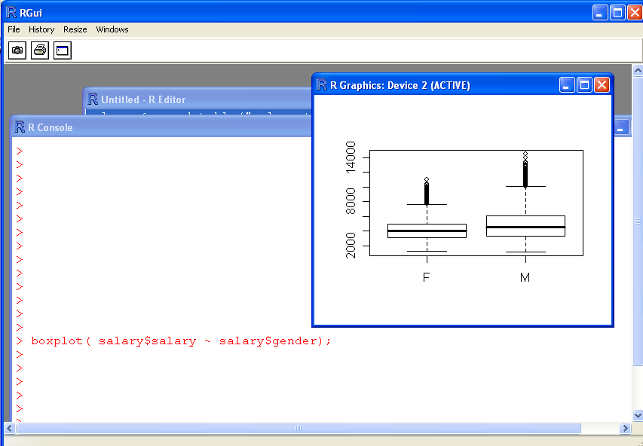
Analyze the data. Is there a bias in salary due to gender?
Notes:
Yes, at 2%, is this higher or lower than your expectation?

Slide 13
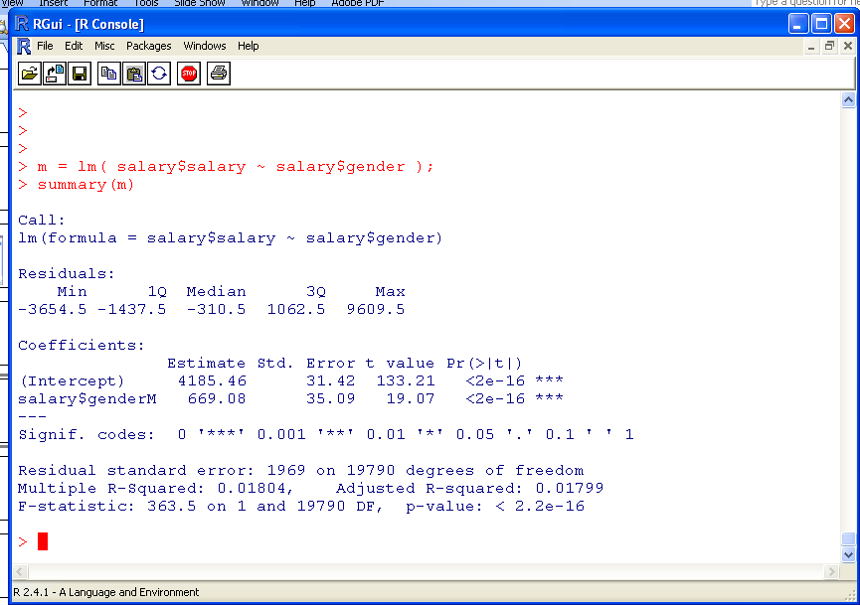
Using regression explore the association between salary between gender.

Slide 14
What is R-squared?
The coefficient of determination, which is the percentage of variance explained by the statistical model.
See http://en.wikipedia.org/wiki/R_square

Slide 15
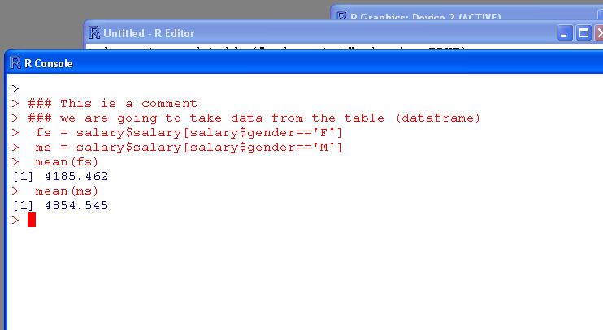
Assess the data
Syntax rules:
x[…] for vectors
fun( … ) for functions

Slide 16
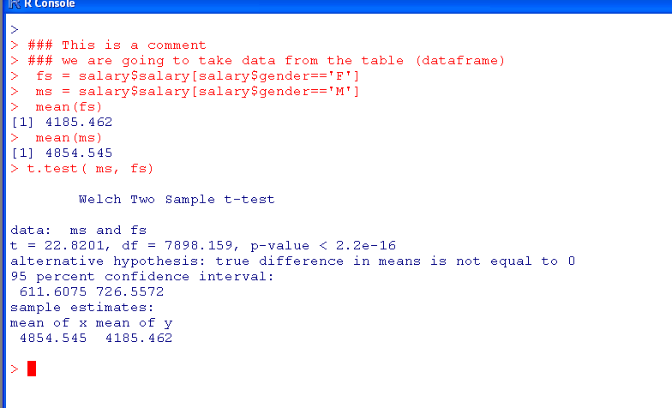
Assignment, t-test
Only 2.2x10⁻¹⁶ chance
given the H0 model.

Slide 17
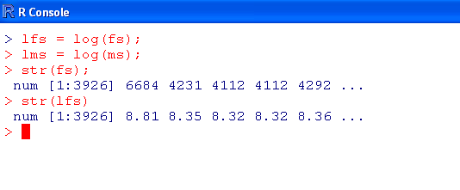
Vector and operations on vectors
Syntax rules:
x[…] for vectors
fun( … ) for functions

Slide 18
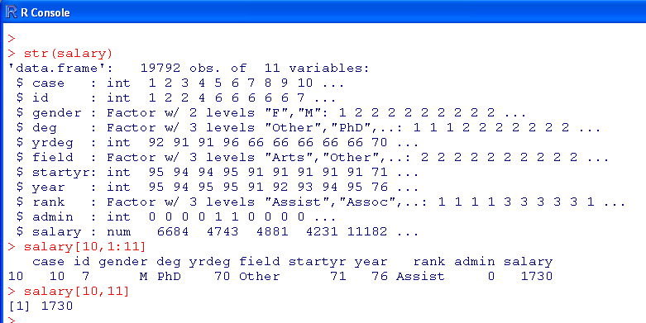
Assess data in a data frame

Slide 19
Brackets and parentheses
# barackets are often for variable-access
x[i,j]
y[1];
z[[1]];
# parentheses are often for functions
t.test(x,y)
If (x <0 ) { x = -x; }
#curly parentheses are for other things

Slide 20
Is salary dependent on rank?
Exercise on your own.
We have used regression and t-test to examine whether gender significantly influences one’s salary. Now, you can modify these scripts to explore the effect of rank.

Slide 21
… …

Slide 22
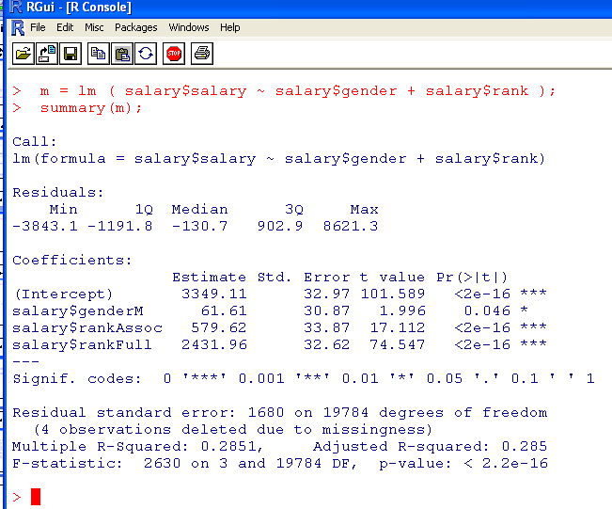
A multiple regression
Notes:
Change to m2

Slide 23
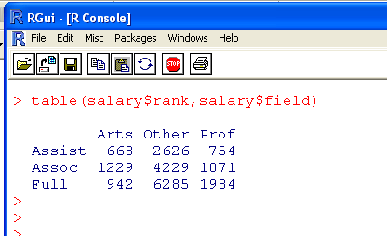
Factors are categorical variables.

Slide 24
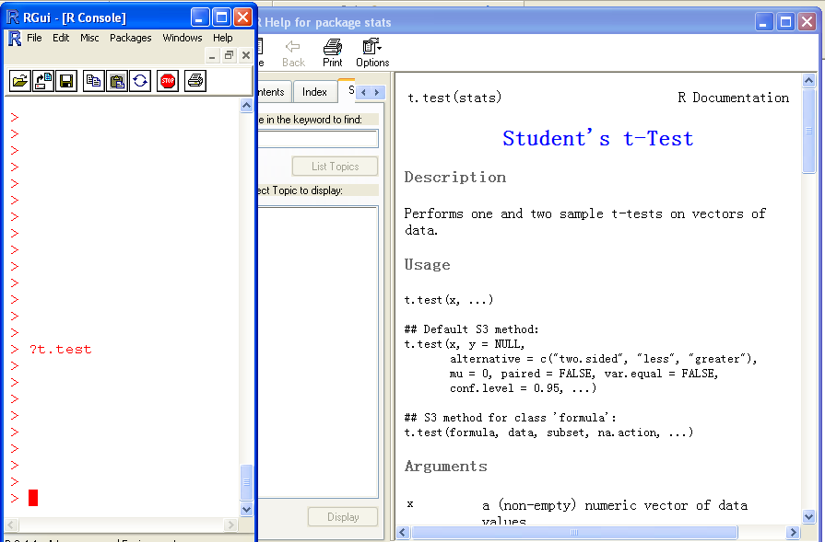
Help!

Slide 25
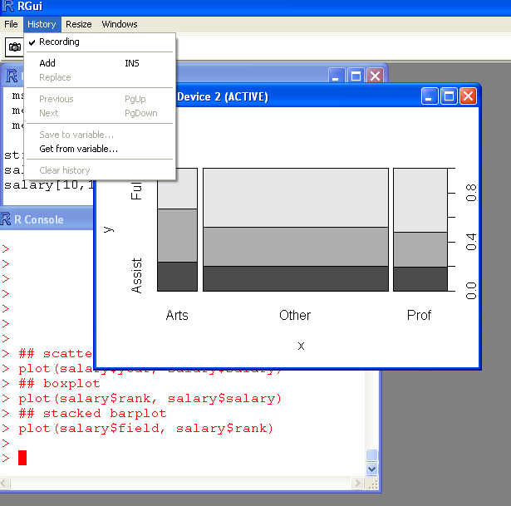
Recording the history in plot-windows, then use page-up and downs to exam plots.

Slide 26
Load a example data
data(airquality) #load the data
names(airquality) #check variable
airquality$date<-with(airquality, ISOdate(1973,Month,Day)) #covert date
plot(Ozone~date, data=airquality) #do the first plot

Slide 27
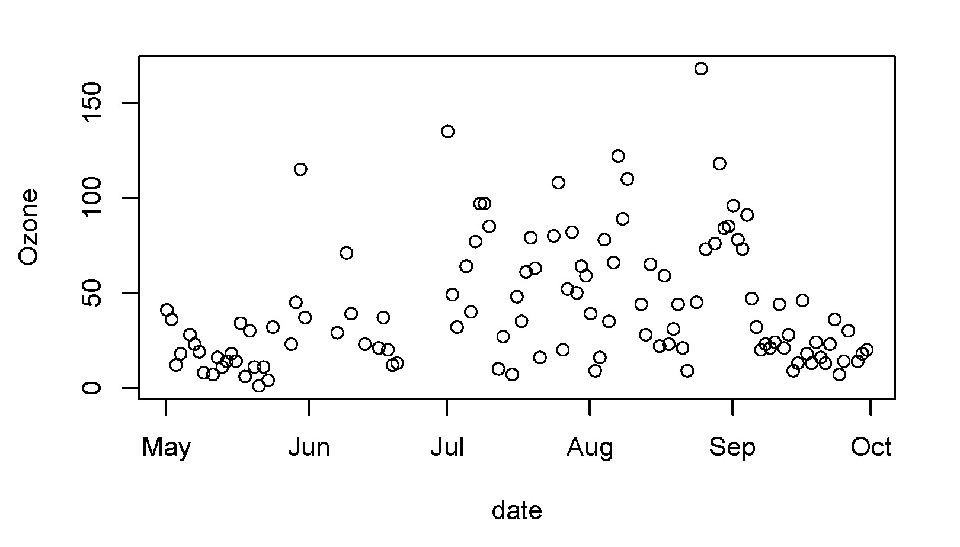
Scatter plot plot(Ozone~date, data=airquality)

Slide 28
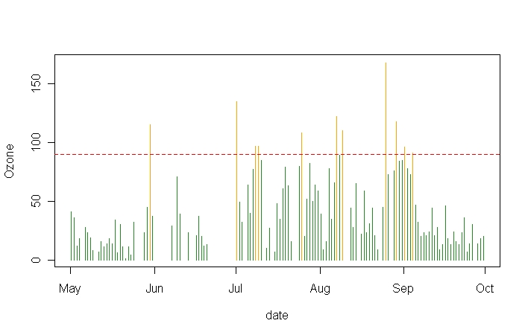
bad<-ifelse(airquality$Ozone>=90, "orange","forestgreen") #assign bad weather
plot(Ozone~date, data=airquality,type="h",col=bad) #do the plot
abline(h=90,lty=2,col="red") #add a horizontal red line

Slide 29
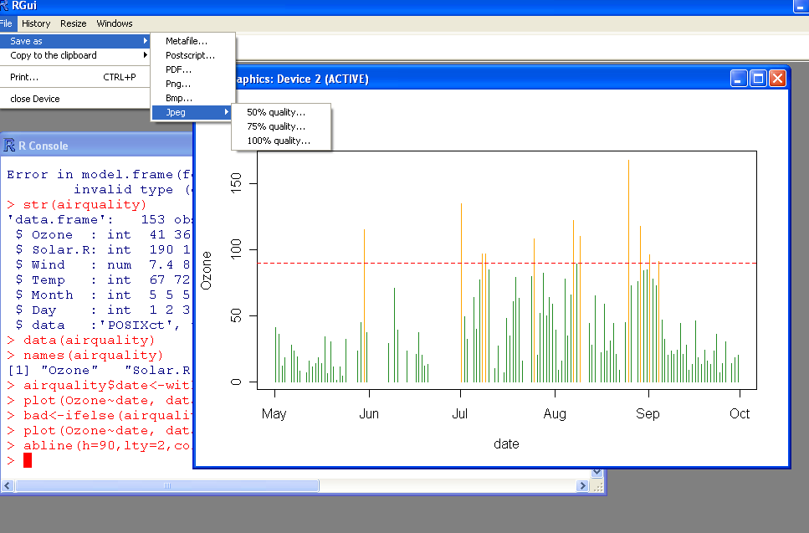
Save your plot.

Slide 30

The R card

